Slide 1
Mendelian Inheritance in Humans
Dr. Mazhar Al Zoubi
UGS 2019

Slide 2
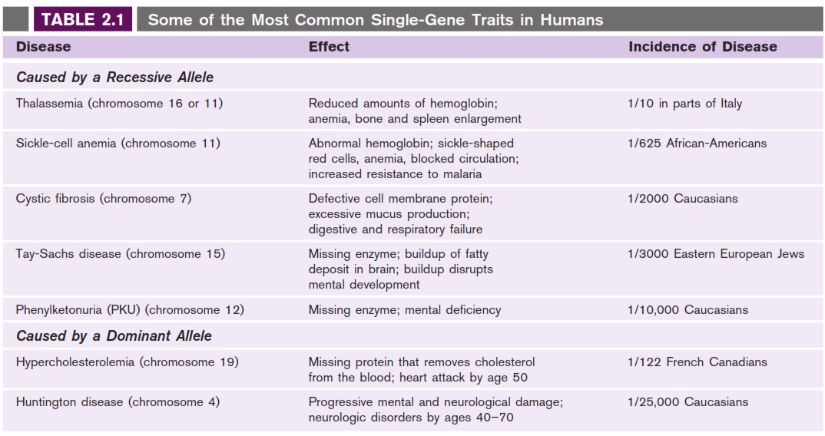

Slide 3
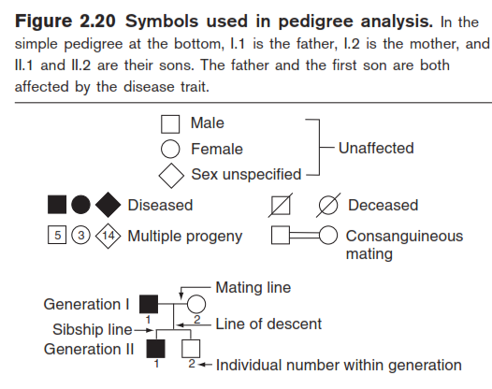

Slide 4
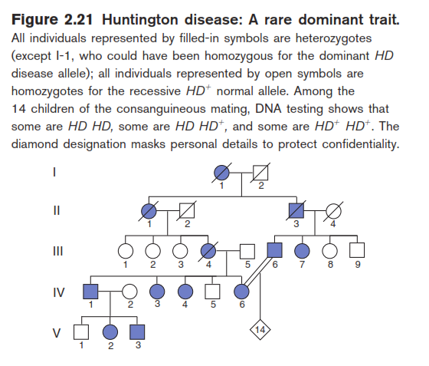

Slide 5
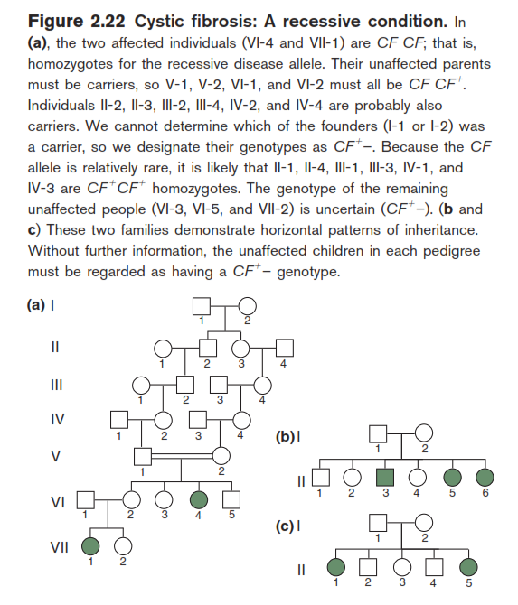

Slide 6
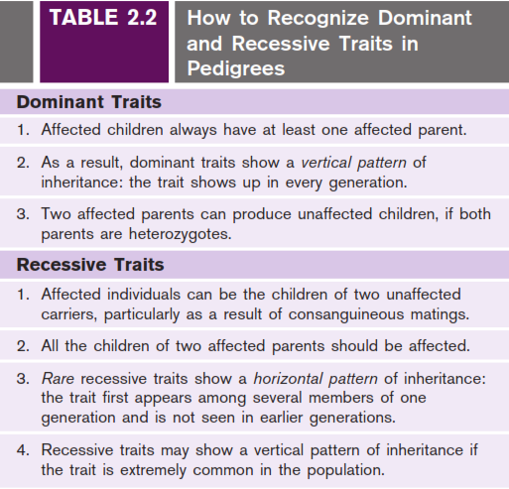

Slide 7
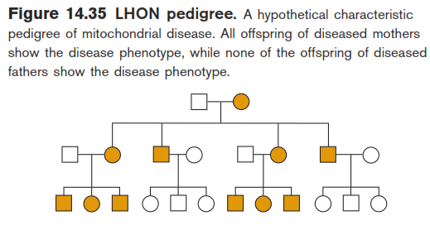
Non-Mendelian Inheritance of Mitochondria
LHON: Leber’s hereditary optic neuropathy
A maternally inherited neurodegenerative disease in humans

Slide 9
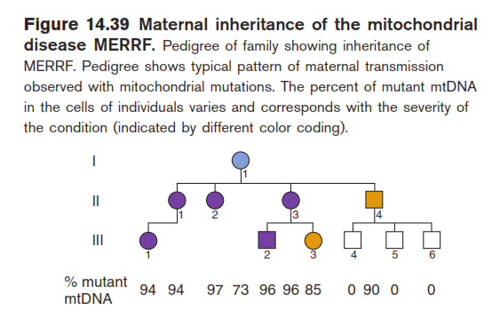
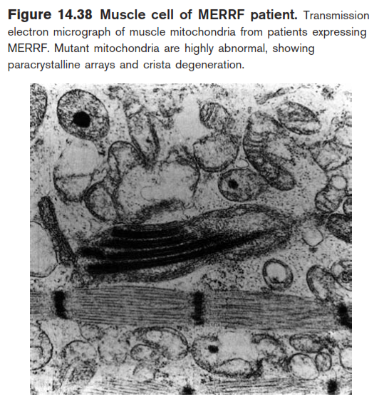
mtDNA Mutations and Human Health
MERRF has a cluster of symptoms related to mutations in mtDNA.
Myoclonic epilepsy and ragged red fiber disease (MERRF)

Slide 10
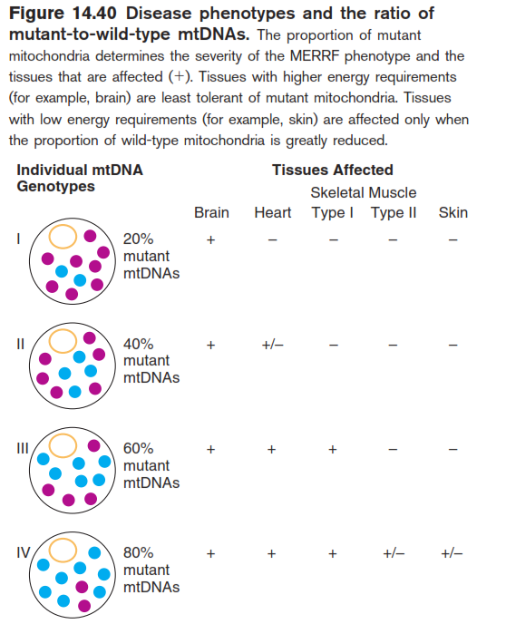
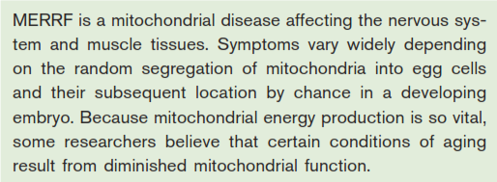

Slide 11
Mitochondrial mutations may have
an impact on aging

