Slide 1
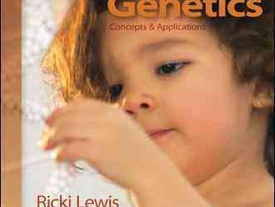
Reference:Human Genetics Concepts and Applications 9th Edition
Chapter 13: Chromosomes

Slide 2
Cytogenetics
Cytogenetics is a subdiscipline within genetics deals with chromosome variations.
In general, excess genetic material has milder effects on health than a deficit.
Still, most large-scale chromosomal abnormalities present in all cells disrupt or halt prenatal development

Slide 3
Portrait of a Chromosome
A chromosome consists primarily of DNA and protein.
Distinguished by size and shape
Essential parts are:
- Telomeres
- Origins of replication sites
- Centromere
Notes:
3

Slide 4
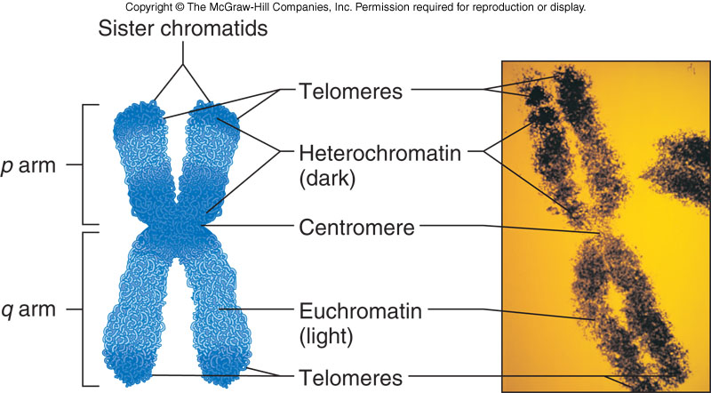
Portrait of a Chromosome
Figure 13.1

Slide 5
Portrait of a Chromosome
Heterochromatin is darkly staining
- Consists mostly of repetitive DNA
Euchromatin is lighter-staining
- Contains most protein-encoding genes
Telomeres are chromosome tips composed of many repeats of TTAGGG
- Shorten with each cell division
Notes:
5

Slide 6
Centromeres
The largest constriction of the chromosome and where spindle fibers attach
The bases that form the centromere are repeats of a 171-base DNA sequence
Replicated at the end of S-phase
- Facilitated by centromere protein A
CENP-A is passed to next generation
- An example of an epigenetic change
Notes:
6

Slide 7
Subtelomeres
The chromosome region between the centromere and telomeres
Consists of 8,000 to 300,000 bases
Near telomere the repeats are similar to the telomere sequence
Contains at least 500 protein-encoding genes
About 50% are multigene families that include pseudogenes
Notes:
7

Slide 8
Subtelomeres
Figure 13.2
Figure 13.2

Slide 9
Karyotype
A chromosome chart
Displays chromosomes arranged by size and structure
Humans have 24 chromosome types
- Autosomes are numbered 1-22 by size
- Sex chromosomes are X and Y
Notes:
9

Slide 10
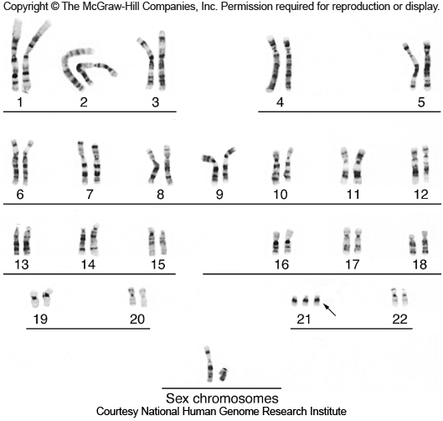
Karyotype
Figure 13.3
Notes:
10

Slide 11
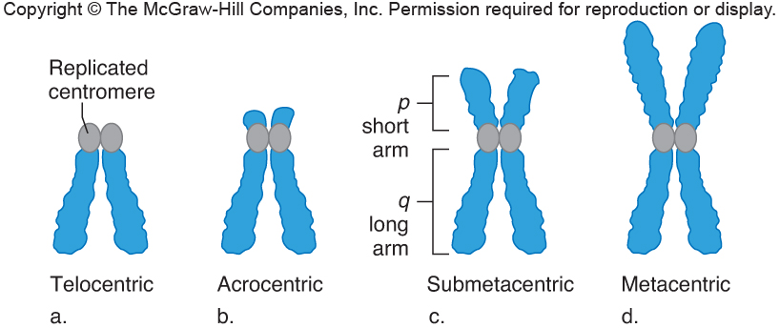
Centromere Positions
At tip – Telocentric
Close to end – Acrocentric
Off-center – Submetacentric
At midpoint – Metacentric
Figure 13.4
Notes:
11

Slide 12
Karyotype
Karyotypes are useful at several levels
1) Can confirm a clinical diagnosis
2) Can reveal effects of environmental toxins
3) Can clarify evolutionary relationships
Notes:
12

Slide 13
Visualizing Chromosomes
Tissue is obtained from person
- Fetal tissue: Amniocentesis
Chorionic villi sampling
Fetal cell sorting
Chromosome microarray analysis
- Adult tissue: White blood cells
Skinlike cells from cheek swab
Chromosomes are extracted
Then stained with a combination of dyes and DNA probes
Notes:
13

Slide 14
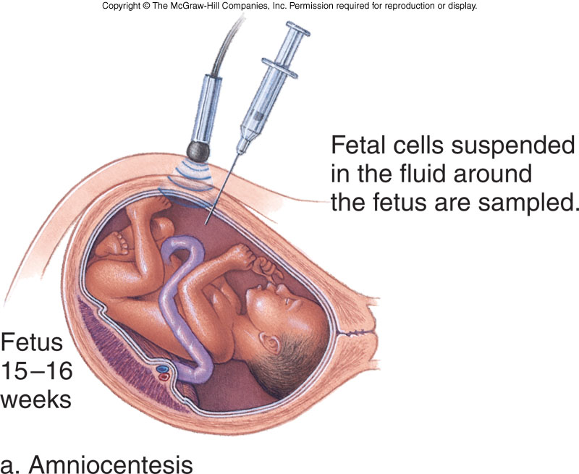
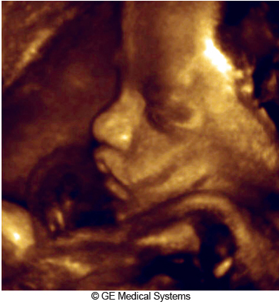
Amniocentesis
Detects about 1,000 of the more than 5,000 known chromosomal and biochemical problems
Ultrasound is used to follow needle’s movement
Figure 13.6
Figure 13.5a
Notes:
14

Slide 15
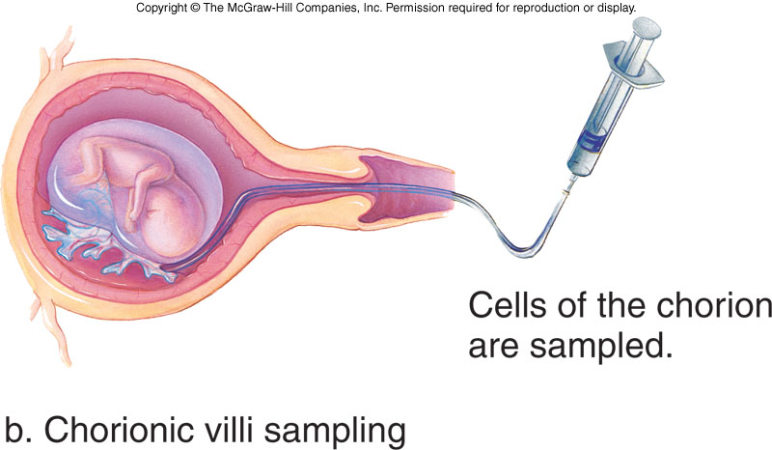
Chorionic Villi Sampling (CVS)
Performed during 10-12th week of pregnancy
Provides earlier results than amniocentesis
However, it does not detect metabolic problems
- And has greater risk of spontaneous abortion
Figure 13.5b
Notes:
15

Slide 16
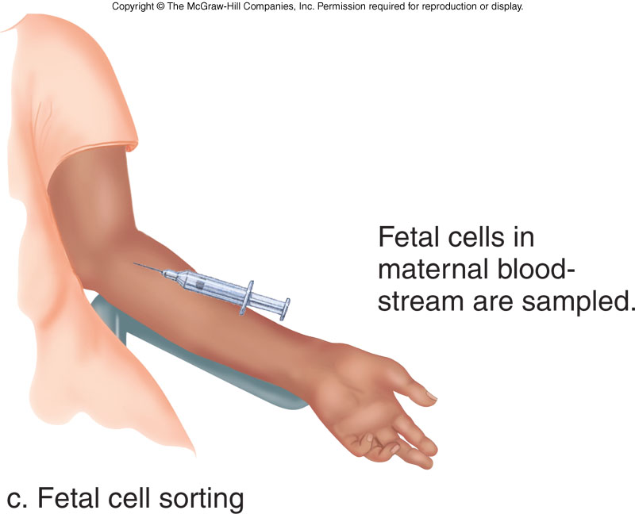
Fetal Cell Sorting
Fetal cells are distinguished from maternal cells by a fluorescence-activated cell sorter - Identifies cell-surface markers
Figure 13.5c
A new technique detects fetal mRNA in the bloodstream of the mother
Notes:
16

Slide 17
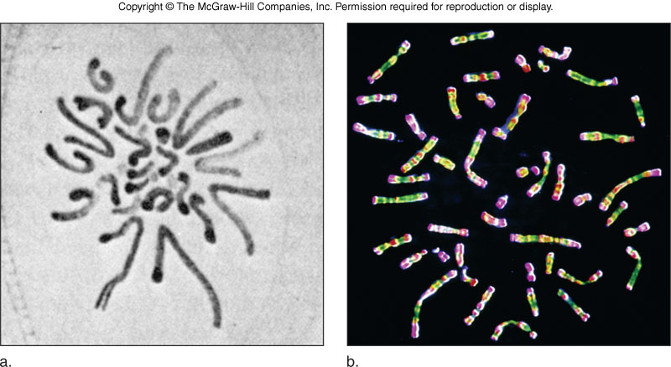
Viewing Chromosomes
1882
Figure 13.8
Now
Drawing by German biologist Walther Flemming
Micrograph of actual stained human chromosomes
Notes:
17

Slide 18
Staining Chromosomes
In the earliest karyotypes, dyes were used to stain chromosomes a uniform color
Chromosomes were grouped into decreasing size classes, designated A through G
In the 1970s, improved staining techniques gave banding patterns unique to each chromosome
Then researchers found that synchronizing the cell cycle of cultured cells revealed even more bands per chromosome
Notes:
18

Slide 19
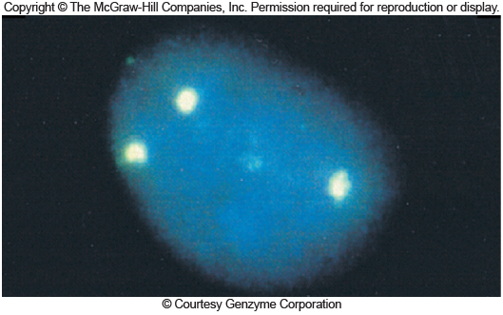
FISH
Fluorescence in situ hybridization
DNA probes labeled with fluorescing dye bind complementary DNA
Fluorescent dots correspond to three copies of chromosome 21
Figure 13.9
Notes:
19

Slide 20
FISH Animation
Please note that due to differing operating systems, some animations will not appear until the presentation is viewed in Presentation Mode (Slide Show view). You may see blank slides in the “Normal” or “Slide Sorter” views. All animations will appear after viewing in Presentation Mode and playing each animation. Most animations will require the latest version of the Flash Player, which is available at http://get.adobe.com/flashplayer.
Figure 2.3

Slide 21
Chromosomal Shorthand
Notes:
21

Slide 22
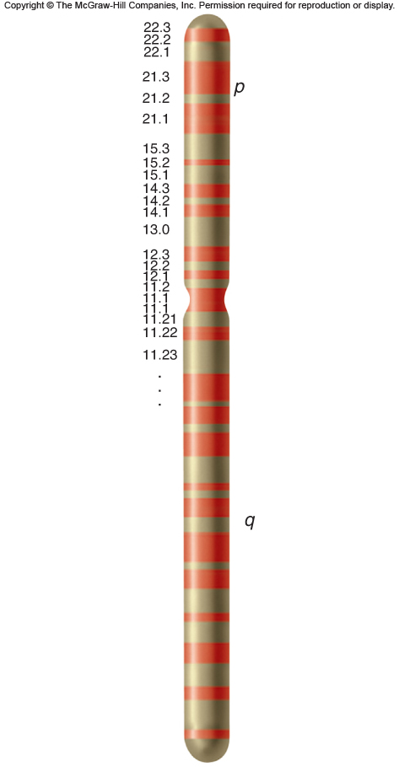
Ideogram
A schematic chromosome map
Indicates chromosome arms (p or q) and delineates major regions and subregions by numbers
Figure 13.10
Notes:
22

Slide 23
Chromosome Abnormalities
A karyotype may be abnormal in two ways:
1) In chromosome number
2) In chromosome structure
Abnormal chromosomes account for at least 50% of spontaneous abortions
Due to improved technology, more people are being diagnosed with chromosomal abnormalities
Notes:
23

Slide 24
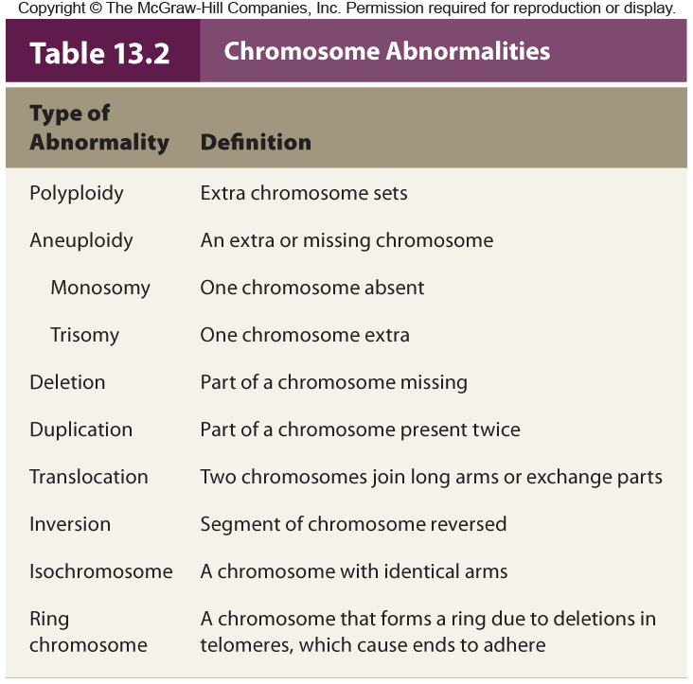
Notes:
24

Slide 25
Polyploidy
Cell with extra chromosome sets is polyploid
Triploid (3N) cells have three sets of chromosomes
- Produced in one of two main ways:
- Fertilization of one egg by two sperm
- Fusion of haploid and diploid gametes
Triploids account for 17% of all spontaneous abortions and 3% of stillbirths and newborn deaths
Notes:
25

Slide 26
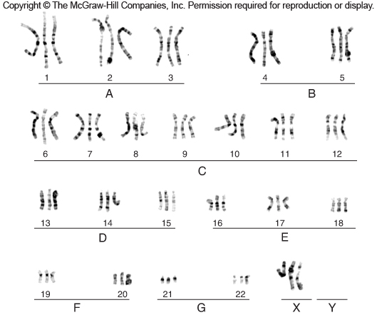
Triploidy
Figure 13.11
Notes:
26

Slide 27
Aneuploidy
A normal chromosomal number is euploid
Cells with extra or missing chromosomes are aneuploid
Most autosomal aneuploids are spontaneously aborted
Those that are born are more likely to have an extra chromosome (trisomy) rather than a missing one (monosomy)
Notes:
27

Slide 28
Nondisjunction
The failure of chromosomes to separate normally during meiosis
Produces gamete with an extra chromosome and another with one missing chromosome
Nondisjunction during Meiosis I results in copies of both homologs in one gamete
Nondisjunction during Meiosis II results in both sister chromatids in one gamete
Notes:
28

Slide 29
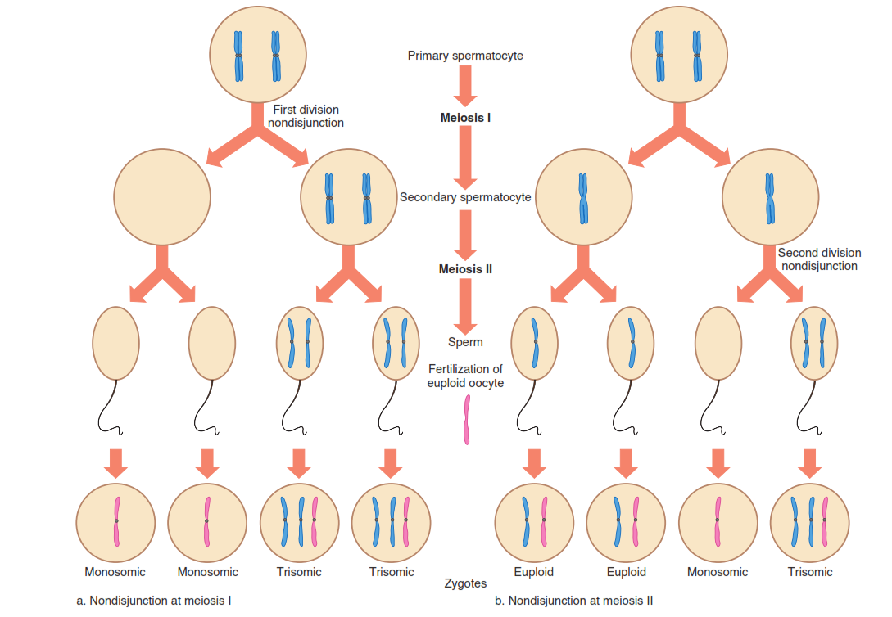

Slide 30
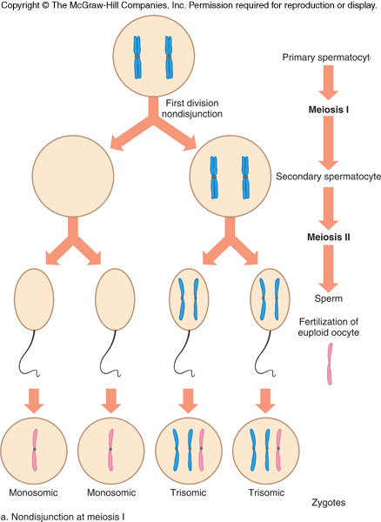
Nondisjunction at Meiosis I
Figure 13.12
Notes:
30

Slide 31
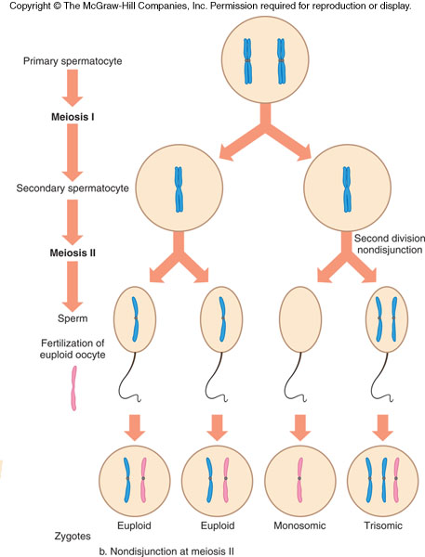
Nondisjunction at Meiosis II
Figure 13.12
Notes:
31

Slide 32
Aneuploidy
Aneuploidy can also arise during mitosis, producing groups of somatic cells with the extra or missing chromosomes
An individual with two chromosomally-distinct cell populations is called a mosaic
A mitotic nondisjunction event that occurs early in development can have serious effects on the health of the individual
Notes:
32

Slide 33
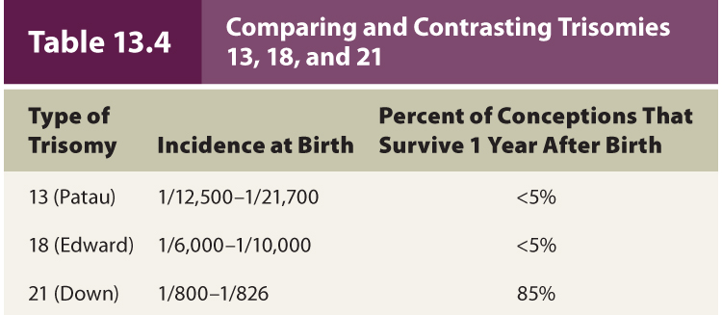
Trisomies
Most autosomal aneuploids cease developing as embryos or fetuses
Most frequently seen trisomies in newborns are those of chromosomes 21, 18, and 13
- Carry fewer genes than other autosomes
Notes:
33

Slide 34
Trisomy 21
Down syndrome
Most common trisomy among newborns
Distinctive facial and physical problems
Figure 13.13
Varying degrees of developmental disabilities
Individuals more likely to develop leukemia
Link with one form of Alzheimer disease
Notes:
34

Slide 35
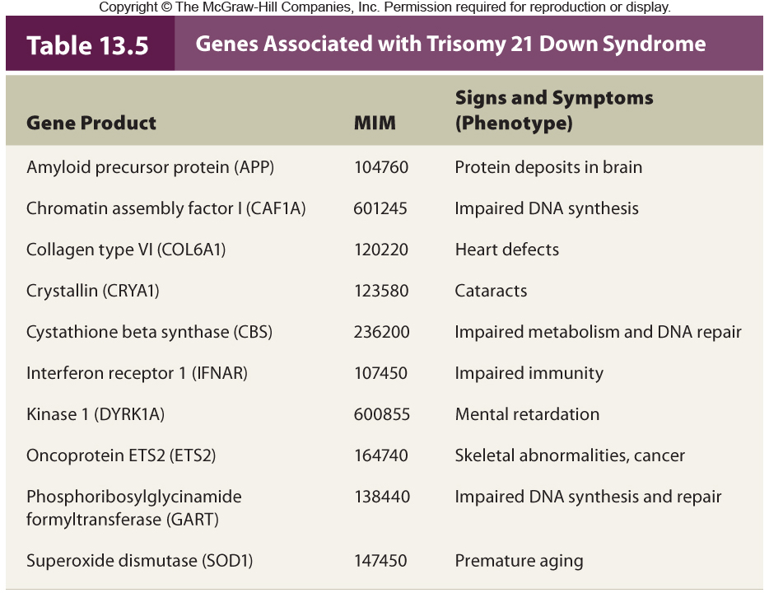
Table 13.6

Slide 36
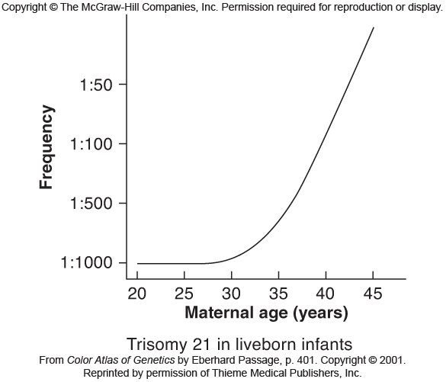
The risk of conceiving an offspring with Down syndrome rises dramatically with maternal age
Figure 13.7
Notes:
36

Slide 37
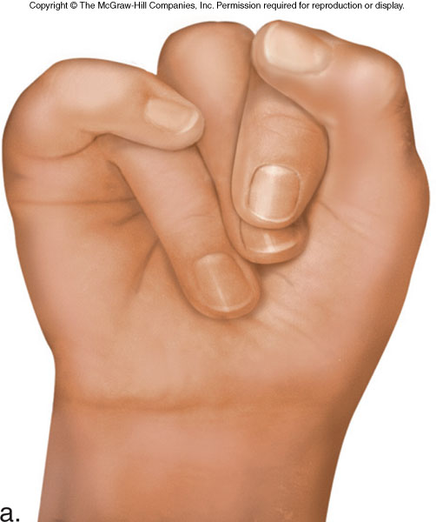
Trisomy 18
Figure 13.14a
Edwards syndrome
Most due to nondisjunction in meiosis II in oocyte and do not survive
Serious mental and physical disabilities
A distinctive feature: Oddly-clenched fists
Notes:
37

Slide 38
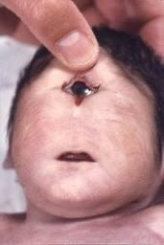
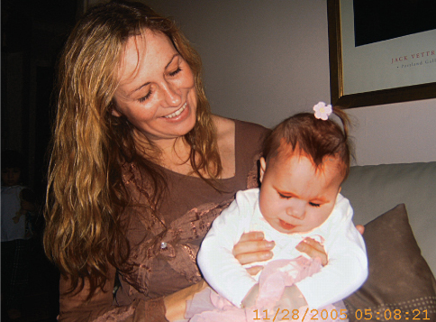
Trisomy 13
Figure 13.14b
Patau syndrome
Very rare and generally do not survive 6 months
Serious mental and physical disabilities
A distinctive feature: Eye fusion
Notes:
38

Slide 39
Sex Chromosome Aneuploids

Slide 40
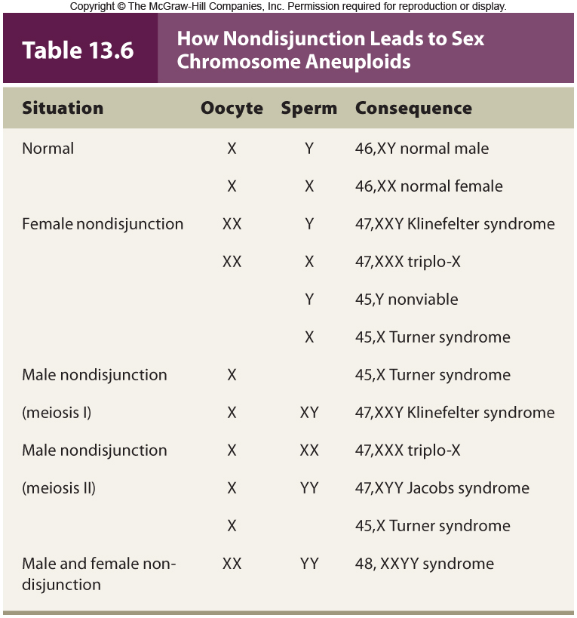
Table 13.7

Slide 41
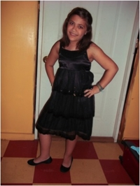
Turner Syndrome
Called the XO syndrome
1 in 2,500 female births
99% of affected fetuses die in utero
Features include short stature, webbing at back of neck, incomplete sexual development (infertile), impaired hearing
Individuals who are mosaics may have children
Notes:
41

Slide 42
Triplo-X
Called the XXX syndrome
1 in 1,000 female births
Few modest effects on phenotype include tallness, menstrual irregularities, and slight impact on intelligence
X-inactivation of two X chromosomes occurs and cells have two Barr bodies
May compensate for presence of extra X
Notes:
42

Slide 43
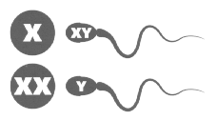
Klinefelter Syndrome
Called the XXY syndrome
1 in 500 male births
Phenotypes include:
Incomplete sexual development
Rudimentary testes and prostate
Long limbs, large hands and feet
Some breast tissue development
Most common cause of male infertility
Notes:
43

Slide 44
XXYY Syndrome
Likely arises due to unusual oocyte and sperm
Associated with more severe behavioral problems than Klinefelter syndrome
Obsessive compulsive disorder, learning disabilities
Individuals are infertile
Treated with testosterone
Notes:
44

Slide 45
XYY Syndrome
Also known as Jacobs syndrome
1 in 1,000 male births
96% are phenotypically normal
Modest phenotypes may include great height, acne, speech and reading disabilities
Studies suggesting increase in aggressive behaviors are not supported
Notes:
45

Slide 46
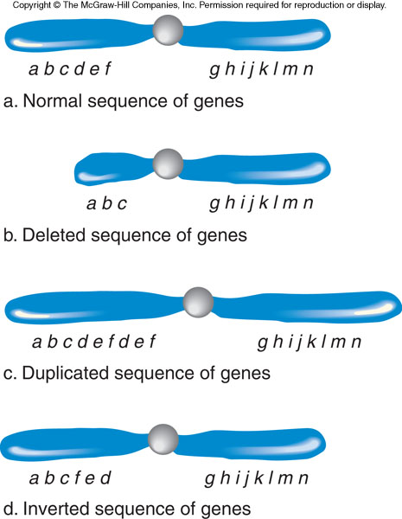
Chromosome Structural Abnormalities
Figure 13.15
Notes:
46

Slide 47
Chromosome Structural Abnormalities
Please note that due to differing operating systems, some animations will not appear until the presentation is viewed in Presentation Mode (Slide Show view). You may see blank slides in the “Normal” or “Slide Sorter” views. All animations will appear after viewing in Presentation Mode and playing each animation. Most animations will require the latest version of the Flash Player, which is available at http://get.adobe.com/flashplayer.
Figure 2.3

Slide 48
Deletions
A deletion refers to a missing genetic segment from a chromosome
Deletions are often not inherited
- Rather they arise de novo
Larger deletions increase the likelihood that there will be an associated phenotype
Cri-du-chat (cat cry) syndrome
- Deletion 5p–
Notes:
48

Slide 49
Duplications
A duplication refers to the presence of an extra genetic segment on a chromosome
Duplications are often not inherited
- Rather they arise de novo
The effect of duplications on the phenotype is generally dependent on their size
- Larger duplications tend to have an effect, while smaller one do not
Notes:
49

Slide 50
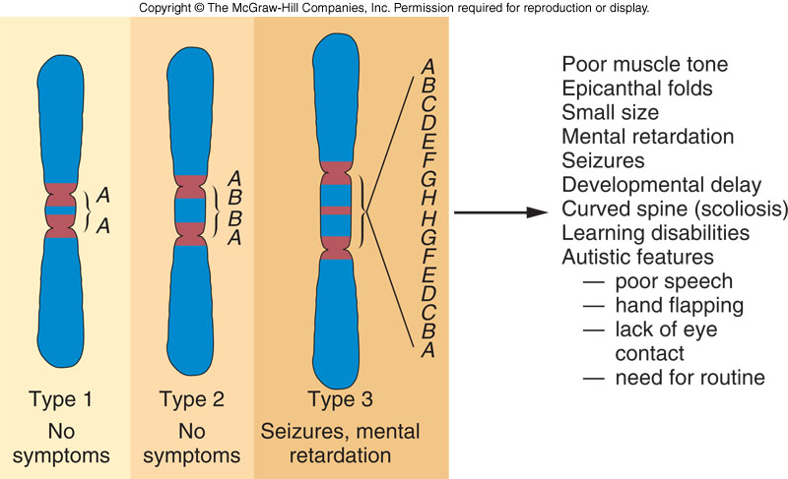
Duplications in Chromosome 15
Figure 13.17
Notes:
50

Slide 51
Translocations
In a translocation, two nonhomologous chromosomes exchange segments
There are two major types:
1) Robertsonian translocation
2) Reciprocal translocation
Notes:
51

Slide 52
Robertsonian Translocations
Two nonhomologous acrocentric chromosomes break at the centromere and their long arms fuse
- The short arms are often lost
Affect 1 in 1,000 people
Translocation carriers have 45 chromosomes
- Produce unbalanced gametes
Notes:
52

Slide 53
Translocation Down Syndrome
About 5% of Down syndrome results from a Robertsonian translocation between chromosomes 21 and 14
Tends to recur in families, which also have more risk of spontaneous abortions
One of the parents is a translocation carrier
- They may have no symptoms
- However, the distribution of the unusual chromosome leads to various imbalances
Notes:
53

Slide 54
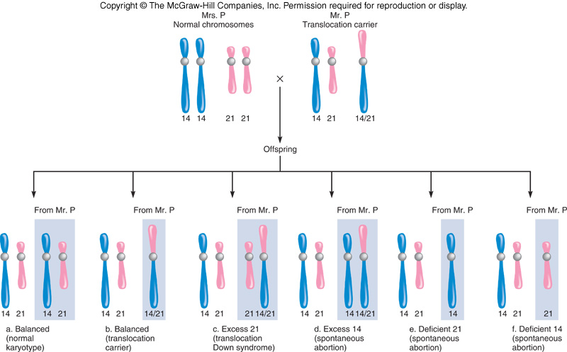
Figure 13.18
Figure 13.19

Slide 55
Reciprocal Translocations
Two nonhomologous chromosomes exchange parts
About 1 in 500 people are carriers
- Are usually healthy because they have the normal amount of genetic material (but it is rearranged)
However, if the translocation breakpoint interrupts a gene, there may be an associated phenotype
Notes:
55

Slide 56
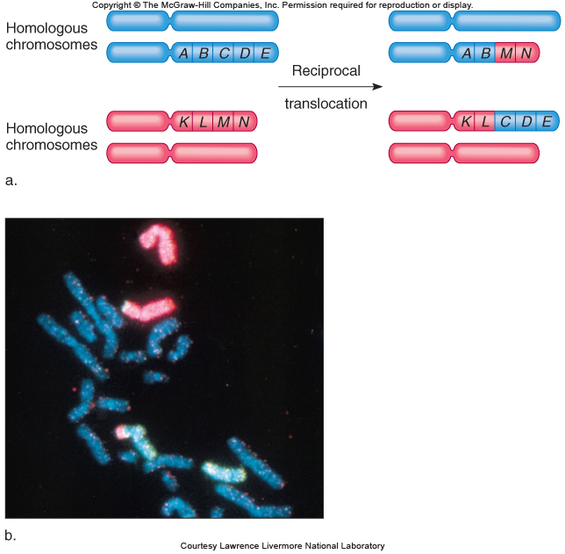
Figure 13.19
Figure 13.19

Slide 57
Inversions
An inversion is a chromosome segment that is flipped in orientation
5-10% cause health problems probably due to disruption of genes at the breakpoints
Paracentric inversion = Inverted region does NOT include centromere
Pericentric inversion = Inverted region includes centromere
Inversions may impact meiotic segregation
Notes:
57

Slide 58
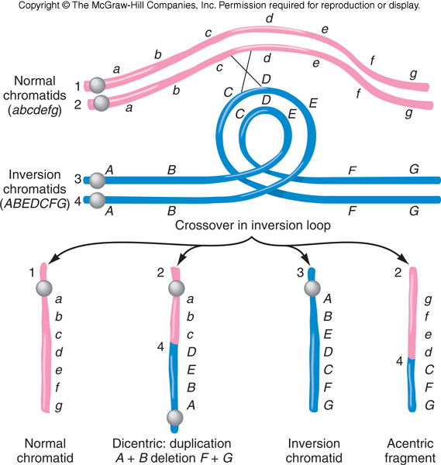
Segregation of a Paracentric Inversion
Figure 13.20
Figure 13.21

Slide 59
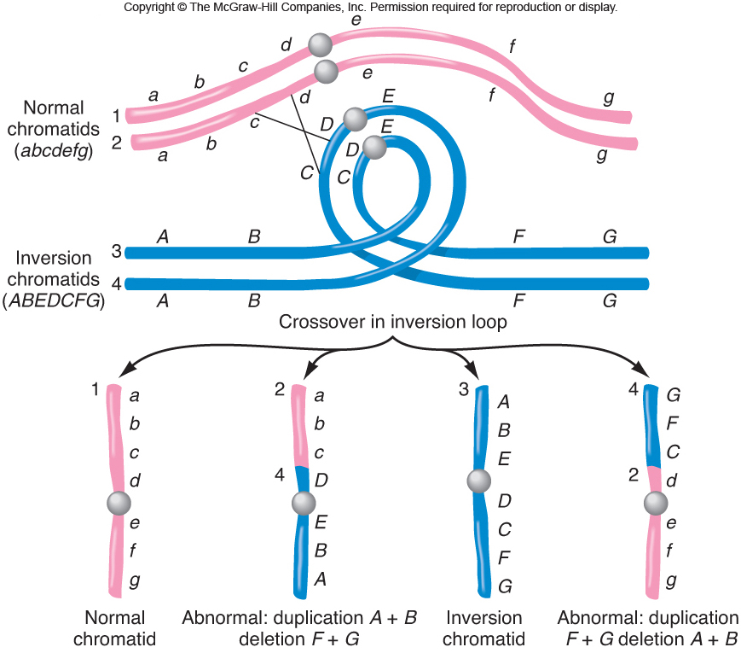
Segregation of a Pericentric Inversion
Figure 13.21
Figure 13.21

Slide 60
Consequence of an Inversion Animation
Please note that due to differing operating systems, some animations will not appear until the presentation is viewed in Presentation Mode (Slide Show view). You may see blank slides in the “Normal” or “Slide Sorter” views. All animations will appear after viewing in Presentation Mode and playing each animation. Most animations will require the latest version of the Flash Player, which is available at http://get.adobe.com/flashplayer.
Figure 2.3

Slide 61
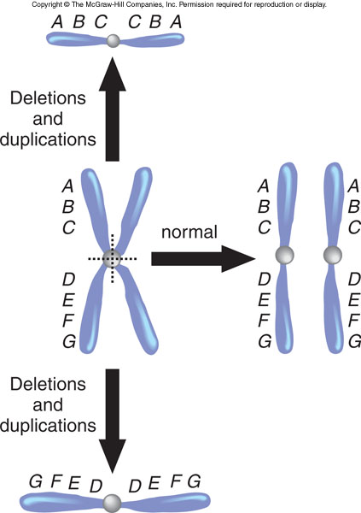
Isochromosomes
Chromosomes with identical arms
Form when centromeres divide along the incorrect plane during meiosis
Figure 13.22
Notes:
61

Slide 62
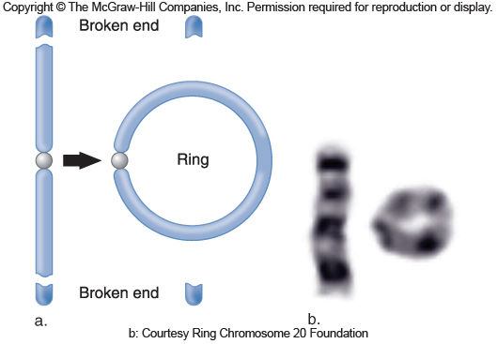
Ring Chromosomes
Occur in 1 in 25,000 conceptions
May arise when telomeres are lost and sticky chromosome ends fuse
Genes can be lost or disrupted causing symptoms
Figure 13.23
Notes:
62

Slide 63
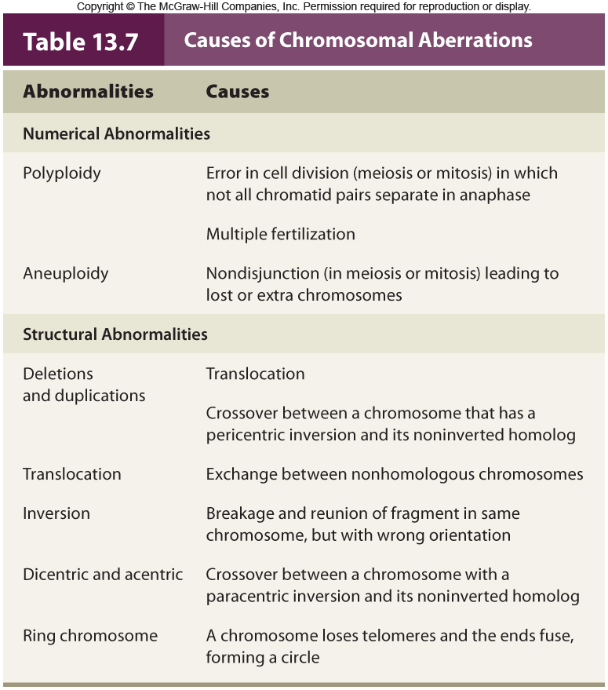
Table 13.8

Slide 64
Uniparental Disomy
Inheritance of two chromosomes or chromosome parts from the same parent
UPD requires the simultaneous occurrence of two rare events
1) Nondisjunction of the same chromosome in both sperm and egg
2) Trisomy followed by chromosome loss
Notes:
64

Slide 65
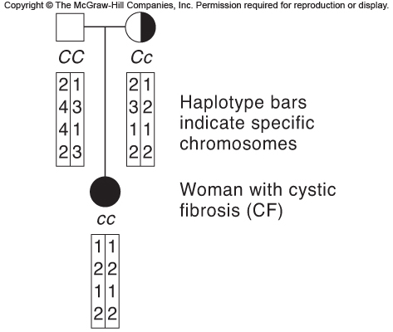
Uniparental Disomy
Figure 13.24
Figure 13.24

