Slide 1
Special aspects of renal metabolism.
Role of kidney in acid base balance
Dr. Mazhar Al Zoubi
UGS 2019

Slide 2
Outline:
Discuss urea and creatinine metabolism.
Understand the role of kidney in the regulation of hydrogen ions and bicarbonate buffer system.
Discuss amino acids absorption by the kidney and their disorders.

Slide 3
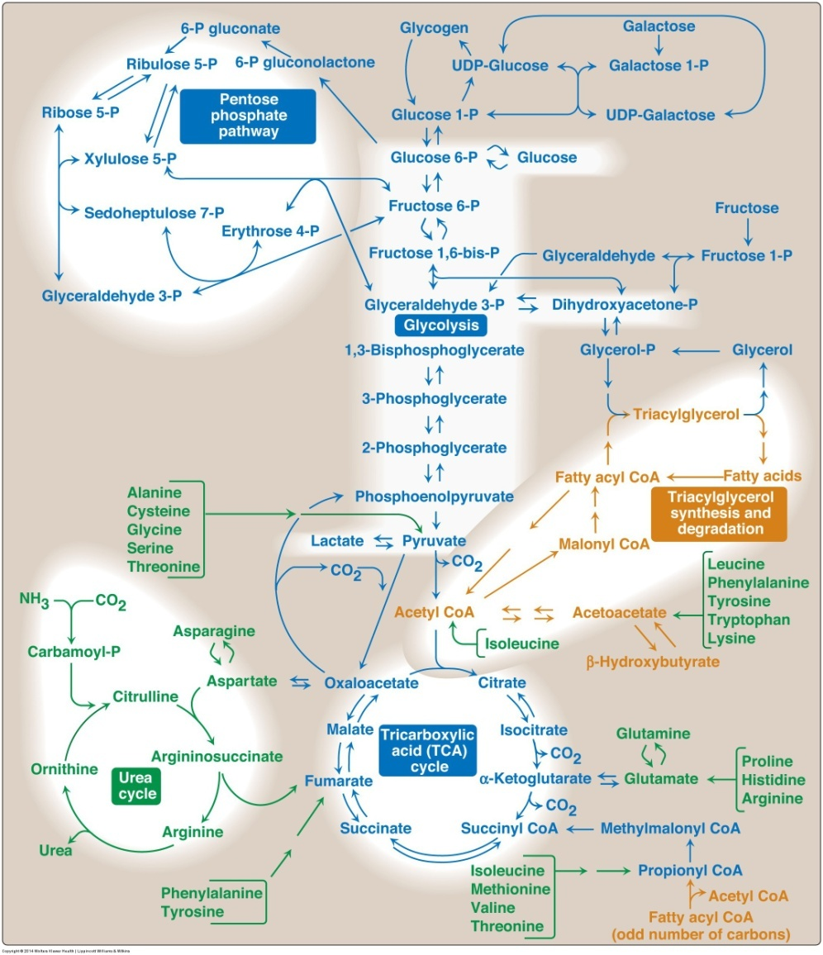
Urea Metabolism

Slide 4
Nitrogen Disposing Route

Slide 5
Protein are different from CHO and Lipids by having NO storage form as a supply for amino acids for future need
Therefore, any excess amino acids will be degraded to produce free ammonia and α-keto acids BY
Transamination and
Oxidative deamination

Slide 6
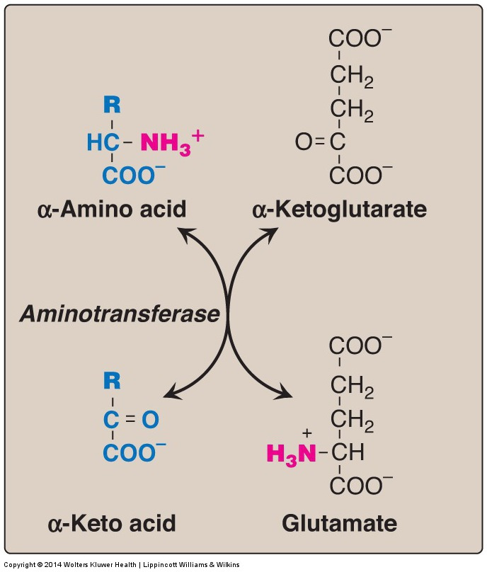

Slide 7
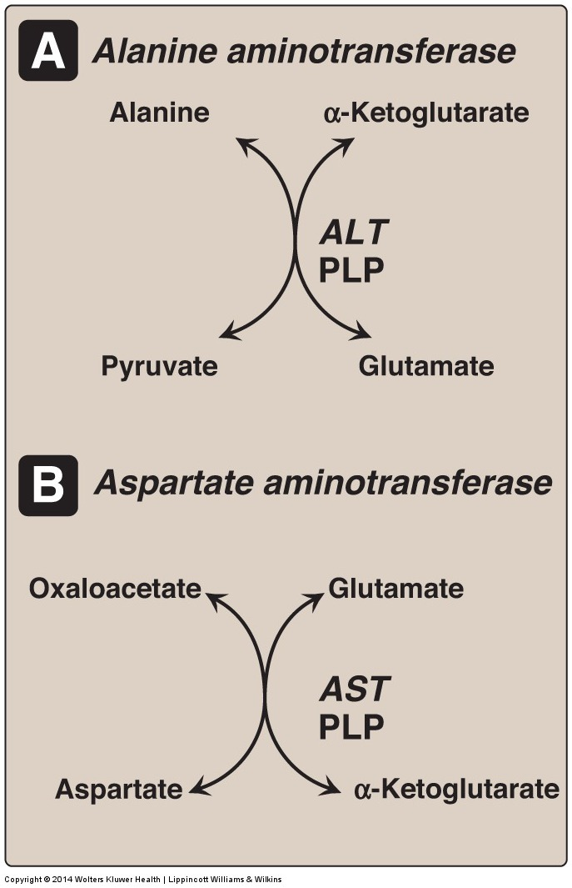

Slide 8
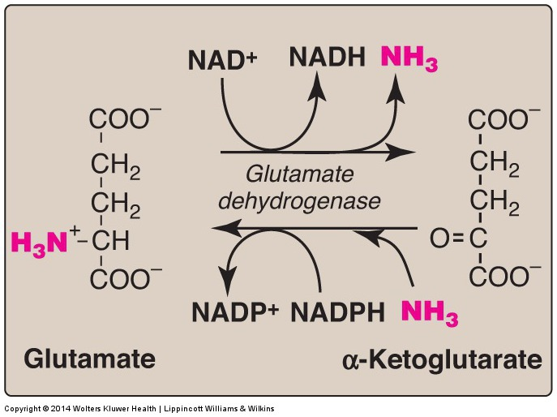

Slide 9
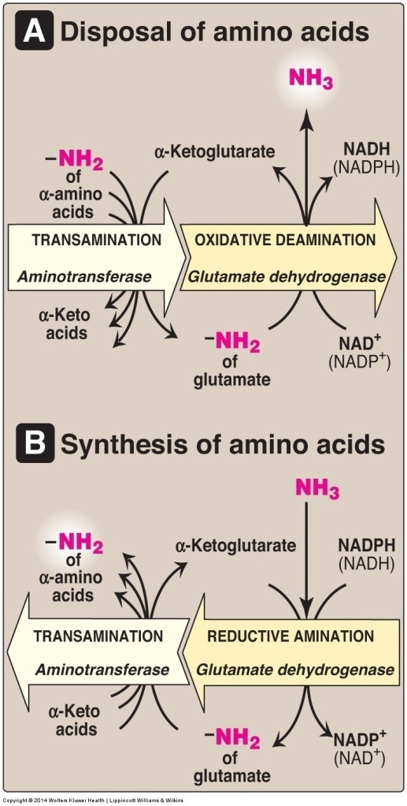

Slide 10
Transport of ammonia to the liver

Slide 11
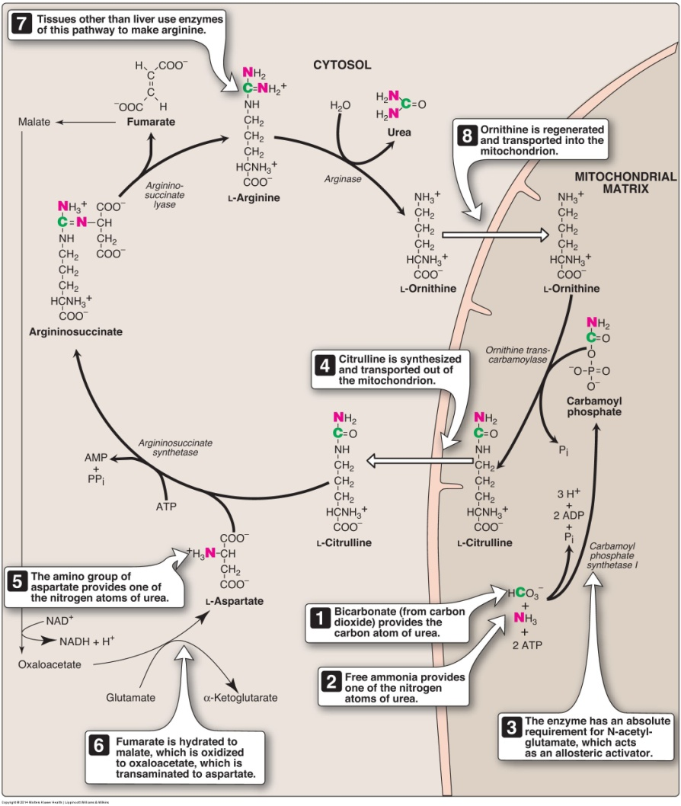

Slide 12
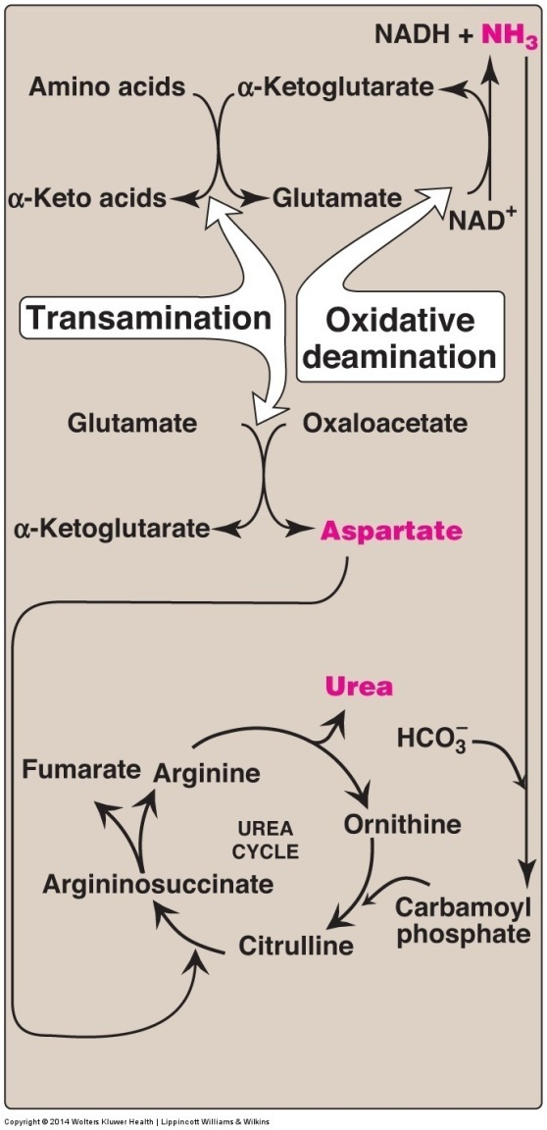

Slide 13
Hyperammonemia
Serum ammonia are normally low (5–35 μmol/L)
Ammonia has a direct neurotoxic effect on the CNS
At high concentrations, ammonia can cause coma and death
Acquired hyperammonemia:
Congenital hyperammonemia:
1:25,000
Ornithine transcarbamylase deficiency, which is X-linked

Slide 14
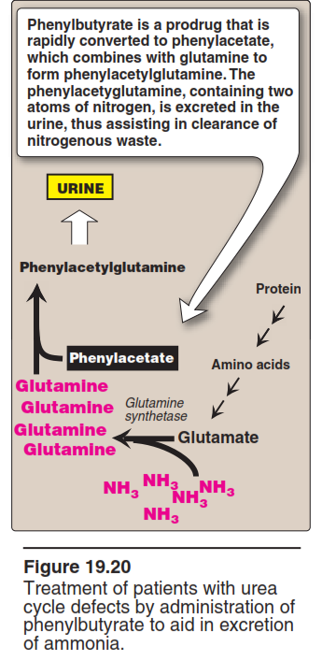

Slide 15
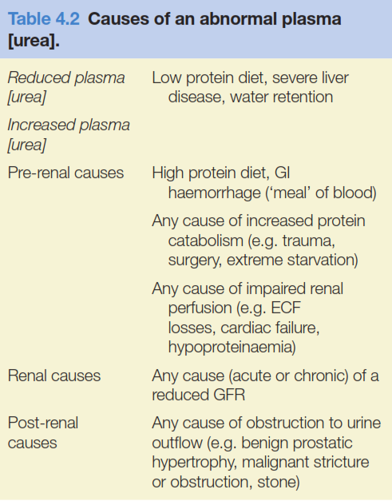

Slide 16
Creatinine Metabolism

Slide 17
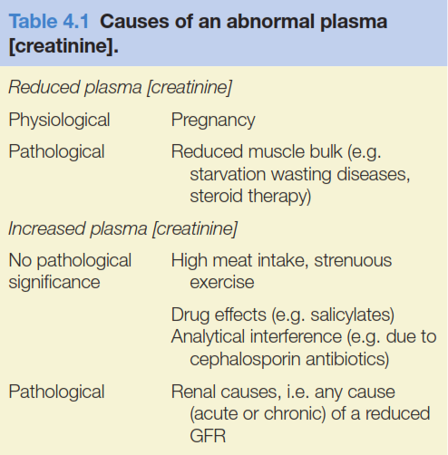

Slide 18
Acid Base Balance

Slide 19
Metabolic Alkalosis

Slide 20
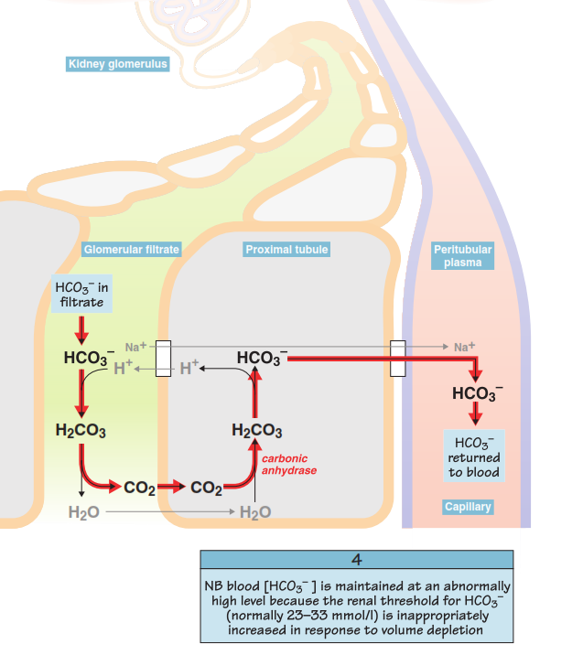
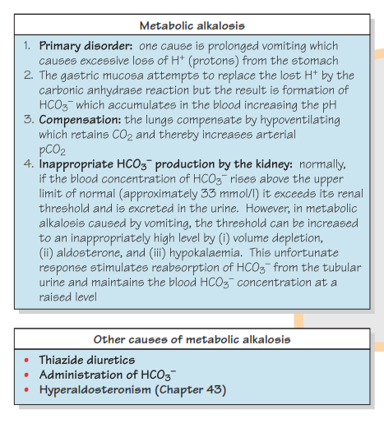

Slide 21
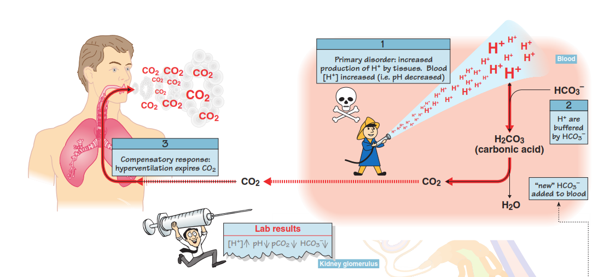
Metabolic Acidosis

Slide 22
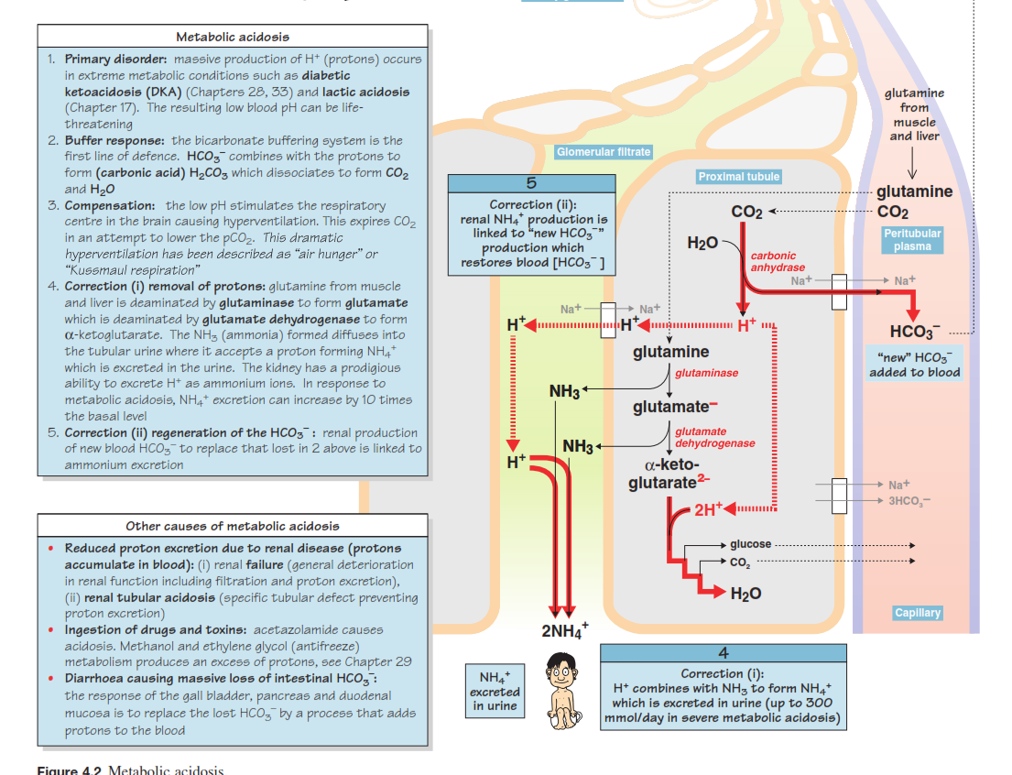

Slide 23
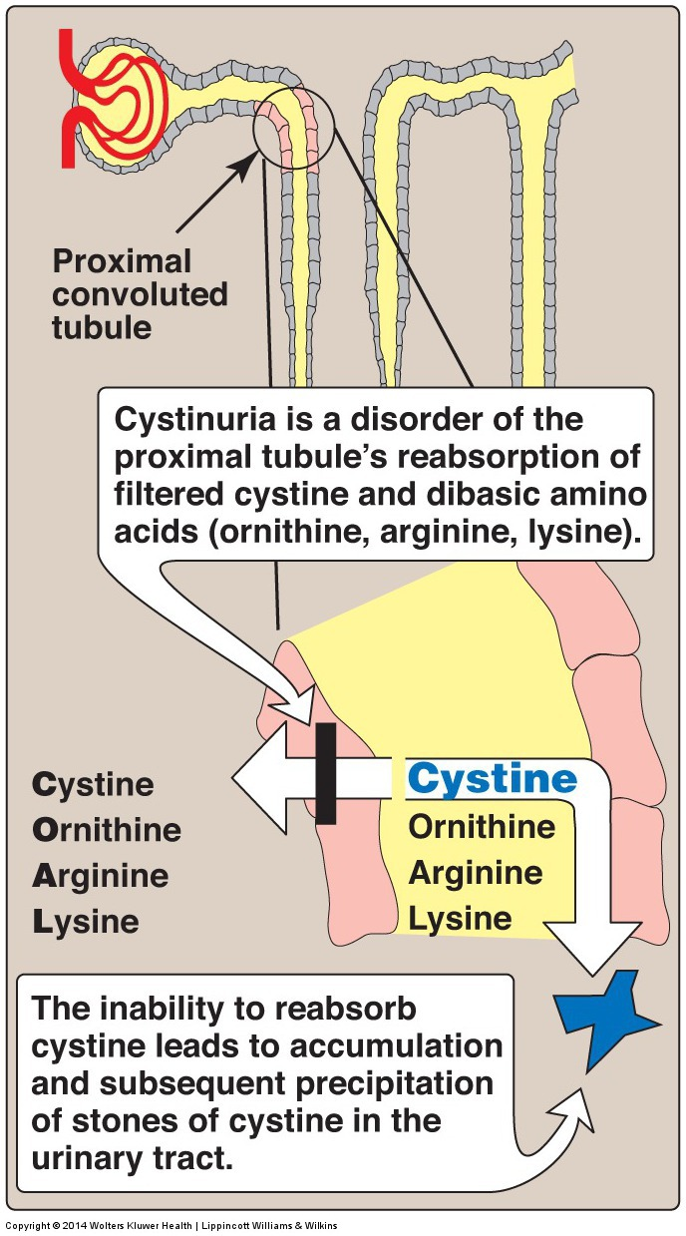
Cystinuria
At least 7 different transport systems are known for different amino acids.
The small intestine and the proximal tubule of the kidney have common transport systems for amino acid uptake.
For example, one system is responsible for the uptake of cystine , ornithine, arginine, and lysine “COAL”.

Slide 24
Cystinuria occurs at a frequency of 1 in 7,000 individuals, making it one of the most common inherited diseases, and the most common genetic error of amino acid transport.
The disease expresses itself clinically by the precipitation of cystine to form kidney stones (calculi), which can block the urinary
Cystinuria, this carrier system is defective, and all four amino acids appear in the urine
tract.
Drink water

Slide 25
Central importance in the mechanisms involved in H⁺secretion and in maintaining the HCO₃⁻ buffering capacity in the blood.
Hydrogen ions are secreted from renal tubular cells into the lumina, where they are buffered by constituents of the glomerular filtrate.

Slide 26
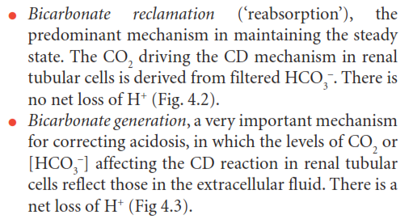
Two renal mechanisms control [HCO₃⁻] in the ECF:

Slide 27
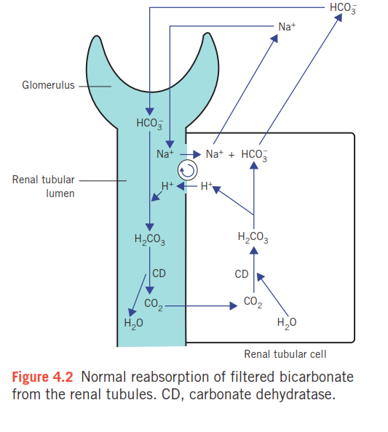
brush border

Slide 28
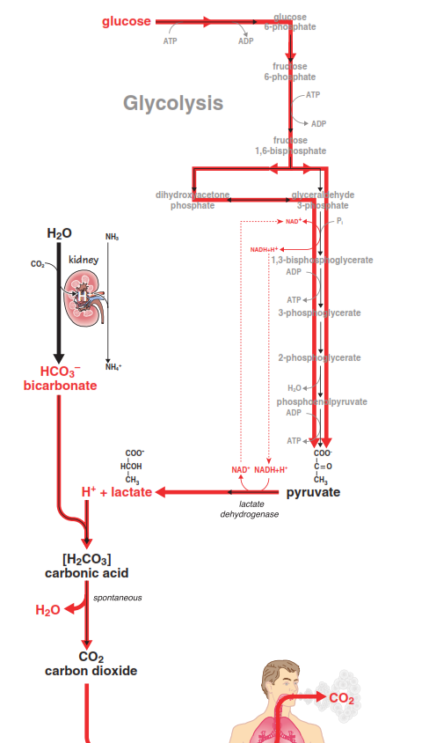
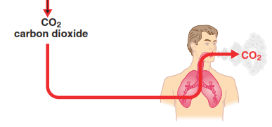

Slide 29
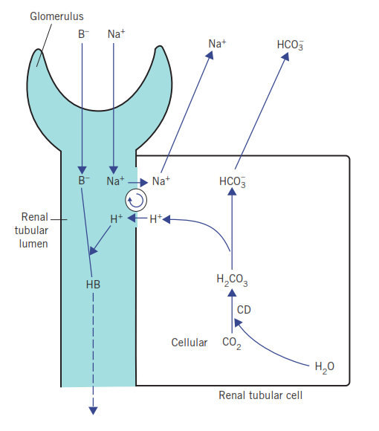
proximal tubules

Slide 30
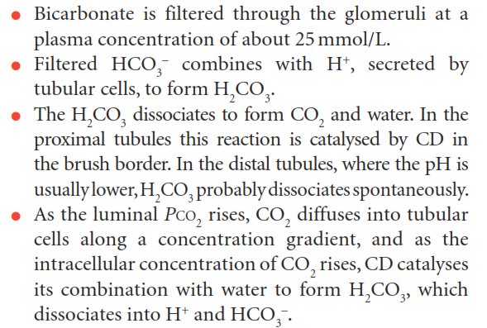
Normal urine is nearly HCO₃⁻ free.

Slide 31
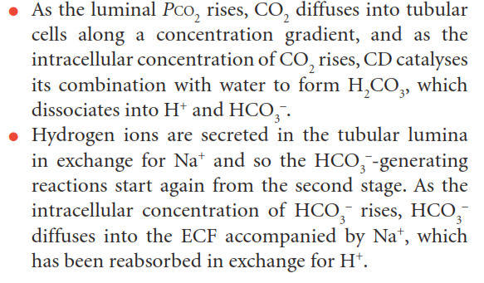

Slide 32
There is net loss of H⁺ from the body as well as a net gain of HCO₃⁻
Therefore this mechanism is well suited to correcting any type of acidosis.

Slide 33
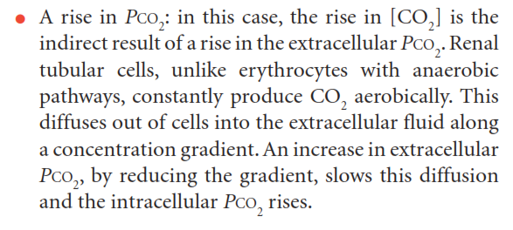
Within tubular cells, CD may be stimulated by the following.

Slide 35
Phosphate is normally the most important buffer in urine
At low pH, urinary phosphate cannot maintain the essential buffering of continued H⁺ secretion.

Slide 36
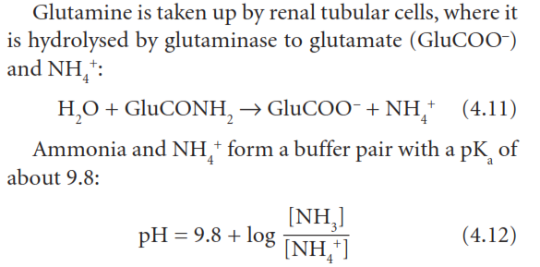

Slide 37
