Slide 1
The male reproductive system

Slide 2
Structures of the testes
The male gonads are the testes, which have two functions:
spermatogenesis
secretion of testosterone.
Normally, the testes occupy the scrotum, which lies outside the body cavity and is maintained at 35°C - 36°C, or 1°C - 2°C below body temperature.
maintained by a countercurrent arrangement of testicular arteries and veins, which facilitates heat exchange.

Slide 3
80% of the adult testis is composed of seminiferous tubules, which produce the sperm.
The epithelium lining the seminiferous tubules consists of three cell types:
spermatogonia, which are the stem cells
spermatocytes, which are cells in the process of becoming sperm
Sertoli cells, which support the developing sperm.

Slide 4
The Sertoli cells have four important functions that support spermatogenesis:
Provide nutrients to the differentiating sperm (which are isolated from the bloodstream).
Form tight junctions with each other, creating a barrier between the testes and the bloodstream called the blood-testes barrier.
imparts a selective permeability (admits “allowable” substances such as testosterone to cross but prohibiting noxious substances that might damage the developing sperm).

Slide 5
Sertoli cells secrete an aqueous fluid into the lumen of the seminiferous tubules, which helps to transport sperm through the tubules into the epididymis.
Secrete androgen-binding protein into the lumen of the seminiferous tubule, near the developing sperm cells.
Androgen-binding protein helps to keep local levels of testosterone high.

Slide 6
The remaining 20% of the adult testis is connective tissue interspersed with Leydig cells.
The function of the Leydig cells is synthesis and secretion of testosterone, the male sex steroid hormone.
Testosterone has both:
local (paracrine) effects that support spermatogenesis in the testicular Sertoli cells
endocrine effects on other target organs (e.g., skeletal muscle and the prostate).

Slide 7
Spermatogenesis
Spermatogenesis occurs continuously throughout the reproductive life of the male.
Spermatogenesis occurs along the length of the seminiferous tubules.
One full cycle of spermatogenesis requires about 64 days.

Slide 8
Spermatogenesis
The process can be divided into three phase:
Mitotic divisions of spermatogonia generate the spermatocytes, which will become mature sperm.
Meiotic divisions of the spermatocytes, which decrease the chromosome number and produce haploid spermatids.
Spermiogenesis, in which spermatids are transformed into mature sperm through the loss of cytoplasm and the development of flagella.

Slide 9
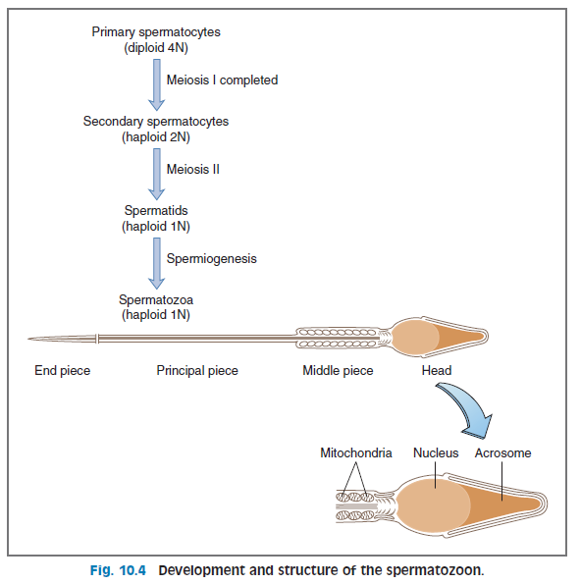

Slide 10
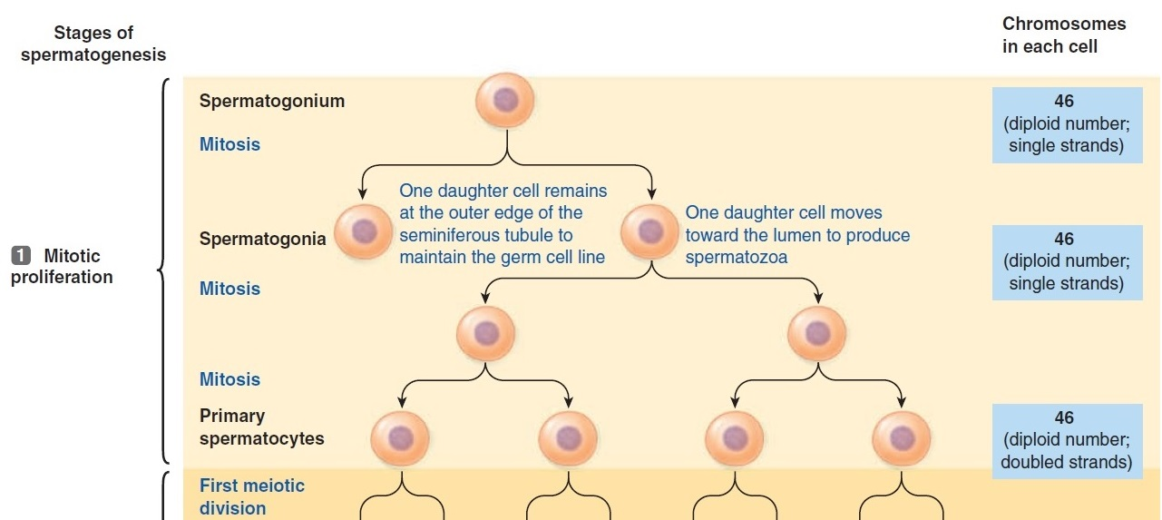
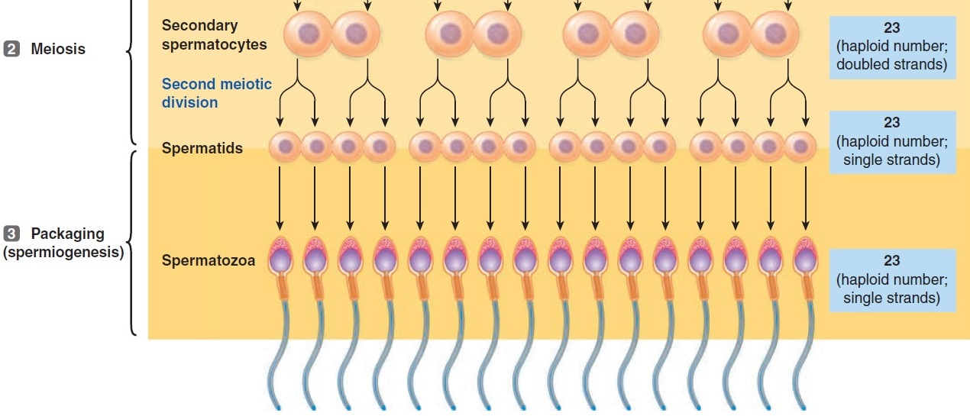

Slide 11
Storage of Sperm, Ejaculation, and Function of Sex Accessory Glands

Slide 12
Sperm leave the testes through ducts that carry them to the epididymis, the primary location for the maturation and storage of sperm. They remain viable in the epididymis for several months.
During sexual arousal, contractions of the smooth muscle around the ducts advance sperm through the epididymis. At ejaculation, sperm are expelled into the vas deferens and then into the urethra. The ampulla of the vas deferens provides another storage area for sperm and secretes a fluid rich in citrate and fructose, which nourishes the ejaculated sperm.

Slide 13
The seminal vesicles secrete a fluid rich in fructose, citrate, prostaglandins, and fibrinogen.
As the vas deferens empties its sperm into the ejaculatory duct, each seminal vesicle contributes its secretions, which also will be nutritive for the ejaculated sperm.
The prostaglandins present in seminal fluid may assist in fertilization in two ways:
React with cervical mucus to make it more penetrable by sperm.
Induce peristaltic contractions in the female reproductive tract (i.e., the uterus and fallopian tubes) to propel the sperm up the tract.

Slide 14
The prostate gland adds its own secretion to the ejaculate, a milky aqueous solution rich in citrate, calcium, and enzymes.
The prostatic secretion is slightly alkaline, which
increases sperm motility
aids in fertilization by neutralizing acidic secretions from the vas deferens and the vagina.
Collectively, the combined secretions of the male sex accessory glands compose 90% of the volume of semen, and sperm compose the remaining 10%.

Slide 15
Ejaculated sperm cannot immediately fertilize an ovum. They must reside in the female reproductive tract for 4–6 hours for capacitation to occur.
Capacitation is a process in which inhibitory factors in the seminal fluid are washed free, cholesterol is withdrawn from the sperm membrane, and surface proteins are redistributed. Ca²⁺ influx into the sperm increases their motility, and the motion of the sperm becomes whiplike.

Slide 16
Capacitation also results in the acrosomal reaction, in which the acrosomal membrane fuses with the outer sperm membrane.
This fusion creates pores through which hydrolytic and proteolytic enzymes can escape from the acrosome, creating a path for sperm to penetrate the protective coverings of the ovum.

Slide 17
Synthesis and secretion of testosterone
Testosterone, the major androgenic hormone, is synthesized and secreted by the Leydig cells of the testes.
Pathway is similar to that in the adrenal cortex, but:
The testes lack the enzymes 21β-hydroxylase and 11β-hydroxylase, and therefore cannot synthesize glucocorticoids or mineralocorticoids.
The testes have an additional enzyme, 17β-hydroxysteroid dehydrogenase, which converts androstenedione to testosterone.

Slide 18
Testosterone is not active in all androgenic target tissues. In some tissues, dihydrotestosterone is the active androgen.
In those tissues, testosterone is converted to dihydrotestosterone by the enzyme 5α-reductase.

Slide 19
98% of the circulating testosterone is bound to plasma proteins, such as sex hormone-binding globulin and albumin. Because only free (unbound) testosterone is biologically active, sex hormone–binding globulin essentially functions as a reservoir for the circulating hormone.
The synthesis of sex hormone - binding globulin is stimulated by estrogens and inhibited by androgens.

Slide 20
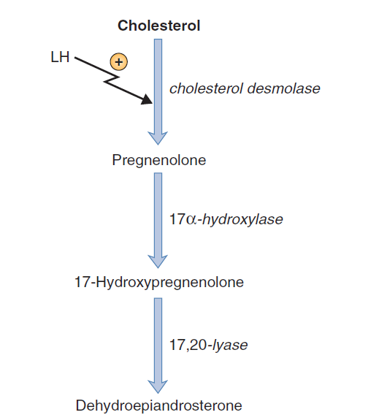
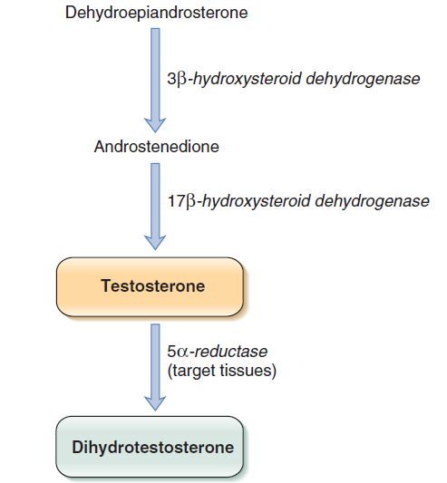

Slide 21
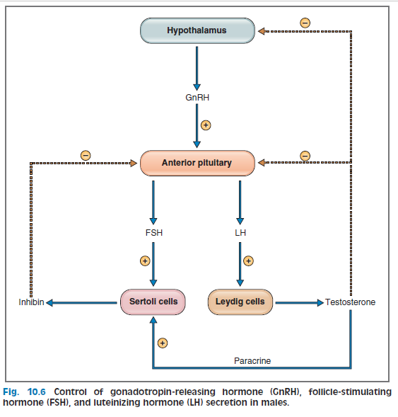
Regulation of the testis function

Slide 22
Actions of androgens
In some target tissues, testosterone is the active androgenic hormone. In other target tissues, testosterone must be activated to dihydrotestosterone by the action of 5α-reductase.

Slide 23
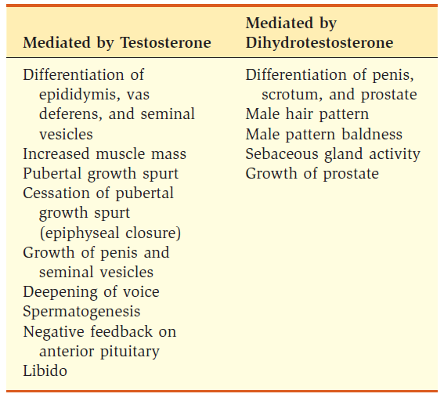
Actions of androgens

Slide 24
The mechanism of action of androgens begins with binding of testosterone or dihydrotestosterone to an androgen-receptor protein in the cells of target tissues.
The androgen-receptor complex moves into the nucleus, where it initiates gene transcription.
New messenger ribonucleotides (mRNAs) are generated and translated into new proteins that are responsible for the various physiologic actions of androgens.

