Slide 1
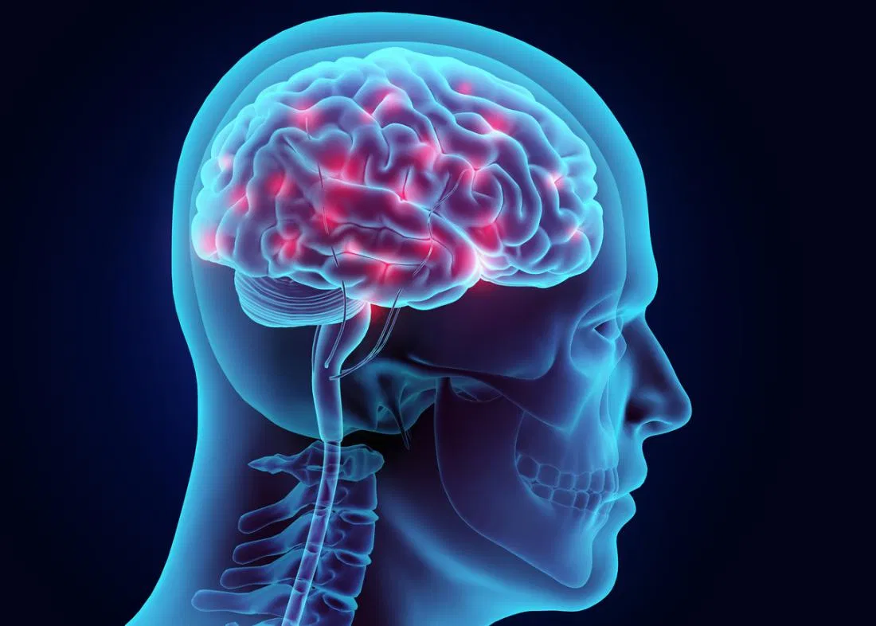
Anticonvulsants
Dr. Romany H Thabet, Ph.D.
Notes:
‹#›

Slide 2
Definitions
Convulsion: Sudden attack of involuntary muscular contractions and relaxations.
Seizure: Abnormal central nervous system electrical activity.
Epilepsy: A group of recurrent disorders of cerebral function characterized by both seizures and convulsions.
Notes:
‹#›

Slide 3
Partial (focal) Seizures
Excessive electrical activity in one cerebral hemisphere. -Affects only part of the body.
Simple Partial: Person may experience a range of strange or unusual sensations.
Motor
Sensory
Autonomic
Key feature: preservation of consciousness.
Notes:
‹#›

Slide 4
Partial (focal) Seizures
Complex Partial:
Loss of awareness at seizure onset. Person seems dazed or confused and exhibits meaningless behaviors.
Typically originate in frontal or temporal lobes (e.g. Temporal lobe epilepsy)
Notes:
‹#›

Slide 5
Generalized Seizures
Excessive electrical activity in both cerebral hemispheres.
Usually originates in the thalamus or brainstem.
Affects the whole body.
Loss of consciousness is common.
Notes:
‹#›

Slide 6
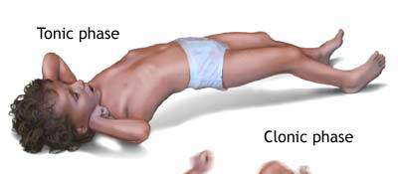
Generalized Seizures
Myoclonic: Brief shock-like muscle jerks generalized or restricted to part of one extremity.
Atonic: Sudden loss of muscle tone.
Tonic Seizures: sudden stiffening of the body, arms, or legs
Clonic Seizures: rhythmic jerking movements of the arms and legs without a tonic component
Tonic-clonic (grand mal):
Tonic phase followed by clonic phase
http://www.nlm.nih.gov/medlineplus/ency/images/ency/fullsize/19076.jpg
Notes:
‹#›

Slide 7
Tonic-Clonic Seizure
Can last from one to several minutes
Therapeutic intervention = lorazepam injection
Notes:
‹#›

Slide 8
Generalized Seizures
Absence (petit mal): Person appears to “blank out” - “Daydreaming”
Simple Absence (primarily effects consciousness only)
Complex Absence
Atypical Absence (Includes physical symptoms like eye blinking or lip movements)
Lenox-Glastaut Syndrome.
Atypical absence, atonic and myclonic
Status Epilepticus: A seizure lasting longer than 30 min, or 3 seizures without a normal period in between
May be fatal
Emergency intervention required
Notes:
‹#›

Slide 9
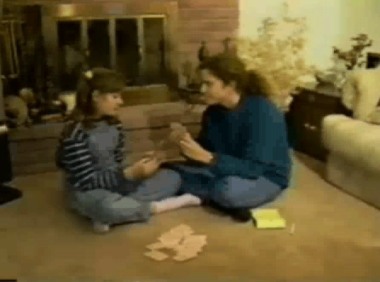
Absence Seizure
Can last from a second to several minutes
Notes:
‹#›

Slide 10
Treatment
Monotherapy with anticonvulsant
Increase dose gradually until seizures are controlled or adverse effects become unacceptable.
Multiple-drug therapy may be required.
Achieve steady-state kinetics
Monitor plasma drug levels
Avoid sudden withdrawal
Notes:
‹#›

Slide 11
Mechanisms of Action
3 main categories of therapeutics:
Inhibition of voltage-gated Na+ channels to slow neuron firing.
Enhancement of the inhibitory effects of the neurotransmitter GABA.
Inhibition of calcium channels.
Notes:
‹#›
Some drugs falls into more than one category, and some have MOAs that don’t fall into any of these categories.

Slide 12
There are Many Adverse Effects of Therapeutics!!!!
CNS Effects:
Drowsiness, sedation, somnolence
Depression
Dizziness
Slurred speech
Ataxia
Nystagmus
Diploplia
Vertigo
Headache
Confusion
Tremor
Interference with cognitive functions in learning situations
GI Effects
Dry Mouth
Nausea
Vomiting
Anorexia
Diarrhea
Rash
Fetal Abnormalities and birth defects
Notes:
‹#›

Slide 13
Anti-convulsant Pharmacotherapy
Medications are listed next with general guidelines for use.
good first choice, second choice, etc.
Actual use will depend more on a combination of your experiences in the clinic and patient individuality and response.
Notes:
‹#›

Slide 14
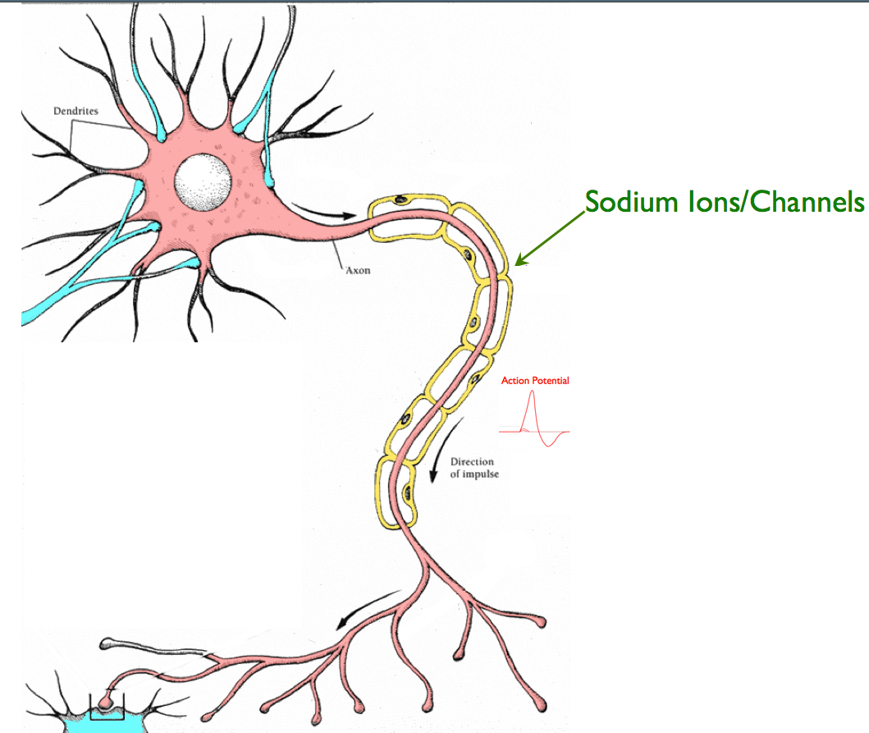
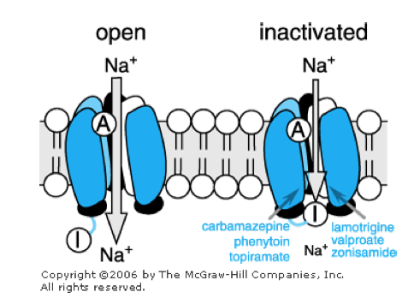
Na+ Channel Inhibitors
Notes:
‹#›

Slide 15
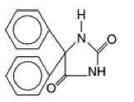
Na+ Channel Inhibitors
Phenytoin (Dilantin, Phenytek):
Indications:
First choice for partial and generalized tonic-clonic seizures
Some efficacy in clonic, myoclonic, atonic,
No effect on infantile spasms or absence seizures
Drug Interactions:
Decreases blood levels of many medications
Increases blood levels of phenobarbital & warfarin
Notes:
‹#›

Slide 16
Na+ Channel Inhibitors
Phenytoin (Dilantin, Phenytek):
Adverse Effects:
Hirsutism & coarsening of facial features
Acne
Gingival hyperplasia (20-40%)
Brush teeth >8 times per day
A primary reason not to prescribe for children
Decreased serum concentrations of folic acid, thyroxine, and vitamin K with long-term use.
Notes:
‹#›

Slide 17
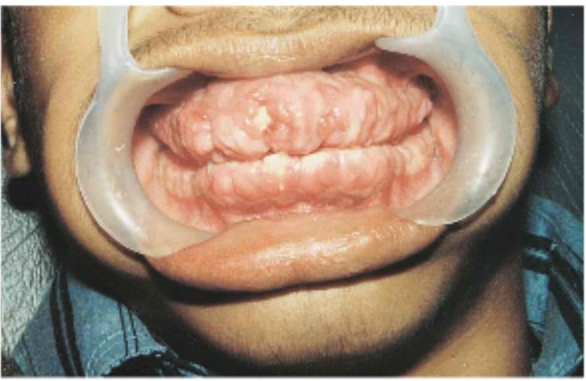
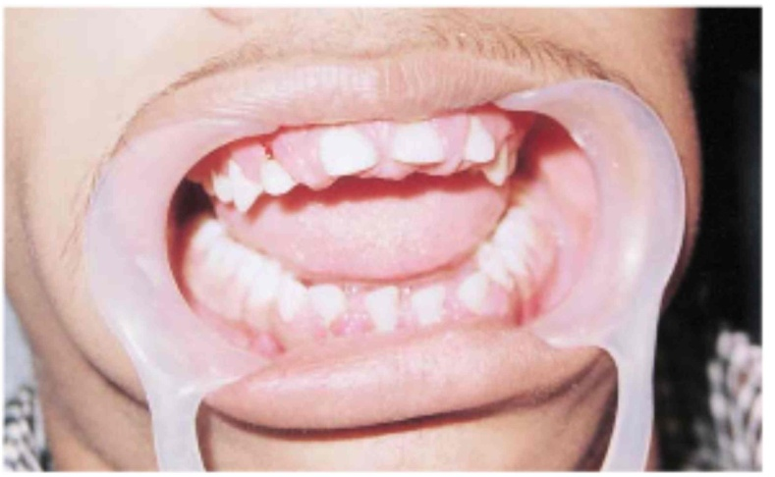
Phenytoin Induced Gingival Hyperplasia
17 year old boy treated with 300mg/day phenytoin for 2 years (unsupervised)
Partial recovery at 3 months after discontinuation
Images in Clinical Medicine (Feb 2000) 342:325

Slide 18
Phenytoin
Phenytoin has dose-dependent clearance due to progressive saturation of its hepatic metabolism by cyt P-450 at normal therapeutic plasma levels, and ~10 ug/ml is considered the minimal effective plasma concentration for seizure control.
Due to saturation of its metabolism, even small increases in maintenance dosage can cause large, unpredictable increases in plasma drug concentrations, which increases the risk of adverse effects such as ataxia, nystagmus, confusion, gingival hyperplasia, hirsuitism (and the list goes on). In addition, other drugs that either inhibit or induce P-450 can produce marked changes in phenytoin plasma levels.
Images in Clinical Medicine (Feb 2000) 342:325

Slide 19
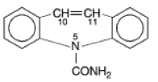
Na+ Channel Inhibitors
Carbamzepine (Tegretol, Carbatrol):
Indications:
First choice for complex partial and generalized tonic-clonic seizures.
Contraindications:
May exacerbate absence or myoclonic seizures.
Blood disorders
Liver disorders
Notes:
‹#›

Slide 20
Na+ Channel Inhibitors
Carbamazepine (Tegretol, Carbatrol):
Drug Interactions:
CBZ metabolism is affected by many drugs, and CBZ affects the metabolism of many drugs.
Adverse Effects:
Mild leukopenia or hyponatremia
Circulating concentrations of thyroid hormones may be depressed; TSH remains normal.
Notes:
‹#›

Slide 21
Na+ Channel Inhibitors
Oxcarbazepine (Trileptal):
FDA approved in 2000 for partial seizures
Complex partial seizures
Primary & secondarily generalized tonic-clonic seizures
No effect on absence or myoclonic seizures
Fewer adverse effects than CBZ, phenytoin
Notes:
‹#›

Slide 22
Na+ Channel Inhibitors
Valproic Acid (Valproate; Depakene, Depakote):
Other Mechanisms of Action:
1) Some inhibition of T-type Ca2+ channels.
2) Increases GABA production and decreases GABA metabolism.
Indications:
Simple or complex partial, & primary generalized tonic-clonic
Also used for absence, myoclonic, and atonic seizures.
Highly effective for photosensitive epilepsy and juvenile myoclonic epilepsy.
Contraindications:
Liver disease
Notes:
‹#›

Slide 23
Na+ Channel Inhibitors
Valproic Acid (Valproate; Depakene, Depakote):
Drug Interactions:
Affects metabolism of many drugs through liver enzyme inhibition
Phenobarbital
“Drunkenness”
Clorazepam
Prolonged absence seizures
Notes:
‹#›

Slide 24
Na+ Channel Inhibitors
Valproic Acid (Valproate; Depakene, Depakote):
Adverse Effects:
Weight gain (30-50%)
Dose-related tremor
Transient hair loss
Polycystic ovary syndrome and menstrual disturbances
Bone loss
Ankle swelling
Spina bifida
Acute pancreatitis
Notes:
‹#›

Slide 25
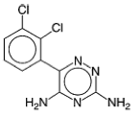
Na+ Channel Inhibitors
Lamotrigine (Lamictal):
Other Mechanism of Action:
May inhibit synaptic release of glutamate.
Indications:
Adjunct therapy (ages 2 & up):
Simple & complex partial seizures
Generalized seizures of Lennox-Gastaut Syndrome
Monotherapy (adults):
Simple & complex partial seizures
Contraindications:
May make myoclonic seizures worse.
Notes:
‹#›

Slide 26
Na+ Channel Inhibitors
Lamotrigine (Lamictal):
Adverse Effects:
Rash (10%)
Rare progression to serious systemic illness
Increased alertness
Notes:
‹#›

Slide 27
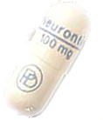
Na+ Channel Inhibitors
Topiramate (Topamax):
Other Mechanism of Action:
Enhances post-synaptic GABAA receptor currents.
Kainate receptor antagonist (blocks a certain type of glutamate channel)
Indications:
Adjunct therapy for partial and primary generalized tonic-clonic seizures in adults and children over 2.
Decreases tonic and atonic seizures in children with Lennox-Gastaut syndrome.
Contraindications:
History of kidney stones
Notes:
‹#›

Slide 28
Na+ Channel Inhibitors
Topiramate (Topamax):
Drug Interactions:
CBZ, phenytoin, phenobarbital, & primidone decrease blood levels
Adverse Effects:
Nervousness & paresthesias
Psychomotor slowing, word-finding difficulty, impaired concentration, interference with memory
Weight loss & anorexia
Metabolic acidosis
Notes:
‹#›

Slide 29
Na+ Channel Inhibitors
Zonisamide (Zonegran):
Other Mechanism of Action:
Inhibits T-type Ca2+ currents.
Binds to GABA receptors.
Facilitates dopaminergic and serotonergic neurotransmission.
Notes:
‹#›

Slide 30
Na+ Channel Inhibitors
Zonisamide (Zonegran):
Indications:
Approved for adjunct treatment of partial seizures in adults.
Appears to have a broad spectrum:
Myoclonic seizures
Infantile spasms
Generalized & atypical absence seizures
Lennox-Gastaut Syndrome
Drug Interactions:
Phenytoin and carbamazepine decrease its half-life by half.
Notes:
‹#›

Slide 31
Na+ Channel Inhibitors
Zomisamide (Zonegran):
Adverse Effects:
Weight loss
Abnormal thinking
Nervousness
Agitation/irritability
Usually well tolerated
Notes:
‹#›

Slide 32
Na+ Channel Inhibitors
Lidocaine: Only when other drugs are refractory for status epilepticus.
Notes:
‹#›

Slide 33
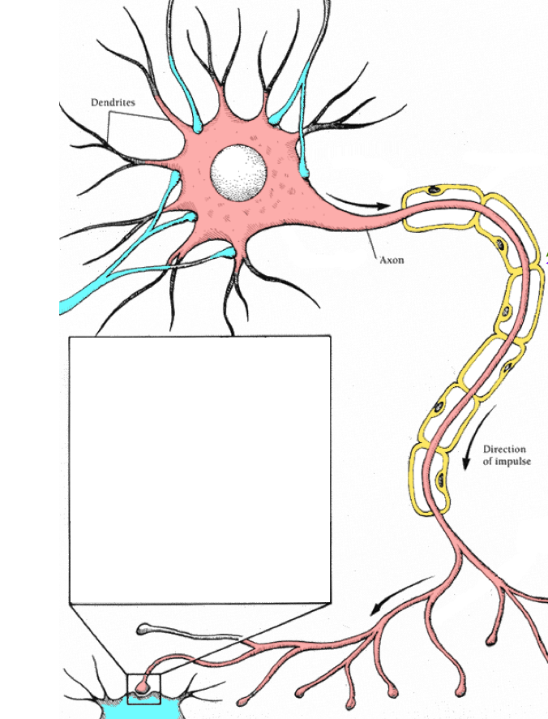
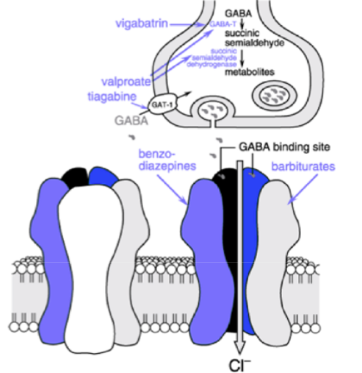
Enhancement of GABA Inhibition
Notes:
‹#›

Slide 34
Enhancement of GABA Inhibition
Barbiturate drugs: Phenobarbital (Luminal) & Primidone (Mysoline):
Mechanism of Action:
Increases the duration of GABAA-activated Cl- channel opening.
Notes:
‹#›

Slide 35
Enhancement of GABA Inhibition
Phenobarbital (Luminal):
Indications:
Second choice for partial and generalized tonic-clonic seizures.
Rapid absorption has made it a common choice for seizures in infants, but adverse cognitive effects cause it to be used less in older children and adults.
Status epilepticus
Contraindications:
Absence Seizures
Notes:
‹#›

Slide 36
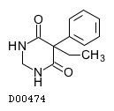
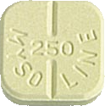
Enhancement of GABA Inhibition
Primidone (Mysoline):
Indications:
Adjuvant or monotherapy for partial and generalized tonic-clonic seizures
May control refractory generalized tonic-clonic seizures
Contraindications:
History of porphyria
Notes:
‹#›

Slide 37
Enhancement of GABA Inhibition
Phenobarbital (Luminal) & Primidone (Mysoline):
Drug Interactions:
Other CNS depressants
Increased metabolism of vitamin D and K
Phenytoin increases the conversion of primidone to phenobarbital.
Notes:
‹#›

Slide 38
Enhancement of GABA Inhibition
Phenobarbital (Luminal) & Primidone (Mysoline):
Adverse Effects:
Agitation and confusion in the elderly.
Worsening of pre-existing hyperactivity and aggressiveness in children
Sexual side effects
Physical dependence
Notes:
‹#›

Slide 39
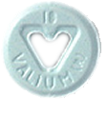
Enhancement of GABA Inhibition
Benzodiazepine drugs:
Diazepam (Valium), lorazepam (Ativan), clonazepam (Klonopin), clorazepate (Transxene-SD)
Mechanism of Action:
Increases the frequency of GABAA-activated Cl- channel opening.
Notes:
‹#›

Slide 40
Enhancement of GABA Inhibition
Benzodiazepine drugs:
Indications:
Only clonazepam & clorazepate approved for long-term treatment.
Clorazepate
In combination for partial seizures
Clonazepam
Lennox-Gastaut Syndrome, myoclonic, atonic, and absence seizures
Tolerance develops after about 6 months
Notes:
‹#›

Slide 41
Enhancement of GABA Inhibition
Benzodiazepine drugs:
Indications:
Diazepam and lorazepam are used in treatment of status epileticus.
Diazepam is painful to inject; lorazepam is more commonly used in acute treatment.
Diazepam
Intermittent use for control of seizure clusters
Diazepam frequently combined with phenytoin.
Notes:
‹#›

Slide 42
Enhancement of GABA Inhibition
Benzodiazepine drugs:
Contraindications:
Diazepam in children under 9
Narrow angle glaucoma
Adverse Effects:
Hypotonia, Dysarthria
Muscle in-coordination (clonazepam)
Behavioral disturbances (especially in children)
Aggression, Hyperactivity, Irritability and Difficulty concentrating
Notes:
‹#›

Slide 43
Enhancement of GABA Inhibition
Tiagabine (Gabitril):
Mechanism of Action:
Inhibition of GABA transporter (GAT-1) – reduces reuptake of GABA by neurons and glial cells.
Indications:
Approved in 1998 as an adjunct therapy for partial seizures in patients at least 12 years old.
Contraindications:
Absence seizures
Notes:
‹#›

Slide 44
Enhancement of GABA Inhibition
Tiagabine (Gabitril):
Interactions:
Blood levels decreased by CBZ, phenytoin, phenobarbital, & primidone
Adverse Effects:
Asthenia
Abdominal pain
Notes:
‹#›

Slide 45
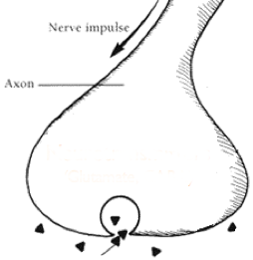
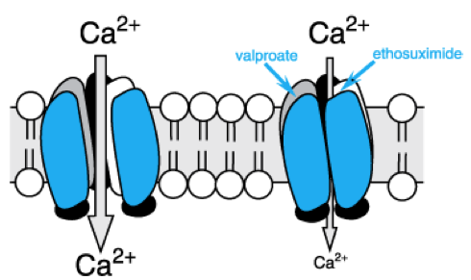
Calcium Channel Blockers
Notes:
‹#›

Slide 46
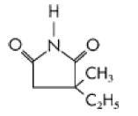
Voltage-Gated Ca2+ Channel T Currents
Ethosuximide (Zarontin):
Mechanism of Action:
Reduces low threshold Ca2+currents (T currents) in the thalamic neurons.
Half-life is ~60 hr in adults; ~30hr in children.
Indications:
First line for absence seizures
Contraindications:
May exacerbate partial & tonic-clonic seizures
Notes:
‹#›

Slide 47
Voltage-Gated Ca2+ Channel T Currents
Ethosuximide (Zarontin):
Adverse Effects:
Psychotic behavior
Blood dyscrasias
Persistent headaches
Anorexia
Hiccups
Lupus-like syndromes
Toxicity:
parkinson-like symptoms
photophobia
Notes:
‹#›

Slide 48
Blockade of Calcium Channels (α2−δ)
Gabapentin (Neurontin):
Mechanism of Action:
Originally designed to be a centrally acting GABA agonist.
Selective inhibition of v-g Ca2+ channels containing the α2δ1 subunit.
Indications:
adjunct therapy in adults and children with partial & secondarily generalized seizures.
Also effective as monotherapy.
Notes:
‹#›

Slide 49
Blockade of Calcium Channels (α2−δ)
Gabapentin (Neurontin):
Contraindications:
Can exacerbate myoclonic & absence seizures.
Adverse Effects:
Weight Gain (5%) with ankle edema
Irritability
Behavioral problems in children (6%)
Has been associated with movement disorders.
Notes:
‹#›

Slide 50
Blockade of Calcium Channels (α2−δ)
Pregabalin (Lyrica):
Mechanism of Action:
Same as gabapentin
Indications:
Approved in 2005
Adjunct therapy for partial & secondarily generalized seizures
Contraindications:
No effect on absence, myoclonic, or primary generalized tonic-clonic seizures
Other uses:
Prescribed for neuropathic pain, fibromyalgia
Notes:
‹#›

Slide 51
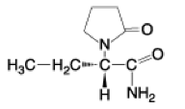
Other/Unknown MOA
Levetiracetam (Keppra):
Mechanism of Action:
Not exactly known
Binding affinity to Synaptic Vesicle Protein 2A correlates with its anticonvulsant activity.
Also blocks calcium channel N-currents, increases intracellular Ca²⁺ levels, modulates GABA channel currents
Indications:
Approved in 1999 as an adjunct therapy for adults with partial seizures.
Some patients have success with monotherapy
Notes:
‹#›

Slide 52
Other/Unknown MOA
Levetiracetam (Keppra):
Contraindications:
Renal dysfunction
Adverse Effects:
Asthenia
Infection
Behavioral problems in children
Notes:
‹#›

Slide 53
Other/Unknown MOA
Magnesium chloride: Used for magnesium deficiency seizures.
Paraldehyde: Alcohol withdrawal seizures.
Notes:
‹#›

Slide 54
Primary Generalized Tonic-Clonic (Grand Mal) Seizures
Drugs of Choice:
Phenytoin
Carbamazepine
Oxcarbazepine
Valproate
Alternatives
Lamotrigine
Topiramate
Zonisamide
Levetiracetam
Primidone
Phenobarbital
Diazepam
Notes:
‹#›

Slide 55
Partial, Including Secondarily Generalized Seizures
Drugs of Choice:
Phenytoin
Carbamazepine
Oxcarbazepine
Valproate
Alternatives
Lamotrigine
Topiramate
Zonisamide
Levetiracetam
Primidone
Phenobarbital
Gabapentin
Pregabalin
Tiagabine
Notes:
‹#›

Slide 56
Absence (Petit Mal)
Drugs of Choice:
Ethosuximide
Valproate
Alternatives
Clonazepam
Zonisamide
Notes:
‹#›

Slide 57
Atypical Absence, Myoclonic, Atonic Seizures
Drug of Choice:
Valproate
Alternatives
Clonazepam
Topiramate
Zonisamide
Levetiracetam
Notes:
‹#›

