Slide 1
Epidemiology of sexual transmitted diseases
Community medicine
Lecture #1

Slide 2
Overview
Worldwide STIs Negative impact on health
Risk factors of STIs
Epidemiology
Mortality rate associated with viral hepatitis
Emerging disease that can be sexually transmitted
STIs in Middle East
STIs epidemiology in Jordan
Prevention and control of STIs
Prevention strategies
Barriers of prevention
Pelvic inflammatory disease (PID)
Risk factors
Epidemiology of PID
Prevention

Slide 3
Overview
Sexually transmitted diseases (STIs) are infections that are passed from one person to another through sexual contact.
Some STIs can also be spread through non-sexual means
Blood or blood products
Mother to child during pregnancy and childbirth.

Slide 4
Eight of these pathogens are linked to the greatest incidence of sexually transmitted disease
Syphilis
Gonorrhoea
Chlamydia
Trichomoniasis
Hepatitis B
Herpes simplex virus (HSV or herpes)
HIV
Human papillomavirus (HPV)

Slide 5
Most STDs affect both men and women, but in many cases, it can be more severe for women.
STIs can have serious reproductive health consequences beyond the immediate impact of the infection itself (e.g., infertility or mother-to-child transmission).
The majority of STIs have no symptoms or only mild symptoms that may not be recognized as an STI (Asymptomatic).

Slide 6
Worldwide STIs Negative impact on health
Fetal and neonatal deaths:
Syphilis in pregnancy leads to over 300 000 fetal and neonatal deaths each year and places an additional 215 000 infants at increased risk of early death.
B. Cervical cancer:
The human papillomavirus infection is responsible for an estimated 530 000 cases of cervical cancer and 264 000 cervical cancer deaths each year.

Slide 7
C. Infertility:
STIs, such as gonorrhea and chlamydia, are important causes of infertility worldwide.
D. HIV risk:
The presence of STIs increases the risk of acquiring or transmitting HIV infection (by two to three times, in some populations).
E. Physical, psychological and social consequences of STIs severely compromise the quality of life of those infected.

Slide 8
Risk factors of STIs
Unprotected sex.
Multiple partners.
Young age <25.
Alcohol and Drug use.
Homosexuality.
History of STIs.

Slide 9
Epidemiology
Every day, there is more than 1 million sexually transmitted infections (STIs) are acquired worldwide.
Each year, there are an estimated 357 million new infections with 1 of 4 STIs:
Trichomoniasis (143 million),
Chlamydia (131 million),
Gonorrhea (78 million),
Syphilis (5.6 million).

Slide 10
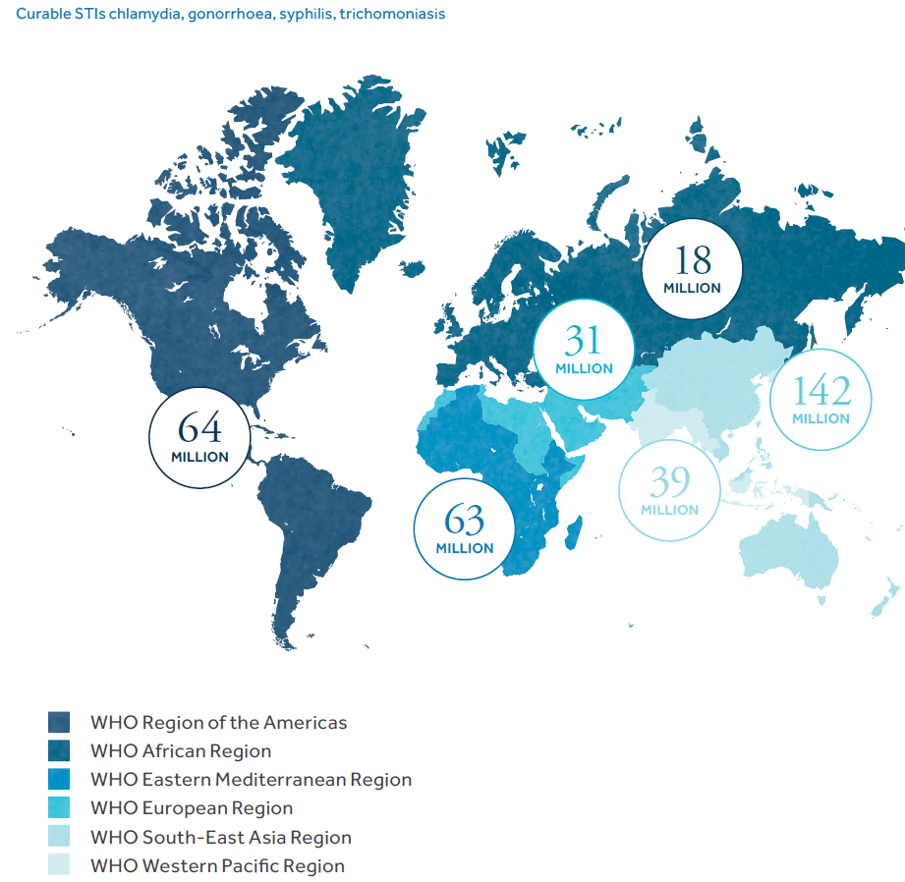

Slide 11
HSV : account for more than 500 million people.
HPV: account for more than 290 million women.
STIs such as HSV type 2 and syphilis can increase the risk of HIV acquisition.
Viral hepatitis is responsible for an estimated 1.4 million deaths per year from;
47 % hepatitis B (HB-B)
48% HB-C
Rest for HB-A and HB-E

Slide 12
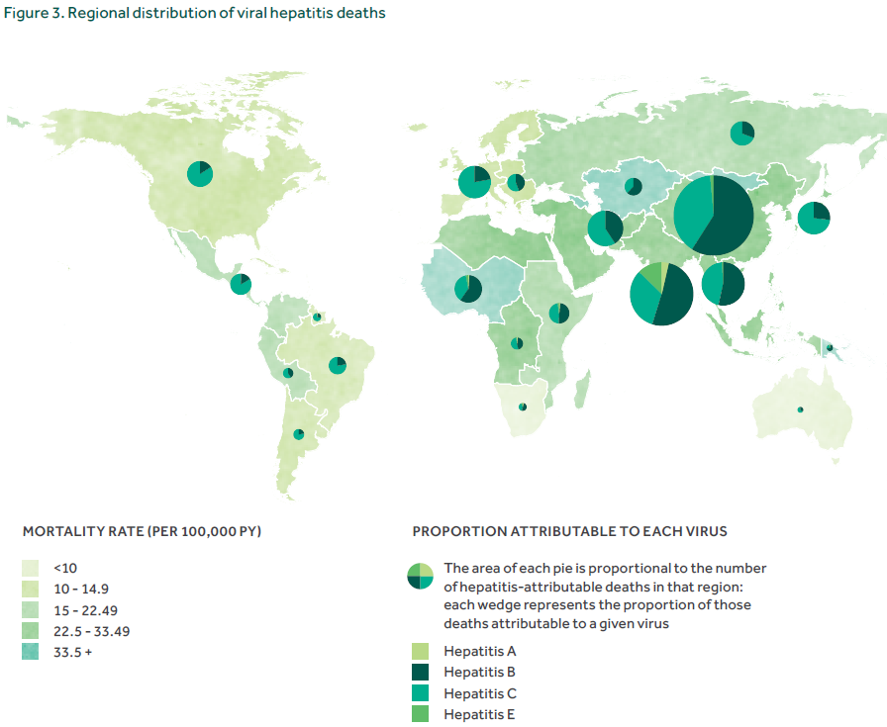
Mortality rate associated with viral hepatitis:

Slide 13
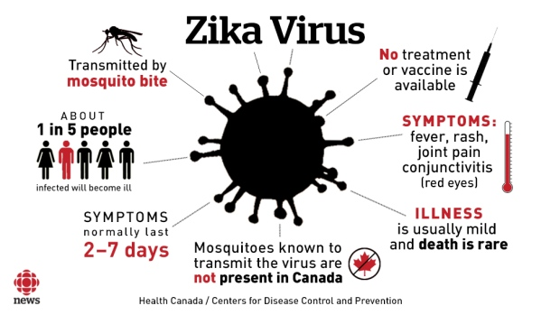
Emerging disease that can be sexually transmitted

Slide 14
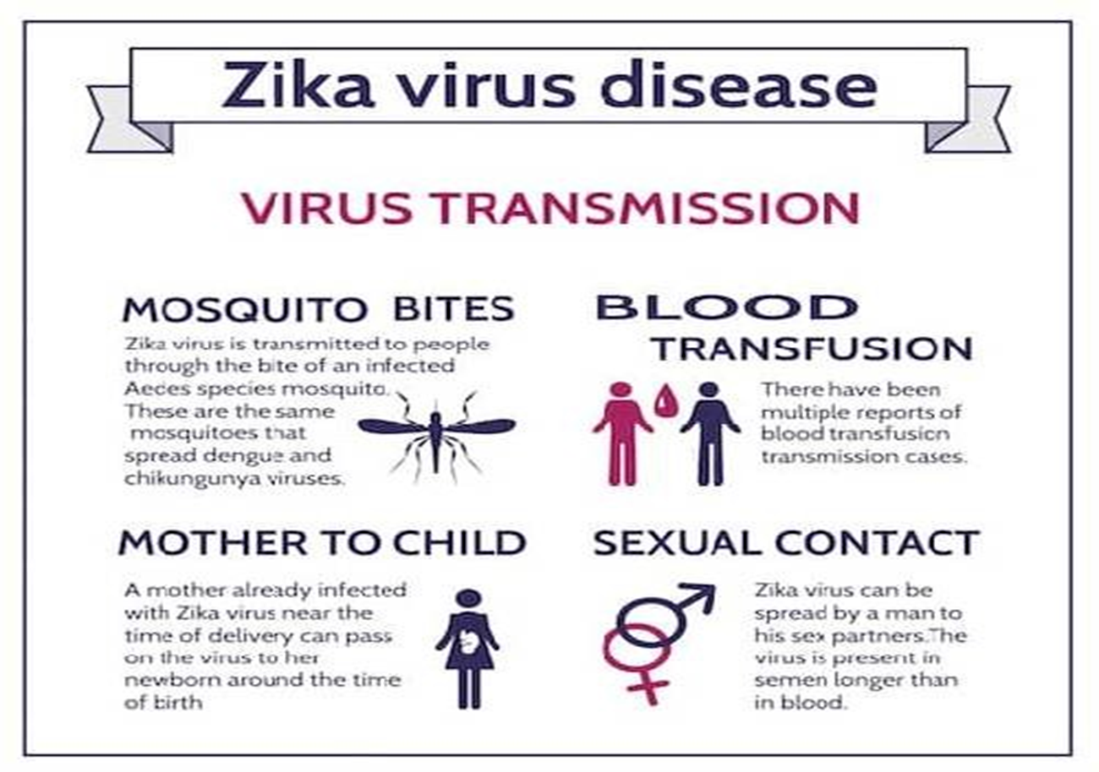

Slide 15
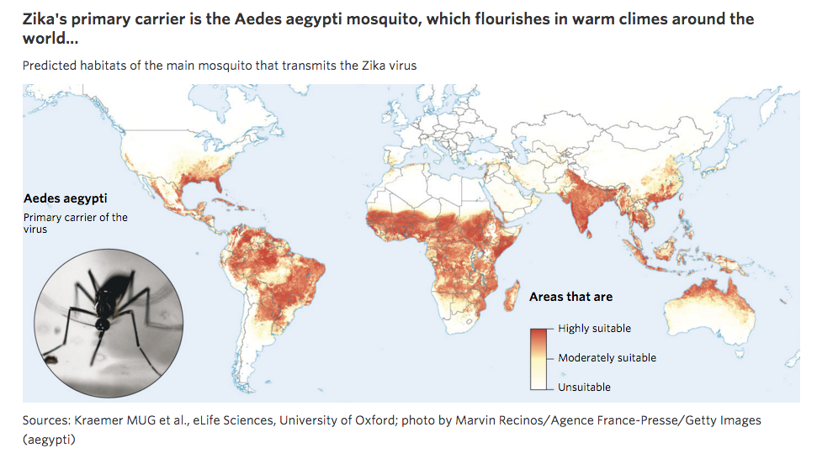

Slide 16
STIs in Middle East
HIV prevalence in Middle Eastern countries is low, with an average of 0.2%
Between 2001 and 2009 it has increased from 0.1% to 0.2%
The number of new infections doubled between 2001(36 000) and 2009 (75 000);
The actual number of people living with HIV/AIDS also doubled from 180 000 in 2001 to 460 000 in 2009.
Currently, the male/female sex ratio is 4:1.

Slide 17
STIs epidemiology in Jordan
STIs among women of childbearing age in Jordan:
Chlamydia trachomatis, 0.6%
Neisseria gonorrhoeae, 2.2%
Trichomonas vaginalis, 0.7%
The prevalence of chlamydial infection was 4.6% among symptomatic patients with urethritis

Slide 18
HIV prevalence rates are likely to be underestimated, on average by 0.2% to 1%;
This due to fear of stigma that may reduce testing and care-seeking behavior in addition to inadequate surveillance system

Slide 19
Prevention and control of STIs
STI control is a public health outcome measured by reduced incidence and prevalence.
The means to achieve this include:
(I) Targeting and outreach to populations at greatest risk
(ii) Promoting and providing tools for safe sex
(Iii) Effective clinical interventions
(early diagnosis & proper treatment)
(iv) Provide an enabling environment
(that will enhance early detection)
(v) Surveillance and reliable data

Slide 20
Prevention strategies
Counseling and behavioral approaches
Counseling and behavioral interventions offer primary prevention against STIs (including HIV), as well as against unintended pregnancies.
Vaccines and other biomedical interventions
Health services for screening and treatment of STIs

Slide 21
1. Counseling and behavioral approaches
Comprehensive sexuality education
Safer sex/risk-reduction counseling
Counseling can improve people’s ability to recognize the symptoms of STIs and increase the likelihood they will seek care or encourage a sexual partner to do so.
Condom promotion
There is strong evidence that male latex condoms reduce transmission of HIV by at least 80–85%, are effective against most other STIs.
Interventions targeted at key populations
Sex workers
Homosexual
People who inject drugs
Education and counseling tailored to the needs of adolescents

Slide 22
Barriers of prevention
Lack of public awareness
Lack of training of health workers
Long-standing, widespread stigma around STIs
Cultural and religious values that promote abstention could be effective in reducing STIs rates, however, is not enough

Slide 23
2. Vaccines and other biomedical interventions
Safe and highly effective vaccines are available for 2 STIs: hepatitis B and HPV.
These vaccines have represented major advances in STI prevention.
The vaccine against hepatitis B is included in infant immunization programs and has already prevented an estimated 1.3 million deaths from chronic liver disease and cancer.
HPV vaccination could prevent the deaths of more than 4 million women over the next decade in low- and middle-income countries, where most cases of cervical cancer occur, if 70% vaccination coverage can be achieved.
HPV vaccine is available as part of routine immunization programs in high- and middle-income countries.

Slide 24
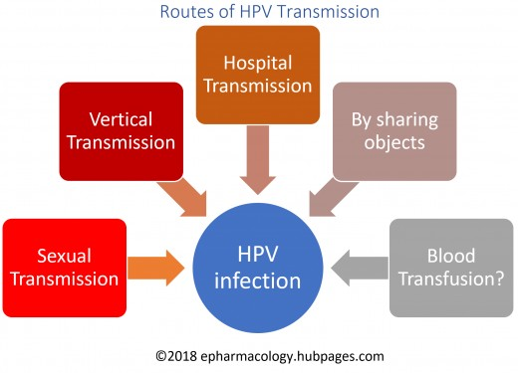

Slide 26
Other biomedical interventions to prevent some STIs include adult male circumcision and microbicides.
Male circumcision reduces the risk of heterosexually acquired HIV infection in men by approximately 60% and provides some protection against other STIs, such as herpes and HPV.
Vaginal microbicide, has shown some effectiveness against HSV-2.

Slide 27
3. Health services for screening and treatment of STIs
People seeking screening and treatment for STIs face numerous problems;
Limited resources
Stigmatization
Poor quality of services
Little or no follow-up of sexual partners
In many countries, STI services are provided separately and not available in primary health care, family planning and other routine health services
In many settings, services are often unable to provide screening for asymptomatic infections
Marginalized populations with at high risk of STIs often do not have access to healthcare or STIs screening programs.

Slide 28
Pelvic inflammatory disease (PID)
PID is a clinical syndrome that results from the ascension of microorganisms from the cervix and vagina to the upper genital tract
PID is a serious complication of some sexually transmitted diseases (STIs), especially chlamydia and gonorrhea
PID is a frequent and important infection that occurs among women of reproductive age
PID can lead to infertility and permanent damage of a woman’s reproductive organs

Slide 29
Approximately, 30-50% of PID cases is due to with Chlamydia trachomatis and Neisseria gonorrhoeae infection
Endogenous microorganisms, found at high levels in women with bacterial vaginosis, also have been implicated in the pathogenesis of PID

Slide 30
Risk factors
Risk factors for PID include factors associated with STIs acquisition
History of STIs or prior PID
A small increased risk of PID associated with intrauterine device (IUD)

Slide 31
Epidemiology of PID
In US, the estimated prevalence of self-reported lifetime PID was 4.4% in sexually experienced women of reproductive age (18–44 years).
This estimated to 2.5 million women in the United States with a reported lifetime history of PID diagnosis .
The prevalence was highest in women at increased risk, such as those with previous sexually transmitted infections (STIs).
Direct medical expenditures for PID and its squeal were estimated at $1.88 billion in 1998

Slide 32
Prevention
Preventing STIs.
Screening of women at risk for STIs and treatment of infected women and their sex partners can help to minimize the risk of PID.
Screening of young sexually active women for chlamydia has been shown to decrease the incidence of PID.
CDC recommends that providers screen the following populations for chlamydia and gonorrhea:
all sexually active women younger than 25 years
older women with risk factors
new or multiple sex partners
sex partner who has a sexually transmitted infection

Slide 33
Epidemiology of urinary tract infections
Community medicine
Lecture 2

Slide 34
Overview
Urinary tract infections (UTIs) are among the most common bacterial infections acquired in the community and in hospitals.
Women are at greater risk of developing a UTI than are men.
Many women experience more than one infection during their lifetimes.
UTIs are a significant cause of morbidity in infant boys, older men and females of all ages.

Slide 35
Causative agents of UTIs
Caused by a range of pathogens, but most commonly by
Escherichia coli
Klebsiella pneumoniae
Proteus mirabilis
Enterococcus faecalis
Staphylococcus saprophyticus.
Escherichia coli (E.coli) are the bacteria most frequently implicated in uncomplicated UTI and catheter-associated UTI, and are becoming increasingly resistant to antibiotics
80% of community – acquired
50% of hospital-acquired

Slide 37
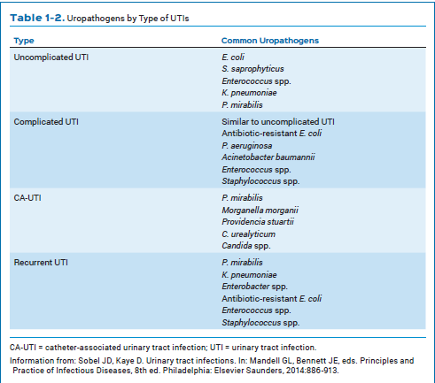

Slide 38
Complicated UTIs are those occurring in…
Men
Children
Pregnancy
People with suspected pyelonephritis
People with recurrent UTI
Failed antibiotic treatment or persistent symptoms
Catheterized patients
Hospital-acquired infections
Recent urinary tract instrumentation
People with abnormalities of genitourinary tract
People with renal impairment
People with impaired host defenses

Slide 39
Epidemiology
Urinary tract infections (UTIs) are some of the most common bacterial infections, affecting 150 million people each year worldwide
75 % sporadic
25 % recurrent
2 % complicated
In 2007, in the United States alone, there were an estimated 10.5 million office visits for UTI symptoms and 2–3 million emergency department visits

Slide 40
Currently, the societal costs of these infections, including health care costs and time missed from work, are approximately $3.5 billion per year in the US alone.
Serious sequel of UTI include;
Frequent recurrences,
Pyelonephritis with sepsis,
Renal damage in young children,
Pre-term birth,
Complications caused by frequent antimicrobial use.

Slide 41
About 20-30 % of pregnant women with asymptomatic bacteriuria.
Screening for UTI during pregnancy is recommended.
Effects of UTI in pregnancy : Increased incidence of fetal death and growth retardation.

Slide 42
UTI is one of the most common hospital-acquired infections;
In the US, 70–80% of complicated UTIs are attributable to indwelling catheters, accounting for 1 million cases per year.
About 12-60% inpatients will have a urinary catheter at some time during admission.

Slide 43
Risk factors
Risk factors specific to women for UTIs include:
Female anatomy. A woman has a shorter urethra than a man does, which shortens the distance that bacteria must travel to reach the bladder.
Sexual activity. Sexually active women tend to have more UTIs than do women who aren't sexually active. Having a new sexual partner also increases risk.
Certain types of birth control. Women who use diaphragms for birth control may be at higher risk, as well as women who use spermicidal agents.
Menopause. After menopause, a decline in circulating estrogen causes changes in the urinary tract that make you more vulnerable to infection.

Slide 44
Other risk factors for UTIs include:
Urinary tract abnormalities. Babies born with urinary tract abnormalities that don't allow urine to leave the body normally or cause urine to back up in the urethra have an increased risk of UTIs.
Blockages in the urinary tract. Kidney stones or an enlarged prostate can trap urine in the bladder and increase the risk of UTIs.
A suppressed immune system. Diabetes and other diseases that impair the immune system — the body's defense against germs — can increase the risk of UTIs.
Catheter use. People who can't urinate on their own and use a tube (catheter) to urinate have an increased risk of UTIs. This may include people who are hospitalized, people with neurological problems that make it difficult to control their ability to urinate and people who are paralyzed.
A recent urinary procedure. Urinary surgery or an exam of your urinary tract that involves medical instruments can both increase your risk of developing a urinary tract infection.

Slide 46
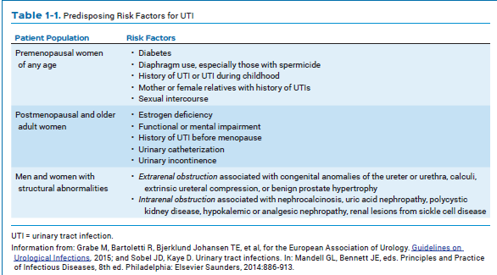

Slide 47
Risk factors for developing a catheter acquired UTI (CAUTI) include:
Prolonged catheterization, is the most important risk.
Female gender,
Older age
Diabetes.

Slide 48
Hospital acquired UTI was the highest nosocomial infection in 90s

Slide 49
This nosocomial UTI rate has been changed due to effective prevention strategies to minimize cath-related UTI.
In 2015, hospital acquired UTI rate were declined, and pneumonia and GI tract infections become the most common nosocomial infection.

Slide 50
Prevention
Drink plenty of liquids, especially water
Drink cranberry juice
Wipe from front to back
Empty your bladder soon after intercourse
Avoid potentially irritating feminine products.
Using deodorant sprays or other feminine products, such as douches and powders, in the genital area can irritate the urethra
Change your birth control method.
Diaphragms, or un-lubricated or spermicide-treated condoms.

Slide 52
GUIDELINE FOR PREVENTION OF CAUTI
CDC guidelines provide recommendations for catheter use, catheter insertion, catheter care, and implementation of programs to prevent CAUTI.
Reducing un- necessary catheter placement and minimizing the duration the catheter are the primary strategies for CAUTI prevention.

Slide 53
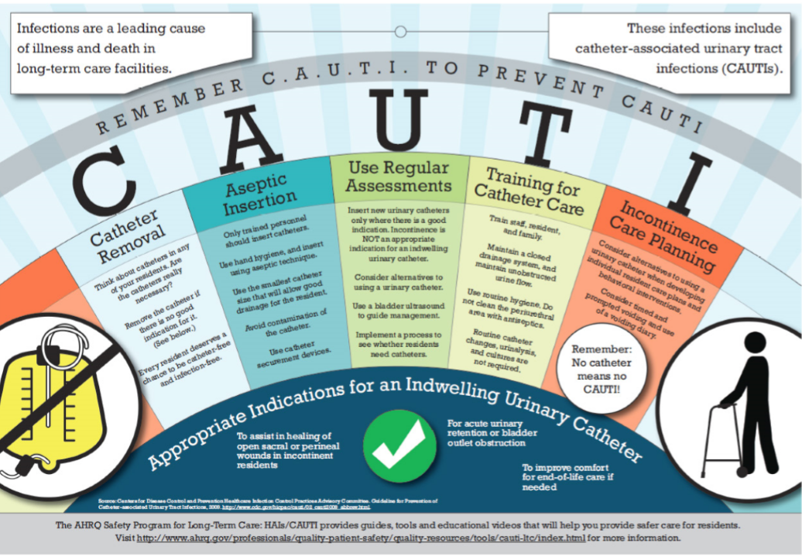

Slide 54
The Summary of Recommendations is organized as follows:
Recommendations for who should receive indwelling urinary catheters
(or, for certain populations, alternatives to indwelling catheters)
Recommendations for catheter insertion
(proper way and aseptic techniques)
Recommendations for catheter maintenance
(regular check, re-placement guidelines, & duration);
Quality improvement programs to achieve appropriate placement, care, and removal of catheters
Administrative infrastructure required
Surveillance strategies
(screening for infections especially for long term inpatient on catheter).

Slide 55
Pediatric UTI
Affect 3% of children every year
Annually, pediatric UTI's account for over 1 million office visits in the U.S.
0.7% of all physician visits by children
Each year there are approximately 13,000 pediatric admissions for pyelonephritis, with inpatient costs exceeding $180 million
Throughout childhood, the risk of UTI is 8% for girls and 2% for boys
Sexually active girls experience more UTIs than sexually inactive girls
During the first year of life, more boys than girls get UTI's, with a tenfold increased risk for uncircumcised compared to circumcised boys.

Slide 56
Risk factors
Structural abnormalities of the urinary tract.
Acquired Causes of UTI
Urinary Stones
Sexual Abuse
Dysfunctional Voiding Syndrome
Fungal UTIs have associated risk factors that include
immunosuppression
underlying structural abnormalities of the urinary tract
invasive vascular access lines

Slide 57
Older adults UTI
The second most common infection in geriatric population.
It is the most frequently diagnosed infection in long-term care residents, accounting for over a third of all nursing home-associated.
The incidence of UTI is higher in women compared with men across all age groups.
Over 10% of women older than 65 years of age reported having a UTI within the past 12 months .
This number increases to almost 30% in women over the age of 85 years

Slide 58
Risk factors
Factors facilitating the development of UTI include:
Pelvic prolapse
Cystocele
Rectocele
Bladder diverticulum
Urinary reflux
Incontinence
Lack of perineal hygiene
Vaginal atrophy
Estrogen deficiency in women
Prostate diseases in men
The main risk factors in the elderly
Mental status changes
Immunosuppression
DM
Neurological diseases
Invasive procedures
Strictures and anatomical changes

Slide 59
Prevention of UTI among elderly
Prevention strategies for recurrent UTI in postmenopausal include:
Use of antibiotic as a prophylaxis
Non-antimicrobial therapies, such as estrogen replacement therapy and cranberry formulations
Development of prevention strategies, including aseptic insertion of urinary catheters, minimizing use of catheters and minimizing duration of catheter use, has led to a decrease in the incidence of CA-UTI .
In adults who require catheterization, the use of antimicrobial-coated catheters may delay bacterial colonization and thus decreases the incidence of CA-UTI

