Slide 1
Parturition and lactation

Slide 2
Parturition
Parturition is the delivery of the fetus.
Occurs approximately 40 weeks after the onset of the last menstrual period.

Slide 3
Parturition
The mechanism of parturition is unclear.
Roles for estrogen, progesterone, cortisol, oxytocin, prostaglandins, relaxin, and catecholamines have been proposed.

Slide 4
Events that may contribute to parturition
Once the fetus reaches a critical size, distention (stretching) of the uterus increases its contractility.
Uncoordinated contractions, known as Braxton Hicks contractions, begin approximately 1 month before parturition.
Stretch or irritation of the cervix: elicits uterine contraction by initiating reflexes to the body of the uterus.

Slide 5
Events that may contribute to parturition
Positive feedback theory → stretching of the cervix by the fetus’s head finally becomes great enough to elicit a strong reflex increase in contractility of the uterine body.
This pushes the baby forward, which stretches the cervix more and initiates more positive feedback to the uterine body. Thus, the process repeats until the baby is expelled.

Slide 6
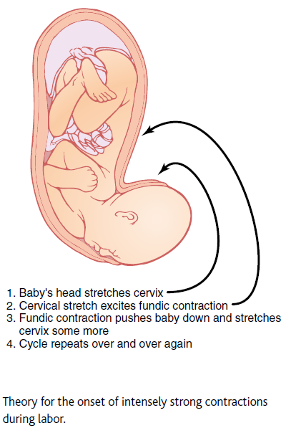

Slide 7
Abdominal Muscle Contractions During Labor
Once uterine contractions become strong during labor, pain signals originate both from the uterus and from the birth canal → elicit neurogenic reflexes in the spinal cord to the abdominal muscles → intense contractions of these muscles.
The abdominal contractions add greatly to the force that causes expulsion of the baby.

Slide 8
Near term, the fetal hypothalamic-pituitary-adrenal axis is activated and the fetal adrenal cortex produces significant amounts of cortisol. Cortisol increases the estrogen/progesterone ratio, which increases the sensitivity of the uterus to contractile stimuli.
Estrogen and progesterone have opposite effects on uterine contractility: Estrogen increases contractility, and progesterone decreases it.

Slide 9
Estrogen stimulates (and progesterone inhibits) local production of the prostaglandins PGE₂ and PGF_{2α}. Thus the increasing estrogen/progesterone ratio stimulates local prostaglandin production.
Prostaglandins increase the intracellular calcium concentration of uterine smooth muscle, thereby increasing its contractility.
Prostaglandins also promote gap junction formation between uterine smooth muscle cells to permit synchronous contraction of the uterus.
Prostaglandins cause softening, thinning (effacement), and dilation of the cervix early in labor.

Slide 10
Oxytocin is a powerful stimulant of uterine contractions (indeed, it is used to induce labor).
Uterine oxytocin receptors are up-regulated toward the end of gestation.
Dilation of the cervix, as occurs during the progression of labor, stimulates oxytocin secretion.
However, maternal blood levels of oxytocin do not increase near term.
physiologic role of oxytocin is uncertain.

Slide 11
Stages of normal labor
First stage: a period of progressive cervical dilatation.
Uterine contractions originating at the fundus and sweeping downward move the head of the fetus toward the cervix and progressively widen and thin the cervix.
It lasts for hours

Slide 12
Second stage
Once the cervix is fully dilated, fetal membranes rupture and the amniotic fluid is lost suddenly through the vagina.
The fetus’s head moves rapidly into the birth canal until it is forced through the cervix and delivered through the vagina.
May last 30 minutes or more in the first pregnancy and as little as 1 minute after many pregnacies.

Slide 13
Third stage: the placenta separates from the uterine decidual tissue and is delivered.
During this last stage, powerful contractions of the uterus also serve to constrict uterine blood vessels and limit postpartum bleeding.
(10-45 minutes)
After delivery of the placenta, hormone concentrations return to their prepregnant levels, except for prolactin, whose levels remain high if the mother breastfeeds the infant.

Slide 14
Lactation

Slide 15
Throughout pregnancy, estrogen and progesterone stimulate the growth and development of the breasts, preparing them for lactation.
Estrogen also stimulates prolactin secretion by the anterior pituitary, and prolactin levels steadily increase over the course of pregnancy.
However, although prolactin levels are high during pregnancy, lactation does not occur as progesterone blocks the action of prolactin on the breast.

Slide 16
Lactation is maintained by suckling, which stimulates the secretion of both oxytocin and prolactin.

Slide 17
Prolactin
Peptide hormone synthesized by lactotropes
Prolactin promotes mammary gland development and milk production.
Notes:
Prolactin release in episodic fashion
Profiles of pulsatile PRL release in relation to sleep in a representative postmenopausal woman (a), man (b), and cycling woman (c). Serum PRL values were determined at 10-min intervals for 24 h. The black bar refers to the period of sleep.
Prolactin is a hormone found in both males and females and is primarily responsible for the female's ability to produce milk. Though healthy males do not seem to make use of the hormone, the presence of low levels does not seem to have any adverse or undesirable effects on men. High levels of prolactin, however, interfere with the male's ability to produce testosterone, which can lead to a number of problems.
Both males and females normally have low levels of prolactin. In males, between 2 and 18 nanograms per milliliter is considered normal. At this concentration, the hormone does not interfere with the male sex hormones and causes no ill effects. It is believed that prolactin may be linked to immune function because certain immune cells have been shown to secrete small levels of it. It does not, however, appear that this hormone is necessary for proper immune response, so higher levels that are still within the normal range may not be indicative of greater immune health.
In mammals, prolactin is the primary hormone responsible for the production of milk and the enlargement of the mammary glands. Though only females nurse their young, males do have underdeveloped mammary glands. One of the effects of prolactin in males is that it can cause these glands to swell and, rarely, the presence of high levels of this hormone over a long period of time can cause males to produce small amounts of milk.
High levels of prolactin are also linked to low levels of testosterone. A deficiency of this male sex hormone can seriously interfere with a male's sex characteristics. The presence of too much prolactin in males can lead to the loss of sexual desire and a significantly lowered sperm count. Over time, too much can lead to temporary infertility and impotence. These symptoms go away when a male's prolactin level is returned to normal.
In addition to affecting sex characteristics, high levels of prolactin in men can lead to other problems related to the lack of testosterone. Fatigue is a common effect of low testosterone, as is a loss of muscle mass and of strength. If left untreated, high levels of prolactin can lead to loss of bone density, which greatly increases the chance of breaking or fracturing a bone, and can lead to loss of height as well.

Slide 18
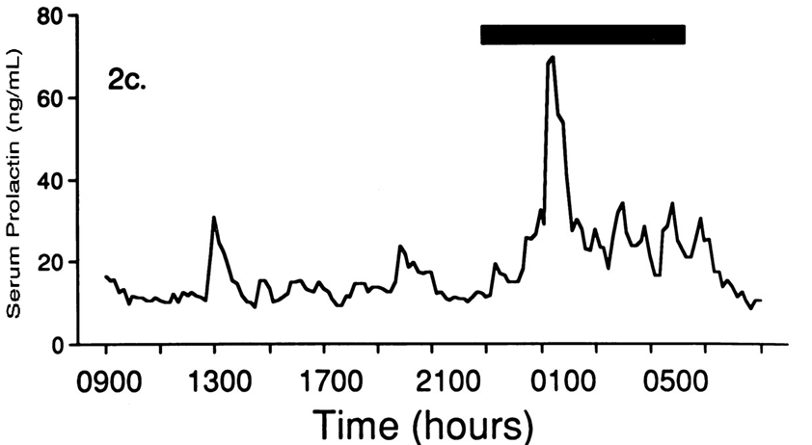
Prolactin
Secreted in a pulsatile fashion (about 14 pulses per day in the late follicular phase to about 9 pulses per day in the late luteal phase).
Diurnal variation with the lowest levels occurring the midmorning after the patient awakes. Levels rise 1 hour after the onset of sleep.
Notes:
Prolactin release in episodic fashion
Profiles of pulsatile PRL release in relation to sleep in a representative postmenopausal woman (a), man (b), and cycling woman (c). Serum PRL values were determined at 10-min intervals for 24 h. The black bar refers to the period of sleep.
Prolactin is a hormone found in both males and females and is primarily responsible for the female's ability to produce milk. Though healthy males do not seem to make use of the hormone, the presence of low levels does not seem to have any adverse or undesirable effects on men. High levels of prolactin, however, interfere with the male's ability to produce testosterone, which can lead to a number of problems.
Both males and females normally have low levels of prolactin. In males, between 2 and 18 nanograms per milliliter is considered normal. At this concentration, the hormone does not interfere with the male sex hormones and causes no ill effects. It is believed that prolactin may be linked to immune function because certain immune cells have been shown to secrete small levels of it. It does not, however, appear that this hormone is necessary for proper immune response, so higher levels that are still within the normal range may not be indicative of greater immune health.
In mammals, prolactin is the primary hormone responsible for the production of milk and the enlargement of the mammary glands. Though only females nurse their young, males do have underdeveloped mammary glands. One of the effects of prolactin in males is that it can cause these glands to swell and, rarely, the presence of high levels of this hormone over a long period of time can cause males to produce small amounts of milk.
High levels of prolactin are also linked to low levels of testosterone. A deficiency of this male sex hormone can seriously interfere with a male's sex characteristics. The presence of too much prolactin in males can lead to the loss of sexual desire and a significantly lowered sperm count. Over time, too much can lead to temporary infertility and impotence. These symptoms go away when a male's prolactin level is returned to normal.
In addition to affecting sex characteristics, high levels of prolactin in men can lead to other problems related to the lack of testosterone. Fatigue is a common effect of low testosterone, as is a loss of muscle mass and of strength. If left untreated, high levels of prolactin can lead to loss of bone density, which greatly increases the chance of breaking or fracturing a bone, and can lead to loss of height as well.

Slide 19
Prolactin in pregnancy
Prolactin contributes to the growth of the ductal system in breast.
During pregnancy, the anterior pituitary gland of the mother enlarges at least 50 percent and increases its production of prolactin.
Prolactin concentration in blood rises steadily from the fifth week of pregnancy until birth of the baby, at which time it has risen to 10 to 20 times the normal nonpregnant level to promote milk secretion.
Notes:
Prolactin release in episodic fashion
Profiles of pulsatile PRL release in relation to sleep in a representative postmenopausal woman (a), man (b), and cycling woman (c). Serum PRL values were determined at 10-min intervals for 24 h. The black bar refers to the period of sleep.
Prolactin is a hormone found in both males and females and is primarily responsible for the female's ability to produce milk. Though healthy males do not seem to make use of the hormone, the presence of low levels does not seem to have any adverse or undesirable effects on men. High levels of prolactin, however, interfere with the male's ability to produce testosterone, which can lead to a number of problems.
Both males and females normally have low levels of prolactin. In males, between 2 and 18 nanograms per milliliter is considered normal. At this concentration, the hormone does not interfere with the male sex hormones and causes no ill effects. It is believed that prolactin may be linked to immune function because certain immune cells have been shown to secrete small levels of it. It does not, however, appear that this hormone is necessary for proper immune response, so higher levels that are still within the normal range may not be indicative of greater immune health.
In mammals, prolactin is the primary hormone responsible for the production of milk and the enlargement of the mammary glands. Though only females nurse their young, males do have underdeveloped mammary glands. One of the effects of prolactin in males is that it can cause these glands to swell and, rarely, the presence of high levels of this hormone over a long period of time can cause males to produce small amounts of milk.
High levels of prolactin are also linked to low levels of testosterone. A deficiency of this male sex hormone can seriously interfere with a male's sex characteristics. The presence of too much prolactin in males can lead to the loss of sexual desire and a significantly lowered sperm count. Over time, too much can lead to temporary infertility and impotence. These symptoms go away when a male's prolactin level is returned to normal.
In addition to affecting sex characteristics, high levels of prolactin in men can lead to other problems related to the lack of testosterone. Fatigue is a common effect of low testosterone, as is a loss of muscle mass and of strength. If left untreated, high levels of prolactin can lead to loss of bone density, which greatly increases the chance of breaking or fracturing a bone, and can lead to loss of height as well.

Slide 20
Prolactin
After birth of the baby, the basal level of prolactin secretion returns to the nonpregnant level over the next few weeks.
Each time the mother nurses her baby, nervous signals from the nipples to the hypothalamus cause a 10- to 20-fold surge in prolactin secretion that lasts for about 1 hour.
Notes:
Prolactin release in episodic fashion
Profiles of pulsatile PRL release in relation to sleep in a representative postmenopausal woman (a), man (b), and cycling woman (c). Serum PRL values were determined at 10-min intervals for 24 h. The black bar refers to the period of sleep.
Prolactin is a hormone found in both males and females and is primarily responsible for the female's ability to produce milk. Though healthy males do not seem to make use of the hormone, the presence of low levels does not seem to have any adverse or undesirable effects on men. High levels of prolactin, however, interfere with the male's ability to produce testosterone, which can lead to a number of problems.
Both males and females normally have low levels of prolactin. In males, between 2 and 18 nanograms per milliliter is considered normal. At this concentration, the hormone does not interfere with the male sex hormones and causes no ill effects. It is believed that prolactin may be linked to immune function because certain immune cells have been shown to secrete small levels of it. It does not, however, appear that this hormone is necessary for proper immune response, so higher levels that are still within the normal range may not be indicative of greater immune health.
In mammals, prolactin is the primary hormone responsible for the production of milk and the enlargement of the mammary glands. Though only females nurse their young, males do have underdeveloped mammary glands. One of the effects of prolactin in males is that it can cause these glands to swell and, rarely, the presence of high levels of this hormone over a long period of time can cause males to produce small amounts of milk.
High levels of prolactin are also linked to low levels of testosterone. A deficiency of this male sex hormone can seriously interfere with a male's sex characteristics. The presence of too much prolactin in males can lead to the loss of sexual desire and a significantly lowered sperm count. Over time, too much can lead to temporary infertility and impotence. These symptoms go away when a male's prolactin level is returned to normal.
In addition to affecting sex characteristics, high levels of prolactin in men can lead to other problems related to the lack of testosterone. Fatigue is a common effect of low testosterone, as is a loss of muscle mass and of strength. If left untreated, high levels of prolactin can lead to loss of bone density, which greatly increases the chance of breaking or fracturing a bone, and can lead to loss of height as well.

Slide 21
Prolactin
This prolactin acts on the mother’s breasts to keep the mammary glands secreting milk into the alveoli for the subsequent nursing periods.
If this prolactin surge is absent or blocked, the breasts lose their ability to produce milk within 1 week.
Notes:
Prolactin release in episodic fashion
Profiles of pulsatile PRL release in relation to sleep in a representative postmenopausal woman (a), man (b), and cycling woman (c). Serum PRL values were determined at 10-min intervals for 24 h. The black bar refers to the period of sleep.
Prolactin is a hormone found in both males and females and is primarily responsible for the female's ability to produce milk. Though healthy males do not seem to make use of the hormone, the presence of low levels does not seem to have any adverse or undesirable effects on men. High levels of prolactin, however, interfere with the male's ability to produce testosterone, which can lead to a number of problems.
Both males and females normally have low levels of prolactin. In males, between 2 and 18 nanograms per milliliter is considered normal. At this concentration, the hormone does not interfere with the male sex hormones and causes no ill effects. It is believed that prolactin may be linked to immune function because certain immune cells have been shown to secrete small levels of it. It does not, however, appear that this hormone is necessary for proper immune response, so higher levels that are still within the normal range may not be indicative of greater immune health.
In mammals, prolactin is the primary hormone responsible for the production of milk and the enlargement of the mammary glands. Though only females nurse their young, males do have underdeveloped mammary glands. One of the effects of prolactin in males is that it can cause these glands to swell and, rarely, the presence of high levels of this hormone over a long period of time can cause males to produce small amounts of milk.
High levels of prolactin are also linked to low levels of testosterone. A deficiency of this male sex hormone can seriously interfere with a male's sex characteristics. The presence of too much prolactin in males can lead to the loss of sexual desire and a significantly lowered sperm count. Over time, too much can lead to temporary infertility and impotence. These symptoms go away when a male's prolactin level is returned to normal.
In addition to affecting sex characteristics, high levels of prolactin in men can lead to other problems related to the lack of testosterone. Fatigue is a common effect of low testosterone, as is a loss of muscle mass and of strength. If left untreated, high levels of prolactin can lead to loss of bone density, which greatly increases the chance of breaking or fracturing a bone, and can lead to loss of height as well.

Slide 22
As long as lactation continues, there is suppression of ovulation because prolactin:
inhibits GnRH secretion by the hypothalamus
Inhibits the action of GnRH on the anterior pituitary → inhibits FSH and LH secretion
Antagonizes the actions of LH and FSH on the ovaries.

Slide 23
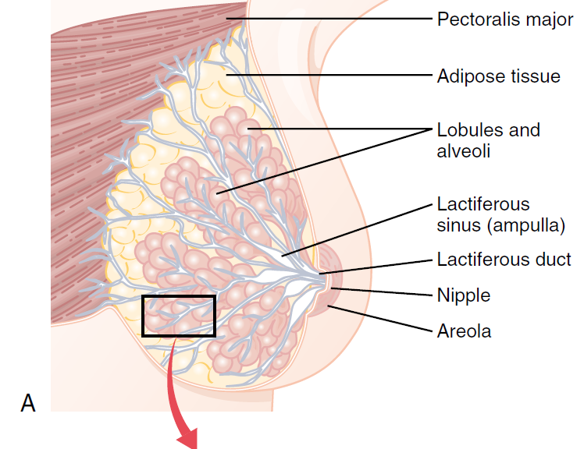
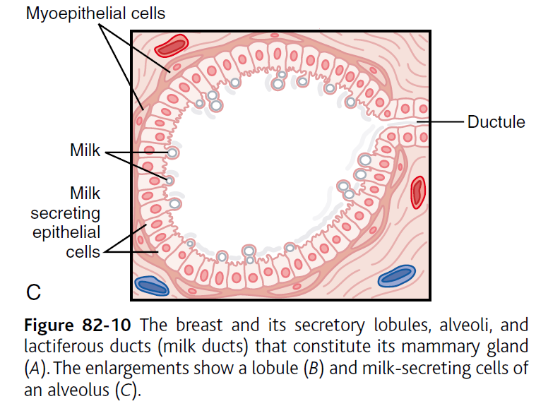
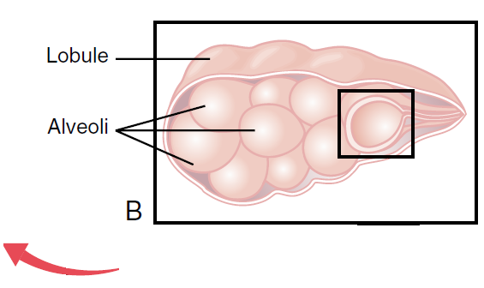
Effects of oxytocin on milk ejection

Slide 24
Effects of oxytocin on milk ejection
In lactation, oxytocin causes milk to be expressed from the alveoli into the ducts of the breast so that the baby can obtain it by suckling.
Suckling stimulus on the nipple of the breast → signals transmitted through sensory nerves to the oxytocin neurons in the paraventricular and supraoptic nuclei in the hypothalamus → release of oxytocin by the posterior pituitary gland → oxytocin carried by blood to the breasts → contraction of myoepithelial cells.

Slide 25
Menopause

Slide 26
Menopause, or the climacteric, is the cessation of menstrual cycles in women.
It occurs at approximately 50 years of age.
For several years preceding menopause, anovulatory cycles (menstrual cycles in which ovulation does not occur) become more common and the number of functioning ovarian follicles decreases.

Slide 27
Accordingly, estrogen secretion gradually declines and eventually ceases.
Because of the decreased level of estrogen → reduced negative feedback on the anterior pituitary → increased secretion and pulsatility of FSH and LH at menopause.

Slide 28
The symptoms of menopause are caused by the loss of the ovarian source of estrogen.
They include:
thinning of the vaginal epithelium
decreased vaginal secretions
decreased breast mass
accelerated bone loss
vascular instability (“hot flashes”)
emotional lability.

Slide 29
Because estrogen can be produced from androgenic precursors in adipose tissue, obese women tend to be less symptomatic than nonobese women.

