Slide 1
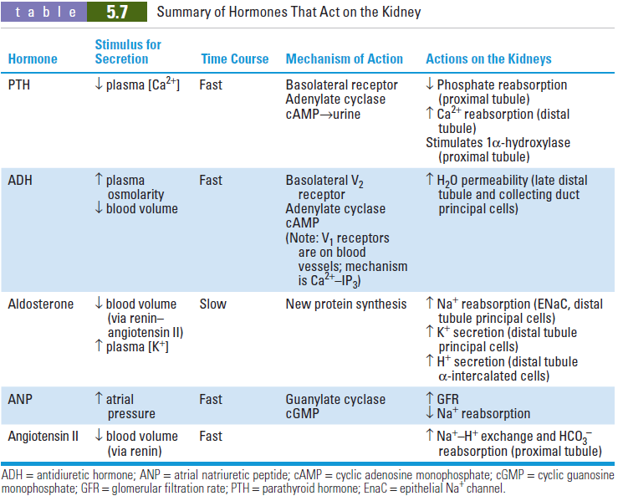

Slide 2
Acid-base balance

Slide 3
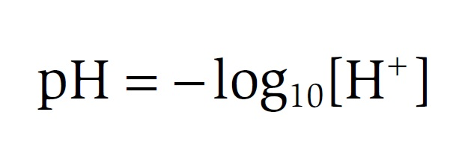
pH of body fluids
The normal range of arterial pH is 7.37–7.42.
When arterial pH is less than 7.37, it is called acidemia.
When arterial pH is greater than 7.42, it is called alkalemia.
The pH range compatible with life is 6.8–8.0.

Slide 4
pH of body fluids
Intracellular pH is approximately 7.2.
Transporters in cell membranes regulate intracellular pH:
Na⁺-H⁺ exchangers extrude H⁺ from cells, which tends to alkalinize intracellular fluid (ICF).
Cl⁻-HCO3⁻ exchangers extrude HCO3⁻ from cells, which tends to acidify ICF.

Slide 5
pH of body fluids
The mechanisms that contribute to maintaining pH in the normal range include:
buffering of H⁺ in both ECF and ICF
respiratory compensation,
renal compensation.
The mechanisms for buffering and respiratory compensation occur rapidly, within minutes to hours.
The mechanisms for renal compensation are slower, requiring hours to days.

Slide 6
Acid production in the body
Two types of acid are produced in the body:
Volatile
Nonvolatile

Slide 7
Volatile acid
Is CO₂
Is produced from the aerobic metabolism of cells.
CO₂ combines with H₂O to form weak acid H₂CO₃, which dissociates into H⁺ and HCO3⁻ by the following reactions:
Carbonic anhydrase, which is present in most cells, catalyzes the reversible reaction between CO₂ and H₂O.
CO₂ + H₂O ↔ H₂CO₃ ↔ H⁺ + HCO₃⁻

Slide 8
Nonvolatile acids
Also called fixed acids.
Include sulfuric acid (a product of protein catabolism) and phosphoric acid (a product of phospholipid catabolism).
Are normally produced at a rate of 40 to 60 mmoles/day.
Other fixed acids that may be overproduced in disease or may be ingested include ketoacids, (β-hydroxybutyric acid and acetoacetic acid), lactic acid, and salicylic acid.

Slide 9
Buffers
A buffer is a mixture of a weak acid and its conjugate base or a weak base and its conjugate acid.
It prevents changes in pH when H⁺ ions are added to or removed from a solution.

Slide 10
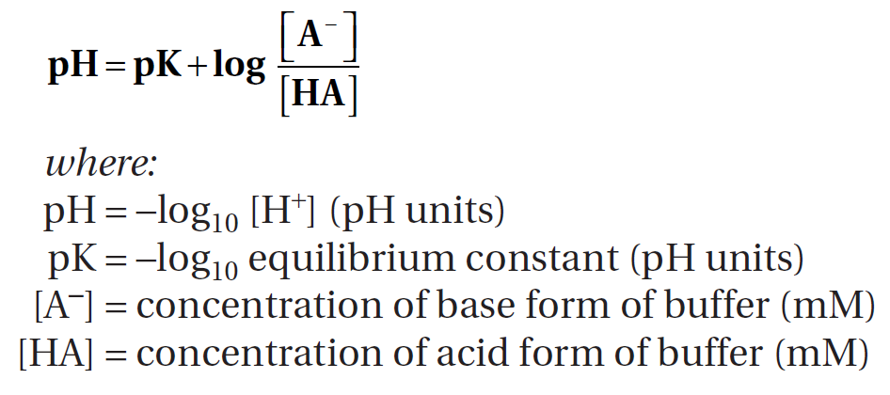
Using the Henderson-Hasselbalch equation to calculate pH
A⁻, the base form of the buffer, is the H⁺ acceptor.
HA, the acid form of the buffer, is the H⁺ donor.
When the concentrations of A⁻ and HA are equal, the pH of the solution equals the pK of the buffer.

Slide 11
Titration curves
Are graphic representations of the Henderson-Hasselbalch equation.
They describe how the pH of a buffered solution changes as H⁺ ions are added to it or removed from it.
As H⁺ ions are added to the solution, the HA form is produced; as H⁺ ions are removed, the A⁻ form is produced.
A buffer is most effective within 1.0 pH unit of the pK of the buffer (in the linear portion of the titration curve), where the addition or removal of H⁺ causes little change in pH.

Slide 12
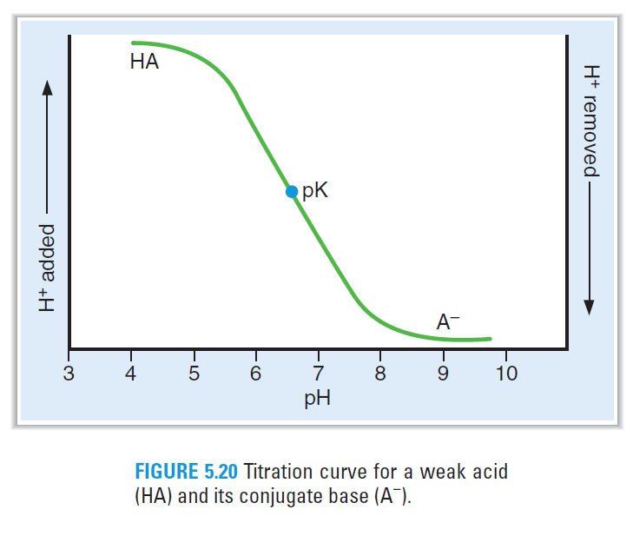
According to the Henderson-Hasselbalch equation, when the pH of the solution equals the pK, the concentrations of HA and A⁻ are equal.

Slide 13
Extracellular buffers
The major extracellular buffer is bicarbonate (HCO3¯ ), which is produced from CO₂ and H₂O.
The pK of the CO₂/HCO₃⁻ buffer pair is 6.1.

Slide 14
Extracellular buffers
Phosphate is a minor extracellular buffer.
The pK of the H₂PO4⁻/HPO₄⁻² buffer pair is 6.8.
Phosphate is most important as a urinary buffer; excretion of H⁺ as H₂PO₄⁻ is called titratable acid.

Slide 15
Intracellular buffers
Organic phosphates
(e.g., AMP, ADP, ATP, 2,3-diphosphoglycerate [DPG]).
Proteins
Imidazole and α-amino groups on proteins have pKs that are within the physiologic pH range.
Hemoglobin is a major intracellular buffer.
In the physiologic pH range, deoxyhemoglobin is a better buffer than oxyhemoglobin.

Slide 16
Renal mechanisms in acid-base balance

Slide 17
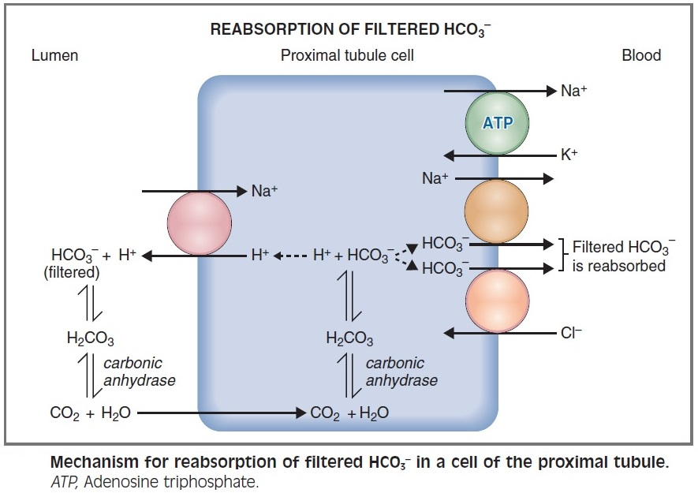
1. Reabsorption of filtered HCO3⁻

Slide 18
Reabsorption of filtered HCO3⁻
Occurs primarily in the proximal tubule.
H⁺ and HCO₃⁻ are produced in the proximal tubule cells from CO₂ and H₂O.
CO₂ and H₂O combine to form H₂CO₃, catalyzed by intracellular carbonic anhydrase
H₂CO₃ dissociates into H⁺ and HCO₃⁻
H⁺ is secreted into the lumen via the Na⁺-H⁺ exchange mechanism in the luminal membrane.
The HCO3⁻ is reabsorbed (by Na+-HCO3⁻ cotransport and Cl⁻-HCO3⁻ exchange).

Slide 19
Reabsorption of filtered HCO3⁻
In the lumen, the secreted H⁺ combines with filtered HCO₃⁻ to form H₂CO₃, which dissociates into CO₂ and H₂O, catalyzed by brush border carbonic anhydrase. CO₂ and H₂O diffuse into the cell to start the cycle again.
The process results in net reabsorption of filtered Na⁺ and HCO₃⁻. However, it does not result in net secretion of H⁺ → produces little change in tubular fluid pH.

Slide 20
Regulation of reabsorption of filtered HCO3⁻
1) Filtered load
Increases in the filtered load of HCO₃⁻ result in increased rates of HCO₃⁻ reabsorption.
However, if the plasma HCO₃⁻ concentration becomes very high (e.g., metabolic alkalosis), the filtered load will exceed the reabsorptive capacity, and HCO₃⁻ will be excreted in the urine.

Slide 21
2) P_{CO2}
Increases in P_{CO2} result in increased rates of HCO₃⁻ reabsorption because the supply of intracellular H⁺ for secretion is increased.
This mechanism is the basis for the renal compensation for respiratory acidosis.
Decreases in P_{CO2} result in decreased rates of HCO₃⁻ reabsorption because the supply of intracellular H⁺ for secretion is decreased.
This mechanism is the basis for the renal compensation for respiratory alkalosis.

Slide 22
3) ECF volume
HCO3⁻ is a part of isosmotic reabsorption in the proximal tubule → changes in ECF volume alter isosmotic reabsorption via changes in the Starling forces in the peritubular capillaries.
ECF volume expansion results in decreased HCO3⁻ reabsorption.
ECF volume contraction results in increased HCO3⁻ reabsorption → contraction alkalosis.

Slide 23
4) Angiotensin II
↓ ECF volume → Angiotensin II stimulates Na⁺-H⁺ exchange in the proximal tubule → stimulates HCO3⁻ reabsorption → increases the blood HCO3⁻ concentration
contributes to the contraction alkalosis that occurs secondary to ECF volume contraction.

Slide 24
2. Excretion of fixed H⁺
Titratable acid is H⁺ excreted with urinary buffers.
Fixed H⁺ produced from the catabolism of protein and phospholipid is excreted by two mechanisms, titratable acid and NH₄⁺.

Slide 25
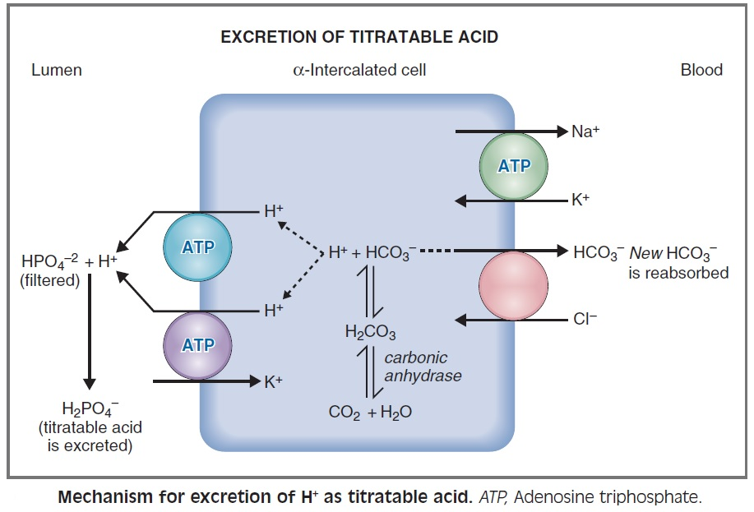
Excretion of H⁺ as titratable acid (H₂PO₄⁻)

Slide 26
Excretion of H⁺ as titratable acid (H₂PO₄⁻)
H⁺ and HCO₃⁻ are produced in the intercalated cells from CO₂ and H₂O.
H⁺ is secreted into the lumen by H⁺-ATPase and H⁺-K⁺ ATPase , and the HCO₃⁻ is reabsorbed into the blood (“new” HCO3⁻).
In the urine, the secreted H⁺ combines with filtered HPO₄⁻² to form H₂PO₄⁻, which is excreted as titratable acid.
The H⁺-ATPase is stimulated by aldosterone.

Slide 27
Excretion of H⁺ as titratable acid (H₂PO₄⁻)
This process results in net secretion of H⁺ and net reabsorption of newly synthesized HCO₃⁻.
As a result of H⁺ secretion, the pH of urine becomes progressively lower. The minimum urinary pH is 4.4.
The amount of H⁺ excreted as titratable is determined by the amount of urinary buffer (usually HPO₄⁻²) and the pK of the buffer.

Slide 28
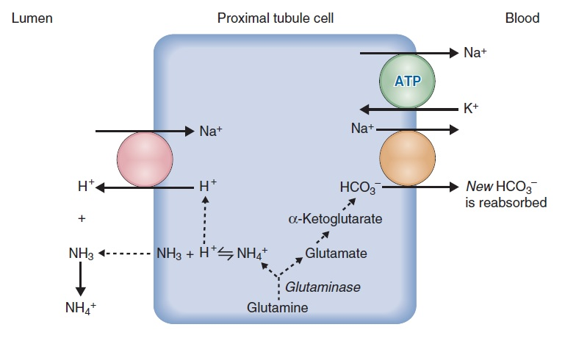
Excretion of H⁺ as NH₄⁺
1)

Slide 29
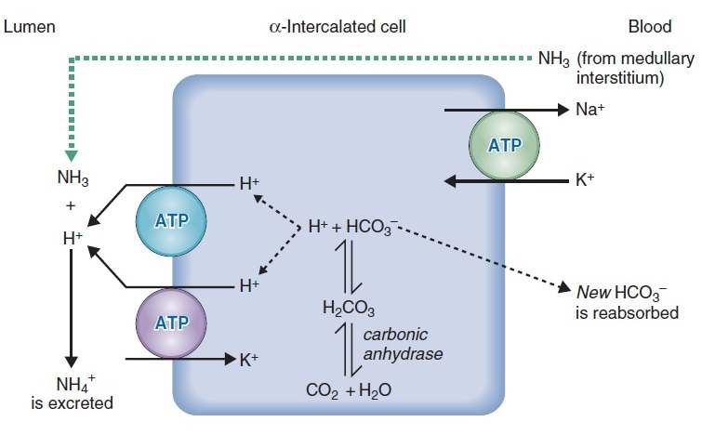
Excretion of H⁺ as NH₄⁺
2)

Slide 30
Excretion of H⁺ as NH₄⁺
In the proximal tubule, NH₃ is produced in renal cells from glutamine. It then diffuses down its concentration gradient from the cells into the lumen. It combines with H⁺ → NH₄⁺ is produced.
In the thick ascending limb of the loop of Henle, NH₄⁺ is reabsorbed by Na⁺-K⁺-2Cl⁻ cotransporter and deposited in the medullary interstitial fluid.

Slide 31
In the intercalated cells, NH₃ diffuses from the medullary interstitium into the lumen.
H⁺ and HCO₃⁻ are produced from CO₂ and H₂O.
H⁺ is secreted into the lumen via H⁺-ATPase and H⁺-K⁺ ATPase and combines with NH₃ to form NH₄⁺, which is excreted.
This process is termed diffusion trapping because the water-soluble form of the buffer (NH₄⁺) is trapped and excreted.
The HCO₃⁻ is reabsorbed into the blood (“new” HCO₃⁻).

Slide 32
The amount of H⁺ excreted as NH₄⁺ depends on both the amount of NH₃ synthesized by renal cells and the urine pH.
The lower the pH of the tubular fluid, the greater the excretion of H⁺ as NH₄⁺; at low urine pH, there is more NH₄⁺ relative to NH₃ in the urine, thus increasing the gradient for NH₃ diffusion.
In acidosis, an adaptive increase in NH₃ synthesis occurs and aids in the excretion of excess H⁺.

Slide 33
Hyperkalemia inhibits NH3 synthesis, which produces a decrease in H⁺ excretion as NH₄⁺ (type 4 renal tubular acidosis [RTA]).
For example, hypoaldosteronism causes hyperkalemia and thus also causes type 4 RTA.
Conversely, hypokalemia stimulates NH₃ synthesis, which produces an increase in H⁺ excretion.

Slide 34
Acid-base disorders

Slide 35
1. Metabolic acidosis
Overproduction or ingestion of fixed acid or loss of base produces a decrease in arterial [HCO3⁻]. This decrease is the primary disturbance in metabolic acidosis.
Decreased HCO₃⁻ concentration causes a decrease in blood pH (acidemia).
Acidemia causes hyperventilation (Kussmaul breathing), which is the respiratory compensation for metabolic acidosis.

Slide 36
Correction of metabolic acidosis consists of increased excretion of the excess fixed H⁺ as titratable acid and NH₄⁺, and increased reabsorption of “new” HCO₃⁻, which replenishes the blood HCO₃⁻ concentration.
In chronic metabolic acidosis, an adaptive increase in NH₃ synthesis aids in the excretion of excess H⁺.

Slide 37
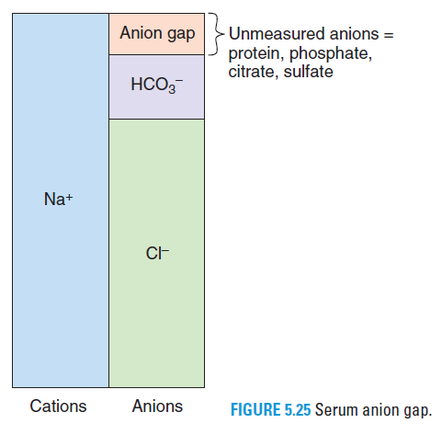
Serum anion gap = [Na⁺]–([Cl⁻] + [HCO₃⁻])
The serum anion gap represents unmeasured anions in serum. These unmeasured anions include phosphate, citrate, sulfate, and protein.

Slide 38
The normal value of the serum anion gap is 12 mEq/L (range, 8 to 16 mEq/L).
In metabolic acidosis, the serum [HCO₃⁻] decreases. For electroneutrality, the concentration of another anion must increase to replace HCO₃⁻. That anion can be Cl⁻ or it can be an unmeasured anion.

Slide 39
The serum anion gap is increased if the concentration of an unmeasured anion (e.g., phosphate, lactate, β-hydroxybutyrate, and formate) is increased to replace HCO₃⁻.
The serum anion gap is normal if the concentration of Cl⁻ is increased to replace HCO₃⁻ (hyperchloremic metabolic acidosis).

Slide 40
2. Metabolic alkalosis
Loss of fixed H⁺ or gain of base produces an increase in arterial [HCO₃⁻]. This increase is the primary disturbance in metabolic alkalosis.
For example, in vomiting, H⁺ is lost from the stomach, HCO₃⁻ remains behind in the blood, and the [HCO₃⁻] increases.
Increased HCO₃⁻ concentration causes an increase in blood pH (alkalemia).
Alkalemia causes hypoventilation, which is the respiratory compensation for metabolic alkalosis.

Slide 41
Correction of metabolic alkalosis consists of increased excretion of HCO₃⁻ because the filtered load of HCO₃⁻ exceeds the ability of the renal tubule to reabsorb it.
If metabolic alkalosis is accompanied by ECF volume contraction (e.g., vomiting), the reabsorption of HCO₃⁻ increases (secondary to ECF volume contraction and activation of the renin–angiotensin II–aldosterone system), worsening the metabolic alkalosis (i.e., contraction alkalosis).

Slide 42
3. Respiratory acidosis
Is caused by decreased alveolar ventilation and retention of CO₂.
Increased arterial P_{CO2}, which is the primary disturbance, causes an increase in [H⁺] and [HCO3⁻] by mass action.
There is no respiratory compensation for respiratory acidosis.

Slide 43
Renal compensation consists of increased excretion of H⁺ as titratable acid and NH₄⁺ and increased reabsorption of “new” HCO₃⁻.
This process is aided by the increased P_{co2}, which supplies more H⁺ to the renal cells for secretion. The resulting increase in serum [HCO₃⁻] helps to normalize the pH.
In acute respiratory acidosis, renal compensation has not yet occurred.
In chronic respiratory acidosis, renal compensation (increased HCO₃⁻ reabsorption) has occurred. Thus, arterial pH is increased toward normal (i.e., a compensation).

Slide 44
4. Respiratory alkalosis
Is caused by increased alveolar ventilation and loss of CO₂.
Decreased arterial P_{CO2}, which is the primary disturbance, causes a decrease in [H⁺] and [HCO₃⁻] by mass action.
There is no respiratory compensation for respiratory alkalosis.

Slide 45
Renal compensation consists of decreased excretion of H+ as titratable acid and NH₄⁺ and decreased reabsorption of “new” HCO₃⁻. This process is aided by the decreased P_{CO2}, which causes a deficit of H⁺ in the renal cells for secretion. The resulting decrease in serum [HCO₃⁻] helps to normalize the pH.

Slide 46
In acute respiratory alkalosis, renal compensation has not yet occurred.
In chronic respiratory alkalosis, renal compensation (decreased HCO₃⁻ reabsorption) has occurred. Thus, arterial pH is decreased toward normal (i.e., a compensation).

Slide 47
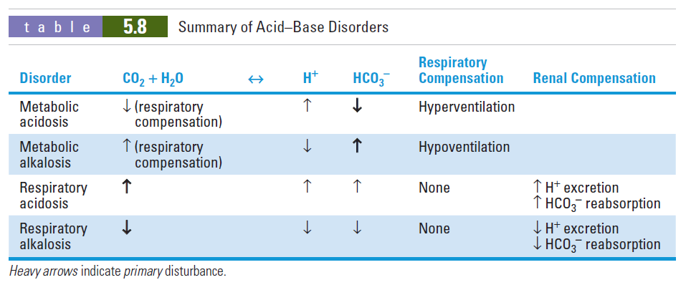

Slide 48
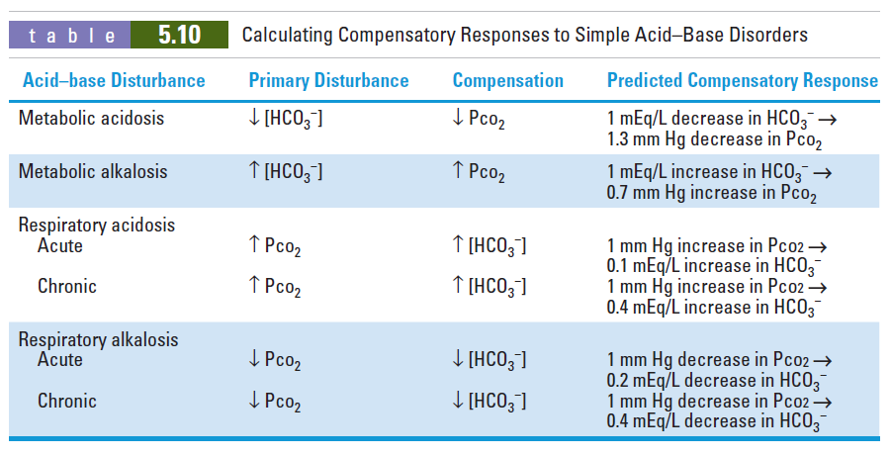

Slide 49
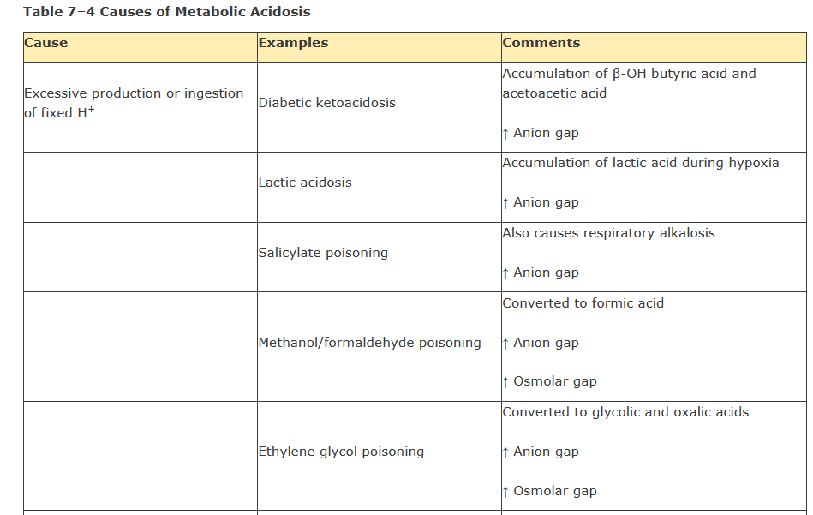

Slide 50
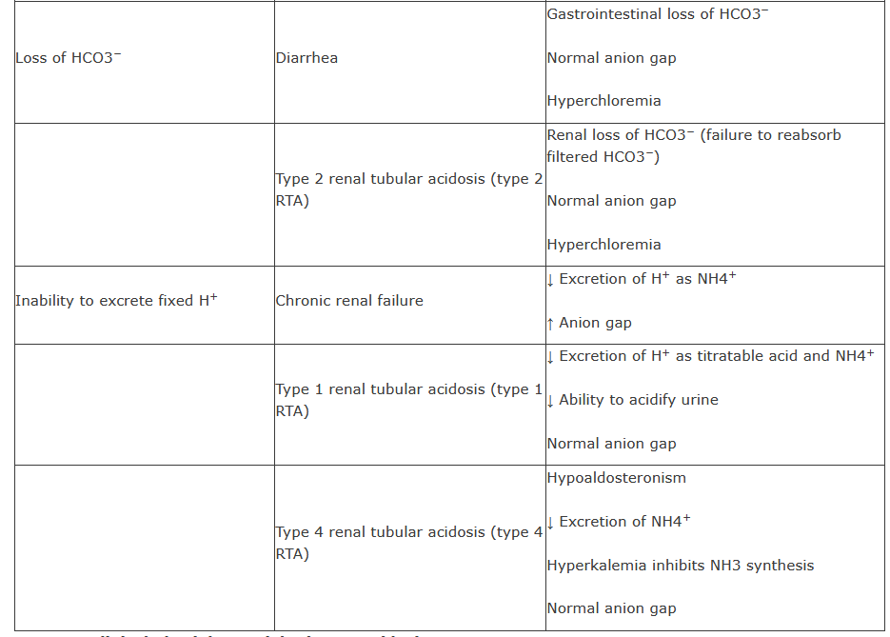

Slide 51
