Slide 1
Information Technology
Med 311
Dr. Ola Soudah

Slide 2
What do we mean with HIS?
Health information systems (HIS)
All computer systems (including hardware, software, operating systems, and end-user devices connecting people to the systems), networks (the electronic connectivity between systems, people, and organizations), and the data those systems create and capture through the use of software.
These are the “building blocks” for all of the functions and applications that comprise the work of health care providers, organizations and professionals.

Slide 3
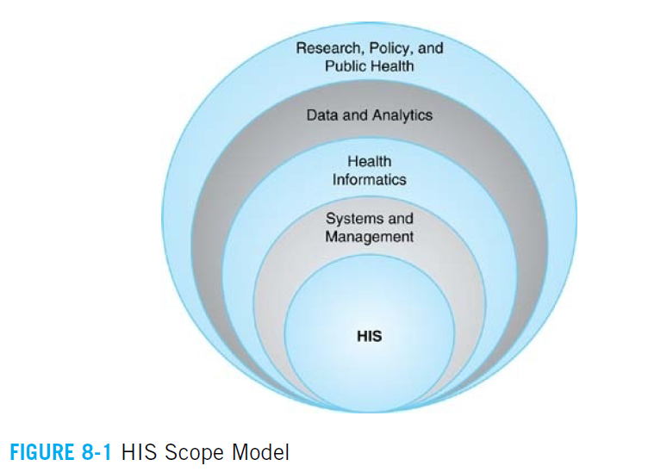
“HIS Scope Model”
Balgrosky (2015) has developed the “HIS Scope Model”
In this model, HIS are organized and managed to facilitate several higher level purposes.

Slide 4
HIS System Applications in Health Care
The key purpose of these systems is to manage the organization’s expenses and revenues.
For most health care entities, you’ll also find more sophisticated systems to manage two of their most costly resources—staff and equipment.

Slide 5
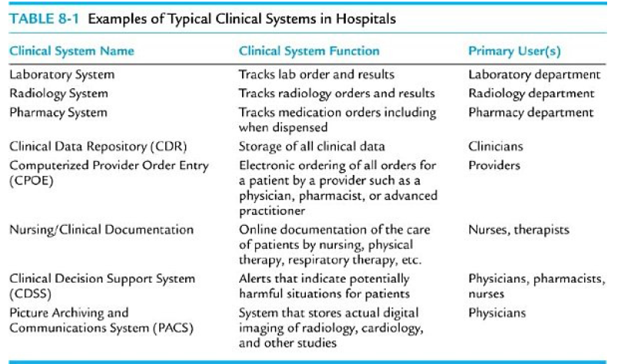

Slide 6
THE ELECTRONIC MEDICAL RECORD (EMR)
Electronic Medical Records (EMRs): An application environment composed of the clinical data repository, clinical decision support, controlled medical vocabulary, order entry, computerized provider order entry, pharmacy, and clinical documentation applications.
It could be as physical document or as digital document.
It is completely owned by the HCO.
IOM encourage the adoption of EMR due to its value in improving patient safety and healthcare quality.

Slide 7
Adoption of Clinical Systems by Hospitals
The Healthcare Information and Management Systems Society (HIMSS) had designed a model to track EMR progress at hospitals and health systems in the U.S. called the Electronic Medical Record Analytical Model (EMRAM).
Electronic Medical Record Analytical Model (EMRAM) A conceptual model that tracks the advancement of health care organizations into the age of digital record keeping and networking.

Slide 8
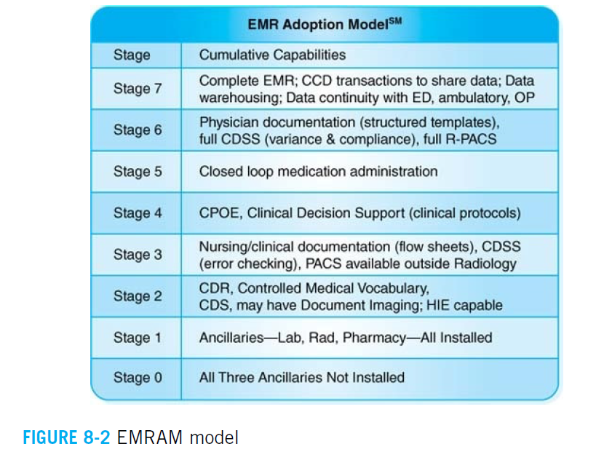
EMRAM

Slide 9
The single greatest barrier for EMR adoption is the cost of purchasing and implementing EMR systems.
The larger the physician practice, the higher degree of administrative complexity, and the higher the rate of EMR adoption.
“top 5 ‘major barriers’ to EMR adoption:
Cost of purchasing a system
Loss of productivity
Annual maintenance costs
Adequacy of training
Finding EMR to meet practice needs

Slide 10
From EMR to EHR
Electronic Health Records (EHRs) Data collection with a focus on the total health of the patient which goes beyond standard clinical data collected in the provider’s office and includes a broader view of a patient’s care.
EHR VS EMR
EHR is a broader term than EMR.
The data in the EHR are accessible to many different entities, particularly the patient (ex. Mychart).
The information goes with the patient to various health care settings, information available to other providers.

Slide 11
“The concept of meaningful use of EHR rested on the ‘5 pillars’ of health outcomes policy priorities, namely:
Improve quality, safety, efficiency, and reduce health disparities
Engage patients and families in their health
Improve care coordination
Improve population and public health
Ensure adequate privacy and security for patient health information

Slide 12
In 1996, Congress passed the Health Insurance Portability and Accountability Act (HIPAA) with the intent of developing standards for health care data and their exchange and regulations on privacy protections.
The concept of Protected Health Information (PHI) is to protect all.
Protected health information (PHI) under the U.S. law is any information about health status, provision of health care, or payment for health care that is created or collected by a Covered Entity (or a Business Associate of a Covered Entity), and can be linked to a specific individual.

Slide 13
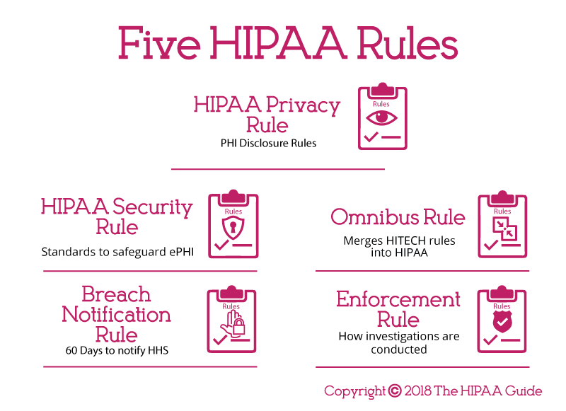

Slide 14
HIPAA Privacy Rule: The Privacy Rule dictates how, when and under what circumstances PHI can be used and disclosed.
HIPAA Security Rule: The Security Rule sets the minimum standards to safeguard ePHI.
Breach Notification Rule: The Department of Health and Human Services must be notified if a data breach has been discovered.
Omnibus Rule: the prohibition of using PHI for marketing or fundraising purposes without authorization.
Enforcement Rule: fines can be issued for HIPPA regulations violation.

Slide 15
THE FUTURE OF HEALTHCARE INFORMATION TECHNOLOGY
The era of carrying your personal EHR on a card in your purse, wallet, or embedded under your skin in a microchip with every conceivable piece of medical information about you.
The ability to have a new physician evaluate your medical history without ever physically seeing you.
Are on the horizon

Slide 17
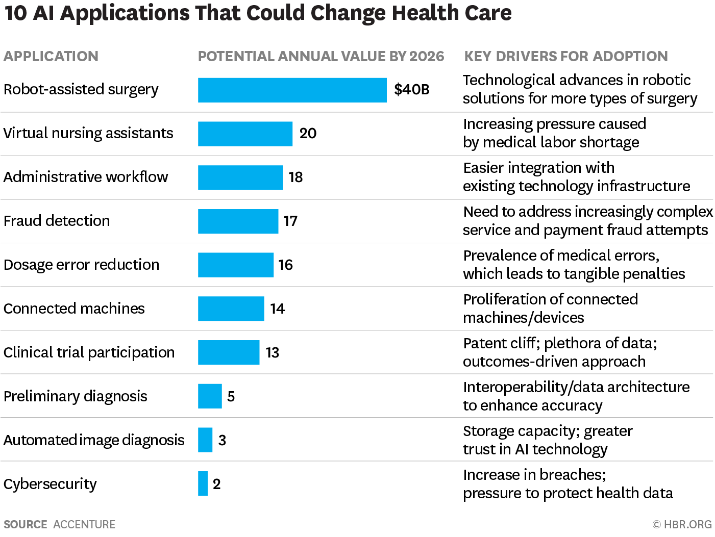

Slide 18
Current practices and issues related to technology
“ehealth is the transfer of health resources and health care by electronic means.
“mHealth is the use of mobile technologies for the purposes of health care, public health, and health-related activities at the individual level”
Telemedicine or Telehealth: The remote delivery of health-related information from one site to another via electronic communications to improve a person’s health awareness and access to health-related information.
Health informatics: The use of information systems and technology to redesign, improve, and create the ways disciplines such as the practice of medicine, nursing, medical imaging, and public health do their work.

Slide 19
Data integrity and safety. “garbage in, garbage out”
Interoperability: This refers to the ability of computer systems or software to exchange and make use of information.
Cyber-security: The issues of security of patient data have come to the fore in recent years, as significant security breaches, data spills, and data hacking threats have been prominent in the media.
ICD-10 Adoption.
Analytics/Big Data.
Research and Policy.

Slide 20
THE IMPACT OF INFORMATION TECHNOLOGY ON THE HEALTH CARE MANAGER
New competencies for managers: know how to use, and quickly adapt for new tools to manage the workload.
Managers should be able to navigate technology used by his or her team and understand the barriers to be addressed to increase productivity and enhance job satisfaction.
Managers should maintain HIPPA compliance among employee and prevent information leak.
Able to manage New employees related to new technology.
Know when and how to adopt such technology and how this will increase productivity and/or enhance quality.

