Slide 1
Physiology of Pregnancy

Slide 2
Pregnancy
The reproductive system of women undergoes dramatic changes during pregnancy.
The production of gonadotropin and gonadal steroids is switched from the maternal hypothalamic-pituitary-ovarian axis, which is strongly repressed during pregnancy, to the fetal placenta.
The endocrine function of fetal placental tissue is dominant that:
(1) maintains a quiescent gravid uterus,
(2) alters maternal physiology to ensure fetal nutrition in utero, (3) alters maternal pituitary function and mammary gland development to ensure ongoing fetal nutrition after birth,
(4) determines the time of labor and delivery (also called parturition).
(5)The placenta also plays an important role in fetal testosterone production and male differentiation of the reproductive system before the fetal hypothalamus and pituitary develop into a functional axis.

Slide 3
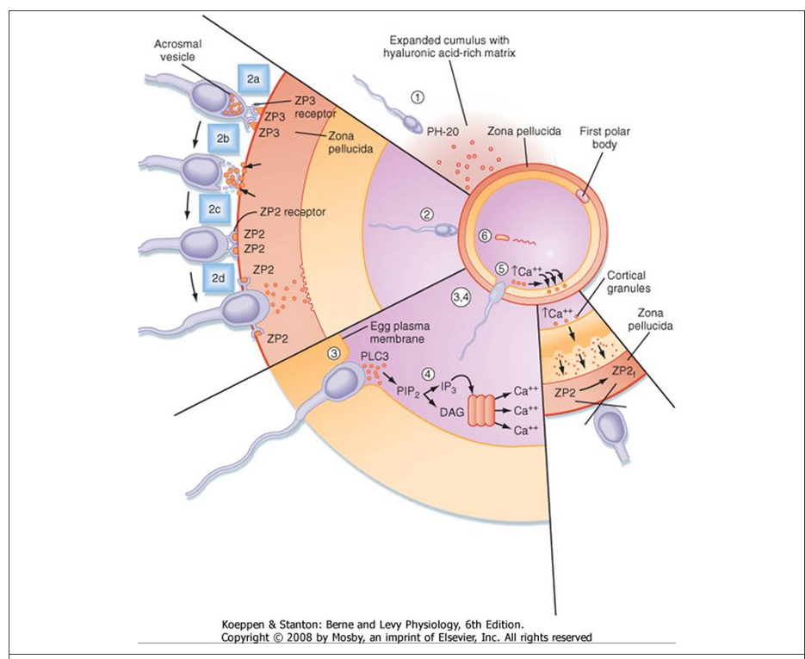

Slide 4
Pregnancy
If the ovum is fertilized by a sperm, the fertilized ovum begins to divide and will become the fetus.
The period of development of the fetus is called pregnancy or gestation, which, in humans, lasts approximately 40 weeks.

Slide 5
Pregnancy
Is characterized by steadily increasing levels of estrogen and progesterone.
Their functions include:
Maintenance of the endometrium for the fetus
Suppression of ovarian follicular function (by inhibiting FSH and LH secretion)
Stimulation of breast development.

Slide 6
Pregnancy
In early pregnancy (the first trimester), the source of steroid hormones is the corpus luteum.
In mid-to-late pregnancy (the second and third trimesters), the source is the placenta.

Slide 7
Events of early pregnancy

Slide 8
Maturation and fertilization of the ovum

Slide 9
1. Fertilization
Fertilization of the ovum takes place within 24 hours of ovulation, in a distal portion of the oviduct called the ampulla.
Once a sperm penetrates the ovum, the second polar body is extruded and the fertilized ovum begins to divide.
Four days after ovulation, the fertilized ovum (the blastocyst) with approximately 100 cells, arrives in the uterine cavity.

Slide 10
2. Implantation
The blastocyst floats freely in the uterine cavity for 1 day and then implants in the endometrium 5 days after ovulation.
The receptivity of the endometrium to the fertilized ovum is critically dependent on a low estrogen/progesterone ratio and corresponds to the period of highest progesterone output by the corpus luteum.

Slide 11
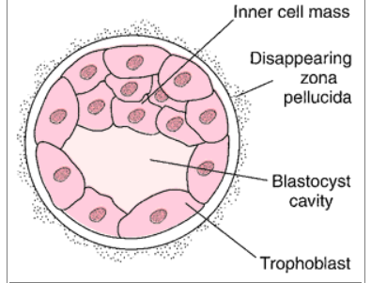
2. Implantation
At the time of implantation, the blastocyst consists of an inner mass of cells, which will become the fetus, and an outer rim of cells called the trophoblast.
The trophoblast invades the endometrium and forms an attachment to the maternal membranes. Thus the trophoblast contributes the fetal portion of the placenta.

Slide 12
2. Implantation
At the point of implantation, under stimulation by progesterone, the endometrium differentiates into a specialized layer of decidual cells. Eventually, the decidua will envelop the entire conceptus (= the embryo and its appendages or associated membranes).
Trophoblastic cells proliferate and form the syncytiotrophoblast

Slide 13
Syncytiotrophoblasts
Syncytiotrophoblasts initially perform three general types of function: adhesive, invasive, and endocrine. Syncytiotrophoblasts express adhesive surface proteins (i.e., cadherins and integrins) that bind to uterine surface epithelia
The endocrine function begins with the onset of implantation, when syncytiotrophoblasts start secreting the LH-like protein human chorionic gonadotropin, which maintains the viability of the corpus luteum and thus progesterone secretion. Syncytiotrophoblasts also become highly steroidogenic. By 10 weeks, the syncytiotrophoblasts acquire the ability to make progesterone at sufficient levels to maintain pregnancy independently of a corpus luteum. Syncytiotrophoblasts produce several other hormones, as well as enzymes that modify hormones.

Slide 14
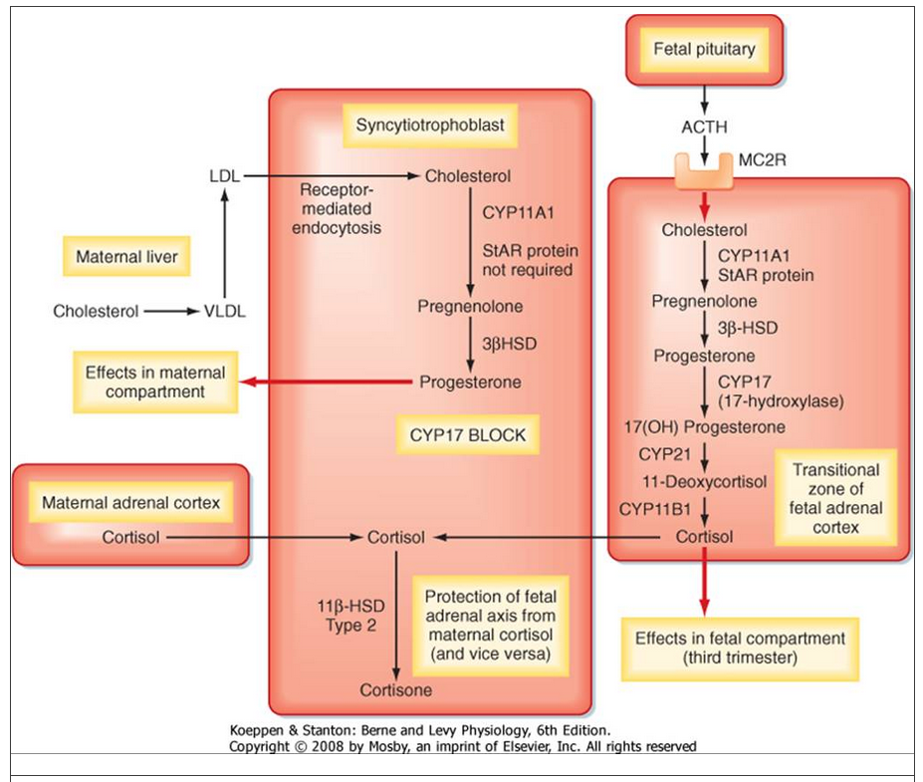
Estrogen???

Slide 15
3. Secretion of HCG and “rescue” of the corpus luteum
The trophoblast, which will become the placenta, begins secreting human chorionic gonadotropin (HCG) approximately 8 days after ovulation.
HCG, which has biologic activity similar to LH, is critical because it “informs” the corpus luteum that fertilization has occurred.

Slide 16
3. Secretion of HCG and “rescue” of the corpus luteum
The corpus luteum (now under the direction of HCG) continues to synthesize progesterone and estrogen, which maintain the endometrium for implantation.
HCG from the trophoblast (placenta) “rescues” the corpus luteum from regression.
The high levels of estrogen and progesterone also suppress the development of the next cohort of ovarian follicles.

Slide 17
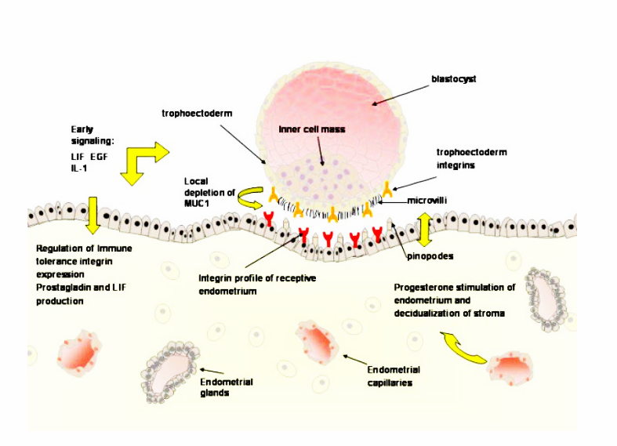

Slide 18
Hormones of pregnancy
The duration of pregnancy is counted from the date of the last menstrual period.
Pregnancy lasts approximately 40 weeks from the onset of the last menstrual period, or 38 weeks from the date of the last ovulation.
Pregnancy is divided into three trimesters, each of which corresponds to approximately 13 weeks.

Slide 20
Hormones of pregnancy – First trimester
HCG is produced by the trophoblast, beginning about 8 days after fertilization.
HCG “rescues” the corpus luteum from regression and, with an LH-like action, stimulates corpus luteal production of progesterone and estrogen.
HCG levels are maximal at approximately gestational week 9 and then decline. Although HCG continues to be produced for the duration of pregnancy, its function beyond the first trimester is unclear.

Slide 21
Hormones of pregnancy – Second and third trimester
During the second and third trimesters, the placenta assumes responsibility for production of steroid hormones.

Slide 22
Synthesis of progesterone (A) and estriol (B) during pregnancy.
Progesterone is synthesized entirely by the placenta. Estriol synthesis requires the placenta, the fetal adrenal
gland, and the fetal liver.
(DHEA = Dehydroepiandrosterone).

Slide 23
Nutrition of the fetus

Slide 24
Response of the mother’s body to pregnancy

Slide 25
The uterus increases from about 50 grams to 1100 grams.
The breasts approximately double in size.
The various hormones can cause marked changes in a pregnant woman’s appearance, sometimes resulting in the development of edema, acne, and masculine or acromegalic features.

Slide 26
Weight gain
The average weight gain during pregnancy is about 11 to 16 kg, with most of this gain occurring during the last two trimesters.
Fetus = 3.5 kg
Amniotic fluid, placenta, fetal membranes = 1 kg
Uterus = + 1.4 kg
Breasts = + 0.9 kg
Extra fluid in the blood and ECF = 2.3 kg
Fat accumulation = 1.4 - 6 kg .

Slide 27
Weight gain
During pregnancy, a woman often has a greatly increased desire for food, as a result of:
removal of food substrates from the mother’s blood by the fetus
hormonal factors.

Slide 28
Metabolism
BMR in the latter half of pregnancy increases about 15%. This is due to increased secretion of hormones, such as:
thyroxine
adrenocortical hormones
sex hormones
Sensation of becoming overheated.
Greater amounts of energy are expended for muscle activity due to extra load carried.

Slide 29
Nutrition
The greatest growth of the fetus occurs during the last trimester of pregnancy.
Its weight almost doubles during the last 2 months of pregnancy.

Slide 30
Nutrition
The mother does not absorb sufficient protein, calcium, phosphates, and iron from her diet during the last months of pregnancy to supply these extra needs of the fetus.
However, the mother’s body has already been storing these substances in the placenta and mostly in the normal storage depots of the mother.

Slide 31
Nutrition
Inappropriate intake of elements → maternal deficiencies (especially calcium, phosphates, iron, and the vitamins).
Examples:
iron → hypochromic anemia.
Vitamin D → poor calcium absorption.
Vitamin K → hemorrhage (particularly brain hemorrhage) caused by the birth process.

Slide 32
Maternal circulatory system
Blood flow through the placenta, and maternal cardiac output increase during pregnancy.
The mother’s CO increases to 30-40% above normal by week 27; then, for reasons unexplained, it falls to a little above normal during the last 8 weeks of pregnancy, despite the high uterine blood flow.
Reversible mild hypertrophy may develop.

Slide 33
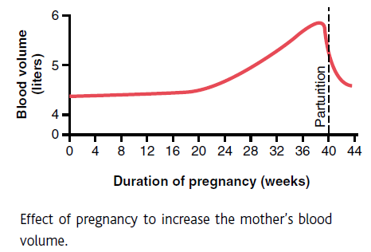
Maternal blood volume increases during pregnancy (due to aldosterone and estrogens) → high volume state

Slide 34
Blood volume increases by 30-50% (from normal 5 L into 7.5 L).
Increase in plasma volume is relatively higher than increase in RBCs volume → decrease hematocrit → physiologic anemia of pregnancy.

Slide 35
Decreased blood pressure is observed due to the vasodilatory effects of progesterone.
When lying in a supine position → uterus presses on the inferior vena cava → ↓blood return to the right atrium → hypotension.

Slide 36
Maternal respiration increases during pregnancy.
The total amount of oxygen used by the mother shortly before birth of the baby is about 20 % above normal and a large amount of carbon dioxide is formed.
Increased minute ventilation.

Slide 37
Expanded uterus presses on the diaphragm* → total excursion of the diaphragm is decreased → difficult breathing → rapid breathing (increased RR to maintain extra ventilation).
* Partly compensated by progesterone-induced ligament relaxation in the thoracic cavity.

Slide 38
Maternal kidney function
Slight increase in the rate of urine formation.
Increased production of salt and water retaining hormones (especially steroid hormones by the placenta and adrenal cortex) → increases renal tubules’ reabsorptive capacity for sodium, chloride, and water

Slide 39
Maternal kidney function
The renal blood flow and glomerular filtration rate increase up to 50 % during normal pregnancy due to renal vasodilation (probably due to increased levels of nitric oxide or the ovarian hormone relaxin).

Slide 40
Uterus presses on pelvic veins → varicose veins and swelling in the lower legs and ankles.
This is also caused by fluid retention and increased blood volume.
Placenta → releases progesterone and relaxin → loosening of ligaments around the sacroiliac joint and the symphysis pubis in preparation for parturition.

Slide 41
Gastrointestinal system
Hormonal changes affect the GI tract by:
Smooth muscle relaxation
Decreased peristalsis
Constipation and bloating
Relaxation of lower esophageal sphincter
Gastric reflux and heartburn
Morning sickness
Changes in taste perception

Slide 42
The nervous system
Release of estrogen and progesterone during pregnancy may cause:
Irritability
Anxiety
Depression
Mental fogginess
Decreased ability to concentrate
Fatigue and sleep deprivation

Slide 43
Breasts develop under the effect of estrogen and progesterone.
Estrogen also stimulates the production of prolactin in the anterior pituitary.
However, the high levels of progesterone inhibit the effects of prolactin until the baby is born.

Slide 44
Blood coagulation
Estrogen promotes blood clotting by:
increasing plasma fibrinogen and the activity of coagulation factors.
inhibiting the activity of antithrombin III
Increased risk of venous thromboembolism

