Slide 1
Female reproductive system

Slide 2
The female reproductive tract consists of:
The female gonads (the ovaries)
the uterus
the fallopian tubes.
The ovaries have two functions:
oogenesis
secretion of the female sex steroid hormones
Progesterone
estrogen.

Slide 3
The ovary
The ovary has three zones:
The cortex is the outer and largest zone. It is lined by germinal epithelium and contains all of the oocytes, each of which is enclosed in a follicle. The ovarian follicles are also responsible for steroid hormone synthesis.
The medulla is the middle zone and is a mixture of cell types.
The hilum is the inner zone, through which blood vessels and lymphatics pass.

Slide 4
The ovarian steroid hormones have both paracrine and endocrine functions.
Locally (within the ovaries) the ovarian steroid hormones support the development of the ova.
Systemically, the ovarian steroid hormones act on a variety of target tissues including uterus, breast, and bone.
The functional unit of the ovaries is the single ovarian follicle (= one germ cell surrounded by endocrine cells).

Slide 5
Functions of the ovarian follicle
Provides nutrients for the developing oocyte
Releases the oocyte at the proper time (ovulation)
Prepares the vagina and fallopian tubes to aid in fertilization of the egg by a sperm
Prepares the lining of the uterus for implantation of the fertilized egg
Maintains steroid hormone production for the fetus until the placenta can assume this role.

Slide 6
Oogenesis
In the developing ovaries → primordial germ cells produce oogonia by mitotic divisions until gestational weeks 20-24.
At gestational weeks 8-9 → some of the oogonia enter the prophase of meiosis and become primary oocytes.
6 months after birth → all oogonia have become oocytes.
The oocytes remain in a state of suspended prophase.
Simultaneously, there is attrition of oocytes.

Slide 7
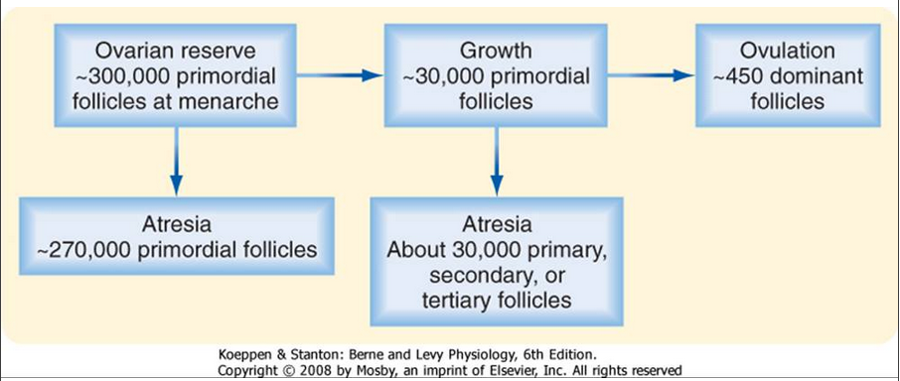

Slide 8
Development of ovarian follicles

Slide 9
Development of ovarian follicles – First stage
It parallels the prophase of the oocyte.
It lasts many years (13-50 years).
As the primary oocyte grows, the granulosa cells proliferate and nurture the oocyte with nutrients and steroid hormones.
The primordial follicle develops into a primary follicle, theca interna cells develop, and granulosa cells begin to secrete fluid.
No follicle progresses beyond this first stage in prepubertal ovaries.

Slide 10
Development of ovarian follicles – Second stage
It takes place over a period of 70–85 days and is present only during the reproductive period.
During each menstrual cycle, a few follicles enter this sequence.
A fluid containing steroid hormones, mucopolysaccharides, proteins, and FSH accumulates in a central area of the follicle called the antrum.

Slide 11
Development of ovarian follicles – Second stage
The steroid hormones reach the antrum by direct secretion from granulosa cells. The granulosa and theca cells continue to grow.
At the end of the second stage, the follicle is called a graafian follicle and has an average diameter of 2–5 mm.

Slide 12
Development of ovarian follicles – Third stage
It occurs 5–7 days after menses (menses marks the end of the previous cycle).
A single graafian follicle achieves dominance over its cohorts, and the cohorts regress.
Within 48 hours, the dominant follicle grows to 20 mm in diameter.
On day 14 of a 28-day menstrual cycle, ovulation occurs and the dominant follicle ruptures and releases its oocyte into the peritoneal cavity.

Slide 13
Development of ovarian follicles – Third stage
At this time, the first meiotic division is completed and the resulting secondary oocyte enters the nearby fallopian tube, where it begins the second meiotic division.
In the fallopian tube, if fertilization by a sperm occurs, the second meiotic division is completed, producing the haploid ovum with 23 chromosomes.

Slide 14
The residual elements of the ruptured primary follicle form the corpus luteum.
Composed primarily of granulosa cells, but also of theca cells, capillaries, and fibroblasts.
It synthesizes and secretes steroid hormones, which are necessary for implantation and maintenance of the zygote.

Slide 15
If fertilization does occur → the corpus luteum will secrete steroid hormones until the placenta assumes this role, later in pregnancy.
If fertilization does not occur, the corpus luteum regresses during the next 14 days (the second half of the menstrual cycle) and is replaced by a scar called the corpus albicans.

Slide 16
Summary of ovarian follicle trajectory
The ovarian follicle is the functional unit of the ovary, and it performs both gametogenic and endocrine functions. A histological section of the ovary from a premenopausal cycling woman contains follicular structures at many different stages of development. The life history of a follicle can be divided into the following stages:
1. Resting primordial follicle
2. Growing preantral (primary and secondary) follicle
3. Growing antral (tertiary) follicle
4. Dominant (preovulatory, graafian) follicle
5. Dominant follicle within the periovulatory period
6. Corpus luteum (of menstruation or of pregnancy)
7. Atretic follicles

Slide 17
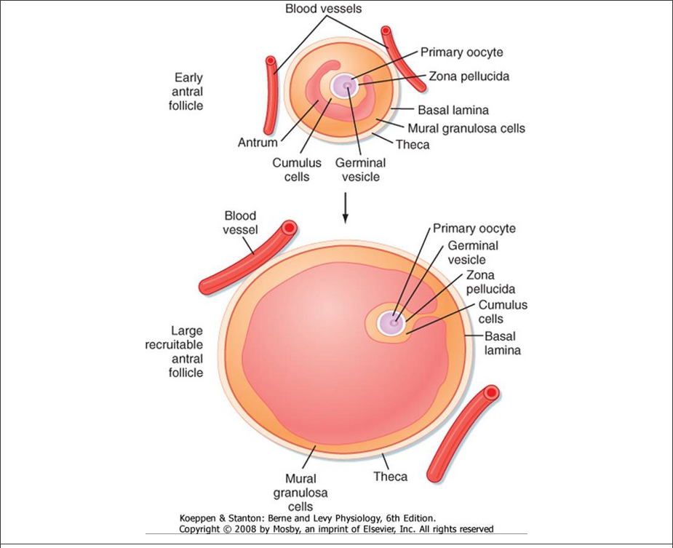

Slide 18
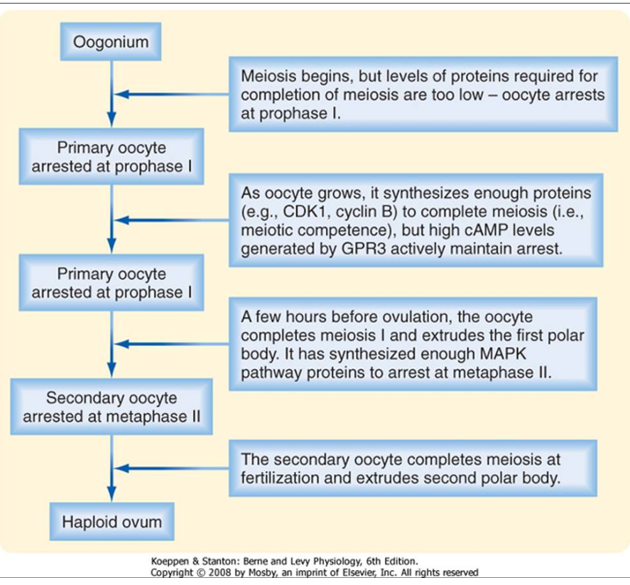

Slide 20
Synthesis and secretion of estrogen and progesterone
Theca cells produce progesterone (stimulated at the first step by LH).
Theca cells also synthesize androstenedione →
androstenedione diffuses to the nearby granulosa cells, which contain
17β-hydroxysteroid dehydrogenase, which converts androstenedione to testosterone
aromatase, which converts testosterone to 17β-estradiol (stimulated by FSH).

Slide 21
Synthesis and secretion of estrogen and progesterone

Slide 22
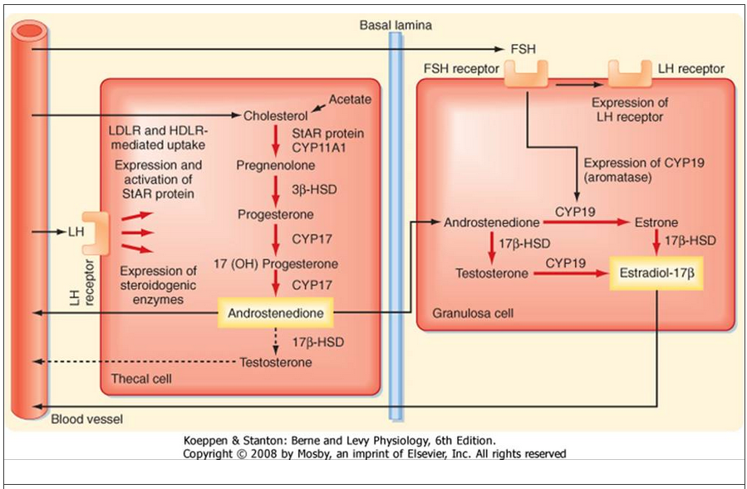

Slide 23
Regulation of the ovaries
Hypothalamic control – GnRH
Pulsatile GnRH activity stimulates the anterior pituitary to secrete FSH and LH.
Anterior pituitary gland – FSH and LH
FSH
Stimulates the growth of granulosa cells in primary follicles and stimulates estradiol sysnthesis.
Estradiol then supports the trophic effect of FSH on follicular cells.
These two effects are mutually reinforcing.

Slide 24
Regulation of the ovaries
LH
Initiates ovulation.
Just prior to ovulation, the concentration of LH rises sharply → induces rupture of the dominant follicle → oocyte release.
LH stimulates formation of corpus luteum (luteinization).
LH maintains steroid hormone production by the corpus luteum during the luteal phase of the menstrual cycle.

Slide 25
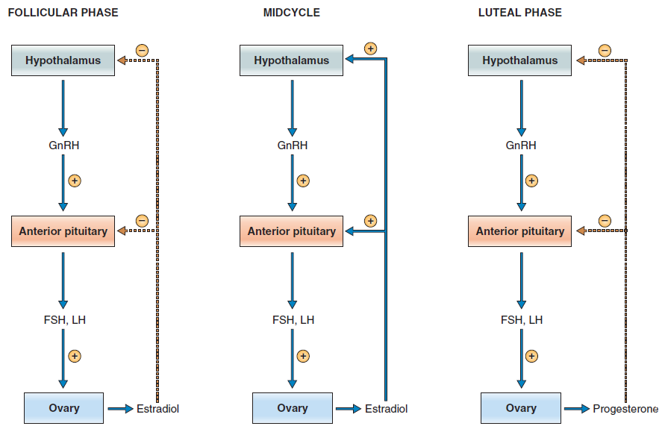
Negative and positive feedback control - estrogen and progesterone

Slide 26
Negative and positive feedback control - estrogen and progesterone
The follicular and luteal phases are characterized by negative feedback of estradiol and progesterone, respectively, on the anterior pituitary.
Midcycle is characterized by positive feedback of estradiol on the anterior pituitary.

Slide 27
Actions of estrogen
Has both negative and positive feedback effects on FSH and LH secretion.
Causes maturation and maintenance of the fallopian tubes, uterus, cervix, and vagina.
Causes the development of female secondary sex characteristics at puberty.
Causes the development of the breasts.

Slide 28
Actions of estrogen
Up-regulates estrogen, LH, and progesterone receptors.
Causes proliferation and development of ovarian granulosa cells.
Maintains pregnancy.
Lowers the uterine threshold to contractile stimuli during pregnancy.
Stimulates prolactin secretion (but then blocks its action on the breast).

Slide 29
Actions of progesterone
Has negative feedback effects on FSH and LH secretion during luteal phase.
Maintains secretory activity of the uterus during the luteal phase.
Maintains pregnancy.
Raises the uterine threshold to contractile stimuli during pregnancy.
Participates in development of the breasts.

Slide 30
The menstrual cycle

Slide 31
Follicular phase
Days 0-14
A primordial follicle develops to the graafian stage, with atresia of neighboring follicles.
LH and FSH receptors are up-regulated in theca and granulosa cells.
Estradiol levels increase and cause proliferation of the uterus.
FSH and LH levels are suppressed by the negative feedback effect of estradiol on the anterior pituitary.
Progesterone levels are low.

Slide 32
Ovulation
Occurs 14 days before menses, regardless of cycle length.
A burst of estradiol synthesis at the end of the follicular phase has a positive feedback effect on the secretion of FSH and LH (LH surge).
Ovulation occurs as a result of the estrogen-induced LH surge.
Estrogen levels decrease just after ovulation (but rise again during the luteal phase).
Cervical mucus increases in quantity; it becomes less viscous and more penetrable by sperm.

Slide 33
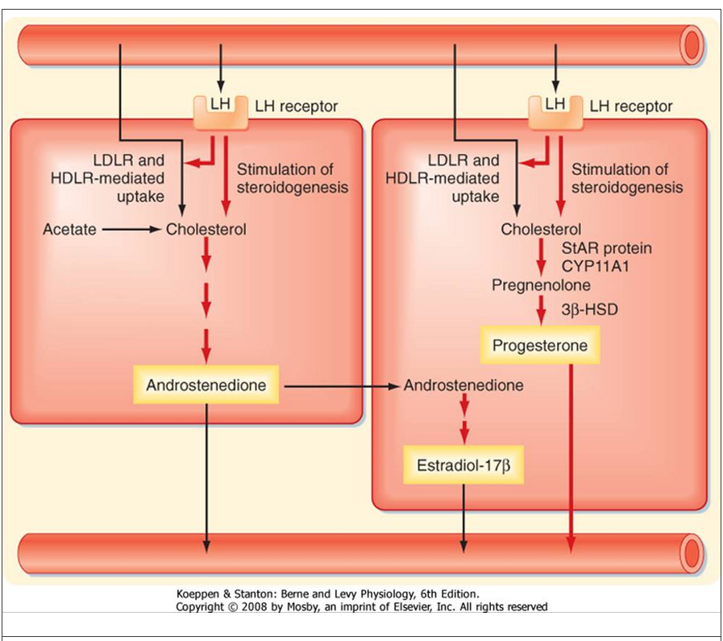

Slide 34
Luteal phase
Days 14-28
The corpus luteum begins to develop, and it synthesizes estrogen and progesterone.
Vascularity and secretory activity of the endometrium increase.
Basal body temperature increases.
If fertilization does not occur, the corpus luteum regresses at the end of the luteal phase.
As a result, estradiol and progesterone levels decrease abruptly.

Slide 35
Menses
Days 0-4
The endometrium is sloughed because of the abrupt withdrawal of estradiol and progesterone.

Slide 36
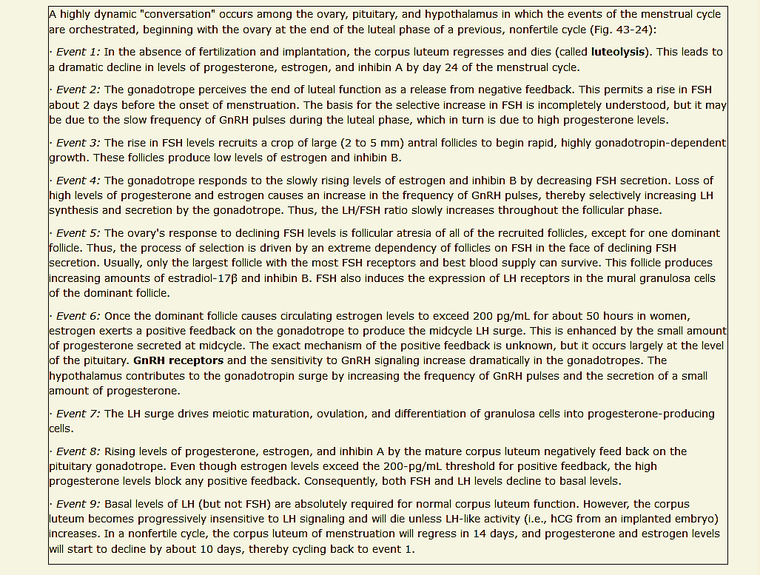
Summary Menstrual cycle

Slide 38
Follicular phase
Luteal phase

Slide 39
Follicular phase
Luteal phase

