Slide 1
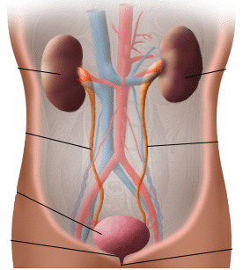
Urinary Tract Infections
Instructor : Noor Al-Saleh

Slide 2
Introduction
All area in the urinary tract system –in healthy human- is sterile
Normal flora is found on the tip of the urethra (skin/vaginal NF)
Most encountered bacterial agents:
- E.coli
- Klebsiella spp
- Proteus spp

Slide 3
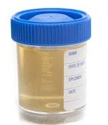
Urine specimen
The representative sample to diagnose UTI is
URINE SAMPLE
Specimen Collection:
1- Early morning midstream
2- Catheter urine sample
3- Supra-pubic bladder aspiration
4- Pediatric bags

Slide 4
Early morning Mid Stream
Early morning sample is the most concentrated sample
Mid stream sample reduces the contamination chance
→ Most common and suitable sample

Slide 5
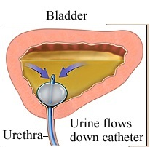
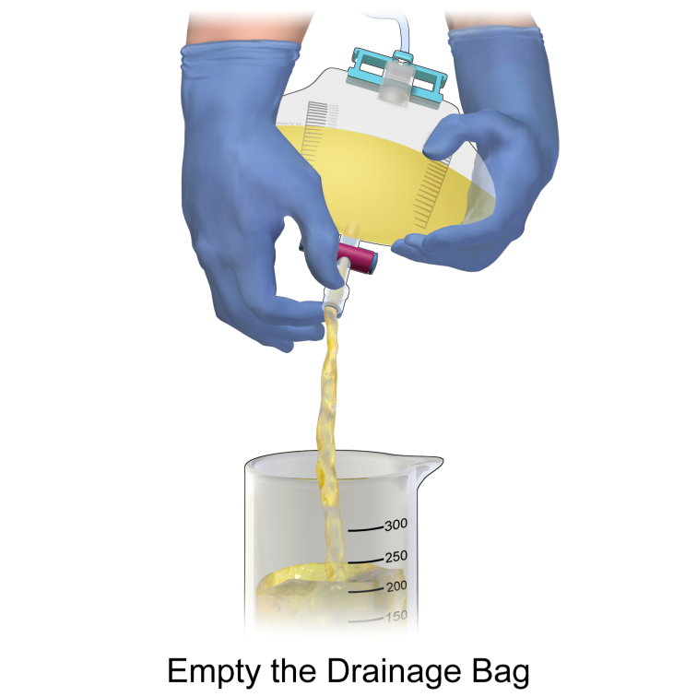
Catheter urine sample
For patients who can’t urinate by themselves (coma, operations..)
Indwelling catheters are NOT suitable for urine culture

Slide 6
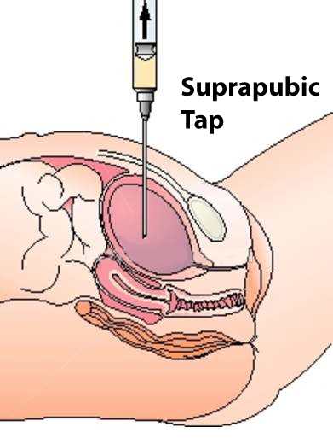
Supra-pubic bladder aspiration
Urine is withdrawn into syringe from bladder by inserting needle through the abdomen
The bladder must be full before performing this technique
This procedure is used when:
- Patient is continuously giving contaminated samples
- When it’s important to isolate anaerobic microorganisms

Slide 7
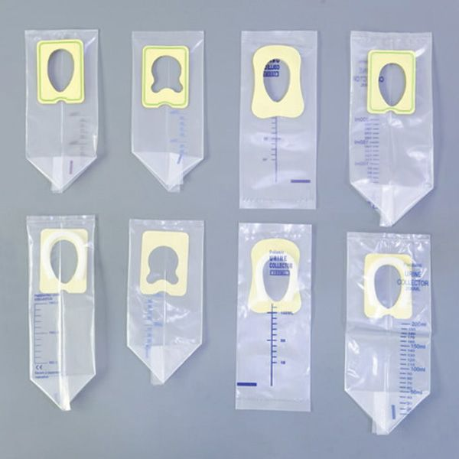
Pediatric bags
For infants and small children
Urine collection bag is adhered to the skin surrounding the urethral area

Slide 8
Urine analysis
Evaluation of urine is obtained by:
Macroscopic Examination
Microscopic Examination
Urine Culture

Slide 9
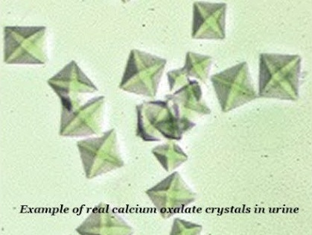
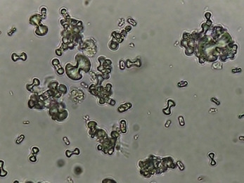
Microscopic Examination
Crystalluria: Urine crystals
Calcium oxalate
Dihydrate Calcium oxalate
Envelope shape
Monohydrate Calcium oxalate
Dumbbell shape

Slide 10
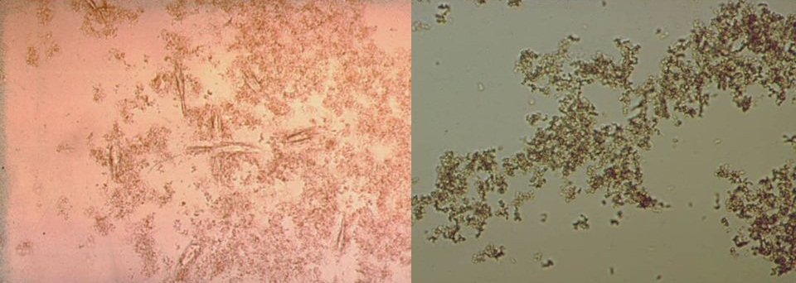
Microscopic Examination
2. Amorphous urates – Acidic pH
3. Amorphous phosphates – Alkaline pH

Slide 11
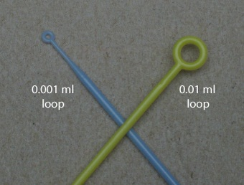
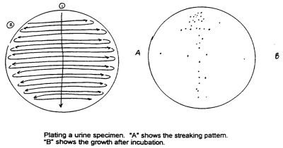
Urine culture
- Urine sample is mixed and cultivated on different plates
- T-shape streaking technique is used
- Calibrated loops of 0.01 or 0.001 ml are used

Slide 12
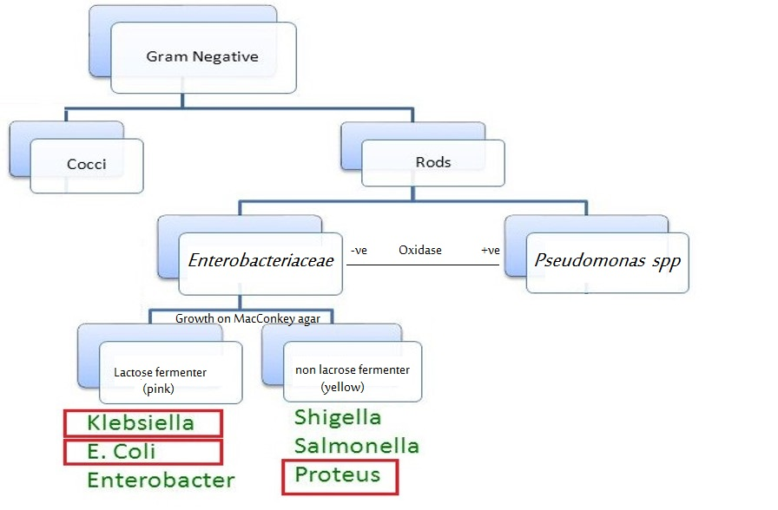
Most encountered bacteria

Slide 13
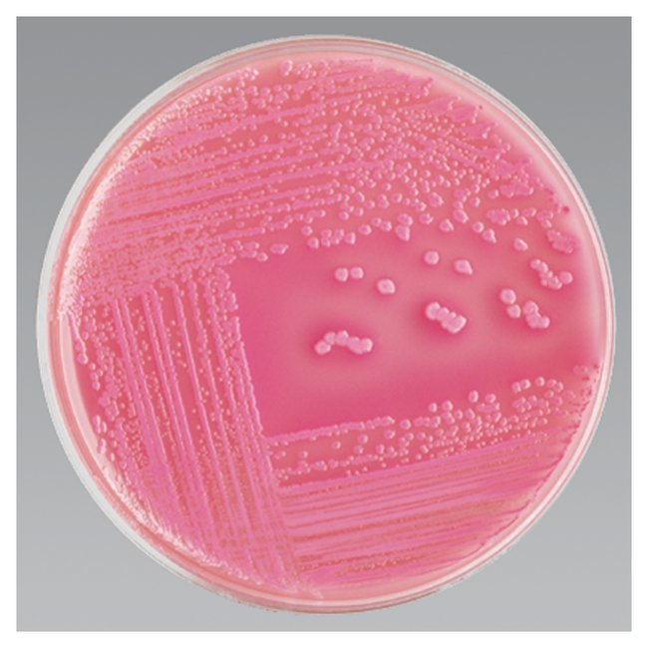
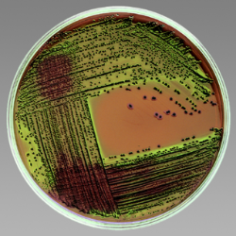
E.coli
Under microscope (Gram stain)
Gram –ve rods
Growth on MacConkey media
Small pink colonies
(lactose-fermenter)
Growth on EMB media
Metallic green colonies
IMViC results (++--)

Slide 14
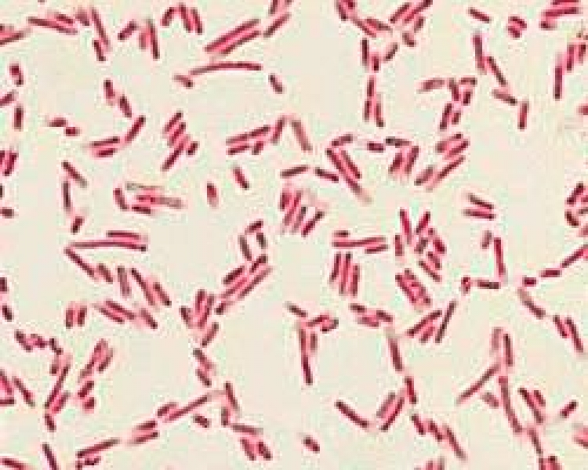
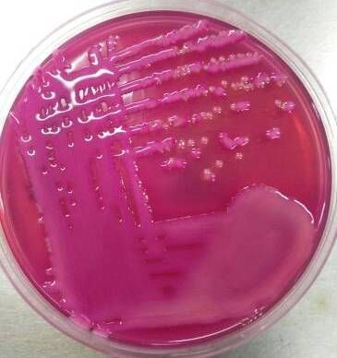
Klebseilla spp
Under microscope (Gram stain)
Gram –ve rods
Growth on MacConkey media
Small pink mucoid colonies
(lactose-fermenter)
IMViC reaction:
Klebsiella pneumoniae --++
Klebsiella oxytoxa +-++

Slide 15
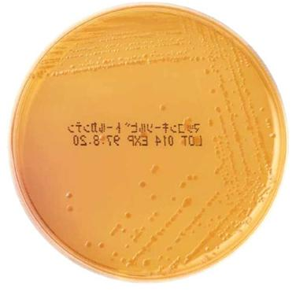
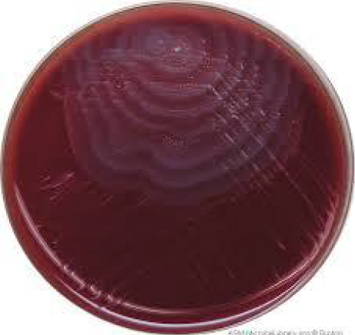
Proteus spp
Under microscope (Gram stain)
Gram –ve rods
Growth on MacConkey media
Small yellowish colonies
(non-lactose-fermenter)
Growth on Blood media
Ring's pattern due to their motility
(SWARMING)

Slide 16
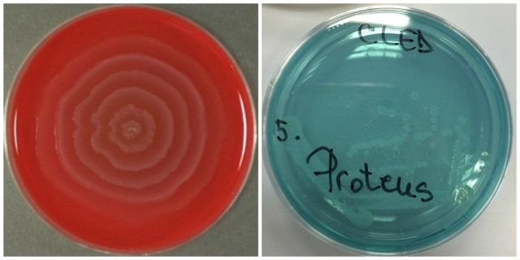
Proteus spp
CLED Agar (Cystine-Lactose-Electrolyte-Deficient Agar)
It supports the growth of urinary pathogens but prevents swarming of Proteus sp

Slide 17
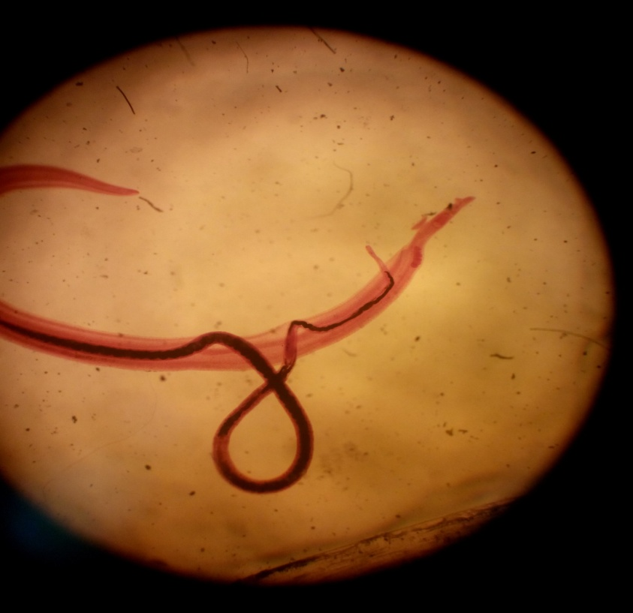
Schistosoma
Schistosomes – Blood Flukes
Schistosoma haematobium
Schistosoma japonicum
Schistosoma mansoni
Disease – schistosomiasis
Ova (eggs) exit in urine or stool → Diagnostic Stage

Slide 18
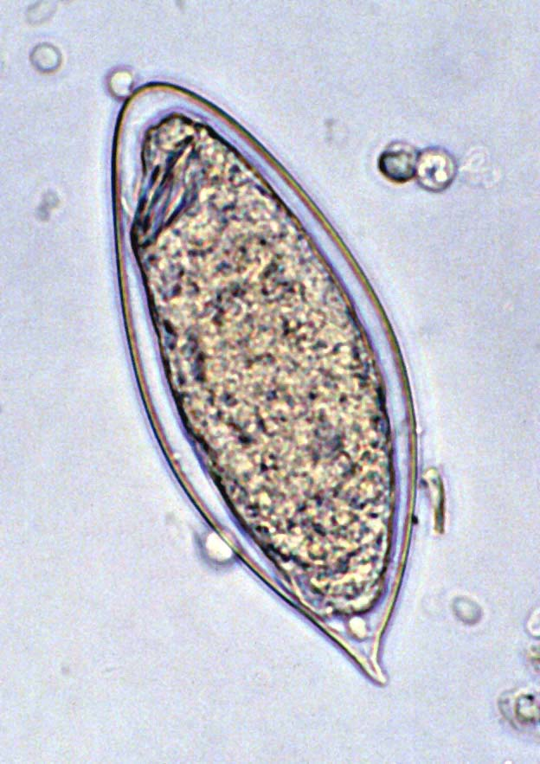
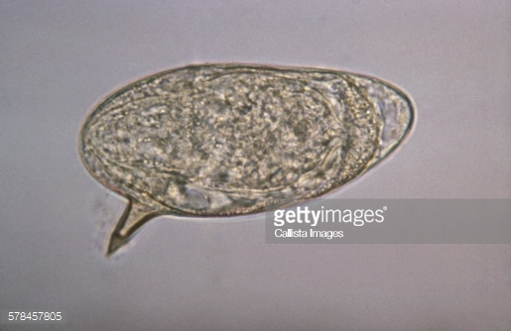
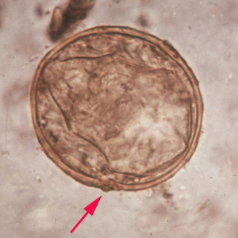
Schistosoma eggs
Schistosoma haematobium
Oval shape
Sharp terminal/polar spine
Found in urine, occasionally in stool
Wet mount preparation for diagnosis
Schistosoma mansoni
Oval shape
Sharp lateral spine
Schistosoma japonicum
Spherical shape
Small lateral spine

