Slide 1
Research Ethics
Medical ethics
Dr. Reema Karasneh

Slide 2
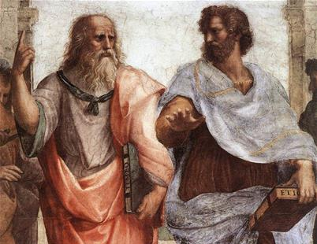
Historical events that have influenced human research
First Documented Human Subject Research (1700’s)
The Era of Modern Science (1900’s)
Nuremberg Code (December 9, 1946 World war II)
Thalidomide (In the late 1950s)
Tuskegee Syphilis Study (1932-1972)
Declaration of Helsinki (1964)
Beecher Article (1966 )

Slide 3
First Documented Human Subject Research (1700’s)
Among the first human subject research experiments to be documented were vaccination trials
In these early trials physicians used themselves or their family members as test subjects. For example:
Edward Jenner (1749-1823) first tested smallpox vaccines on his son and on neighbourhood children.
Johann Jorg (1779-1856) swallowed 17 drugs in various doses to record their properties.
Louis Pasteur (1822-1895) "agonized over treating humans," even though he was confident of the results obtained through animal trials. He finally did so only when he was convinced the death of the child, the first test subject (Joseph Meister), "appeared inevitable." was the first person to be inoculated against rabies by Louis Pasteur, and the first person to be successfully treated for the infection.

Slide 4
The Era of Modern Science (1900’s)
Walter Reed's well-known experiments to develop an inoculation for yellow fever were at the forefront of these advances.
These experiments, however, unlike earlier experiments with vaccinations, were carefully examined.

Slide 5
Nuremberg Code December 9, 1946 World war II
American military court opened criminal proceedings against 23 leading German physicians and administrators for their participation in war crimes and crimes against humanity.
German physicians conducted medical experiments on thousands of camp prisoners without their consent. Most of the subjects of these experiments died or were permanently disabled as a result.
As a direct result of the trial, the Nuremberg Code was established in 1948, stating that:
Informed consent is essential.
Research should be based on prior animal work.
The risks should be justified by the anticipated benefits.
Only qualified scientists must conduct research.
Physical and mental suffering must be avoided.
Research in which death or disabling injury is expected should not be conducted
Although it did not carry the force of law, the Nuremberg Code was the first international document which advocated voluntary participation and informed consent

Slide 6
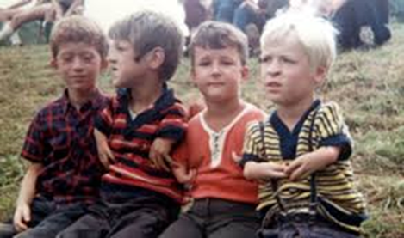
Thalidomide In the late 1950s
Thalidomide was approved as a sedative in Europe; it was not approved in the United States by the FDA.
The drug was prescribed to control sleep and nausea throughout pregnancy, but it was soon found that taking this drug during pregnancy caused severe deformities in the fetus.
Many patients did not know they were taking a drug that was not approved for use by the FDA, nor did they give informed consent. 12,000 babies were born with severe deformities due to thalidomide.
For the first time, drug manufacturers were required to prove to FDA the effectiveness of their products before marketing them.

Slide 7
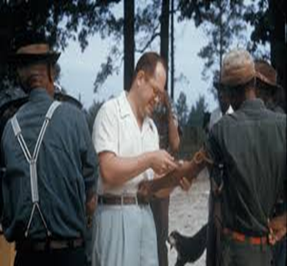
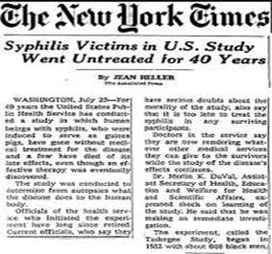
Tuskegee Syphilis Study 1932-1972
A research project conducted by the U.S. Public Health Service.
Six hundred low-income African-American males, 400 of whom were infected with syphilis, were monitored for 40 years. Free medical examinations were given; however, subjects were not told about their disease.
Even though a proven cure (penicillin) became available in the 1950s, the study continued until 1972 with participants being denied treatment. In some cases, when subjects were diagnosed as having syphilis by other physicians, researchers intervened to prevent treatment.
Many subjects died of syphilis during the study.
The study was stopped in 1973 by the U.S. Department of Health, Education, and Welfare only after its existence was publicized and it became a political embarrassment.

Slide 8
Declaration of Helsinki 1964
In 1964 the World Medical Association (WMA) developed a code of research ethics that came to be known as the Declaration of Helsinki.
It is a reinterpretation of the Nuremberg Code
It is a set of ethical principles and recommendations guiding medical doctors in biomedical research involving human participants.
Journal editors required that research be performed in accordance with the Declaration.
This document set the stage for the implementation of the Institutional Review Board (IRB) process.
Revised and amended in 1975, 1983, 1989, 1996, 2000, 2002, 2004, and 2008
Is the basis for Good Clinical Practices used today

Slide 9
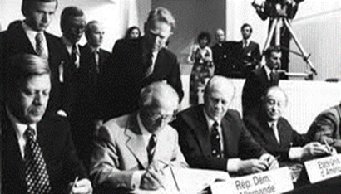
Issues addressed in the Declaration of Helsinki include:
Research with humans should be based on the results from laboratory and animal experimentation
Research protocols should be reviewed by an independent committee prior to initiation
Informed consent from research participants is necessary
Research should be conducted by medically/scientifically qualified individuals
Risks should not exceed benefits

Slide 10
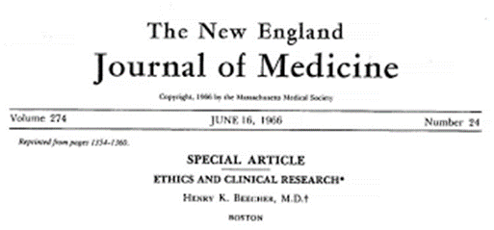
Beecher Article (1966)
In 1966 Dr. Henry K. Beecher, an anesthesiologist, wrote an article describing 22 examples of research studies with controversial ethics that had been conducted by reputable researchers and published in major journals
(Beecher HK. "Ethics and Clinical Research" NEJM June 16, 1966) (http://www.dartmouth.edu/~cphs/docs/beecher-article.pdf%20).
Beecher's article played an important role in heightening the awareness of researchers, the public, and the press to the problem of unethical human subjects research.

Slide 11
Ethical Problems with Past Studies
Lack of informed consent
Coercion or undue pressure on volunteers (or on a parent to volunteer their child)
Use or exploitation of a vulnerable populations (children, prisoners, and pregnant women)
Withholding information (e.g. risk) or available treatment
Risks to subjects outweigh benefits
Deception
Violation of rights

Slide 12
Research ethics
‘Research ethics’ refers to the moral principles guiding research, from its inception through to its completion and publication of results and beyond

Slide 13
Why Are Ethics Necessary
There are many advantages to understanding research ethics. Concepts of research ethics:
Provide us with a structure for analysis and decision-making.
Support and remind researchers to protect human subjects.
Provide workable definitions of benefits and risks, along with guidelines for evaluating and balancing the benefits and risks of research studies

Slide 14
ETHICAL PRINCIPLES RELEVANT TO MEDICAL RESEARCH
The autonomy of the research participant
The risk of harm to the research participant
The consequences of the research

Slide 15
The autonomy of the research participant
To give almost exclusive weight to respecting participant autonomy (the 'libertarian position').
If a potential research participant is fully informed, competent and not coerced, then that person has a perfect right to take part in even very dangerous research.

Slide 16
The risk of harm to the research participant
The duty of the researcher to ensure that the potential participant is not put at risk of harm through taking part in the research.
Almost exclusive concern for such risk gives rise to what might be called the paternalistic position
Would consider research that involves more than minimal harm unethical, even if the potential participant gives fully informed consent
Would be little concerned with research that involved no risk of harm but did take place without the consent of the participants
E.g. Research that involved collecting information from patients' medical notes without consent

Slide 17
The consequences of the research
Consequentialist approaches to ethics
It sees the consequences of our choices as being of crucial importance
Benefits and harms both to participants and to those in the future are to be considered.
The risk of harm to research participants may be justified by the good to people in the future who will benefit from the research.
The Declaration of Helsinki rejects this position

Slide 19
CONTRASTING THESE ETHICAL APPROACHES
These different approaches are contrasted
Each approach highlights different values, and the international guidelines on research ethics make use of all three approaches
The importance of consent and confidentiality reflect respect for the autonomy of the participant
The general prohibition on putting the participant at more than minimal risk, reflecting the duty not to harm
The consequentialist approach informs the view that the potential for the research to benefit people in the future is a necessary condition for the research to be undertaken

Slide 20
Summary of international guidelines on research ethics
Research participants should not be put at more than minimal risk of harm as a result of taking part in research
Potential research participants should be fully informed about both the purpose of the study and what will be involved in taking part, including an honest account of risks and benefits
It is difficult or even impossible to carry out some research with individual consent from participants (research using data from case notes or clinical databases). Ethics committees need to be satisfied that such research is of sufficient value to justify the breach of autonomy (confidentiality) and that the research cannot be carried out satisfactorily in any other way.

Slide 21
No coercion must be brought to bear on people to take part in research.
Participant should not feel an obligation to take part
Patients clinical care (outside the research study) should not be affected by their refusal to take part in research.
Payments may be made to patients only to offset reasonable costs, and must not be such as to act as inducement for the person to take part in the research.
Patients who are not competent to give consent for research may still be eligible to take part in research. Ethics committees will need to be satisfied that:
the risk of harm is very low, probably lower than the risk that is acceptable in the case of competent participants
the research aims cannot be achieved by other means
the research is of considerable value
a relevant person (usually a close relative) gives valid consent.

Slide 22
MONITORING ETHICS IN RESEARCH: Institutional Review Boards
Each institution or agency is required to establish a committee called an Institutional Review Board (IRB)
IRBs are composed of five or more members who are representatives of the institution as well as laypeople who have no association with the institution (scientists and non-scientists e.g., faculty members or administrators)
IRB criteria for reviewing and approving research:
Risks to subjects minimised
Risks reasonable in relation to anticipated benefits
Selection of subjects equitable
Data monitored for subjects’ safety
Subjects’ privacy protected and confidentiality of data maintained
You must not begin any data collection involving human beings or animals until you have received ethical approval for your research

Slide 23
Research proposals
Aims of the research
Scientific background of the research
Study design
Participants
who (inclusion and exclusion criteria), how many, how potential participants are identified and recruited, vulnerable groups
Methods of data collection
Procedures for informed consent
Measures taken to ensure confidentiality, privacy and data protection
Methods of data analyses
Expected outcomes, impacts and benefits of research

Slide 24
Human participants’ (or subjects)
Living human beings
Human beings who have recently died
Embryos and foetuses
Human tissue and bodily fluids
Human data and records
Medical, genetic, financial, personnel, criminal and administrative records, test results, …, etc.

Slide 25
‘Risk’ to participants in research
The potential physical or psychological harm, discomfort or stress to human participants that a research project might generate
Ethical issues related to risks participants can arise at any stage of a research project
The nature of the project itself
The context of the research
Procedures adopted
Methods of data collection
Nature of the participants
The type of data collected
What is done with the data and how it is disseminated

Slide 26
Potential benefits
Basic knowledge
Improvement of research or assessment techniques
Practical outcomes
Benefits for researchers
Benefits for research participants

Slide 27
KEY ETHICAL CONSIDERATIONS IN CARRYING OUT RESEARCH
Scientific validity
Safety
Consent procedure
Competency/ Vulnerable groups
Confidentiality
In conducting quantitative and qualitative research
In writing up the research/ Publication

Slide 28
Scientific validity
Are the aims worthwhile?
Is the method appropriate to the aims?
Research that is scientifically poor may be considered unethical for two reasons:
It will not benefit people in the future and so any risk of harm to participants cannot be justified
It may harm people in the future because the results are misleading
Sample size
If the sample size is not large enough to ensure adequate power then the research participants have been put at risk for no scientific gain
A sample size that is too large then more people will have been exposed to risk needlessly

Slide 29
Safety
Are the procedures safe, and are all reasonable precautions being taken?
Is the degree of risk for participants acceptable?
Research participants must be protected from being at much risk of harm, even if the benefit of the research to people in the future is considerable
The term 'minimal risk' is often used to describe an acceptable level of risk
A small chance of a reaction which itself is trivial
e.g. A mild headache or feeling of lethargy
A very remote chance of serious injury or death’

Slide 30
Consent procedure
Informed
Information must be clearly written, honest, sufficient, and balanced
Voluntary (absence of coercion)
Participant must be aware that refusal to take part will not affect clinical care
The relationship between researcher and participant should be free from potential coercion
e.g. Clinician tries to recruit their own patients for research
Payments to encourage participation are coercion and only fair remuneration for expenses should be offered; otherwise people may be encouraged to take risks they ordinarily wouldn’t in return for financial reward
Participants must be made aware that they have the right to withdraw their consent at any stage of the study.

Slide 31
A consent must be obtained
The consent should be given freely after that person is informed of the nature, significance, implications and risks of the trial.
Failure to provide sufficient information may give rise to criminal liability
The participant must have an interview with the researcher during which he must have been given the opportunity to understand the:
Objectives
Risks and inconveniences of the trial
The conditions under which the trial to be conducted
Consent must be formally recorded on a signed, written consent form
Consent once given can be withdrawn at any time
If the research involves the testing of medicines on human participants:

Slide 32
If the research does not involve medicines:
The relevant 'key information' would include:
The purpose of the research
What is involved in taking part
The risks and benefits
General methodology
If the research does not involve medicines:

Slide 33
Vulnerable groups
Are the potential participants competent to decide whether or not to take part?
Is such competence being assessed, when relevant?
Vulnerable group may encompass a multitude of populations:
Children
People with mental illness, learning difficulties, communication difficulties
Prisoners
The disabled
Those who do not readily understood the spoken language
Asylum seekers
Travellers
House-bound people
The homeless

Slide 34
Vulnerable groups
In research terms
This may equate to the individual not being able to understand what their participation in a study will involve
They may find it difficult to make their wishes and preferences understood
This could result in them being less able to make an informed or reasoned decision about their participation
This in turn leads to the potential for the individual to be either manipulated or misled, or to make a decision they later regret
Every effort must be made to secure informed consent from participants (or proxies)

Slide 35
Vulnerable groups
In the case of research and children, parents alone can give consent but every effort must be made to involve the child in the discussions and obtain their approval to be included in the research
Involving vulnerable populations in research is often
Complex
Time-consuming
ethically challenging process
Involving vulnerable populations in research remains an absolute necessity:
They account for a substantial proportion of the population and need to be considered in all aspects of healthcare and medical research
If vulnerable groups remain ‘invisible’ in research then they will only become further disadvantaged
Their views, experiences, and needs will not be represented within the evidence base

Slide 36
Confidentiality
Have participants given consent for confidential data to be accessed in the research?
Are the safeguards to prevent those not involved in the research from having access to confidential data adequate?
Most medical research involves collecting information concerning individuals that should be kept confidential
A researcher could be found negligent if
Reasonable precautions were not taken to ensure that information gained was stored in a secure manner
Information were passed to another person without explicit consent of the research participant

Slide 37
Protecting Privacy and Confidentiality in Research
The ethical principle of autonomy argues strongly for a meaningful informed consent in many areas related to research, including privacy and confidentiality.
Therefore, concerns about protection of confidentiality in the research arena are valid.
Over the years, these concerns have led to two major legislative. The two proposals are as follows:
Patient consent should be required before investigators are allowed access to medical records.
Data from medical records should be made available to investigators without any information that would identify an individual.
Both proposals are consistent with the ethical principle of nonmaleficence—doing no harm—to the subjects participating in a research study.

Slide 38
Problem in Protecting Privacy and Confidentiality in Research
Clinical research that requires access to patient details for recruitment purposes
Researchers may wish to contact all patients who were admitted to hospital with a particular disease
If the hospital gives the contact details of such patients to the researchers, then patients confidentiality will have been breached
This problem can usually be avoided by the hospital or relevant clinician contacting the patient directly to seek consent for contact details to be passed on to the researchers

Slide 39
Problem in Protecting Privacy and Confidentiality in Research
Research that is based on the collection and analysis of existing information in medical records
Seeking individual consent from each patient for access to health records may not be possible in the case of large studies or studies involving records from a long time ago
Information from medical records that identifies individuals is essential for most epidemiologic studies
Review of medical records is often the first step in identifying a group of persons with a disease who will receive subsequent follow-up
Identifying information is essential for linking the records of specific individuals from different sources
(such as hospital records, physicians’ records, employment records, and death certificates in studies of occupational cancer)
If society has a vested interest in the findings from epidemiologic and other biomedical studies, it is necessary to strike a balance between the interests of the individual and those of the community

Slide 40
Procedures designed to protect the confidentiality of subjects in epidemiologic studies
Informed consent is required from study participants for all phases of research, except review of medical records
All data obtained are stored under lock and key
Only study numbers are used on data forms. The key for linking these numbers to individual names is kept separately under lock and key
Individual identifying information is destroyed at the end of the study unless there is a specific justification for retaining this information. Such retention must be approved by the institutional review board (IRB) or committee on human research

Slide 41
Procedures designed to protect the confidentiality of subjects in epidemiologic studies- Cont’d
All results are published only in aggregate or group form so that individuals are never identified
Unless it is essential for the study, individual identifying information is not entered in computer files, and individual identifiers are not included in routine tabulations generated from computerized data
The importance of maintaining privacy and confidentiality is regularly emphasized to the research staff

Slide 42
Quantitative Research
Quantitative research involves studies in which the data that are analyzed are in the form of numbers
Behaviours
Correct answers or errors
Measures are recorded in terms of quantity
Quantitative research involves both experimental and nonexperimental research

Slide 43
Ethical issues in experimental research
Focus on protecting:
Individuals that receive an intervention
Those who are in a “placebo” or control group
e.g., newly developed science program

Slide 44
Ethical issues in nonexperimental research
Nonexperimental research such as survey research focus on:
Protecting the participants
Should be fully informed as to the purpose of the study
Participant demographics
e.g., teachers, college students, the general public
Confidentiality of responses
How the results are intended to be used
Who will have access to the data
Responsibility of “not wasting” a respondent’s time
Only collecting data that has utility (real use)

Slide 45
Qualitative Research
Qualitative research involves data that are recorded in narrative descriptions, not numbers
Researchers use qualitative methods to observe and describe conditions

Slide 46
Ethics and Qualitative Research
Informed consent
Necessary but can be problematic when there is a substantial threat to privacy
A revelation of observed conversations and behaviours could cause harm to participants in their families, communities, or place of employment
The actual research participants, who have given consent, may not be the only people observed.
e.g. a student in a school???
consent is not necessary when
Access to the setting is approved by the agency or institution
Participants who are actively involved have given informed consent
Other observed behaviour is considered public and observable by anyone present in the setting

Slide 47
Publication
Once your data collection is complete, analysed, and the final report formulated the next stage is publication of your findings
As a researcher it is beholden upon you to publish your study, even if your findings are unexpected or unwanted
Many journals expect to see evidence of your ethical review process before they will publish your work
It may also be expected of you to sign a declaration stating your honesty and ethical approach to your research

Slide 48
Core principles that must be adhered to in publication
Authority
Duplicate publication
Research misconduct (falsification, fabrication and plagiarism)
Conflict of interest
Accurate reporting

Slide 49
Authority
Only those who have made a significant contribution should be credited as authors
Significant contributions include
Design of the research
Designing and conducting major analysis
Interpreting findings
Writing a major section of the publication
If someone has made a more minor contribution then they should be acknowledged in a note
The order in which the authors’ names appear should be in relation to their contribution to the work
i.e. whoever did the greatest part comes first and so on
The status of an individual has no role in determining where, or if, their name appears on the publication

Slide 50
Duplicate publication
This is where research is presented as original material but has in fact been published, either in part or entirety, elsewhere
This would deceive the scientific community
Work must not, therefore, be submitted if it has been published in another outlet
e.g. submitted for publication in a journal when it has already been published as a book chapter
Work should only be submitted to one publisher at a time for consideration of publication. Only if it is rejected should it then be offered to another publisher. This increases the length of time it takes to go from writing to publication but will help prevent copyright infringements and duplicate publication
Duplicate publication does not include:
Previous publication as a conference abstract (have a limited audience)
Publication in another language (as long as it is made clear that it is a translation)

Slide 51
Research misconduct
Fabrication
Making up data or results and recording or reporting them
Falsification
Manipulating research materials, equipment, or processes, or changing or omitting data or results such that the research is not accurately represented in the research record
Plagiarism
The appropriation of another person’s ideas, processes, results or words without giving appropriate credit (quotations and referencing)
Research misconduct does not include honest error or differences of opinion

Slide 52
Conflict of interest
A situation in which one experiences conflicting pulls from one’s personal interests and from one’s professional obligations
Direct:
Being paid to say something untrue
Indirect:
Knowing that if you say something positive about a company that gave you a grant, you may be more likely to get a grant from them again in the future
A funding agency may stipulate that they have a right to decide whether you can publish your findings or may delay publication

Slide 53
Accurate reporting
A true and accurate account of your work must be presented.
A full explanation of your study is required including data collection tools, plus methods and analysis.
An objective discussion with conclusion should be provided
Editors are fully entitled to question you about your work and have the right to review your data.
All findings should be reported, even if they don’t fit neatly with your study.
It is imperative that all sources of funding and conflicts of interest are disclosed.
Journal editors have the final responsibility for ensuring that the publications in their journals consist of ethical research practices and report writing

Slide 54
Historic Case Studies

Slide 55
Willowbrook Hepatitis Study (1956)
At an institution for mentally retarded children in Staten Island, New York, a study was initiated to determine the natural history of viral hepatitis and to test the effectiveness of gamma globulin as an agent for inoculating against hepatitis.
Children were deliberately (on purpose) Infected with a mild form of hepatitis.
Although permission was obtained from parents, the parents were not fully informed of the possible hazards involved in the study.
There is evidence that the parents were led to believe that the child would not be enrolled at the school unless the parents signed the consent form.
Ethical problems: exploitation of a vulnerable group of subjects, withholding information about risks, coercion or undue pressure on parents to volunteer their children.

Slide 56
Jewish Chronic Disease Study (1963)
Live cancer cells were injected into senile patients (or patients who were hospitalised with various chronic debilitating diseases) without their knowledge as part of a study of immunity to cancer.
Since the investigators believed that the cells would be rejected, the researchers did not inform the patients or seek consent because they did not want to frighten them.
Ethical problems: lack of informed consent, use of a vulnerable group of subjects.

Slide 57
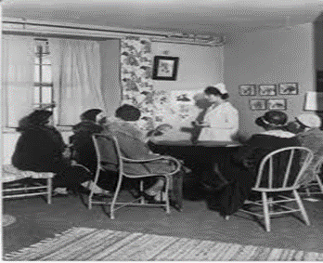
San Antonio Contraceptive Study (1971)
In San Antonio, Texas, a number of Mexican-American women participated in a study to determine side effects of an oral contraceptive.
The women came to a clinic seeking contraceptives.
Unbeknownst to them, the study was designed so that half the women would receive oral contraceptives for the first half of the study, then switched to placebo. The women initially receiving placebo were placed on the oral contraceptive for the second half of the study.
10 of the 76 subjects became pregnant while using placebo.
Ethical problems: lack of informed consent, use of a vulnerable group of subjects, risks to subjects outweighed benefits.

Slide 58
☺
The End

