Slide 1
Sexual differentiation and puberty

Slide 2
Sexual differentiation
Sexual differentiation includes the development of the gonads, internal genital tract, and external genitalia.

Slide 3
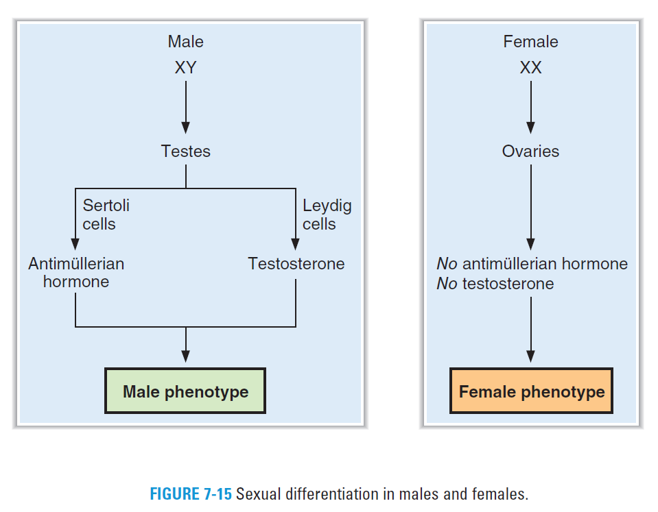

Slide 4
Genetic sex is defined by the sex chromosomes, XY in males and XX in females.
During the first 5 weeks of gestational life, the gonads are indifferent or bipotential - they are neither male nor female.
At approximately gestational week 7 in genetic males, the gene product of the sex-determining region of the Y chromosome (SRY gene) causes the testes to begin developing.

Slide 5
At gestational week 9 in genetic females (in the absence of the SRY gene) the ovaries begin to develop.
Genetic sex normally determines gonadal sex, and the gonads appear in males slightly before they appear in females.

Slide 6
Gonadal sex is defined by the presence of the gonads; testes in males and ovaries in females.
The testes, the male gonads, consist of three cell types:
Germ cells: produce spermatogonia
Sertoli cells: synthesize a glycoprotein hormone called antimüllerian hormone
Leydig cells: synthesize testosterone.

Slide 7
The ovaries, the female gonads, also have three cell types:
Germ cells: produce oogonia.
Meiotic oogonia are surrounded by granulosa cells and stroma
called oocytes in this configuration.
They remain in the prophase of meiosis until ovulation occurs.
Granulosa cells: synthesize estradiol.
Theca cells: synthesize progesterone and estradiol.

Slide 8
Phenotypic sex is defined by the physical characteristics of the internal genital tract and the external genitalia.

Slide 9
Male phenotype
The testes of gonadal males synthesize and secrete antimüllerian hormone and testosterone.
Testosterone stimulates the growth and differentiation of the wolffian ducts, which develop into the male internal genital tract.
Antimüllerian hormone causes atrophy of the müllerian ducts (which would have become the female internal genital tract).

Slide 10
Female phenotype
The ovaries of gonadal females secrete estrogen, but not antimüllerian hormone or testosterone.
Without testosterone, the wolffian ducts do not differentiate.
Without antimüllerian hormone, the müllerian ducts are not suppressed and therefore develop into the female internal genital tract.

Slide 11
Puberty

Slide 12
Gonadotropin secretion over the lifetime
In both males and females, gonadal function is driven by the hypothalamic-pituitary axis, whose activity varies over the life span.

Slide 13
Gonadotropin secretion over the lifetime
Secretion of gonadotropin-releasing hormone (GnRH) begins at gestational week 4, but its levels remain low until puberty.
Secretion of follicle-stimulating hormone (FSH) and luteinizing hormone (LH) begins between gestational weeks 10 and 12. The levels of FSH and LH remain low until puberty.

Slide 14
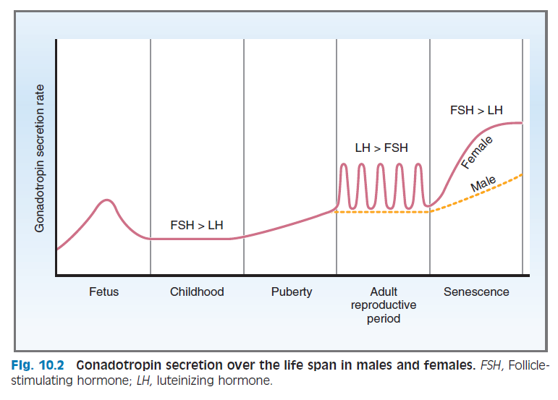
Gonadotropin secretion over the lifetime

Slide 15
Pulsatile Secretion of GnRH, FSH, and LH
The primary event at puberty is the initiation of pulsatile secretion of GnRH → parallel pulsatile secretion of FSH and LH by the anterior pituitary gland.
Early events of puberty include:
appearance of large nocturnal pulses of LH during rapid eye movement (REM) sleep.
increased sensitivity of the GnRH receptor in the anterior pituitary.

Slide 16
Pulsatile Secretion of GnRH, FSH, and LH
Pulsatile secretion of FSH and LH stimulates secretion of the gonadal steroid hormones, testosterone and estradiol.
Increased circulating levels of the sex steroid hormones are then responsible for the appearance of the secondary sex characteristics at puberty.

Slide 17
The onset of the maturational process at puberty is genetically programmed, and familial patterns are evident.
The mechanisms underlying the onset of pulsatile GnRH secretion → not well known.
May be gradual maturation of the hypothalamic neurons that synthesize and secrete GnRH.
The central nervous system and nutritional status may alter the process.
Melatonin may be a natural inhibitor of GnRH
Removal of the pineal gland precipitates early puberty.

Slide 18
Characteristics of puberty
Pulsatility of the hypothalamic-pituitary axis is required for normal reproductive function.

Slide 19
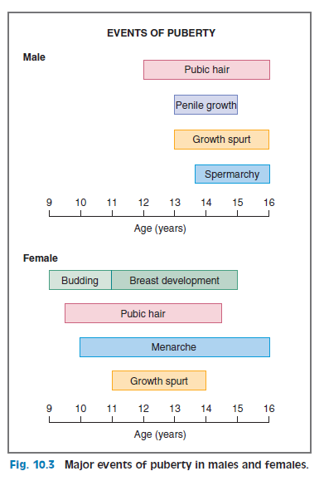
Events of puberty and their timing

Slide 20
Puberty in boys
Activation of the hypothalamic-pituitary axis.
Leydig cell proliferation in the testes.
Increased synthesis and secretion of testosterone by the Leydig cells.
Growth of the testes, largely because of an increased number of seminiferous tubules.
Growth of the sex accessory organs such as the prostate.

Slide 21
Puberty in boys
Pronounced linear growth spurt and closing of the epiphyses when adult height is attained.
As plasma levels of testosterone increase,
facial, pubic, and axillary hair appears
there is growth of the penis
lowering of the voice due to increased size of the larynx and vocal cords
initiation of spermatogenesis.

Slide 22
Puberty in girls
Associated with the activation of the hypothalamic-pituitary axis, which drives the synthesis of estradiol by the ovaries.
The first observable sign is budding of the breasts.
Two years later → menarche (onset of the menstrual cycle).
The growth spurt and closure of the epiphyses typically begin and end earlier in girls than in boys.
The appearance of pubic and axillary hair precedes menarche and is dependent on increased secretion of adrenal androgens.

Slide 23
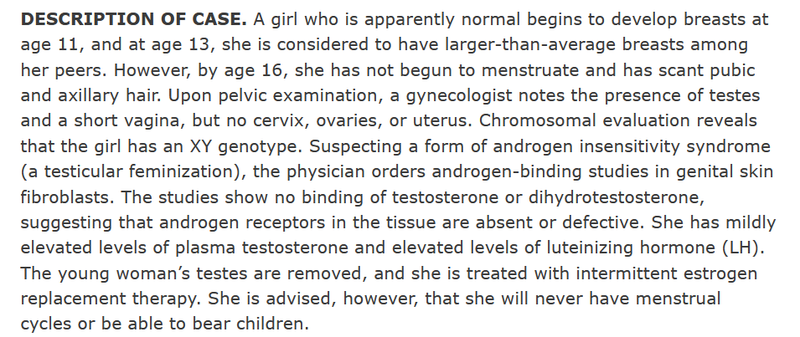
Clinical physiology cases
CASE # 1

Slide 24
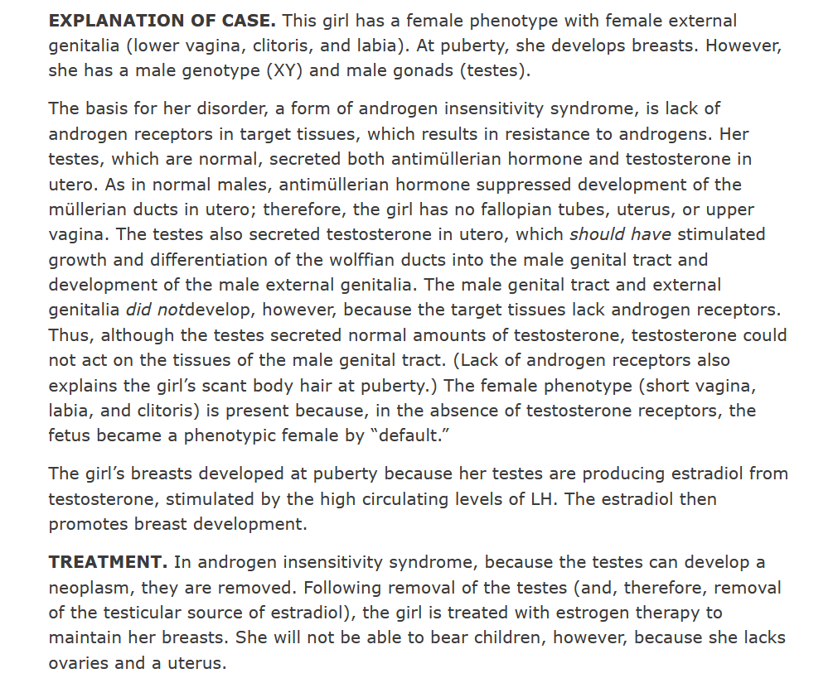

Slide 25
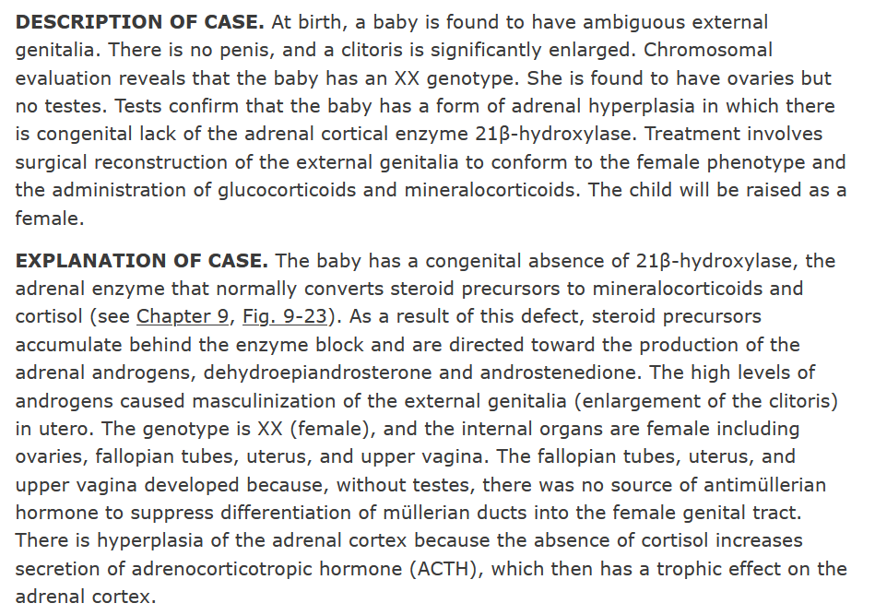
CASE # 2

