Slide 1
Quality Improvement
Lec. 9
MED 311
Dr. Ola Soudah

Slide 2
INTRODUCTION
Institute of medicine (IOM) published in 2000-2001 two reports that start the movement for quality improvement in healthcare setting;
    To err is human: medical errors as the 3rd leading cause of death in US.
    The quality chasm: The report parses the concept of “quality of care” into six basic dimensions.

Slide 3
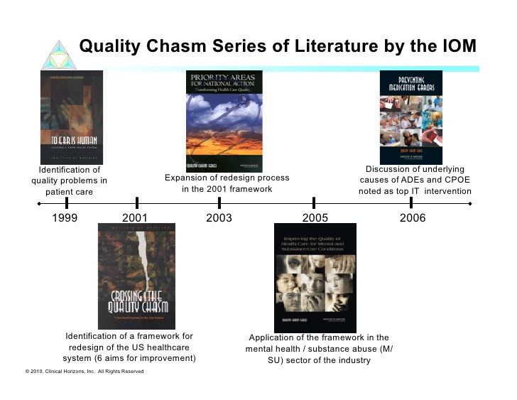

Slide 4
The report diagnosed the quality problem as not one of poorly performing people, but of people struggling to perform within a system that is riddled with opportunities for mistakes to happen.

Slide 5
“Between the health care that we have and the health care that we could have lies not just a gap, but a chasm”.
            Institute of Medicine, Crossing the Quality Chasm, 2001
This poor-quality care causes ongoing damage to human health.
    Between 5.7 and 8.4 million deaths occur annually from poor quality of, which represents between 10 and 15 percent of the total deaths reported by WHO in 2015.

Slide 6
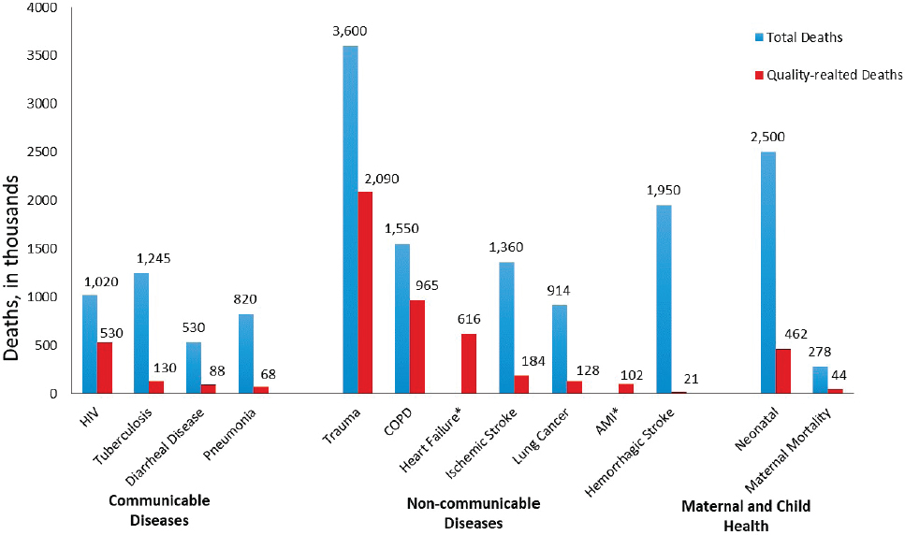
Overall number of deaths from poor-quality care annually in low- and middle-income countries compared with total deaths, in thousands.
* Total deaths unavailable.
NOTE: AMI = acute myocardial infarction; COPD = chronic obstructive pulmonary disorder; HIV = human immunodeficiency virus.
SOURCE: Institute for Health Metrics and Evaluation.

Slide 7
DEFINING QUALITY IN HEALTH CARE
IOM definition of quality
“the degree to which health services for individuals or populations increase the likelihood of desired health outcomes and are consistent with the current professional knowledge”

Slide 8
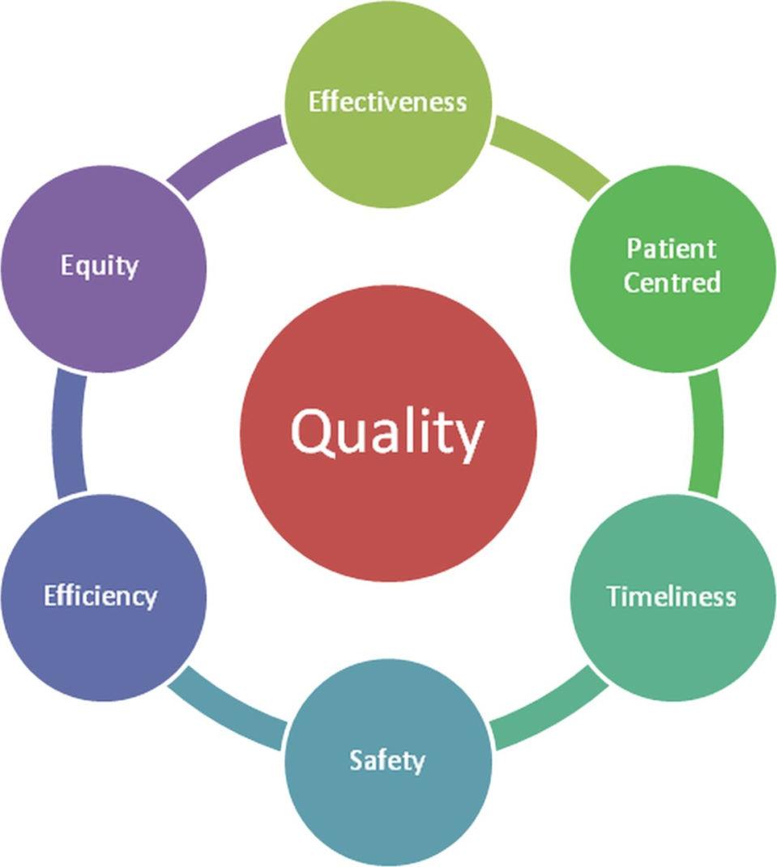
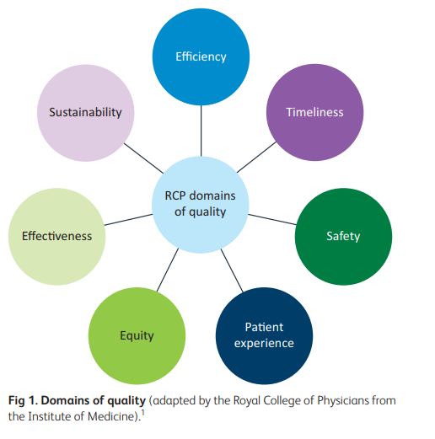

Slide 9
IOM quality chasm
Definitions of the six dimensions of quality in analyzing the current state of quality and identifying future needs:
    Safety: Avoiding harm to patients from the care that is intended to help them.
    Effectiveness: Providing services based on scientific knowledge to all who could benefit, and refraining from providing services to those not likely to benefit (that is, avoiding both overuse of inappropriate care and underuse of effective care).
    Patient-centered: Providing care that is respectful of and responsive to individual preferences, needs, and values and ensuring that people’s values guide all clinical decisions.

Slide 10
    Accessibility, Timeliness, Affordability: Reducing unwanted waits and harmful delays for both those who receive and those who give care; reducing access barriers and financial risk for patients, families, and communities; and promoting care that is affordable for the system.
    Efficiency: Avoiding waste, including waste of equipment, supplies, ideas, and energy, and including waste resulting from poor management, fraud, corruption, and abusive practices.
    Equity: Providing care that does not vary in quality because of personal characteristics such as gender, ethnicity, race, geographic location, and socioeconomic status.

Slide 11
Another way to define (system approach)
“ quality is the result of a system with interdependent parts that must work together to achieve outcomes”
Using this system perspective, Avedis Donabedian defined quality in terms of structures, processes, and outcomes

Slide 12
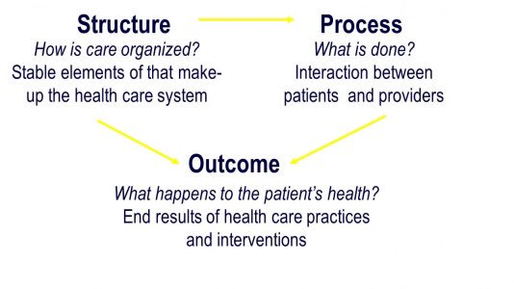
Donabedian triad

Slide 13
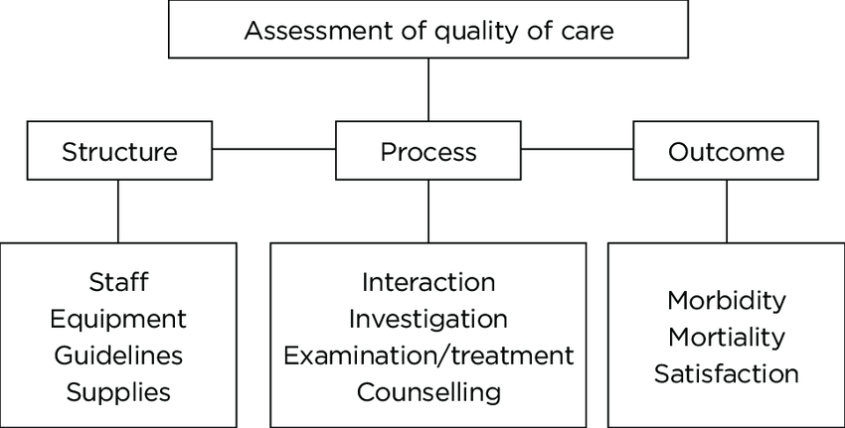
Accessibility and
care delivery

Slide 14
The structural elements of quality involve the material and human resources of an organization and the facility itself.
How to improve??
    The quality of healthcare personnel is documented in their numbers, skill level, and various certifications.
    The quality of facilities lies in accreditation and/or certification.

Slide 15
Process involves the actual delivery of care as well as its management
    (e.g., the quality of basic care including cleanliness, feeding, hydration, delivery of treatments, and keeping patients safe from falls and errors).
Outcomes are the resulting health status of the patients
    (e.g., mortality, morbidity, length of stay, and functional status) and organizations (turnover of staff, cost outcomes).

Slide 16
Moreover, Donabedian defined quality as having at least four components:
    1. The technical management of health and illness.
    2. The management of the interpersonal relationship between the providers of care and their clients.
    3. The amenities of care.
    4. The ethical principles that govern the conduct of affairs in general and the health care enterprise in particular.

Slide 17
The technical management of health focuses on the clinical performance of health care providers.
The management of interpersonal relationships health service quality is driven both by clinical and nonclinical processes, the relationship between patients, caregivers and non-clinical personnel.
The amenities of care speak to the patient’s interest in being treated in comfortable, clean surroundings.
The ethical principles speak to the provider’s ethical conduct in delivering care and his/her interest in furthering societal and organizational well-being (or effectiveness).

Slide 18
In the light of quality
Effectiveness is defined as “providing services based on scientific knowledge to all who could benefit and refraining from providing services to those not likely to benefit (avoiding underuse and overuse)”.
Efficiency is defined as “avoiding waste, in particular waste of equipment, supplies, ideas, and energy”.

Slide 19
WHY IS QUALITY IMPORTANT?
Problems in quality will results :
  Underuse is the failure to provide a service whose benefit is greater than its risk.
  Overuse occurs when a health service is provided when its risk outweighs its benefits or it simply has no added benefit, as with overuse of certain diagnostic tests.
  Misuse occurs, for example, when the right service is provided badly and an avoidable complication reduces the benefit the patient receives.

Slide 20
COMMON ELEMENTS OF QUALITY IMPROVEMENT
The most common used framework for quality improvement are:
    Total quality (continuous quality improvement); CQI.
    Six-sigma.
    Toyota production system, TPS/Lean.

Slide 21
key concepts common to all quality improvement methods
These concepts are: measurement, process variation, and statistical process control.
    Measurement Translation of observable events into quantitative terms.
    Process variation The range of values that a quality metric can take as a result of different causes within the process.
    Statistical Process Control (SPC) is a method by which process variation is measured, tracked, and controlled in an effort to improve the quality of the process.

Slide 22
Measurements
“You can’t manage what you can’t measure.”
In this way, quality improvement is driven by data-based evidence rather than subjective judgments or opinions.

Slide 23
Measurement development process
Good measurement begins with the rigorous definition of the concept to be measured.
        (e.g., wait times: could be defined as the time interval between the arrival of a patient at the office and the time he or she is first seen by the doctor.)
Then requires the use of a measurement methodology that yields reliable (e.g., consistent) and valid (e.g., accurate) measures of the concept.

Slide 24
Having a rigorous definition will result in reliability and method of data collection will yield a valid measure.
Measurement reliability means that if a measure is taken at several points over time or by various people, the measure will generally be consistent (that is, not vary too much).
Validity is the extent to which the measure used actually measures the concept.

Slide 25
Process Variation and Statistical Process Control (SPC)
Shewhart defined Two forms for process variation:
  Special-cause variation is due to unusual, infrequent, or unique events that cause the quality metric to deviate from its average by a statistically significant degree.
  Common-cause variation is due to the usual or natural causes of variation within a process.

Slide 26
Following Shewhart, quality improvement now involves:
    Detecting and eliminating special-cause variation in a process.
    (2) Detecting and reducing, whenever feasible, common-cause variation within a process.

Slide 27
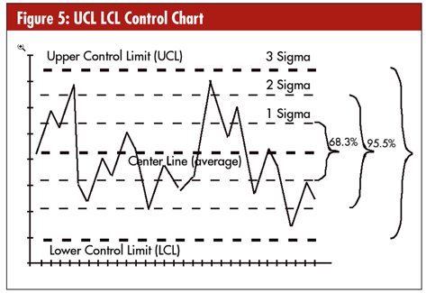
“a picture is worth a thousand words”
Statistical Process Control (SPC) is a branch of statistics that involves time-series analysis with graphic data display.
A control chart will tell you whether your process is out of control, unstable, or unpredictable.
A stable process produces predictable results consistently. Processes that are “out of control” need to be stabilized before they can be improved.

Slide 28
THREE APPROACHES (frameworks) TO QUALITY IMPROVEMENT
Continuous Quality Improvement CQI
  Defined as an organizational process in which employee teams identify and address problems in their work processes.
Five dimensions of CQI:
    (1) Process focus.
    (2) Customer focus.
    (3) Databased decision making.
    (4) Employee empowerment.
    (5) Organization-wide impact.

Slide 29
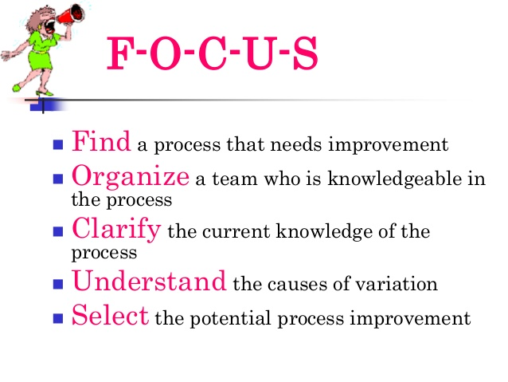
FOCUS-PDCA Cycle
FOCUS–PDCA framework, become the most commonly used quality improvement framework in the health care industry.

Slide 30
FOCUS (Find, Organize, Clarify, Understand, and Select):
  Find means identifying a process problem, preferably a “high-pain” one, to address.
  Organize means to put together a team of people who work on the process. These people would then be trained on process improvement skills and tools.
  Clarify results in the team moving to clarify the process problem through some type of process mapping (flowcharting).
  Understanding the process problem comes next. It involves measurement and data collection of key metrics to document the dimensions of the process problem and to provide a benchmark for goal setting.
  Select means to identify a set of process improvements and then select from them for implementation.

Slide 31
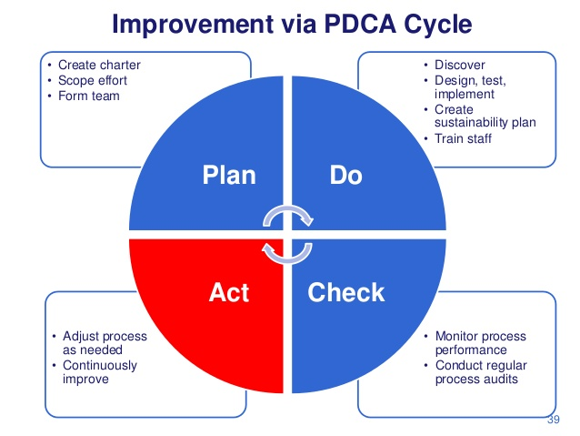
The Shewhart/Deming cycle of PDCA is generally used.

Slide 32
PDCA (Plan, Do, Check, and Act):
  Plan means to take the process improvement from the S phase of FOCUS and create a plan for its implementation.
  Do, not surprisingly, means to actually implement the process improvement.
  Check means to study whether the process is improving, using the measures identified and measured in the U phase of FOCUS.
  Act means to determine whether the process improvement was successful.

Slide 33
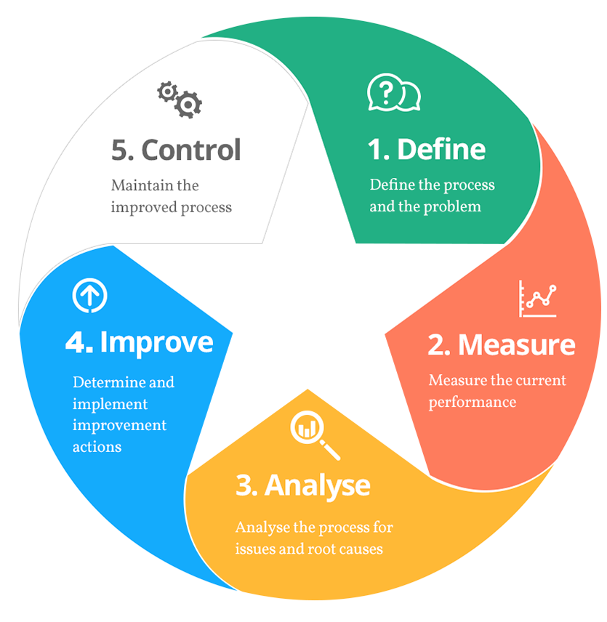
Six Sigma
Six Sigma employs
a structured process
called DMAIC
(Define, Measure,
Analyze, Improve,
and Control):

Slide 34
Define includes understand the scope of work, determining due dates, and mapping the future state of the process, including improvements.
Measure encompasses both the creation of measures or metrics and their application to determine how well a process is performing.
Analyze further breaks down the understanding of the process and often includes flowcharting the process.
Improve specifies the steps that will be taken to meet the goals outlined during the define step.
Control is about ensuring that the improvements are permanent rather than temporary.

Slide 35

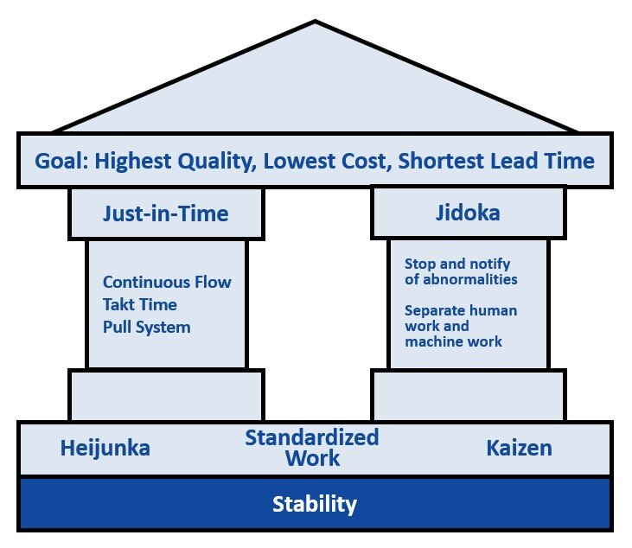
Toyota production way
Lean
Lean: features both strategic (culture) and tactical elements.
What distinguishes Lean from other systems are its rigorous definition of value and its relentless pursuit of the elimination of non–value added activities (waste) in a process.

Slide 37
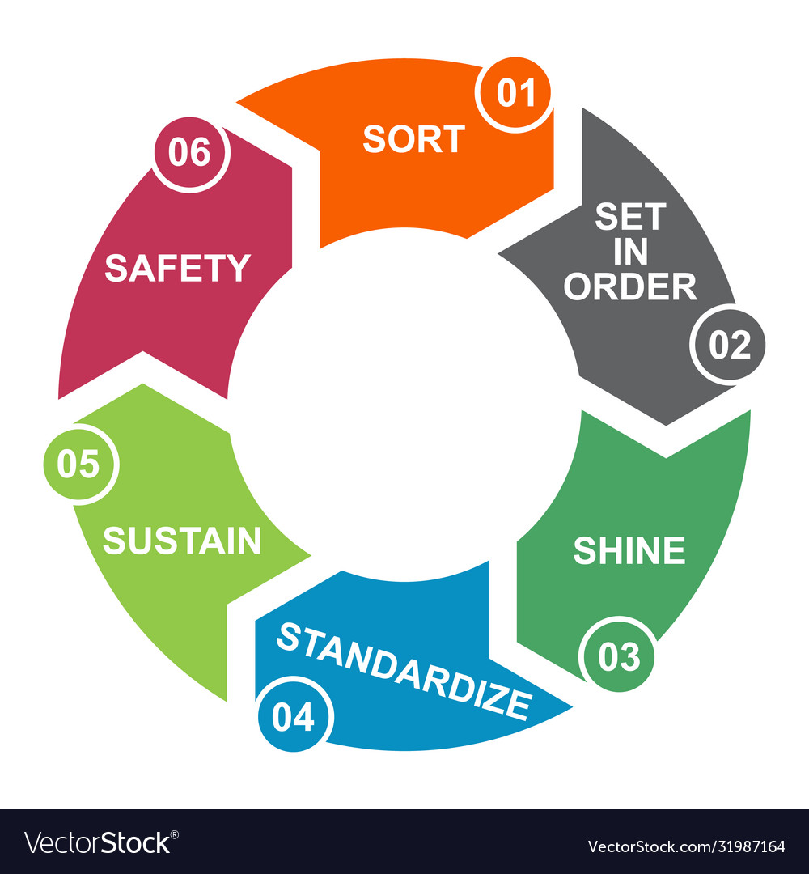
Lean 5 S
Sort: what needs to be present and what can be removed.
Set in order: what's what.
Shine: involves performing regular maintenance or check-ups.
Standardize: systematizes everything that just happened and turns one-time efforts into habits.
Sustain: refers to the process of keeping 5S running smoothly.
Safety: step involves focusing on what can be done to eliminate risks in work processes.

Slide 38
Waste (non-valued added activity) defined as :
Over-production can be defined as production that is in excess, early, and faster than is needed. In health care, this can be seen in the overuse of certain treatment or diagnostic tests.
Motion is wasted when patients, inventory, and personnel move inefficiently around a facility.
Over-processing results when the product provided to the customer is complex or confusing. For example, both hospitals and physicians bill for services that are presented to the patient and insurer at different times.
Defects include medical mistakes and delays in treatment (waiting).
Underutilization of staff is defined as not using staff time efficiently. Such inefficiency often means failing to use staff knowledge, skills, and abilities in an optimal fashion.

Slide 39
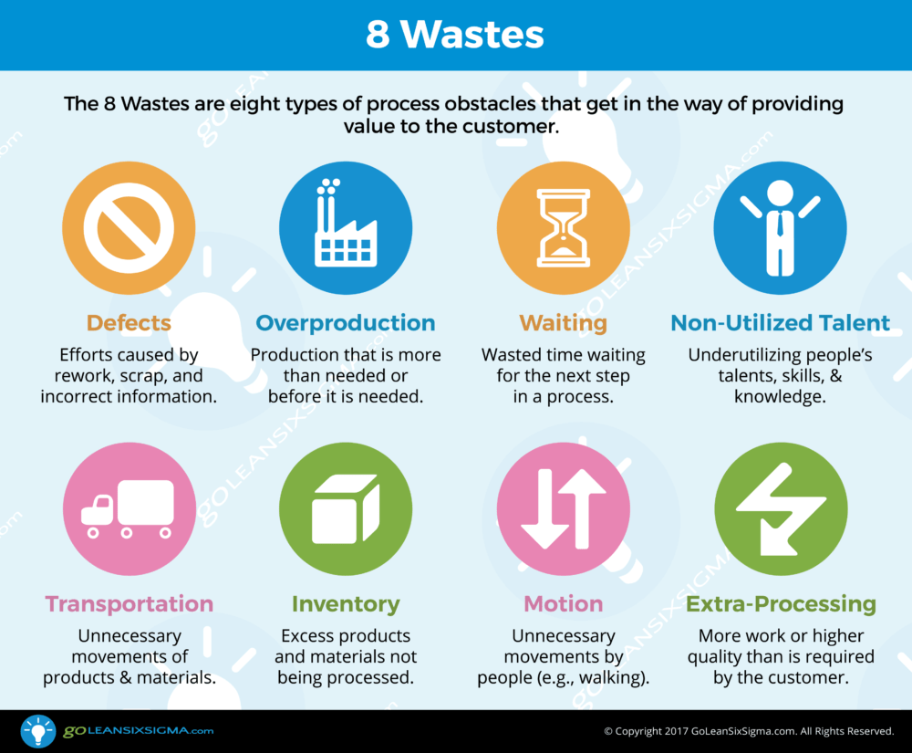

Slide 40
QUALITY IMPROVEMENT TOOLS
Mapping Processes
Data Collection
Analyzing process
Videos: https://www.youtube.com/watch?v=IFPF0TIFG-4

Slide 41
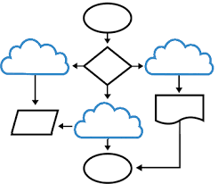
Mapping Processes
Flowchart aka Process Mapping Visual representation of the steps in a process using geometric shapes to denote steps, information flows, and decision points.

Slide 42
Developing a flowchart requires not only substantial investigation (e.g., asking front-line staff and professionals how work is carried out), but also direct observation of each aspect of the process to be flowcharted.
A top-down flowchart is often used for providing an overview of large or complex processes.

Slide 43
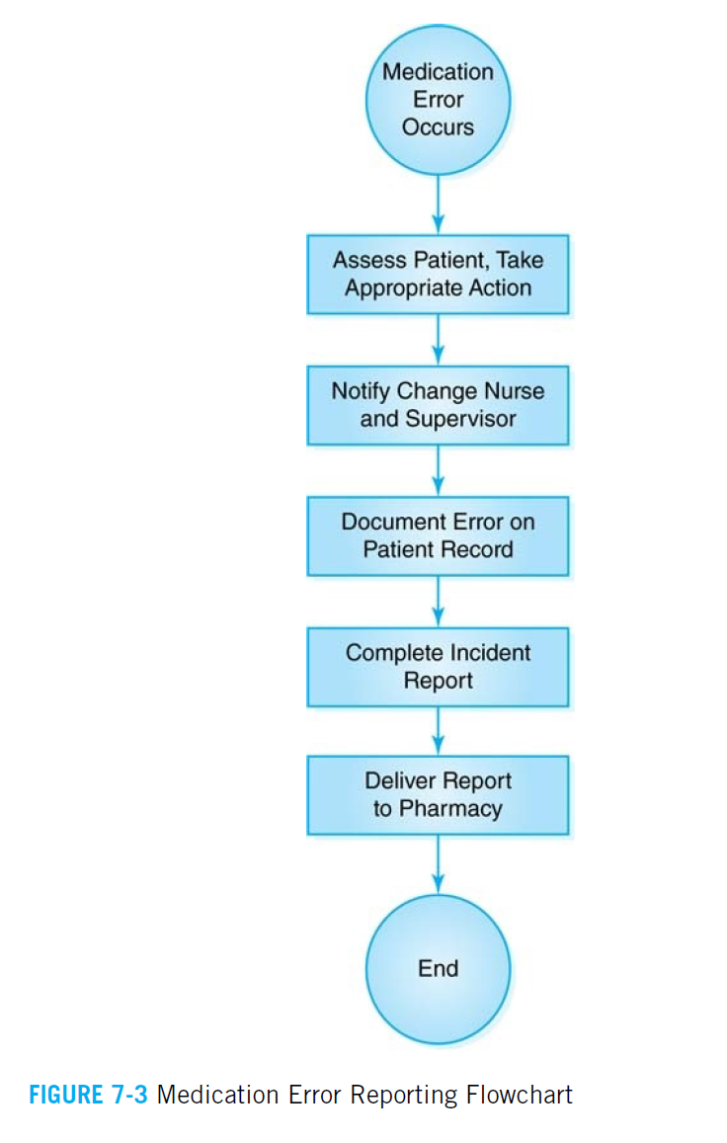

Slide 44
Workflow diagram A combination of geographic and process mapping showing the movements of people, materials, documents, or information in a process.
Value Stream Mapping is used to identify the seven types of waste or non–value added activities discussed in Lean.

Slide 45
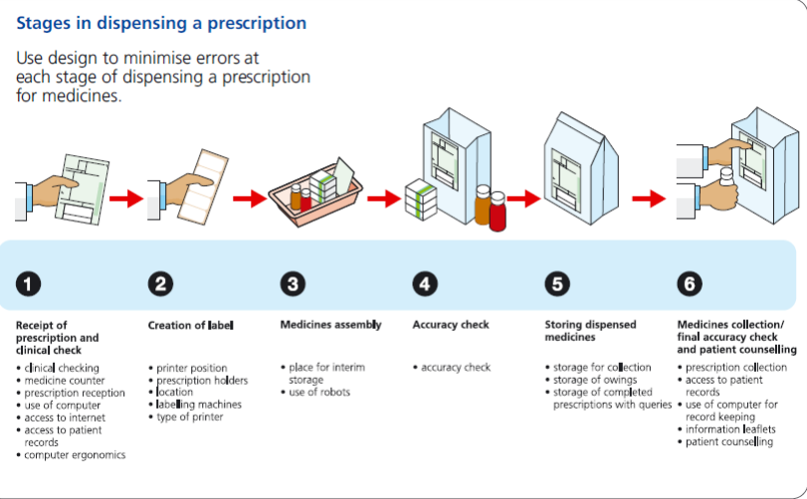

Slide 46
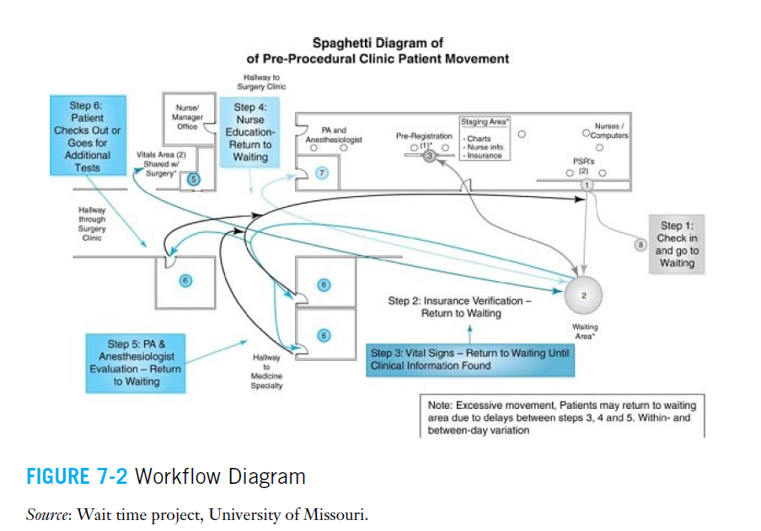

Slide 47
Data Collection
Check sheet A simple data collection form in which occurrence of some event or behavior is tallied (calculated).
The best check sheets are those that are simple and have well-defined categories of what constitutes a particular event or behavior.

Slide 48
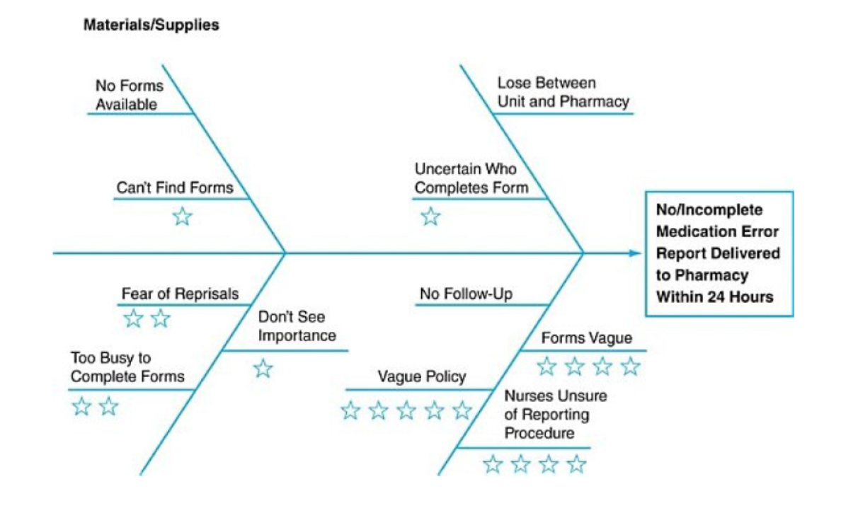
Analyzing Processes
The cause-and-effect diagram helps to identify and organize the possible cause for a problem in a structured format. Also called fishbone diagram or Ishikawa diagram.

Slide 49
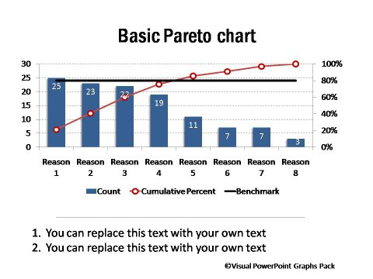
Pareto chart Frequency chart used to identify the frequency of occurrence of process problems.

Slide 50
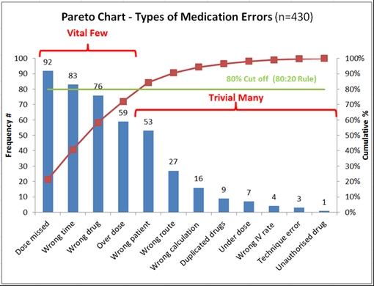
Pareto principle The economic concept that important quality problems that are attributable to a small number of factors (e.g., the 80/20 rule, that 80% of quality problems result from 20% of the possible factors).

Slide 51
Quality improvement has its greatest impact if it becomes a part of the strategic mission of a health care organization.

