Slide 1
Concentration and dilution of urine

Slide 2
Body fluid osmolarity is maintained at a value of about 290 mOsm/L (for simplicity, 300 mOsm/L) by processes called osmoregulation.
Control of water balance is exerted by hormones at the level of the late distal tubule and collecting duct.

Slide 3
Regulation of plasma osmolarity
Is accomplished by varying the amount of water excreted relative to the amount of solute excreted (i.e., by varying urine osmolarity).
1. Response to water deprivation
2. Response to water intake

Slide 5
Corticopapillary osmotic gradient
It is a gradient of osmolarity in the interstitial fluid of the kidney from the cortex to the papilla.
The osmolarity of the cortex is approximately 300 mOsm/L, similar to the osmolarity of other body fluids. Moving from the cortex to the outer medulla, inner medulla, and papilla, the interstitial fluid osmolarity progressively increases. At the tip of the papilla, the osmolarity can be as high as 1200 mOsm/L.

Slide 6
Corticopapillary osmotic gradient in the renal medulla (values are in mOsm)

Slide 7
Corticopapillary osmotic gradient
Corticopapillary osmotic gradient is established by:
countercurrent multiplication
a function of the loop of Henle
urea recycling
a function of the inner medullary collecting ducts,

Slide 8
Counter-current multiplication

Slide 9
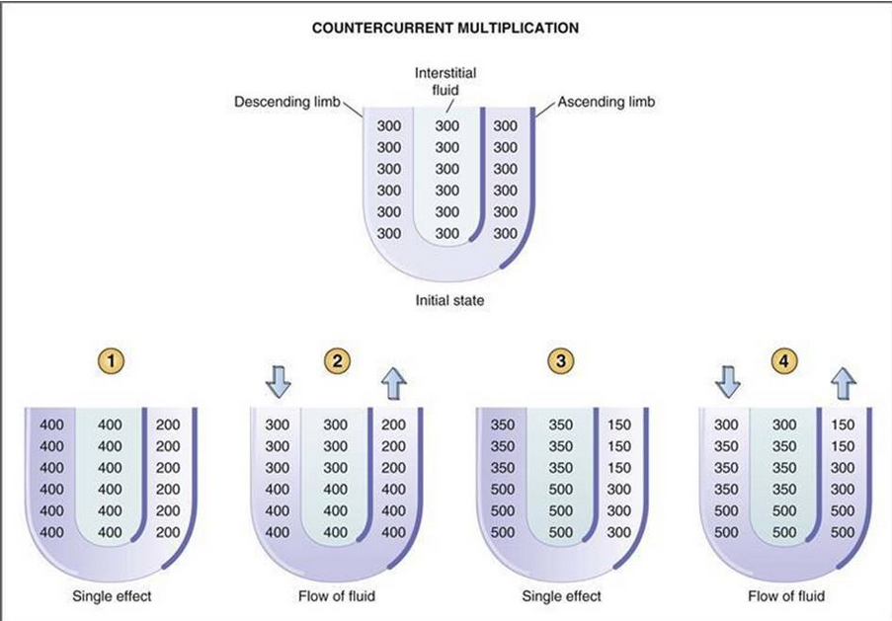

Slide 10
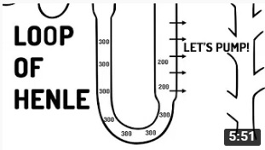
https://www.youtube.com/watch?v=cYyJF_aSC6o
“Loop of Henle explained!!”

Slide 11
Urea recycling

Slide 12
Vasa recta
The vasa recta are capillaries that serve the medulla and papilla of the kidney.
The vasa recta participate in countercurrent exchange.
Countercurrent exchange is a purely passive process that helps maintain the gradient.

Slide 13
Antidiuretic hormone (ADH)
ADH has three actions on the renal tubule:
It increases the water permeability of the principal cells of the late distal tubule and collecting ducts.
It increases the activity of the Na⁺-K⁺-2Cl⁻ cotransporter of the thick ascending limb, thereby enhancing countercurrent multiplication and the size of the corticopapillary osmotic gradient.
It increases urea permeability in the inner medullary collecting ducts, enhancing urea recycling and the size of the corticopapillary osmotic gradient.

Slide 14
In the absence of ADH, the principal cells are impermeable to water.
In the presence of ADH, water channels, or aquaporins, are inserted in the luminal membrane of the principal cells, making them permeable to water.

Slide 15
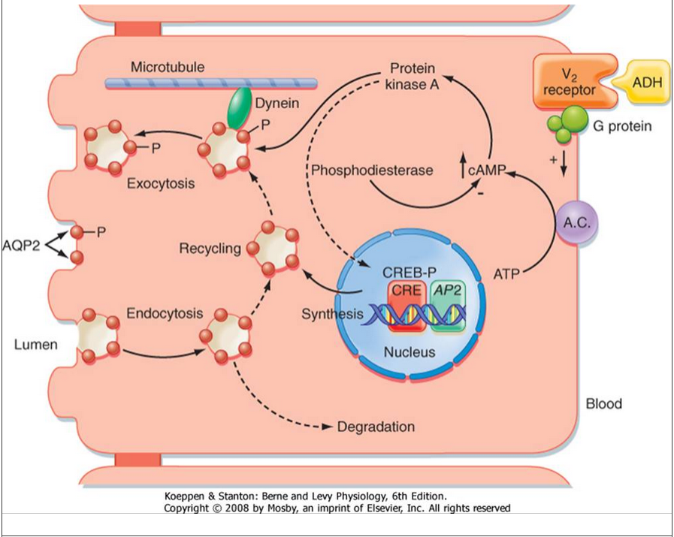
A.C., adenylyl cyclase; AP2, aquaporin-2 gene; AQP2, aquaporin-2; CRE, cAMP response element; CREB-P, phosphorylated cAMP response element-binding protein; -P, phosphorylated proteins.

Slide 16
Production of concentrated urine
Is also called hyperosmotic urine, in which urine osmolarity > blood osmolarity.
Is produced when circulating ADH levels are high (e.g., water deprivation, volume depletion, SIADH).

Slide 17
Production of concentrated urine
80
600
600
400
600
900
900
700
900
900
1000
1200
1200

Slide 18
Proximal tubule – high ADH
The osmolarity of the glomerular filtrate is identical to that of plasma (300 mOsm/L).
Two-thirds of the filtered H2O is reabsorbed isosmotically (with Na⁺, Cl⁻, HCO3⁻, glucose, amino acids, and so forth) in the proximal tubule.
TF/P_{osm} = 1.0 throughout the proximal tubule because H2O is reabsorbed isosmotically with solute.

Slide 19
Thick ascending limb of the loop of Henle—high ADH
Is called the diluting segment.
Reabsorbs NaCl by the Na⁺–K⁺–2Cl⁻ cotransporter.
Is impermeable to H₂O. Therefore, H₂O is not reabsorbed with NaCl, and the tubular fluid becomes dilute.
The fluid that leaves the thick ascending limb has an osmolarity of 100 mOsm/L and TF/P_{osm} < 1.0 as a result of the dilution process.

Slide 20
Early distal tubule - ADH
Is called the cortical diluting segment.
Like the thick ascending limb, the early distal tubule reabsorbs NaCl but is impermeable to water. Consequently, tubular fluid is further diluted.

Slide 21
Late distal tubule – high ADH
ADH increases the H₂O permeability of the principal cells of the late distal tubule.
H₂O is reabsorbed from the tubule until the osmolarity of distal tubular fluid equals that of the surrounding interstitial fluid in the renal cortex (300 mOsm/L).
TF/P_{osm} = 1.0 at the end of the distal tubule because osmotic equilibration occurs in the presence of ADH.

Slide 22
Collecting ducts - high ADH
As in the late distal tubule, ADH increases the H₂O permeability of the principal cells of the collecting ducts.
As tubular fluid flows through the collecting ducts, it passes through the corticopapillary gradient (regions of increasingly higher osmolarity), which was previously established by countercurrent multiplication and urea recycling.

Slide 23
Collecting ducts - high ADH
H₂O is reabsorbed from the collecting ducts until the osmolarity of tubular fluid equals that of the surrounding interstitial fluid.
The osmolarity of the final urine equals that at the bend of the loop of Henle and the tip of the papilla (1200 mOsm/L).
TF/P_{osm} > 1.0 because osmotic equilibration occurs with the corticopapillary gradient in the presence of ADH.

Slide 24
Production of dilute urine
Is called hyposmotic urine, in which urine osmolarity < blood osmolarity.
Is produced when circulating levels of ADH are low (e.g., water intake, central diabetes insipidus) or when ADH is ineffective (nephrogenic diabetes insipidus).

Slide 25
Production of dilute urine
110
450
450
450
70
600
600

Slide 26
1. Corticopapillary osmotic gradient - no ADH
Is smaller than in the presence of ADH because ADH stimulates both countercurrent multiplication and urea recycling.
2. Proximal tubule—no ADH
As in the presence of ADH, two-thirds of the filtered water is reabsorbed isosmotically.
TF/P_{osm} = 1.0 throughout the proximal tubule.

Slide 27
3. Thick ascending limb of the loop of Henle -no ADH
As in the presence of ADH, NaCl is reabsorbed without water, and the tubular fluid becomes dilute (although not quite as dilute as in the presence of ADH).
TF/P_{osm} < 1.0.
4. Early distal tubule—no ADH
As in the presence of ADH, NaCl is reabsorbed without H₂O and the tubular fluid is further diluted.
TF/P_{osm} < 1.0.

Slide 28
Late distal tubules and collecting ducts – no ADH
In the absence of ADH, the cells of the late distal tubule and collecting ducts are impermeable to H₂O.
Thus, even though the tubular fluid flows through the corticopapillary osmotic gradient, osmotic equilibration does not occur.
The osmolarity of the final urine will be dilute with an osmolarity as low as 50 mOsm/L.
TF/P_{osm} < 1.0.

Slide 29
Free-water clearance (C_{H2O})
Is used to estimate the ability to concentrate or dilute the urine.
Free water, or solute-free water, is produced in the diluting segments of the kidney (i.e., thick ascending limb and early distal tubule), where NaCl is reabsorbed and free water is left behind in the tubular fluid.

Slide 30
In the absence of ADH, this solute-free water is excreted and C_{H2O} is positive.
In the presence of ADH, this solute-free water is not excreted but is reabsorbed by the late distal tubule and collecting ducts and C_{H2O} is negative.

Slide 31
Calculation of C_{H2O}

Slide 32
Urine that is isosmotic to plasma (isosthenuric)
C_{H2O} is zero.
is produced during treatment with a loop diuretics, for example.
Urine that is hyposmotic to plasma (low ADH)
C_{H2O} is positive.
is produced with high water intake, central diabetes insipidus, or nephrogenic diabetes insipidus.
Urine that is hyperosmotic to plasma (high ADH)
C_{H2O} is negative.
is produced in water deprivation or SIADH.

