Slide 1
Renal regulation of K, Ca, Mg and PO₄

Slide 2
Renal regulation of potassium

Slide 3
K⁺ balance
Most of the body’s K⁺ (98%) is located in the ICF.
ICF K⁺ concentration (150 mEq/L) is much higher than the ECF concentration (4.5 mEq/L).
This large concentration gradient for K⁺ is maintained by the Na⁺-K⁺ ATPase that is present in all cell membranes.

Slide 4
A small shift of K⁺ into or out of the cells can produce a large change in the ECF K⁺ concentration.
The distribution of K⁺ across cell membranes is called internal K⁺ balance.
A shift of K⁺ out of cells causes hyperkalemia.
A shift of K⁺ into cells causes hypokalemia.

Slide 5
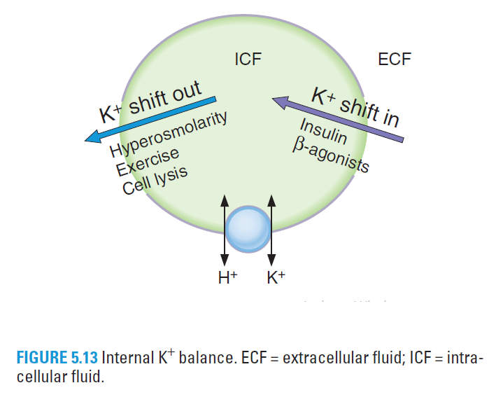
Internal K⁺ balance

Slide 6
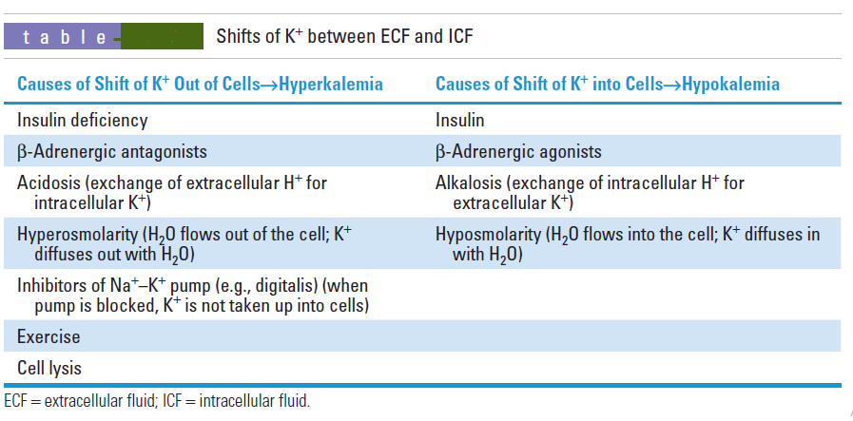

Slide 7
Dietary K⁺ intake in humans is highly variable.
To maintain K⁺ balance, urinary excretion of K⁺ must be equal to K⁺ intake.
Thus on a daily basis, urinary excretion of K⁺ must be capable of varying from 50 to 150 mEq/day.
The renal mechanisms that allow for this variability are called external K⁺ balance.

Slide 8
Renal regulation of K⁺ balance
K⁺ is filtered, reabsorbed, and secreted by the nephron.
K⁺ balance is achieved when urinary excretion of K⁺ exactly equals intake of K⁺ in the diet.
K⁺ excretion can vary widely from 1% to 110% of the filtered load, depending on dietary K⁺ intake, aldosterone levels, and acid - base status.

Slide 9
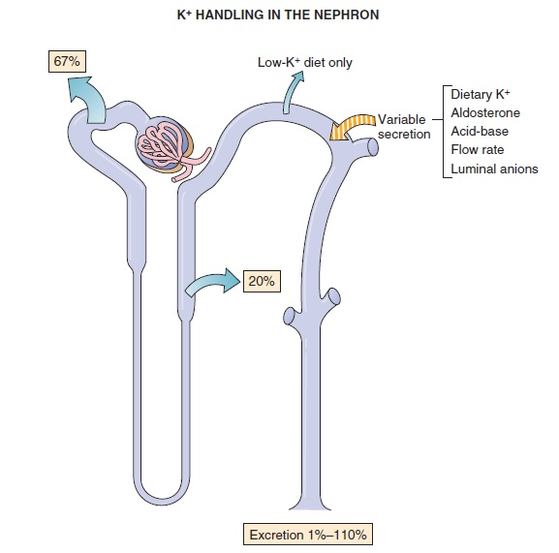
Free filtration
Isosmotic reabsorption
*
* Reabsorption or secretion (as needed)

Slide 10
1. Glomerular capillaries
Filtration occurs freely across the glomerular capillaries.
TF/P_{K+} in Bowman space is 1.0.
2. Proximal tubule
Reabsorbs 67% of the filtered K⁺ along with Na⁺ and H₂O (as a part of the isosmotic fluid reabsorption).

Slide 11
Thick ascending limb of the loop of Henle
Reabsorbs 20% of the filtered K⁺.
K⁺ enters the cells of the thick ascending limb via the Na⁺-K⁺-2Cl⁻ cotransporter and then leaves the cell along either of two possible routes:
K⁺ may diffuse across the basolateral membrane through K⁺ channels, to be reabsorbed, or
K⁺ may diffuse back into the lumen, which does not result in reabsorption.

Slide 12
Distal tubule and collecting duct
Either reabsorb or secrete K⁺, depending on dietary K⁺ intake.
Reabsorption of K⁺
involves an H⁺, K⁺-ATPase in the luminal membrane of the α-intercalated cells (primary active transport).
Occurs only on a low-K⁺ diet (K⁺ depletion). Under these conditions, K⁺ excretion can be as low as 1% of the filtered load because the kidney conserves as much K⁺ as possible.

Slide 13
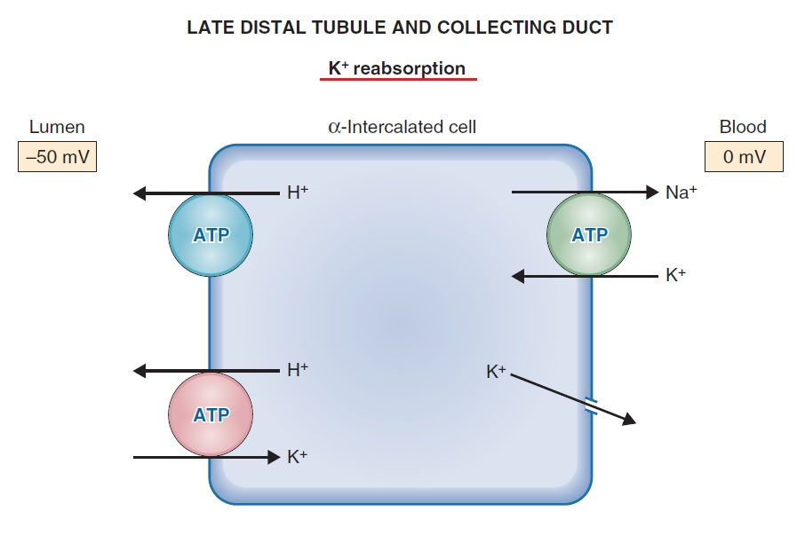

Slide 14
4. Distal tubule and collecting duct
Secretion of K⁺
occurs in the principal cells.
is variable and accounts for the wide range of urinary K⁺ excretion.
depends on factors such as dietary K⁺, aldosterone levels, acid-base status, and urine flow rate.

Slide 15
Mechanism of distal K⁺ secretion
At the basolateral membrane of the principal cell, K⁺ is actively transported into the cell by the Na⁺–K⁺ pump → As in all cells, this mechanism maintains a high intracellular K⁺ concentration.
At the luminal membrane, K⁺ is passively secreted into the lumen through K⁺ channels.
The magnitude of this passive secretion is determined by the chemical and electrical driving forces on K⁺ across the luminal membrane.

Slide 16
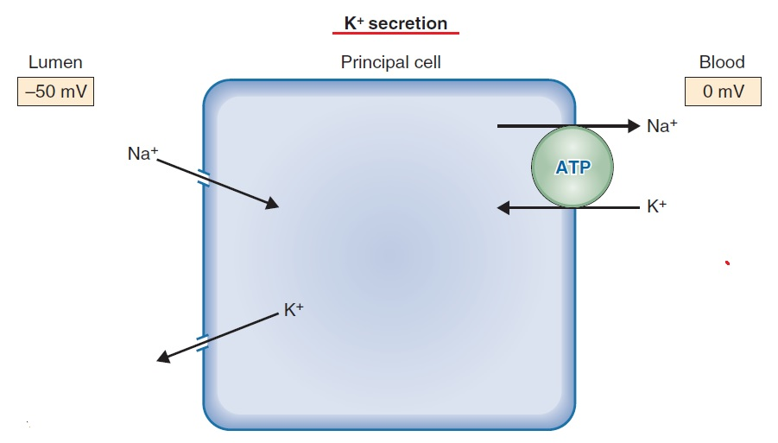
LATE DISTAL TUBULE AND COLLECTING DUCT

Slide 17
Factors that change K⁺ secretion
Distal K⁺ secretion by the principal cells is increased when the electrochemical driving force for K⁺ across the luminal membrane is increased. Secretion is decreased when the electrochemical driving force is decreased.

Slide 18
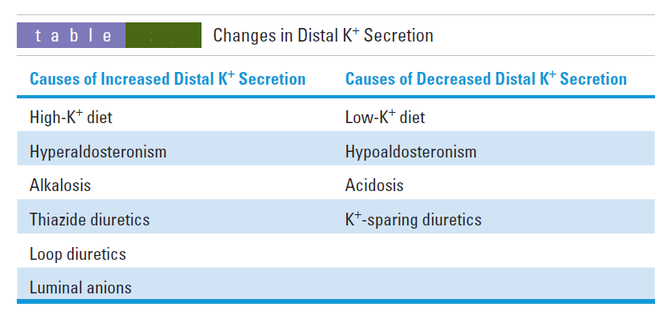
Factors that change distal K⁺ secretion

Slide 19
1. Dietary K⁺
A diet high in K⁺ increases K⁺ secretion, and a diet low in K⁺ decreases K⁺ secretion.
On a high-K⁺ diet, intracellular K⁺ increases (including principal cells), so that the driving force for K⁺ secretion also increases.
On a low-K⁺ diet, intracellular K⁺ decreases so that the driving force for K⁺ secretion decreases. Also, the α-intercalated cells are stimulated to reabsorb K⁺ by the H⁺, K⁺-ATPase.

Slide 20
2. Aldosterone
Increases K⁺ secretion.
Aldosterone:
Induces the synthesis of luminal membrane Na⁺ channels → increased Na⁺ entry into the cells across the luminal membrane → more Na⁺ available for the Na⁺-K⁺ ATPase → more Na⁺ is pumped out → more K⁺ is pumped into the cell.
Increases the quantity of Na⁺–K⁺ pumps → increases K⁺ uptake into the principal cells.
increase the intracellular K⁺ concentration and the driving force for K⁺ secretion.

Slide 21
2. Aldosterone
Aldosterone also increases the number of luminal membrane K⁺ channels.
Hyperaldosteronism increases K⁺ secretion and causes hypokalemia.
Hypoaldosteronism decreases K⁺ secretion and causes hyperkalemia.

Slide 22
3. Acid-base
Effectively, H⁺ and K⁺ exchange for each other across the basolateral cell membrane of the principal cells.
Alkalosis increases K⁺ secretion. The blood contains too little H⁺, therefore, H⁺ leaves the cell across the basolateral membrane and K⁺ enters the cell to maintain electroneutrality → the intracellular K⁺ concentration and the driving force for K⁺ secretion increase.
Acidosis decreases K⁺ secretion. The blood contains excess H⁺ →H⁺ enters the cell across the basolateral membrane and K⁺ leaves the cell to maintain electroneutrality → the intracellular K⁺ concentration and the driving force for K⁺ secretion decrease.

Slide 23
4. Thiazide and loop diuretics
Increase K⁺ secretion.
Diuretics that increase flow rate through the distal tubule and collecting ducts (e.g., thiazide diuretics, loop diuretics) cause dilution of the luminal K⁺ concentration, increasing the driving force for K⁺ secretion. Also, as a result of increased K⁺ secretion, these diuretics cause hypokalemia.

Slide 24
5. K⁺-sparing diuretics
Decrease K⁺ secretion.
Spironolactone is an antagonist of aldosterone; triamterene and amiloride act directly on the principal cells.
The most important use of the K⁺-sparing diuretics is in combination with thiazide or loop diuretics to offset (reduce) urinary K⁺ losses.
If used alone, they cause hyperkalemia.

Slide 25
6. Luminal anions
Excess anions (e.g., HCO3⁻) in the lumen cause an increase in K⁺ secretion by increasing the electronegativity of the lumen and increasing the driving force for K⁺ secretion.

Slide 26
Renal regulation of phosphate

Slide 27
85% of the filtered phosphate is reabsorbed in the proximal tubule by a Na⁺-phosphate cotransporter in the luminal membrane → saturable and has a T_{m}.
Because distal segments of the nephron do not reabsorb phosphate,15% of the filtered load is excreted in urine.

Slide 28
Parathyroid hormone (PTH) inhibits phosphate reabsorption.
PTH binds to a basolateral receptor in the proximal tubule → activates adenylate cyclase → ↑cAMP → series of PKs activated → inhibition Na⁺–phosphate cotransport
→PTH causes phosphaturia and increased urinary cAMP.
Excreted phosphate is a urinary buffer for H⁺ → called titratable acid.

Slide 29
Renal regulation of calcium

Slide 30
Sixty percent of the plasma Ca²⁺ is filtered across the glomerular capillaries
In proximal tubules, 67% of Ca²⁺ is passively reabsorbed → Ca²⁺ reabsorption is tightly coupled to Na⁺ reabsorption.

Slide 31
The thick ascending limb reabsorbs 25% of the filtered Ca²⁺.
This occurs along a paracellular route and is tightly coupled to Na⁺ reabsorption → depends on the lumen-positive potential difference, which is generated by the Na⁺-K⁺-2Cl⁻ cotransporter.
This lumen-positive potential normally drives the reabsorption of divalent cations such as Ca²⁺, as positive charge repels positive charge.
Loop diuretics (e.g., furosemide) cause increased urinary Ca²⁺ excretion.

Slide 32
Together, the distal tubule and collecting duct reabsorb 8% of the filtered Ca²⁺ by an active process and not in relation with Na⁺ reabsorption.
PTH increases Ca²⁺ reabsorption via a basolateral receptor , activation of adenylate cyclase and generation of cAMP.
Thiazide diuretics increase Ca²⁺ reabsorption in the early distal tubule and therefore decrease Ca²⁺ excretion (while they inhibit Na⁺ reabsorption).

Slide 33
Magnesium (Mg²⁺)
Is reabsorbed in the proximal tubule, thick ascending limb of the loop of Henle, and distal tubule (95%).
In the thick ascending limb (the major site for Mg²⁺ reabsorption), Mg²⁺ and Ca²⁺ compete for reabsorption; therefore,
hypercalcemia causes an increase in Mg²⁺ excretion (by inhibiting Mg²⁺ reabsorption).
hypermagnesemia causes an increase in Ca²⁺ excretion (by inhibiting Ca²⁺ reabsorption).

