Slide 1
Renal regulation of sodium and chloride

Slide 2
The formation of urine involves three basic processes:
(1) ultrafiltration of plasma by the glomerulus,
(2) reabsorption of water and solutes from the ultrafiltrate, and
(3) secretion of selected solutes into tubular fluid.
Although an average of 115 to 180 L/day in women and 130 to 200 L/day in men of essentially protein-free fluid is filtered by the human glomeruli each day,* less than 1% of the filtered water and sodium chloride (NaCl) and variable amounts of other solutes are excreted in urine
Reabsorption of NaCl and water represents the major function of nephrons. Approximately 25,000 mEq/day of Na+ and 179 L/day of water are reabsorbed by the renal tubules

Slide 3
Single nephron terminology
Tubular fluid (TF) is urine at any point along the nephron.
Plasma (P) is systemic plasma. It is considered to be constant.
TF/P_{x} ratio
compares the concentration of a substance in tubular fluid at any point along the nephron with the concentration in plasma.

Slide 4
If TF/P = 1.0, then either there has been no reabsorption of the substance or reabsorption of the substance has been exactly proportional to the reabsorption of water.
For example, if TF/P_{Na+} = 1.0, the [Na⁺] in tubular fluid is identical to the [Na⁺] in plasma.
For any freely filtered substance, TF/P = 1.0 in Bowman space (before any reabsorption or secretion has taken place to modify the tubular fluid).

Slide 5
If TF/P < 1.0, then reabsorption of the substance has been greater than the reabsorption of water and the concentration in tubular fluid is less than that in plasma.
For example, if TF/P_{Na+} = 0.8, then the [Na⁺] in tubular fluid is 80% of the [Na⁺] in plasma.

Slide 6
If TF/P > 1.0, then either reabsorption of the substance has been less than the reabsorption of water or there has been secretion of the substance.

Slide 7
TF/P_{inulin}
is used as a marker for water reabsorption along the nephron.
increases as water is reabsorbed.
Inulin is freely filtered, but not reabsorbed or secreted.
For example, if 50% of the filtered water has been reabsorbed, the TF/P_{inulin} = 2.0. For another example, if TF/P_{inulin} = 3.0, then 67% of the filtered water has been reabsorbed (i.e., 1 − 1/3).

Slide 8
[TF/P]_{x}/[TF/P]_{inulin} ratio
This double ratio gives the fraction of the filtered load remaining at any point along the nephron.
For example, if [TF/P]_{Na+}/[TF/P]_{inulin} = 0.3 at the end of the proximal tubule, then 30% of the filtered Na⁺ remains in the tubular fluid and 70% has been reabsorbed into the blood.

Slide 9
General information about Na⁺ reabsorption
Na⁺ is freely filtered across the glomerular capillaries; therefore, the [Na⁺] in the tubular fluid of Bowman space equals that in plasma (i.e., TF/P_{Na+} = 1.0).
Na⁺ is reabsorbed along the entire nephron, and very little is excreted in urine (<1% of the filtered load).

Slide 10
Sodium reabsorption along the nephron

Slide 11
Proximal tubules
Reabsorb two-thirds, or 67%, of the filtered Na⁺ and H₂O, more than any other part of the nephron.
Is the site of glomerulotubular balance (a mechanism for coupling reabsorption to the GFR).
The process is isosmotic. The reabsorption of Na⁺ and H₂O in the proximal tubule is exactly proportional.
Therefore, both TF/P_{Na+} and TF/P_{osm} = 1.0.

Slide 12
Early proximal tubules

Slide 13
Early proximal tubules
Reabsorb Na⁺ (and H₂O) with HCO₃⁻, glucose, amino acids, phosphate, and lactate.
Na⁺ is reabsorbed by cotransport with glucose, amino acids, phosphate, and lactate.
These cotransport processes account for the reabsorption of all of the filtered glucose and amino acids.
Na⁺ is also reabsorbed by countertransport via Na⁺–H⁺ exchange, which is linked directly to the reabsorption of filtered HCO3⁻.

Slide 14
Late proximal tubule
All of the filtered glucose and amino acids, and most of the filtered HCO3⁻ have already been completely removed from the tubular fluid by reabsorption in the early proximal tubule.
In the late proximal tubule, Cl⁻ concentration is high, because (1) HCO3⁻ has been preferentially reabsorbed in the early proximal tubule, and (2) water is isosmotically reabsorbed → the tubular fluid Cl⁻ concentration increases and becomes higher than the Cl⁻ concentration of the glomerular filtrate and of blood.

Slide 15
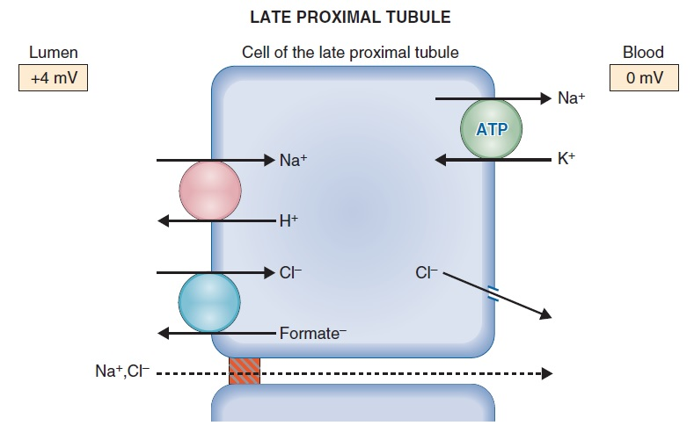
In the late proximal tubule, Na⁺ is reabsorbed with Cl⁻.

Slide 16
Isosmotic reabsorption
In the proximal tubule, solute and water reabsorption are coupled and are proportional to each other.
[TF/P]_{Na+} and [TF/P]_{osmolarity} = 1.0 along the entire proximal tubule.

Slide 17
Mechanism of isosmotic reabsorption
Solute reabsorption is the primary event, and water follows passively.

Slide 18
TF/P ratios along the proximal tubule

Slide 19
Glomerulotubular balance in the proximal tubule
Maintains constant fractional reabsorption (two-thirds, or 67%) of the filtered Na⁺ and H₂O.
If GFR increases →the filtered load of Na⁺ also increases.
Without a change in reabsorption, this increase in GFR would lead to increased Na⁺ excretion.
However, glomerulotubular balance functions such that Na⁺ reabsorption also will increase, ensuring that a constant fraction is reabsorbed.

Slide 20
Glomerulotubular balance in the proximal tubule
Fluid reabsorption is increased by increases in π_{c} of the peritubular capillary blood and decreased by decreases in π_{c}.
Increases in GFR and filtration fraction cause the protein concentration and π_{c} of peritubular capillary blood to increase → increase in fluid reabsorption.
Thus, there is matching of filtration and reabsorption, or glomerulotubular balance.

Slide 21
Effects of ECF volume on proximal tubular reabsorption
ECF volume contraction increases reabsorption. Volume contraction increases peritubular capillary protein concentration and π_{c}, and decreases peritubular capillary P_{c} → increase in proximal tubular reabsorption.
ECF volume expansion decreases reabsorption. Volume expansion decreases peritubular capillary protein concentration and π_{c}, and increases P_{c} →decrease in proximal tubular reabsorption.

Slide 22
2. Thin Descending Limb and Thin Ascending Limb
The thin descending limb is permeable to water and small solutes, such as NaCl and urea.
In countercurrent multiplication, water moves out of the thin descending limb, solutes move into the thin descending limb, and the tubular fluid becomes progressively hyperosmotic as it flows down the descending limb.
The thin ascending limb also is permeable to NaCl, but it is impermeable to water.
During countercurrent multiplication, solute moves out of the thin ascending limb without water and the tubular fluid becomes progressively hyposmotic as it flows up the ascending limb.

Slide 23
3. Thick ascending limb of the loop of Henle
Reabsorbs 25% of the filtered Na⁺.
Reabsorption mechanism is load dependent.
The more Na⁺ is delivered to the thick ascending tubule, the more it reabsorbs.
Contains a Na⁺–K⁺–2Cl⁻ cotransporter in the luminal membrane (active transport).

Slide 24
3. Thick ascending limb of the loop of Henle
It is impermeable to water → NaCl is reabsorbed without water.
tubular fluid [Na⁺] and tubular fluid osmolarity decrease to less than their concentrations in plasma (i.e., TF/P_{Na+} and TF/P_{osm} < 1.0) → diluting segment.
Has a lumen-positive potential difference. Although the Na⁺–K⁺–2Cl⁻ cotransporter appears to be electroneutral, some K⁺ diffuses back into the lumen, making the lumen electrically positive.

Slide 25
3. Thick ascending limb of the loop of Henle

Slide 26
4. Distal tubule and collecting duct
Together reabsorb 8% of the filtered Na⁺.
Reabsorption is load dependent.

Slide 27
4. Distal tubule and collecting duct
Early distal tubule
reabsorbs NaCl by a Na⁺–Cl⁻ cotransporter in the luminal membrane.
Is impermeable to water, as is the thick ascending limb. Thus, reabsorption of NaCl occurs without water, which further dilutes the tubular fluid.
Is called the cortical diluting segment.

Slide 28
Early distal tubule

Slide 29
4. Distal tubule and collecting duct
Late distal tubule and collecting duct
have two cell types:
Principal cells
α-Intercalated cells

Slide 30
Distal tubule and collecting duct
Principal cells
reabsorb Na⁺ and H₂O.
secrete K⁺.
Aldosterone increases Na⁺ reabsorption and increases K⁺ secretion.
About 2% of overall Na⁺ reabsorption is affected by aldosterone.
Antidiuretic hormone (ADH) increases H₂O permeability by directing the insertion of H₂O channels in the luminal membrane. In the absence of ADH, the principal cells are virtually impermeable to water.

Slide 31
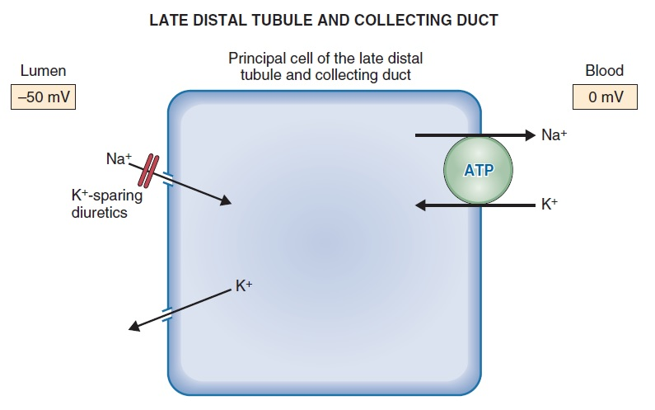
4. Distal tubule and collecting duct
Principal cells
Na⁺ diffuses down electrochemical gradient through
epithelial Na⁺ channels (ENaC)

Slide 32
α-Intercalated cells
secrete H⁺ by an H⁺-adenosine triphosphatase (ATPase), which is stimulated by aldosterone.
reabsorb K⁺ by an H⁺, K⁺-ATPase.

Slide 33
Regulation of Na⁺ balance
ANP, Atriopeptin; EABV, effective arterial blood volume; ECF, extracellular fluid; GFR, glomerular filtration rate; πc, peritubular capillary oncotic pressure.

Slide 34
Regulation of Na⁺ balance

Slide 35
