Slide 1
Tubular reabsorption and secretion

Slide 2
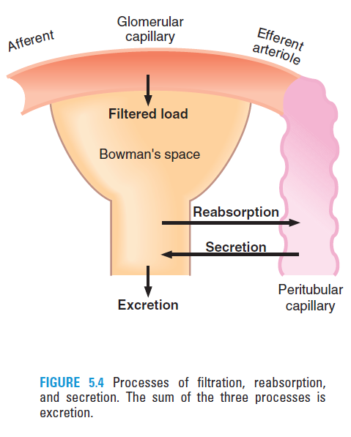
Reabsorption and secretion

Slide 3
Calculation of reabsorption and secretion
Filtered load is the amount of a substance filtered into Bowman’s space per unit time.
Filtered load = GFR x [plasma] x % unbound in plasma
Excretion rate is the amount of a substance excreted per unit time.
Excretion rate = V x [urine]
Reabsorption rate = Filtered load – Excretion rate
Secretion rate = Excretion rate – Filtered load

Slide 4
If the filtered load is greater than the excretion rate, then net reabsorption of the substance has occurred.
If the filtered load is less than the excretion rate, then net secretion of the substance has occurred.

Slide 5
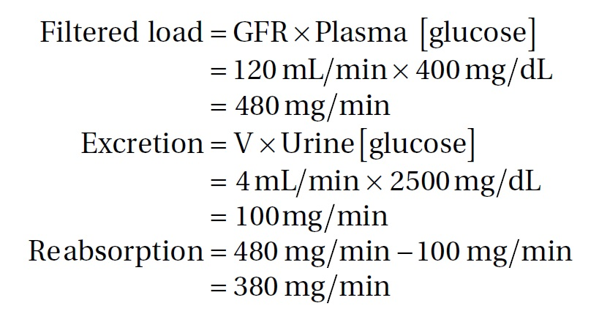
Example:
A woman with untreated diabetes mellitus has a GFR of 120 mL/min, a plasma glucose concentration of 400 mg/dL, a urine glucose concentration of 2500 mg/dL, and a urine flow rate of 4 mL/min.
What is the reabsorption rate of glucose?
Solution:

Slide 6
Reabsorption of glucose

Slide 7
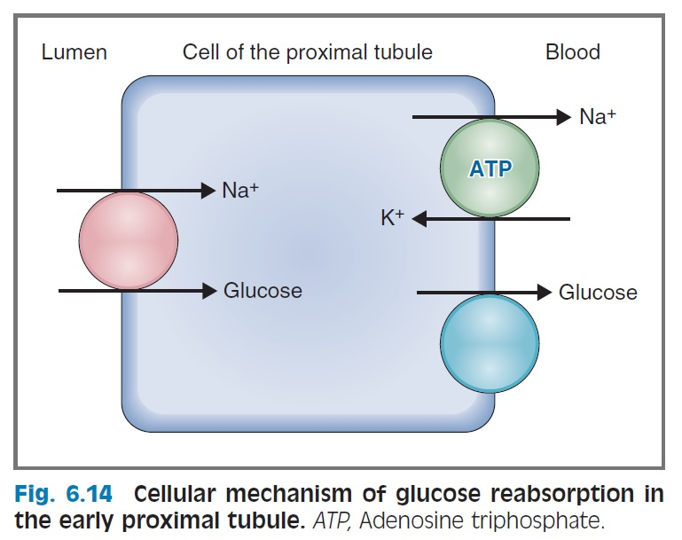
Cellular mechanism for glucose reabsorption
Gliflozin??
Resveratrol??
Luminal membrane
Basolateral membrane

Slide 8
Na⁺-K⁺ ATPase in the peritubular (basolateral) membrane produces a Na⁺ gradient (ECF [Na⁺] > ICF [Na⁺]).
Glucose moves from tubular fluid into the cell on the Na⁺-glucose cotransporter (called SGLT) in the luminal membrane.
Two Na⁺ ions and one glucose bind to the cotransport protein.
In this step, glucose is transported against an electrochemical gradient; the energy for this uphill transport of glucose comes from the downhill movement of Na⁺.
Because ATP is used directly to energize the Na⁺-K⁺ ATPase and indirectly to maintain the Na⁺ gradient, Na⁺-glucose cotransport is called secondary active transport.

Slide 9
Glucose is transported from the cell into peritubular capillary blood by facilitated diffusion.
In this step, glucose is moving down its electrochemical gradient and no energy is required. The proteins involved in facilitated diffusion of glucose are called GLUT1 and GLUT2.

Slide 10
Reabsorption of glucose
Filtered load of glucose
increases in direct proportion to the plasma glucose concentration.
(filtered load of glucose = GFR × [P]_{glucose}).

Slide 11
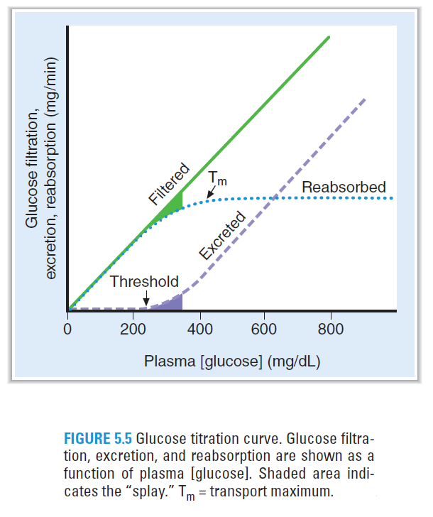
Reabsorption of glucose

Slide 12
Reabsorption of glucose
Na⁺–glucose cotransport in the proximal tubule reabsorbs glucose from tubular fluid into the blood. There are a limited number of Na⁺–glucose carriers.
At plasma glucose concentrations less than 200 mg/dL, all of the filtered glucose can be reabsorbed because plenty of carriers are available; in this range, the line for reabsorption is the same as that for filtration.
At plasma glucose concentrations greater than 350 mg/dL, the carriers are saturated. Therefore, increases in plasma concentration above 350 mg/dL do not result in increased rates of reabsorption. The reabsorptive rate at which the carriers are saturated is the Tm.

Slide 13
Excretion of glucose
At plasma concentrations less than 200 mg/dL, all of the filtered glucose is reabsorbed and excretion is zero. Threshold (defined as the plasma concentration at which glucose first appears in the urine) is approximately 200-250 mg/dL.
At plasma concentrations greater than 350 mg/dL, reabsorption is saturated (Tm). Therefore, as the plasma concentration increases, the additional filtered glucose cannot be reabsorbed and is excreted in the urine.

Slide 14
Splay
Is the region of the glucose curves between threshold and T_{m}.
Occurs between plasma glucose concentrations of approximately 250 and 350 mg/dL.
Represents the excretion of glucose in urine before saturation of reabsorption (T_{m}) is fully achieved.
It is explained by the heterogeneity of nephrons and the relatively low affinity of the Na⁺-glucose carriers.

Slide 15
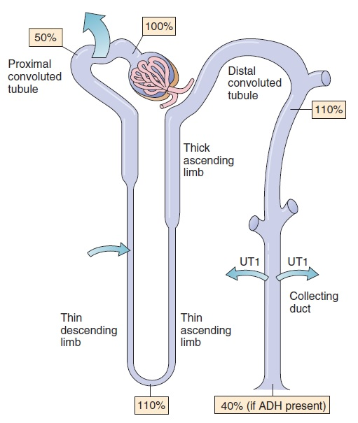
Urea – Example of passive reabsorption
reabsorption – simple diffusion
free filtration
tubular secretion –
Simple diffusion
reabsorption – facilitated diffusion
Reabsorption and secretion of urea depends on its concentration gradient between tubular fluid and peritubular blood.

Slide 16
Para-aminohippuric acid (PAH) – a secreted substance
Filtered load of PAH
As with glucose, the filtered load of PAH increases in direct proportion to the plasma PAH concentration.

Slide 17
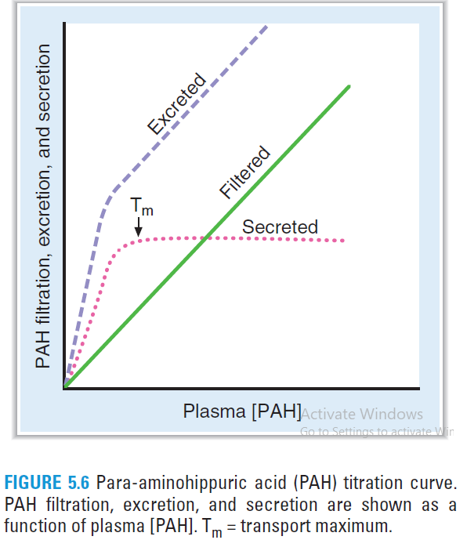
PAH – a secreted substance

Slide 18
Secretion of PAH
Secretion of PAH occurs from peritubular capillary blood into tubular fluid (urine) via carriers in the proximal tubule.
At low plasma concentrations of PAH, the secretion rate increases as the plasma concentration increases.
Once the carriers are saturated, further increases in plasma PAH concentration do not cause further increases in the secretion rate (T_{m}).

Slide 19
Excretion of PAH
Excretion of PAH is the sum of filtration across the glomerular capillaries plus secretion from peritubular capillary blood.
The curve for excretion is steepest at low plasma PAH concentrations (lower than at T_{m}). Once the T_{m} for secretion is exceeded and all of the carriers for secretion are saturated, the excretion curve flattens and becomes parallel to the curve for filtration.
RPF is measured by the clearance of PAH at plasma concentrations of PAH that are lower than at T_{m}.

Slide 20
Relative clearances of substances
Substances with the highest clearances
are those that are both filtered across the glomerular capillaries and secreted from the peritubular capillaries into urine (e.g., PAH).
Substances with the lowest clearances
are those that either are not filtered (e.g., protein) or are filtered and subsequently reabsorbed into peritubular capillary blood (e.g., Na⁺, glucose, amino acids, HCO3⁻, Cl⁻).

Slide 21
Relative clearances of substances
Substances with clearances equal to GFR
are glomerular markers.
are those that are freely filtered, but not reabsorbed or secreted (e.g., inulin).
Relative clearances
PAH > K⁺ (high-K⁺ diet) > inulin > urea > Na⁺ > glucose, amino acids, and HCO3⁻.

Slide 22
Nonionic diffusion

Slide 23
Weak acids
have an HA form and an A⁻ form.
The HA form, which is uncharged and lipid soluble, can “back-diffuse” from urine to blood.
The A⁻ form, which is charged and not lipid soluble, cannot back-diffuse.
At acidic urine pH, the HA form predominates, there is more back-diffusion, and there is decreased excretion of the weak acid.
At alkaline urine pH, the A⁻ form predominates, there is less back-diffusion, and there is increased excretion of the weak acid. For example, the excretion of salicylic acid (a weak acid) can be increased by alkalinizing the urine.

Slide 24
Weak bases
have a BH⁺ form and a B form.
The B form, which is uncharged and lipid soluble, can “back-diffuse” from urine to blood.
The BH⁺ form, which is charged and not lipid soluble, cannot back-diffuse.
At acidic urine pH, the BH⁺ form predominates, there is less back-diffusion, and there is increased excretion of the weak base. For example, the excretion of morphine (a weak base) can be increased by acidifying the urine.
At alkaline urine pH, the B form predominates, there is more back-diffusion, and there is decreased excretion of the weak base.

