Slide 1
Glomerular filtration

Slide 2
Body fluids
Total body water (TBW) is approximately 60% of body weight.
The percentage of TBW is highest in newborns and adult males and lowest in adult females and in adults with a large amount of adipose tissue.

Slide 3
Distribution of water

Slide 4
Distribution of water

Slide 5
Distribution of water
60-40-20 rule
TBW is 60% of body weight.
ICF is 40% of body weight.
ECF is 20% of body weight.

Slide 6
Shifts of water between compartments
Osmolarity is is the concentration of osmotically active particles.
Plasma osmolarity (P_{osm}) is estimated as:
where:
P_{osm} = plasma osmolarity (mOsm/L)
Na⁺ = plasma Na⁺ concentration (mEq/L)
Glucose = plasma glucose concentration (mg/dL)
BUN = blood urea nitrogen concentration (mg/dL)

Slide 7
At steady state, ECF osmolarity and ICF osmolarity are equal.
To achieve this equality, water shifts between the ECF and ICF compartments.
Solutes such as NaCl, NaHCO₃ and mannitol do not cross cell membranes readily and are assumed to be confined to ECF.

Slide 8
Examples of shifts of water between compartments

Slide 9
Examples of shifts of water between compartments

Slide 11
Renal Clearance, Renal Blood Flow (RBF) and Glomerular Filtration Rate (GFR)

Slide 12
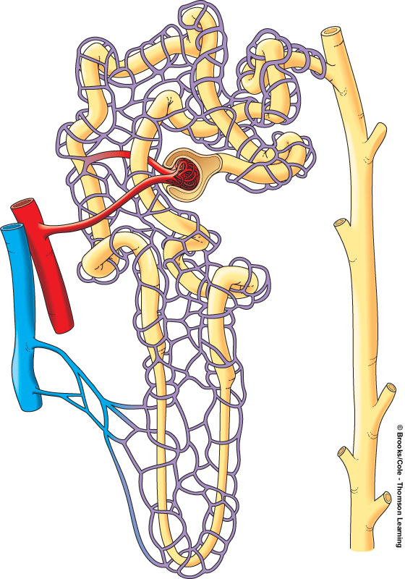
Proximal tubule
Distal
tubule
Juxtaglomerular
apparatus
Collecting
duct
Efferent
arteriole
Afferent
arteriole
Bowman’s
capsule
Glomerulus
Artery
Vein
Cortex
Medulla
Peritubular
capillaries
Loop of
Henle
To renal
pelvis

Slide 14
Three basic processes occur in the nephrons and they are:
glomerular filtration
tubular reabsorption
tubular secretion.

Slide 16
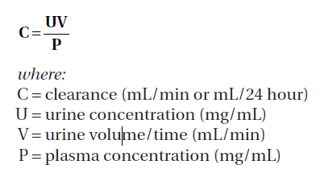
Renal clearance
Indicates the volume of plasma cleared of a substance per unit time.
The units of clearance are mL/min or mL/24 hour.

Slide 17
Renal blood flow (RBF)
Is 25% of the cardiac output.
Is directly proportional to the pressure difference between the renal artery and the renal vein, and is inversely proportional to the resistance of the renal vasculature.
The major mechanism for changing blood flow is by changing arteriolar resistance.
In the kidney, this can be accomplished by changing afferent arteriolar resistance and/or efferent arteriolar resistance.

Slide 18
Factors affecting RBF
Sympathetic nervous system and circulating catecholamines.
Both afferent and efferent arterioles are innervated by sympathetic nerve fibers that produce vasoconstriction by activating α₁ receptors.
However, because there are far more α₁ receptors on afferent arterioles, increased sympathetic nerve activity causes a decrease in both RBF and GFR.
Example: response to hemorrhage.

Slide 19
Angiotensin II
Angiotensin II is a potent vasoconstrictor of both afferent and efferent arterioles → increases resistance → decreases RBF.
However, efferent arterioles are more sensitive to angiotensin II than afferent arterioles, so:
low levels of angiotensin II produce an increase in GFR (by preferentially constricting efferent arterioles),
high levels of angiotensin II produce a decrease in GFR (by constricting both afferent and efferent arterioles).

Slide 20
Atrial natriuretic peptide (ANP)
ANP and related substances such as brain natriuretic peptide (BNP) cause dilation of afferent arterioles and constriction of efferent arterioles.
Dilatory effect of ANP on afferent arterioles is greater than the constrictor effect on efferent arterioles → overall decrease in renal vascular resistance → increase in RBF.
Dilation of afferent arterioles and constriction of efferent arterioles both lead to increased GFR.

Slide 21
Prostaglandins
Several prostaglandins (e.g., prostaglandin E₂ and prostaglandin I₂) are produced locally in the kidneys and cause vasodilation of both afferent and efferent arterioles.
The vasodilatory effects of prostaglandins are clearly protective for RBF.
Prostaglandins attenuate the vasoconstriction produced by the sympathetic nervous system and angiotensin II. Unopposed, this vasoconstriction can cause a profound reduction in RBF, resulting in renal failure.

Slide 22
Dopamine
Dopamine, a precursor of norepinephrine, has selective actions on arterioles in several vascular beds.
At low levels, dopamine dilates cerebral, cardiac, splanchnic, and renal arterioles, and it constricts skeletal muscle and cutaneous arterioles.
protective (vasodilatory) effect on blood flow in several critical organs including the kidneys.
Bradykinin and nitric oxide also causes vasodilation of renal arterioles.

Slide 23
Autoregulation of RBF
Is accomplished by changing renal vascular resistance. If arterial pressure changes, a proportional change occurs in renal vascular resistance to maintain a constant RBF.
RBF remains constant over the range of arterial pressures from 80 to 200 mm Hg (autoregulation).
Myogenic mechanisms: renal afferent arterioles contract in responce to stretch → ↑ resistance
Tubuloglomerular feedback: ↑ renal arterial pressure → ↑ fluid delivery to macula densa → constriction of the nearby afferent arteriole → resistance.

Slide 24
Measurement of RBF
Measurement of RBF depends on the measurement of clearance of para-aminohippuric acid (PAH) → filtered and secreted by renal tubules, but not reabsorbed → almost all of the PAH entering the kidney via the renal artery is excreted in urine.

Slide 25
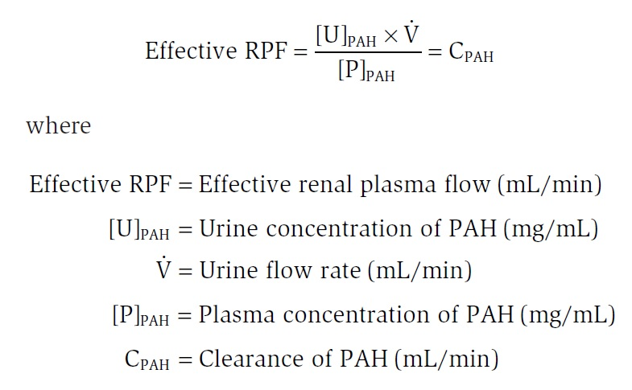
First, renal plasma flow (RPF) is calculated as follows:

Slide 26
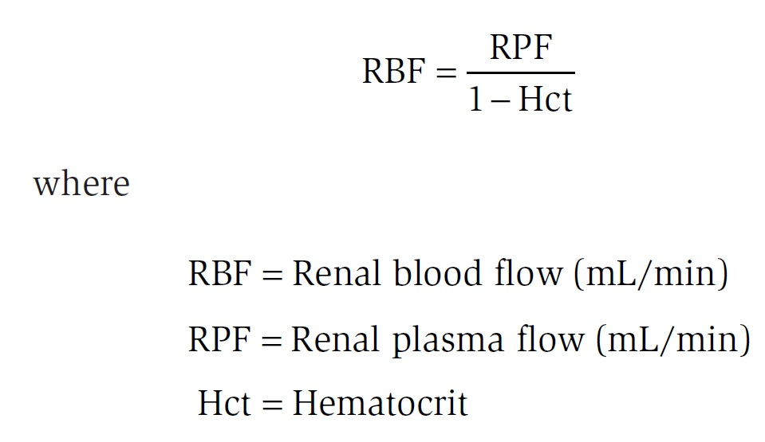
Then, RBF is calculated using the hematocrit (Hct) as follows:

Slide 27
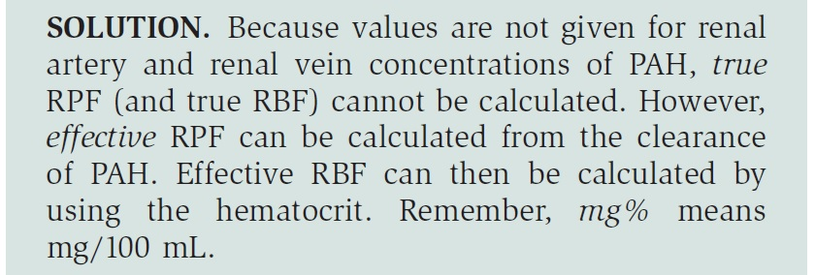

Slide 28
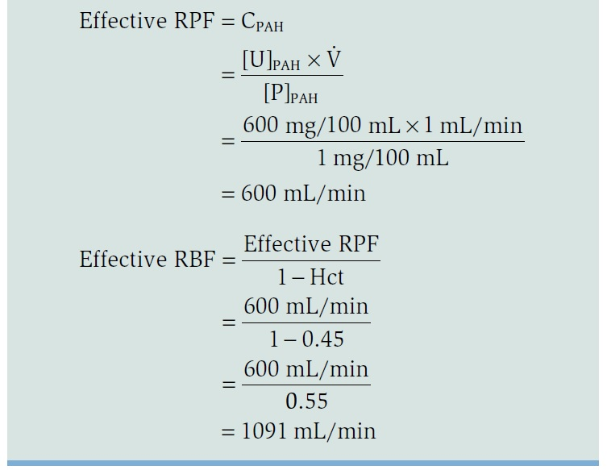

Slide 29
Glomerular filtration

Slide 30
Glomerular filtration is the first step in the formation of urine.
As the RBF enters the glomerular capillaries, a portion of that blood is filtered into Bowman’s space, the first part of the nephron. The fluid that is filtered is similar to interstitial fluid and is called an ultrafiltrate.
The ultrafiltrate contains water and all of the small solutes of blood, but it does not contain proteins and blood cells.

Slide 31
The glomerular barrier consists of
The capillary endothelium: large → fluid, dissolved solutes, and plasma proteins all are filtered across this layer, but not blood cells.
Basement membrane: multilayered →does not permit filtration of plasma proteins.
Epithelium: consists of podocytes → filtration slits → relatively small → barrier to filtration.
Normally, anionic glycoproteins line the filtration barrier and restrict the filtration of plasma proteins, which are also negatively charged.
In glomerular disease, the anionic charges on the barrier may be removed, resulting in proteinuria.

Slide 33
Negatively charged glycoproteins:
These fixed negative charges on the glomerular filtration barrier add an electrostatic component to filtration.
Positively charged solutes will be attracted to the negative charges on the barrier and be more readily filtered; negatively charged solutes will be repelled from the negative charges on the barrier and be less readily filtered.

Slide 34
Starling forces

Slide 35
The driving force for glomerular filtration is the net ultrafiltration pressure across the glomerular capillaries.
Filtration is always favored in glomerular capillaries because the net ultrafiltration pressure always favors the movement of fluid out of the capillary.

Slide 36
Starling equation
where:
K_{f} = the filtration coefficient of the glomerular capillaries

Slide 37
P_{GC} is glomerular capillary hydrostatic pressure, which is constant along the length of the capillary (45 mm Hg).
It is increased by dilation of the afferent arteriole or constriction of the efferent arteriole.
Increases in P_{GC} cause increases in net ultrafiltration pressure and GFR.

Slide 38
P_{BS} is Bowman space hydrostatic pressure. (10 mm Hg)
It is increased by constriction of the ureters.
Increases in P_{BS} cause decreases in net ultrafiltration pressure and GFR.

Slide 39
π_{GC} is glomerular capillary oncotic pressure. It normally increases along the length of the glomerular capillary because filtration of water increases the protein concentration of glomerular capillary blood.
It is increased by increases in protein concentration. Increases in π_{GC} cause decreases in net ultrafiltration pressure and GFR.
π_{BS} is Bowman space oncotic pressure. It is usually zero, and therefore ignored.

Slide 40
Problem
At the afferent arteriolar end of a glomerular capillary, P_{GC} is 45 mm Hg, P_{BS} is 10 mm Hg, and π_{GC} is 27 mm Hg.
What are the value and direction of the net ultrafiltration pressure?
Solution:

Slide 41
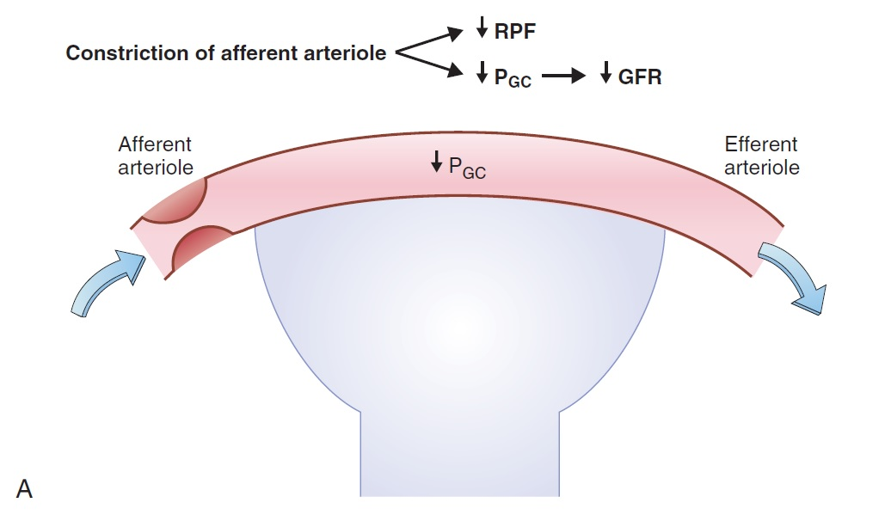
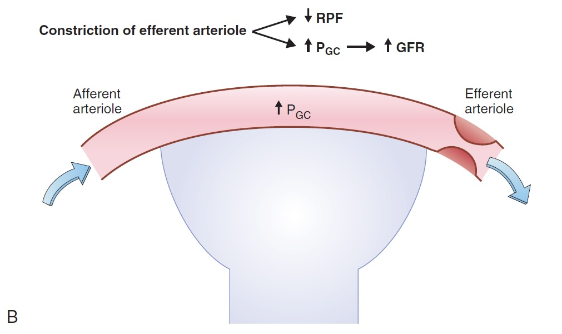
Changes in Starling forces – Effect on GFR and filtration fraction

Slide 42
Changes in Starling forces - effect on GFR and filtration fraction

Slide 43
Glomerular filtration rate (GFR)
Measurement of GFR depends on the measurement of clearance of inulin → freely filtered, but not reabsorbed or secreted by renal tubules → the amount of inulin filtered across the glomerular capillaries is exactly equal to the amount of inulin that is excreted in the urine.

Slide 44
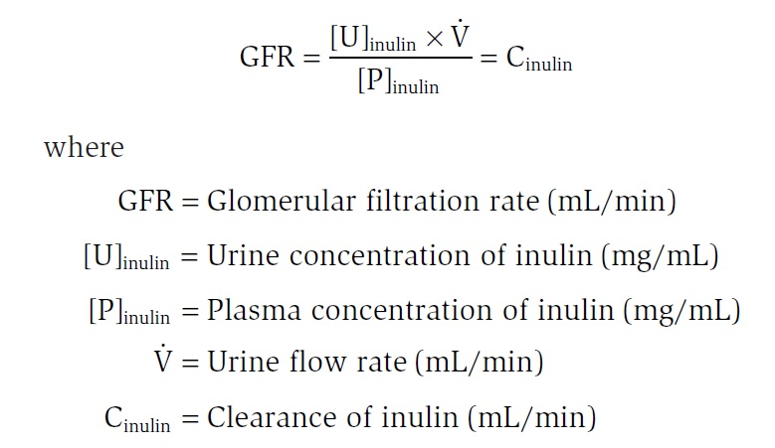
Glomerular filtration rate (GFR)

Slide 45
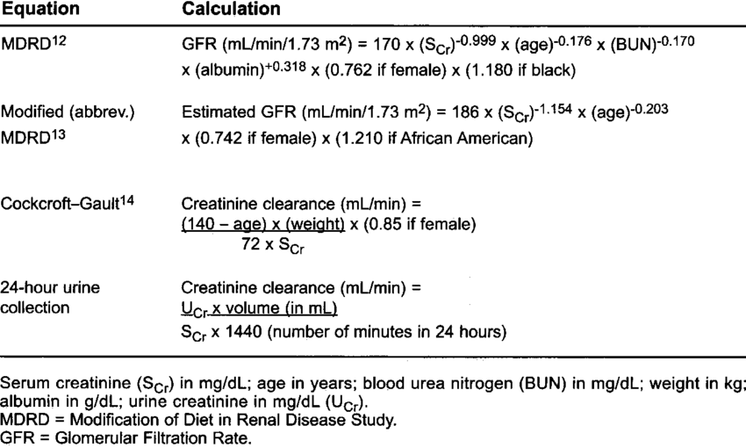
Other methods to estimate GFR
Estimates of GFR with blood urea nitrogen (BUN) and serum [creatinine].

Slide 46
Other methods to estimate GFR
Estimates of GFR with blood urea nitrogen (BUN) and serum [creatinine].
Filtration fraction is the fraction of RPF that is filtered across the glomerular capillaries.
Filtration fraction = GFR / RPF
(=0.20 normally).

