Slide 1
Healthcare Organizations
Lec 7
MED 311
Dr. Ola Soudah

Slide 2
Healthcare organizations (HCOs)
Healthcare organizations (HCOs) include all organizations that provide healthcare.
Any organization has 3 major elements:
    People (includes employee, customers, managers, and all stakeholders).
    Structure (facilities, design, or physical exitance of HCOs).
    Service (duties, tasks and operations performed in the HCOs).
Management system is important for efficient delivery of services HCOs providing.

Slide 3
People
Providers: Institutional and personal caregivers; Employee and Care giving teams.
Customers: Patients and others who use the services of the organization and generally compensate the organization for those services like insurance companies.
Stakeholders: Individuals or groups (buyers, workers, suppliers, regulators, and owners) who have a direct interest in an organization’s success.

Slide 4
Caregiving teams
Cure will result from the coordinated efforts of close to 100 people bringing highly specialized skills and using an array of diverse equipment and an extensive set of drugs and supplies.
Teams are usually housed in purpose-built spaces (e.g., clinics, operating rooms, business offices).

Slide 5
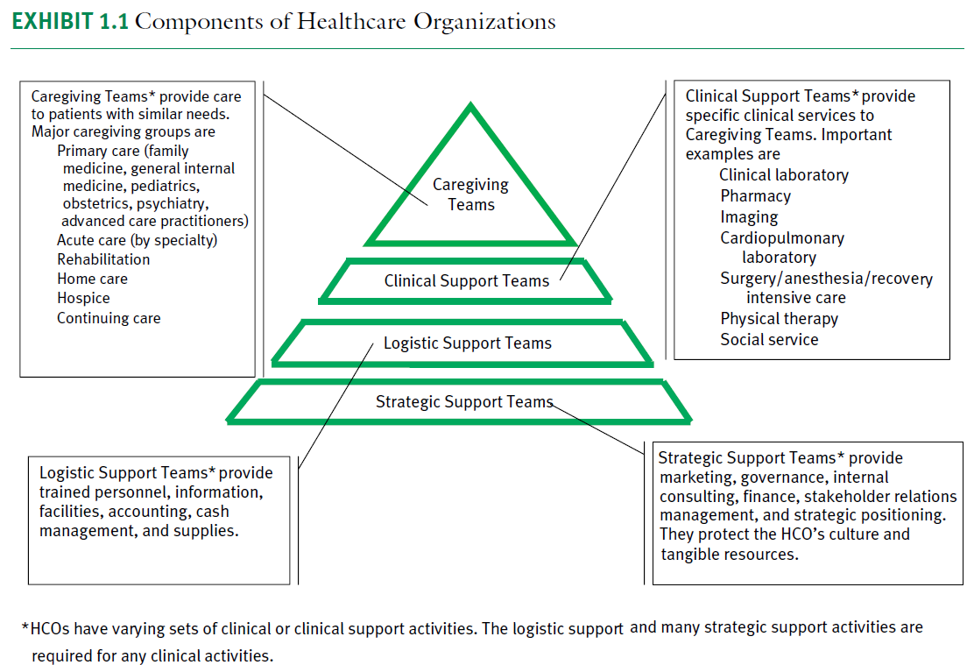

Slide 6
Customer
Patients and Families
    The most important stakeholders.
    They expect, and deserve, care that meets the goals that is safe, effective, patient-centered, timely, efficient, and equitable (IOM quality chasm).
    They also expect reasonably comfortable amenities and confidentiality.
Health Insurers and Payment Agencies
    Patients rely on a variety of mechanisms to pay for care.
Buyers
    Much health insurance is provided through employment, making employers important exchange partners.
    Buyers, always seek to cut the cost of healthcare.

Slide 7
Stakeholders
Stakeholders: Individuals or groups (buyers, workers, suppliers, regulators, and owners) who have a direct interest in an organization’s success.
It majorly includes :
    Owners.
    Suppliers.
    Regulatory agencies.
    Community groups.

Slide 8
Types of HCOs by Service Type
Primary care traditionally refers to the first contact providers of care who are prepared to handle the great majority of common problems for which patients seek care.
Secondary care often refers to specialty care provided by clinicians who focus on one or a small number of organ systems or on a specific type of service, such as obstetrics and gynecology or anesthesiology.
Tertiary care, or subspecialty care, is usually defined in terms of the type of institution in which it is delivered, often academic or specialized health centers. Tertiary care may also be defined in terms of the type of problem that is addressed, such as trauma centers, burn centers, or neonatal intensive care units.

Slide 9
Types of HCOs by Ownership
Types by ownership:
    Not-for-Profit (charity hospitals).
    For-Profit (private or university hospitals).
    Government Owners.
Most hospitals are community hospitals, were controlled by either the local government or not-for-profit organizations owned by the community and expected to fulfill community needs.

Slide 10
How Are Clinical Health Professionals Rewarded and Compensated for Their Services?

Slide 12
Regulatory Agencies
Government regulatory agencies are exchange partners that act on behalf of the patient and buyer (ex. licensing agencies).
Certificate-of-need laws, requiring HCOs to seek permission for construction or expansion.
Quality improvement organizations (QIOs) are external agencies that review the quality of care and use of insurance benefits by individual physicians and patients (ex. ISO, HCAC).

Slide 13
HCOs structure and design
Designing the service delivery system should focus on what creates value to the core organizations and how to engage frontline employees to deliver the ultimate customer experience.
An organizational structure defines how activities such as task allocation, coordination, and supervision (level of authority and power) are directed toward the achievement of organizational aims.
    It allows the expressed allocation of responsibilities for different functions and processes to different entities such as the divisions, departments, individuals, and teams.

Slide 14
Aspects of organization design
Formal aspects: is planned and predefined authority-responsibility relationships, division of work and departmentation, and the hierarchical structure.
Informal aspects: arise spontaneously from members interactions and relationships within the formal structure of organization.
Organization Chart (hierarchical structure ) is a schematic representations of classical organization concepts application to organizational structure.

Slide 15
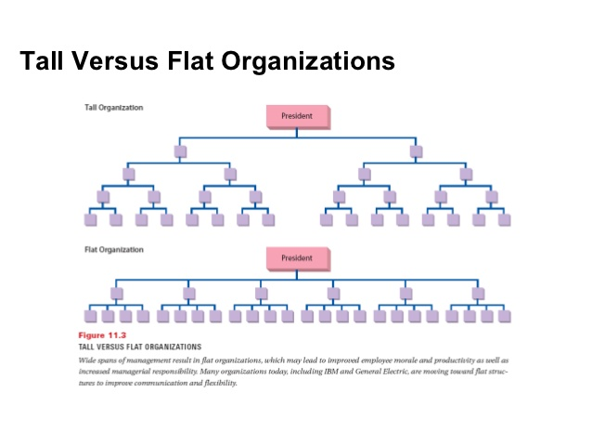

Slide 16
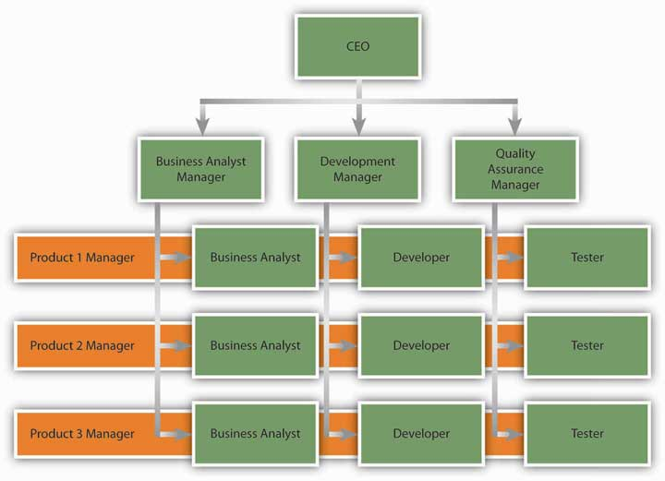
Matrix organizational structure

Slide 17
Classical concepts of organization design
Building Blocks of Structure and design:
    Division of work
    Authority and responsibility
    Departmentation
    Span of control
    Coordination

Slide 18
Division of work
It means to divide the organization work into specific jobs, each consist of specific activities (functions).
Division of work means that entities are organized into numerous departments or units within which work is functionally similar but between which work is dissimilar.
  Ex. Medical or clinical division consist of many departments like surgery and internal medicine,
    Within surgery department activities (function) is similar.
    Between surgery and internal medicine department activities are dissimilar.

Slide 19
Authority and responsibility
Authority is the power of a person’s position in an organization (legitimate power).
Responsibility is the obligation to perform certain functions or achieve certain goals derived from person’s position in the organization.
    People with responsibility are accountable for results.

Slide 20
Authority and responsibility are delegated downward in organizations from high levels of management to lower levels.
It has two forms:
  Line authority: a superior person express direct authority over a subordinate (represent the chain of command).
  Staff authority: is advisory authority, is expressed in form of counseling, advice, or recommendations.

Slide 21
Departmentalization
It is a natural results of division and specialization of work.
Workers with similar activities/specialties
Work group grow larger and larger
Unit/department
Units grow larger and larger into superstructure

Slide 22
Mintzberg suggest 6 basic for grouping people into units:
Knowledge and skills: ex. Surgery department.
Work process and functions: ea. Marketing department.
Time: ex. Night shift.
Output/ outcomes: ex. Grouping by service (outpatient).
Client/ customers: group by patient characteristics (geriatric or women health).
Physical location: ex. ER, OR.

Slide 23
Advantages of grouping:
Have one system of common supervision.
Share resources more efficiently.
Have common measure of performance.
Better communications.

Slide 24
Span of control
Span of control or span of management is defined as the number of subordinate (#employees in one department) reporting directly to a supervisor.
Two types:
    Operative (first line manager)
    Executives (mid – senior level managers)

Slide 25
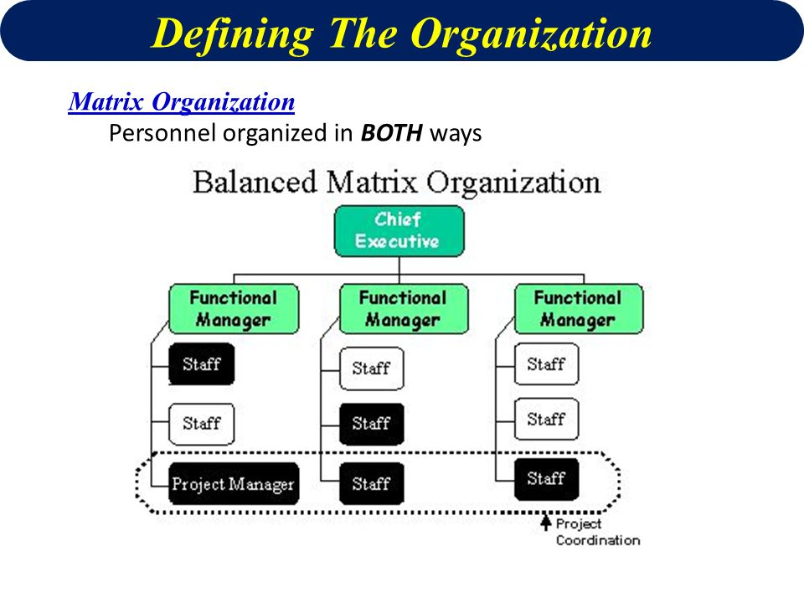
Span of control highly rely on organization design however other factors should be considered:
Type of work.
Manager skills and availability.
Work standards and routines.
Workers self-directing skills.

Slide 26

Co-ordination
Coordination or integration means that each department work in harmony with other departments, knew the share of common tasks, and work schedules of all departments were synchronized.
Mintzberg conceptual framework for coordination mechanisms:
    Mutual adjustment: use informal communication.
    Direct supervision: use authority and responsibilities.
    Standardization of work process: use of procedures and protocols.
    Standardization of work outputs: expected performance.
    Standardization of workers’ skills: orientations, training and continuous education.

Slide 27
How Can a Healthcare System Be Scored?

Slide 28
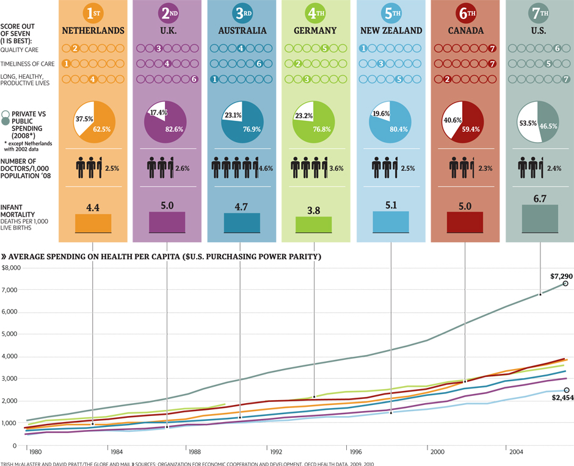

Slide 29
Designing Excellence in an HCO
The Well-Managed HCOs focuses on excellence;
    1. Emphasizing mission, vision, and values. Make the contribution and importance of care itself a shared value.
    2. Building a culture that listens, empowers, trains, and rewards.
    3. Measuring performance, seeking benchmarks, and negotiating realistic goals. Add quality, customer satisfaction, and associated satisfaction measures for every work unit.
    4. Maintaining close relations with all stakeholders.
Excellence is achieved when these needs of both customer and provider stakeholders are optimally met.
Simply by having an excellent management

