Slide 1
Physiology lab 2 Special senses - Audition

Slide 2
Contents
Auditory tests
Rinne test
Weber test
Physiology of balance and equilibrium
Barany chair
Caloric test

Slide 3
Rinne test
It is a hearing test
Primarily used to evaluate loss of hearing in one ear (unilateral hearing loss).
It compares perception of sounds transmitted by air conduction to those transmitted by bone conduction through the mastoid.
Quick screen for the presence of conductive hearing loss.

Slide 4
Rinne test - Procedure
Place a 512 Hz vibrating tuning fork against the patient's mastoid bone and ask the patient to tell you when the sound is no longer heard.
Once the patient signals they can't hear it, place the still vibrating tuning fork 1–2 cm from the auditory canal.
Ask the patient again to indicate when they are no longer able to hear the tuning fork.

Slide 5
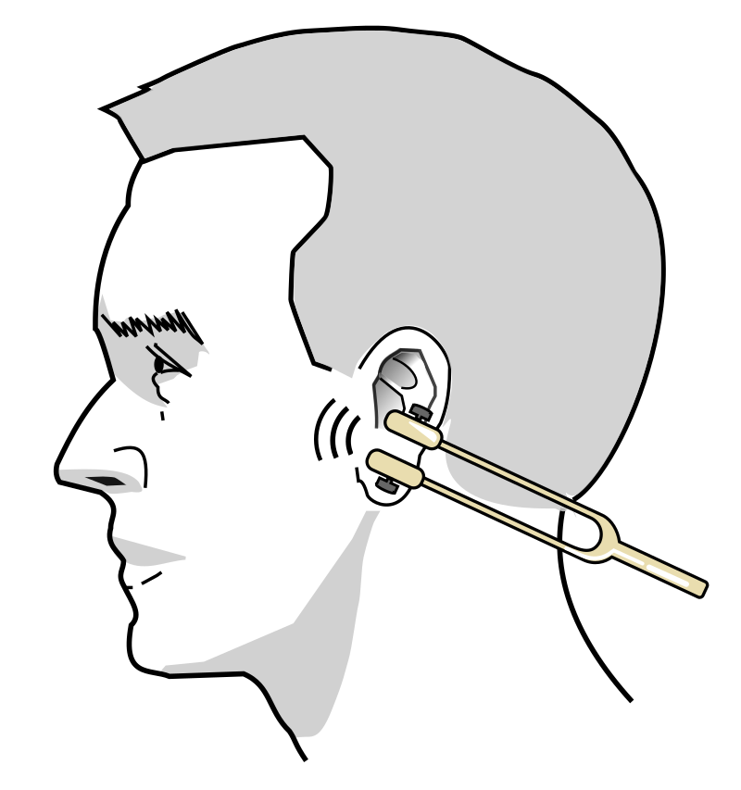
Rinne test - Procedure

Slide 6
Rinne test - Results
Normal hearing
Air conduction should be greater than bone conduction and so the patient should be able to hear the tuning fork next to the pinna after they can no longer hear it when held against the mastoid.

Slide 7
Rinne test - Results
Abnormal hearing
If the patient is not able to hear the tuning fork after it is moved from the mastoid to the pinna, it means that their bone conduction is greater than their air conduction.
→ This indicates there is something inhibiting the passage of sound waves from the ear canal, through the middle ear apparatus and into the cochlea (i.e., there is a conductive hearing loss).

Slide 8
Rinne test - Results
Abnormal hearing
In sensorineural hearing loss the ability to sense the tuning fork by both bone and air conduction is equally diminished → patients will hear the tuning fork by air conduction after they can no longer hear it through bone conduction.
This is the same to normal response, but in sensorineural hearing loss the sound stops much earlier.
The person administering the test places the fork close to their own ear after the patient indicates that the sound has subsided → the sound from the fork is still noticeable to a normal ear.

Slide 9
Weber test
It is a quick screening test for hearing.
It can detect
unilateral (one-sided) conductive hearing loss (middle ear hearing loss)
unilateral sensorineural hearing loss (inner ear hearing loss).

Slide 10
Weber test
Conductive hearing ability is mediated by the middle ear composed of the ossicles: incus, malleus, stapes.
Sensorineural hearing ability is mediated by the inner ear composed of the cochlea with its internal basilar membrane and attached cochlear nerve (cranial nerve VIII).

Slide 11
Weber test
The Weber and the Rinne test are typically performed together with the results of each combined to determine the location and nature of any hearing losses detected.

Slide 12
Weber test - Procedure
A vibrating tuning fork (256 Hz or 512 Hz) is placed
in the middle of the forehead,
above the upper lip under the nose over the teeth, or
on top of the head equidistant from the patient's ears on top of thin skin in contact with the bone.
The patient is asked to report in which ear the sound is heard louder.

Slide 13
Weber test - Results
A normal Weber test has a patient reporting the sound heard equally in both sides.
In an affected patient:
if the defective ear hears the Weber tuning fork louder → a conductive hearing loss in the defective ear.
if the normal ear hears the tuning fork sound better, there is sensorineural hearing loss on the other (defective) ear.

Slide 14
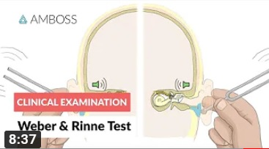
Please watch this video on YouTube:
https://www.youtube.com/watch?v=FgF91K7dU8Y&t=410s
(Weber and Rinne Test - Clinical Examination)

Slide 15
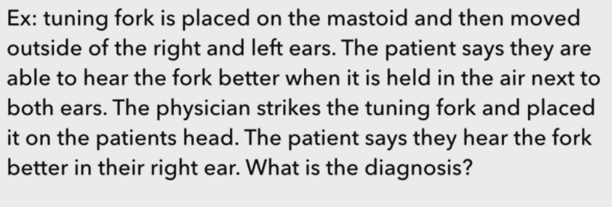
Rinne: Normal for both ears AC>BC
Weber: Localized to the right , sensorineural loss in the left

Slide 16
Tests of balance

Slide 17
Barany chair
The Barany chair is used in motion sickness therapy and in aerospace physiology training, to demonstrate to pilots the effects of spatial disorientation.
The chair was invented by Robert Bárány to do his research into the role of the inner ear in the human sense of balance, for which he received the 1914 Nobel Prize in Physiology or Medicine.

Slide 18
Barany test
The subject is seated on a rotating chair (Barany chair) and turned at a constant velocity (once every 2 seconds) for about 10 revolutions.
If the head is tilted forward approximately 30 degrees (horizontal canal) then the eye movements (nystagmus) will be from side to side.
If the head is tilted 90 degrees toward one of the shoulders (vertical canals) then the eye movement will be up and down.

Slide 19
Barany test
In testing the horizontal canals during rotation to the right a "right nystagmus" will be observed.
However, if the rotation is stopped abruptly, a "postrotary nystagmus" will be observed in a direction opposite to the direction of rotation.
During postrotary nystagmus a subject will tend to turn or fall in the direction of the rotation. This is the result of contralateral stimulation of the extensor muscles since the subject "thinks" he is spinning in the opposite direction.

Slide 20
You can watch minutes 4.47 – 15.26 in the following video to see Barany chair test:
https://www.youtube.com/watch?v=4xFAzjac60c&t=1s
(Barany chair)

Slide 21
Caloric test
By using thermal stimulation it is possible to test the right and left horizontal canals separately.
In this test the head of the subject is tilted back 60 degrees. This places the horizontal canals in an approximate vertical position.

Slide 22
Caloric test
The outer edge of the horizontal canal is very close to the external auditory meatus thus by rinsing the ear with warm or cold water heat transfer can be used to cause the endolymph to rise or fall.
This produces a flow of endolymph and a deflection of the cupula (i.e. caloric nystagmus).

Slide 23
Caloric test
Warm water produces nystagmus toward the treated side, cold water produces the opposite.
Caloric nystagmus normally lasts about 2 minutes. Shorter periods of nystagmus are suggestive of a vestibular disorder.

