Slide 1
Physiology lab 1 Special senses - Vision

Slide 2
Contents
Introduction
Refractive errors.
Visual acuity test by Snellen charts.
Color vision test (Ishihara charts).
Confrontational visual field testing
Mapping of the blind spot.

Slide 3
Introduction
Light waves diverge (radiate outward) in all directions from every point of a light source.
The forward movement of a light wave in a particular direction is known as a light ray.
Divergent light rays reaching the eye must be bent inward to be focused back into a point (the focal point) on the light-sensitive retina and provide an accurate image of the light source.

Slide 5
Process of refraction
Refraction is the bending of a light ray when it enters a medium where its speed is different.
With a curved surface such as a lens, the greater the curvature, the greater is the degree of bending and the stronger the lens.

Slide 6
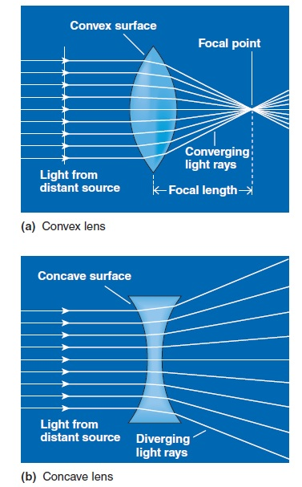
A lens with a convex surface converges the rays (brings them closer together).
(b) A lens with a concave surface diverges the rays (spreads them farther apart).

Slide 7
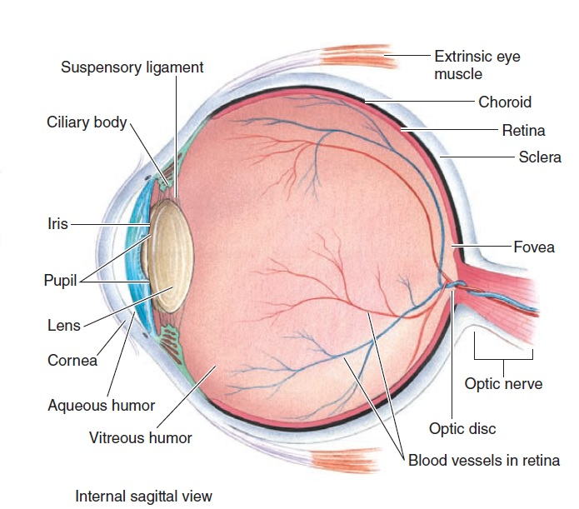
The eye’s refractive structures
The cornea
The lens

Slide 8
The curved corneal surface contributes most extensively to the eye’s total refractive ability because the difference in density at the air–cornea interface is greater than the differences in density between the lens and the fluids surrounding it.
In astigmatism, the curvature of the cornea is uneven, so light rays are unequally refracted.

Slide 9
The refractive ability of a person’s cornea remains constant, because the curvature of the cornea never changes.
The refractive ability of the lens can be adjusted by changing its curvature as needed for near or far vision.

Slide 10
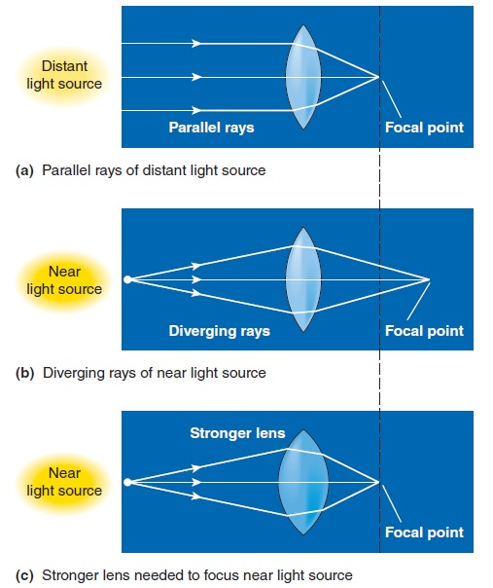
Accomodation
is the ability to adjust the strength of the lens.

Slide 11
Vision acuity
Visual acuity refers to the clarity of vision.
A common cause of low visual acuity is refractive error (ametropia).
Notes:
13._____ Checks acuity with Snellen and from proper distance
14._____ Checks acuity both eyes separately

Slide 12
Emmetropia – (normal vision acuity). A far light source is focused on the retina without accommodation, whereas the strength of the lens is increased by accommodation to bring a near source into focus.

Slide 13
Refractive errors
Myopia (nearsightedness): because the eyeball is too long or the lens is too strong, a near light source is brought into focus on the retina without accommodation (even though accommodation is normally used for near vision), whereas a far light source is focused in front of the retina and is blurry. This condition is corrected by a concave lens.

Slide 14
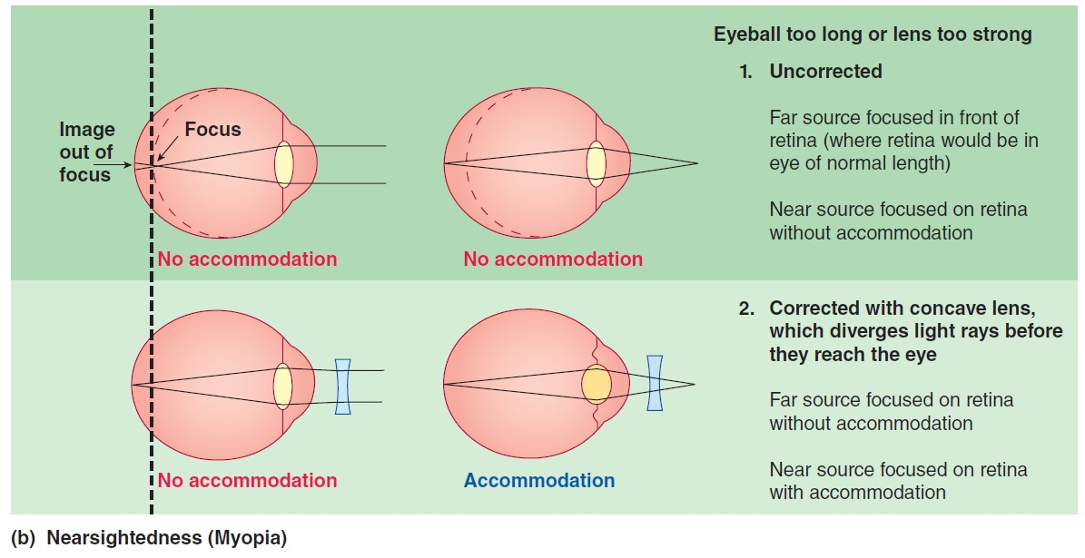

Slide 15
Hypertropia (or hyperopia) - farsightedness. Either the eyeball is too short or the lens is too weak. Far objects are focused on the retina only with accommodation, whereas near objects are focused behind the retina even with accommodation and, accordingly, are blurry. It is corrected with a convex lens.

Slide 17
Presbyopia is a result of loss of the accommodation power of the lens that occurs with aging (45-50 years). The near point (closest point on which one can focus by accommodation of the lens) moves farther from the eye and is corrected with a convex lens.
Astigmatism. Curvature of the lens is not uniform, so light rays are unequally retracted. It is corrected with a cylindrical lens.

Slide 18
Snellen Eye Chart
is an eye chart used to measure visual acuity.
It is print with eleven lines of block letters.
The first line consists of one very large letter, which may be one of several letters, for example E, H, or N.
Subsequent rows have increasing numbers of letters that decrease in size.
A person taking the test covers one eye from 6 metres (20 feet) away, and reads aloud the letters of each row, beginning at the top. The smallest row that can be read accurately indicates the visual acuity in that specific eye.

Slide 19
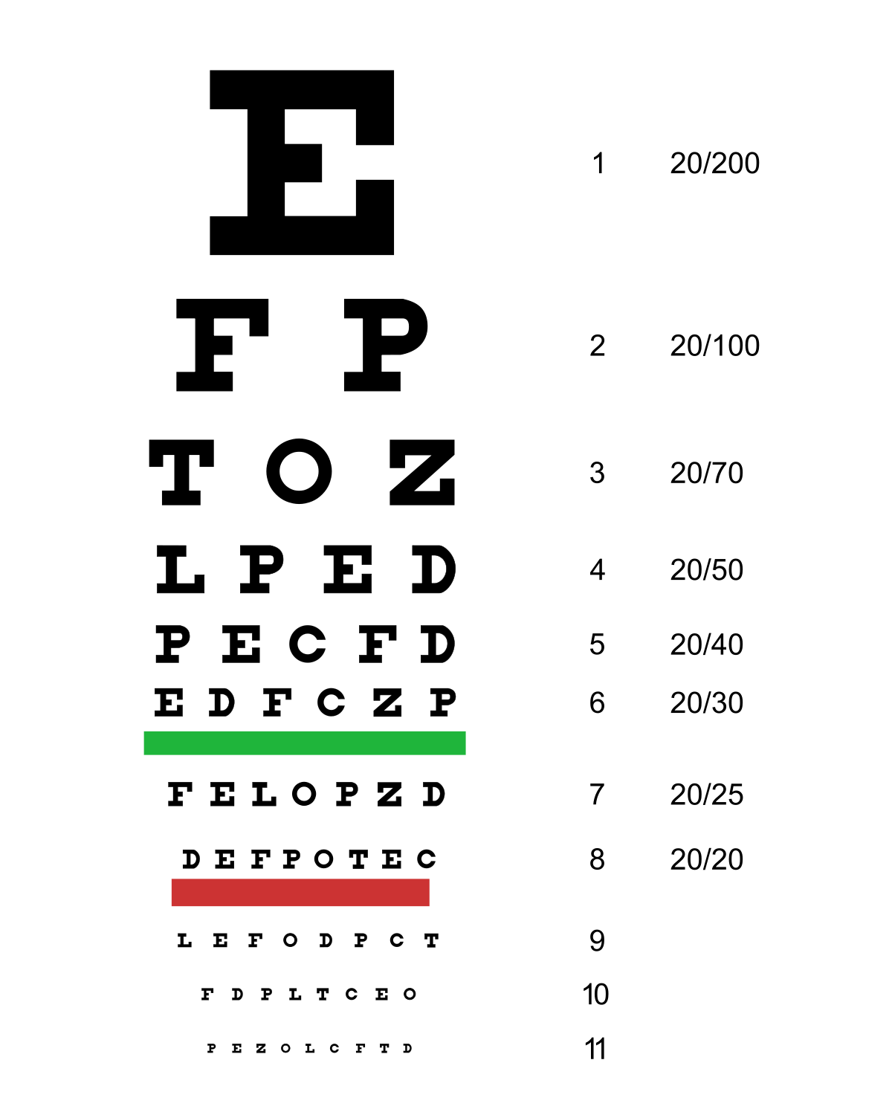
Snellen Eye Chart
Notes:
Snelling Eye Chart
Hand held eye chart

Slide 20
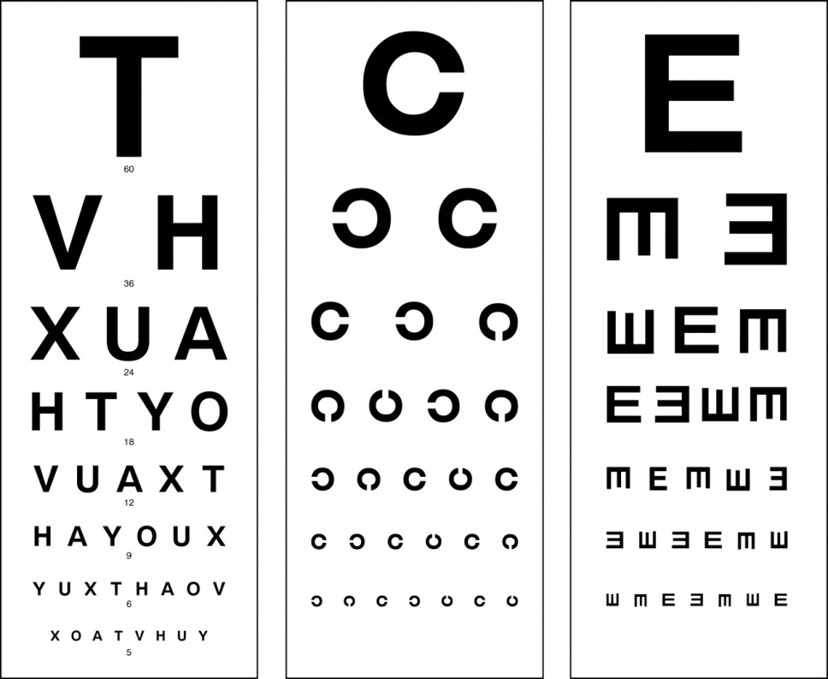

Slide 21
Normal acuity is designated "6/6". Other acuities are expressed as ratios with a numerator of 6.
If the smallest line a person can read is the one designated by 20/40, then the person's acuity is "6/12" ("20/40").
This means that this person needs to approach to a distance of 6 metres to read letters that a person with normal acuity could read at 12 metres.

Slide 22
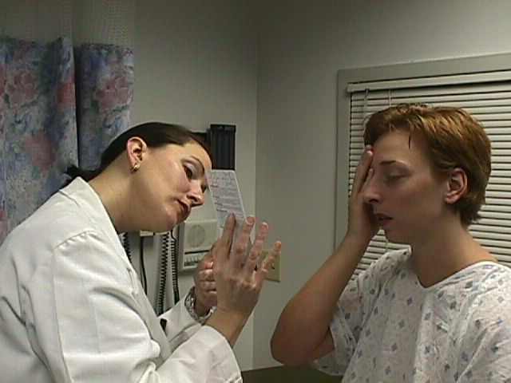
Test for presbyopia
Visual Acuity
 Hold card approx 35 cm from pt’s nose  Ask pt to cover one eye
 Read smallest line  Cover other eye and repeat
Notes:
13, 14. Visual Acuity
Hold card approx 14” from pt’s nose
Ask pt to cover one eye
Read smallest line
Cover other eye and repeat

Slide 23
Color test Ishihara charts

Slide 24
Color vision
Rods provide indistinct gray vision at night, whereas cones provide sharp color vision during the day.
There are four photopigments, one in the rods and one in each of three types of cones—blue, green, and red cones.
Each of the four photopigments absorbs different wavelengths of light in the visible spectrum to varying degrees.

Slide 25
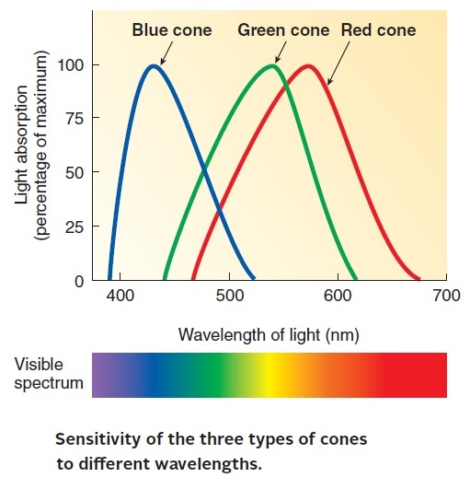
Color vision
Rods absorb all visible wavelengths to some degree. Each type of cone absorbs light best in a particular color range, namely, blue, green, or red.
Color vision depends on the ratios of stimulation of the three cone types.

Slide 26
A distinct color vision center in the primary visual cortex in the occipital lobe of the brain combines and processes these inputs to generate the perception of color, taking into consideration the object in comparison with its background.

Slide 27
Color vision deficiency
Occasionally, individuals lack a particular cone type, so their color vision is a product of the differential sensitivity of only two types of cones, a condition known as color vision deficiency (color blindness).
Not only do color-defective individuals perceive certain colors differently, but they are also unable to distinguish as many varieties of colors.
For example, people with certain color defects cannot distinguish between red and green.

Slide 28
Color vision deficiency
Normal color vision
Red-green color deficiency

Slide 29
Ishihara test
The Ishihara test is a color perception test for red-green color deficiencies.
The full test consists of 38 plates, but the existence of a severe deficiency is usually apparent after only a few plates. There are also Ishihara tests consisting of 10, 14 or 24 test plates.

Slide 30
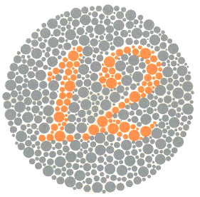
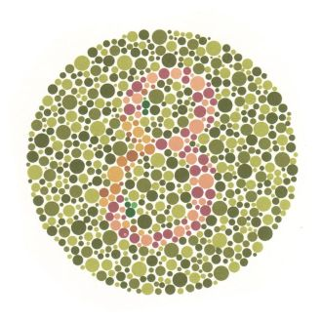
Plate 1 Both normal and those with all color vision deficiencies should read the number 12.
Plate 2
Those with normal color vision should read the number 8.
Those with red-green color vision deficiencies should read the number 3.
Total color blindness should not be able to read any numeral.

Slide 31
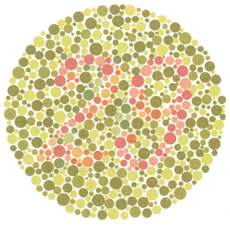
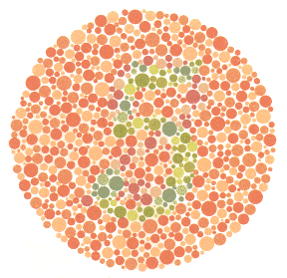
Plate 3 - Normal vision should read the number 29. - Red-green deficiencies should read the number 70. - Total color blindness should not read any numeral.
Plate 4 - Normal color vision should read the number 5. - Red-Green color deficiencies should read the number 2. - Total color blindness should not be able to read any numeral.

Slide 32
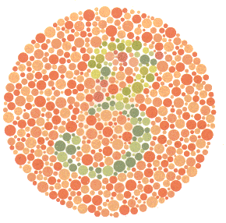
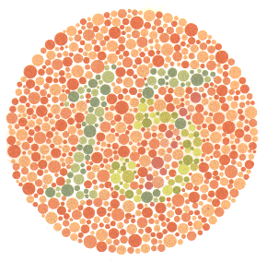
Plate 5 - Normal color vision should read the number 3. - Red-Green deficiencies should read the number 5. - Total color blindness should not be able to read any numeral.
Plate 6 - Normal color vision should read the number 15. - Red-Green deficiencies should read the number 17. - Total color blindness should not be able to read any numeral.

Slide 33
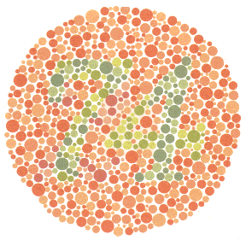
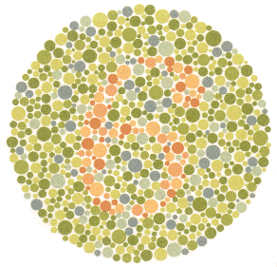
Plate 7 - Normal color vision should read the number 74. - Red-Green color deficiencies should read the number 21. - Total color blindness should not be able to read any numeral.
Plate 8 - Normal color vision should read the number 6. - The majority of those with color vision deficiencies cannot read this number or will read it incorrectly.

Slide 34
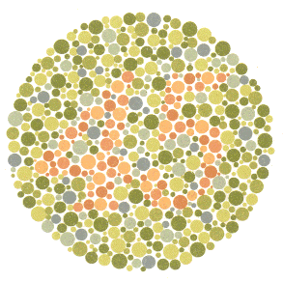
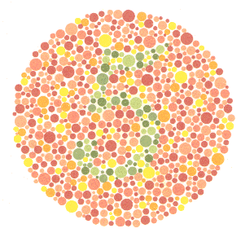
Plate 9 - Normal color vision should read the number 45. - The majority of those with color vision deficiencies cannot read this number or will read it incorrectly.
Plate 10 - Normal color vision should read the number 5. - Those with color vision deficiencies will not read the number or read it incorrectly.

Slide 35
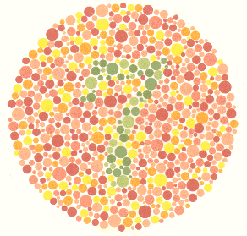
Plate 11 - Normal color vision should read the number 7. - Those with color vision deficiencies will not read this number or read it incorrectly.
Plate 12 - Normal color vision should read the number 16. - Those with color vision deficiencies will not read this number or read it incorrectly.

Slide 36
Plate 13 - Normal color vision will read the number 73. - Those with color vision deficiencies should nor be able to read this number or will read it incorrectly.

Slide 37
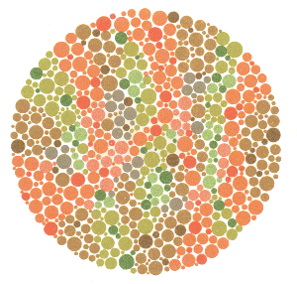
Plate 14 - Normal color vision and those with total color blindness should not be able to read any number. - The majority of those with red-green deficiencies should read the number 5.
Plate 15 - Normal color vision and those with total color blindness should not be able to read any number. - The majority of those with red-green deficiencies should read the number 45.

Slide 38
Plate 16 Normal color vision should read the number 26. In protanopia and strong protanomalia the number 6 is read and in mild protanomalia both numerals are read but the number 6 is clearer than the number 2. In deuteranopia and strong deuteranomalia only the number 2 is read and in mild deuteranomalia both the number 2 is clearer than the number 6.

Slide 39
Plate 17 Normal color vision should read the number 42. In protanopia and strong protanomalia the number 2 is read and in mild protanomalia both numerals are read but the number 2 is clearer than the number 4. In deuteranopia and strong deuteranomalia only the number 4 is read and in mild deuteranomalia the number 4 is clearer than the number 2.

Slide 40
Confrontation Visual Field
This is the most basic type of visual field (VF) testing.
No equipment is necessary; it can be done any time or any place.
This test will only pick up extensive VF loss.

Slide 41
Confrontation Visual Field
Make sure the patient has one eye occluded and is looking at your nose.
Make sure that you are placing the target in the patient's VF not yours!!!

Slide 42
Confrontation VF
Always label with patient's name and date.
Any VF loss must be shown and labeled.

Slide 43
Demonstration of Blind Spot

Slide 44
Basic Phenomenon
The next slide has a cross on the left and a circle on the right.
Close or cover your left eye, then look at the cross with your right eye.
Move your head slowly either toward the screen or away from the screen, staring at the cross with your right eye, until the circle disappears
When the circle disappears, you have found your right eye’s blind spot.

