Slide 1
Temperature regulation

Slide 2
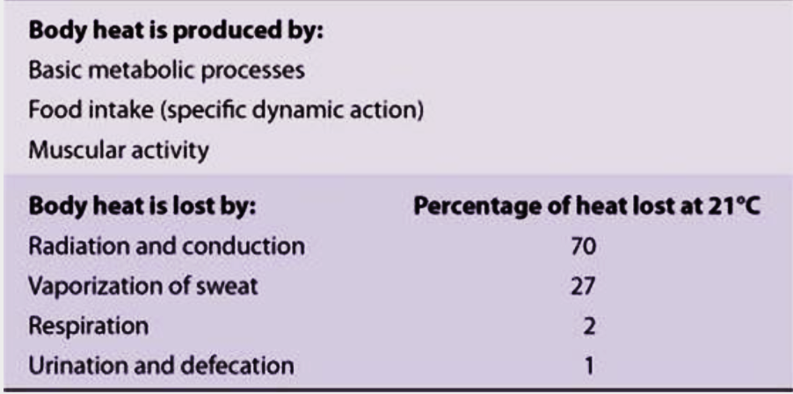
Normal core temperature
35.9–37°C (if measured orally)
36.4 ºC – 37.5 ºC (rectally)
Body temperature is controlled by balancing heat production and heat loss.

Slide 3
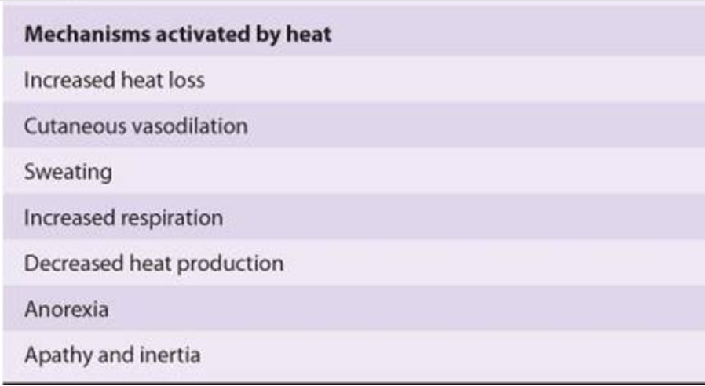
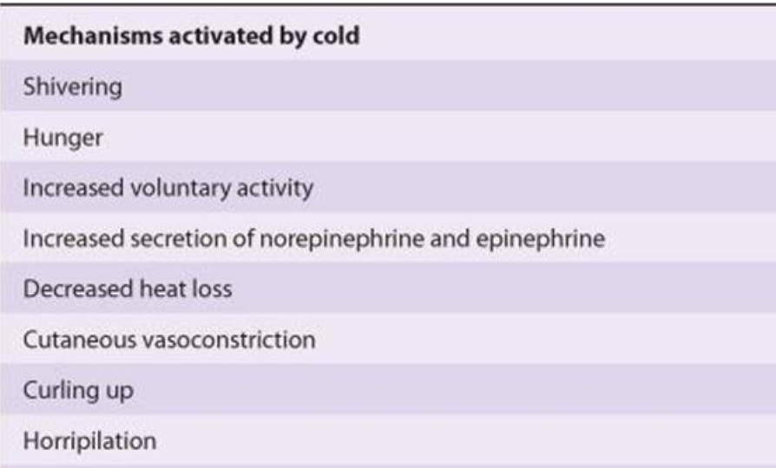

Slide 4
Sources of heat gain and heat loss from the body

Slide 5
Heat production
Heat is a principle by-product of metabolism.
The main factors that determine the rate of heat production (metabolic rate of the body):
Basal rate of metabolism of all the cells of the body.

Slide 6
Heat production
Extra rate of metabolism caused by muscle activity (including muscle contractions caused by shivering)
Shivering is the most potent mechanism for increasing heat production.
Cold temperatures activate the shivering response, which is controlled by the posterior hypothalamus.
α-Motoneurons (lower motor neuron of the brain stem and spinal cord) and γ-motoneurons are activated, causing contraction of skeletal muscle and heat production.

Slide 7
Heat production
Extra metabolism caused by the effect of thyroxine (and, to a less extent, growth hormone and testosterone) on the cells.

Slide 8
Heat production
Extra metabolism caused by the effect of epinephrine, norepinephrine and sympathetic stimulation on the cells.
Cold temperatures activate the sympathetic nervous system and, via activation of β receptors in brown fat, increase metabolic rate and heat production.

Slide 9
Heat production
Extra metabolism needed for digestion, absorption, and storage of food (thermogenic effect of food).

Slide 10
Heat loss
Rate of heat loss depends on:
how rapidly heat can be conducted from where it is produced in the body core to the skin and
how rapidly heat can then be transferred from the skin to the surroundings.
The skin, the subcutaneous tissues, and especially the fat of the subcutaneous tissues act together as a heat insulator for the body.
Blood flow to the skin from the body core provides heat transfer.

Slide 11
Heat-loss mechanisms
Radiation (heat waves) → 60%
Evaporation → 27%
Conduction to air → 15%
Conduction to objects → 3%
Air currents cause heat loss by convection (subsequent to conduction).

Slide 12
Heat-loss mechanisms - response to heat
Heat loss by radiation and convection increases when the ambient temperature increases.
This response is controlled by the anterior hypothalamus.
Increases in temperature → decreased sympathetic tone of cutaneous blood vessels → increase blood flow through the arterioles and increasing arteriovenous shunting of blood to the venous plexus near the surface of the skin → heat loss by radiation and convection.

Slide 13
Heat-loss mechanisms - response to heat
Heat loss by evaporation depends on the activity of sweat glands, which are under sympathetic muscarinic control.

Slide 14
Regulation of sweating by autonomic nervous system
Stimulation of the anterior hypothalamus-preoptic area in the brain by excess heat causes sweating.
The nerve impulses from this area are transmitted in the autonomic pathways to the spinal cord and then through sympathetic outflow to the skin everywhere in the body.
Sweat glands are innervated by cholinergic nerve fibers that run in the sympathetic nerves along with the adrenergic fibers.
So sweat glands can also be stimulated to some extent by epinephrine or NE circulating in the blood (ex.: in exercise).

Slide 15
Temperature-Decreasing Mechanisms When the Body Is Too Hot
Vasodilation of skin blood vessels
Sweating
Decrease in heat production
Inhibition of shivering and chemical thermogenesis.

Slide 16
Temperature-Increasing Mechanisms When the Body Is Too Cold
Skin vasoconstriction throughout the body
Caused by the stimulation of the posterior hypothalamic sympathetic centers.
Piloerection
(not important in human beings).
Increase in thermogenesis.

Slide 17
Hypothalamic set point for body temperature

Slide 18
The temperature of the body is regulated almost entirely by nervous feedback mechanisms, and almost all these operate through temperature-regulating centers located in the hypothalamus (preoptic and anterior hypothalamic nuclei of the hypothalamus).
Temperature detectors are also needed → heat-sensitive (mainly) and cold-sensitive neurons in hypothalamus + cold (mainly) and warmth receptors in the skin and some deep organs.
Posterior hypothalamus integrates the central and peripheral temperature sensory signals

Slide 19
Temperature sensors on the skin and in the hypothalamus “read” the core temperature and relay this information to the anterior hypothalamus.
The anterior hypothalamus compares the detected core temperature to the set-point temperature.
If the core temperature is below the set point, heat-generating mechanisms are activated by the posterior hypothalamus.
If the core temperature is above the set point, mechanisms for heat loss are activated by the anterior hypothalamus.

Slide 20
Fever
Fever means a body temperature above the usual range of normal.
It can be caused by abnormalities in the brain itself or by toxic substances that affect the temperature regulating centers (such as bacterial diseases, brain tumors, heatstroke).

Slide 21
Fever
Many proteins, breakdown products of proteins, and certain other substances, especially lipopolysaccharide toxins released from bacterial cell membranes cause the set-point of the hypothalamic thermostat to rise.
These substances are called pyrogens.

Slide 22
Some pyrogens can act directly and immediately on the hypothalamic temperature-regulating center to increase its set-point.
Other pyrogens function indirectly and require several hours (ex.: endotoxins of gram-negative bacteria).
Phagocytic cells digest bacterial products and then release cytokines. One of the most important is interleukin-1 (IL-1; endogenous pyrogen, leukocyte pyrogen).

Slide 23
Several experiments have suggested that interleukin-1causes fever by first inducing the formation of one of the prostaglandins, mainly prostaglandin E₂, or a similar substance, which acts in the hypothalamus to elicit the fever reaction.
Fever may be also caused by lesions to the hypothalamus.

Slide 24
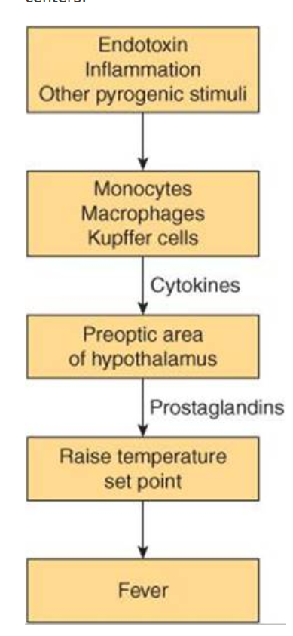

Slide 25
