Slide 1
Primary Diseases of Myelin
Dr Nesreen Bataineh
MD ,FRCPath

Slide 2
Introduction
Axons are ensheathed by myelin → allows rapid propagation of neural impulses.
Diseases of myelin are primarily white matter disorders.
CNS: Oligodendrocytes → Single cell provide myelin for many internodes.
PNS: Schwann cells → Single cell provide myelin only for one internodes.
Loss of myelin interferes with electric impulse transmission along axon
Myelin CNS diseases do not involve the PNS nerves (& vice versa).
Notes:
-Myelin consists of multiple layers of highly specialized, closely apposed plasma membranes that are assembled by oligodendrocytes.

Slide 3
Classification
*
Acquired
Genetic
Notes:
Demyelinating diseases of the CNS are acquired conditions characterized by preferential damage to previously normal myelin.
Dysmyelinating diseases, myelin is not formed properly or has abnormal turnover kinetics.

Slide 4
1. Multiple Sclerosis (Most common)
An autoimmune demyelinating disorder characterized by distinct neurologic deficits separated by time (relapsing and remitting course) caused by white matter lesions separated in space.
Relatively common (1:1000).
F > M (X2), onset between 20‐50*.
Notes:
2nd commonest cause of neurological disability in early-middle adulthood after trauma .
↑ rates in Europe, Canada ,USA..(1/1000)
Low rates in Asia, Africa, Middle East
Migrants adopt the risk of their new environment if they move before age 15y

Slide 5
Pathogenesis
Autoimmune response against myelin antigens (much is unknown).
Loss of tolerance to self myelin Ags
Immune mediated myelin destruction (sparing axons) by many immune cells (mainly CD4+ T cells)
Infection ???
HLA-DR2
IL-2&7 polymorphism
Notes:
Pathogenesis:
Autoreactive T-lymphocytes to Myelin basic protein (MBP)
Autoantibodies against myelin antigens such as myelin oligodendrocyte glycoprotein (MOG)
Viral Triggers
? molecular mimicry between viruses and myelin antigens
-The disease risk is 15-fold higher when the disease is present in a first-degree relative, and the concordance rate for monozygotic twins is approximately 25%, with a much lower rate for dizygotic twins.

Slide 6
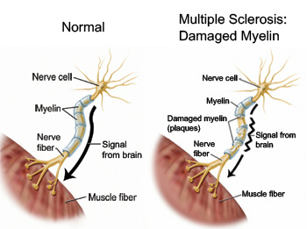
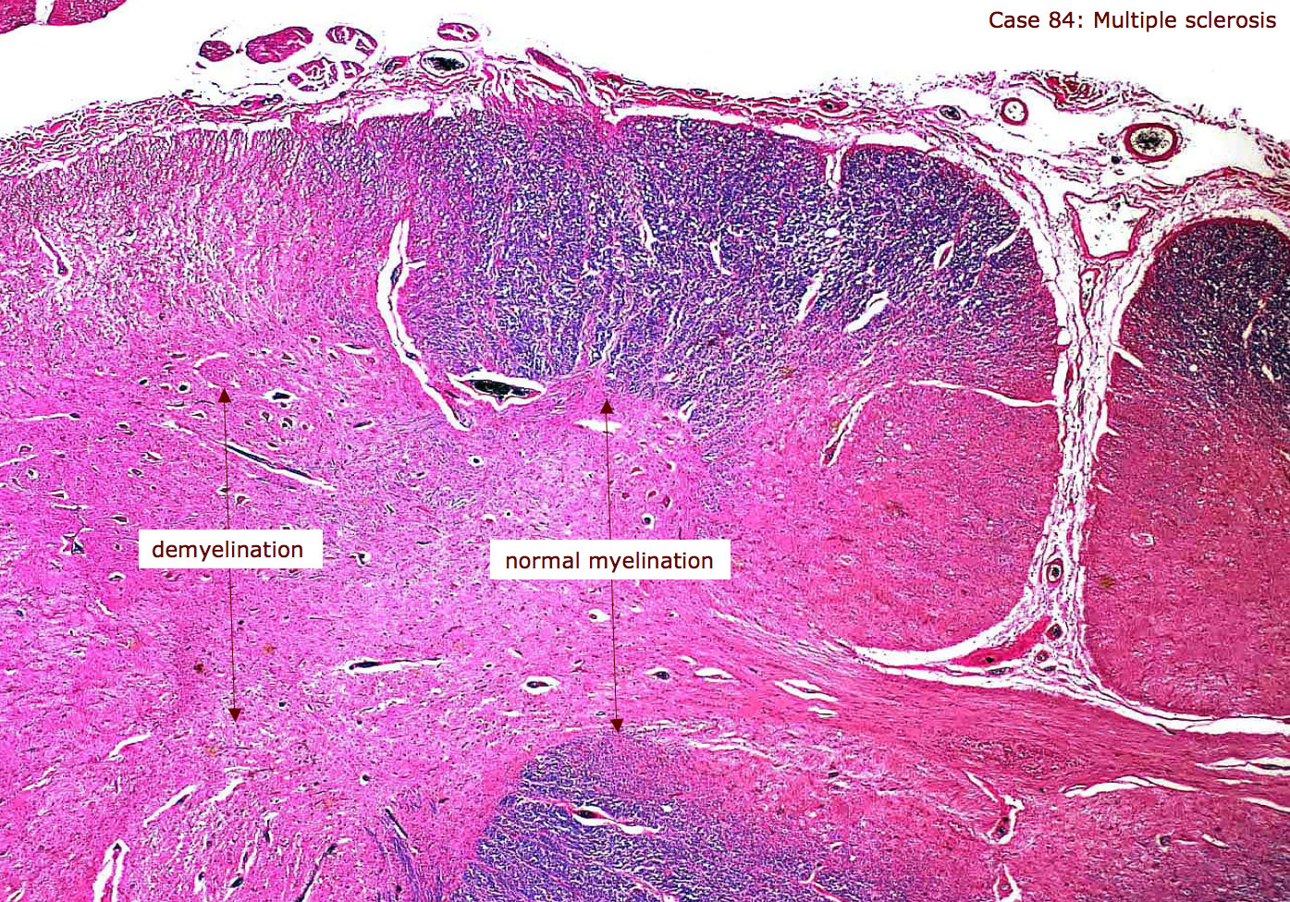

Slide 7
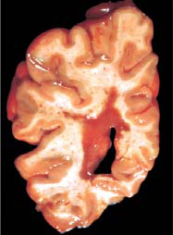
Morphology
Gross:
Glassy looking, grey‐tan plaques (resemble grey matter) scattered randomly throughout the white matter.
Mainly seen near ventricles.

Slide 8
Morphology
Microscopic:
Active plaques (soft pink):
Myelin degradation with inflammation (macrophages, lymphocytes).
Small lesions often are centered on small veins.
4 classes, only one typically is seen in a particular affected patient.
Inactive plaques (hard grey):
No myelin and no inflammatory cells.
Instead → Astrocytic proliferation and gliosis.
Shadow plaques:
Border between normal and affected white matter representing partial and incomplete remyelination.
Axons are preserved
Notes:
Acute stage ‘Active’ plaque :Soft pink Myelin breakdown → phagocytosis , perivascular lymphocytic infiltration , and edema
Inactive plaques → loss of oligodendrocytes ???
type I, which has macrophage infiltrates with sharp margins.
type II, which is similar to type I but also shows complement deposition (suggestingan antibody-mediated component).
type III, with less well-defined borders and oligodendrocyte apoptosis.
type IV, with nonapoptotic oligodendrocyte loss.

Slide 9
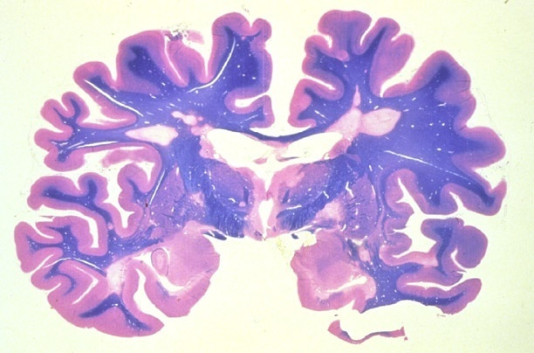
Notes:
Myelinated white matter stains BLUE, and demyelination is loss of blue. Remember MS is a disease PRIMARILLY of WHITE matter.
If you have a good sense of symmetry, you done need to go to neuropathologist school.

Slide 10
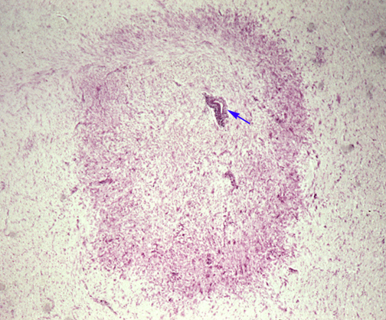
Notes:
مهم
Clinical features:
limb weakness 40%
optic neuritis 20%
parasthesia 20%
dyplopia 10%
bladder dysfunction 5%
vertigo 5%
Clinical course:
Relapsing/remitting MS (85% )
Secondary progressive MS
Steady deterioration following RRMS
(50% patients after 15 years)
Primary progressive MS (15%)
Steady deterioration disease onset
Prognosis:
Benign variant from start (<20%)
Better in women
Patients with< 2 attacks in first year
Death usually due to a complication e.g. chest or urinary infection , pressure sores ….etc.

Slide 11
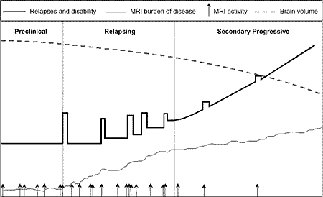
Course of disease
Episodes of relapsing and remitting:
Variable duration marked by neurologic defects, followed by gradual, partial recovery of neurologic function.
The frequency of relapses tends to decrease during the course of time, but there is a steady neurologic deterioration in most affected individuals.
Notes:
Only a minority of individuals(10% to 50%, depending on the population studied) with an episode of optic neuritis which requires multiple episodes to support the diagnosis

Slide 12
Clinical features
MS can affect anywhere in the CNS → wide range of clinical manifestations. BUT the commonest neurologic symptoms and signs are:
Unilateral visual impairment due to involvement of the optic nerve (optic neuritis, retrobulbar neuritis).
After an episode of optic neuritis 10-50% go on to develop MS with involvement of:
Brainstem: Cranial nerve signs, ataxia, nystagmus …
Spinal cord: Motor and sensory defects of trunk and limbs, spasticity, & difficulties with the voluntary control of bladder function.

Slide 13
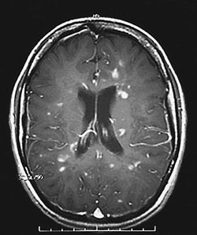
Investigations
CSF:
Mildly ↑ protein
Moderate pleocytosis (↑ lymphocytes).
↑ Oligoclonal IgG bands → Most important.
Radiology:
MRI → Has an important role in Dx.
Some studies indicate that some plaques may be clinically silent even in otherwise symptomatic patients.

Slide 14
2. Other Acquired Demyelinating Diseases
A. Neuromyelitis Optica:
Synchronous bilateral optic neuritis & spinal cord demyelination.
Once considered a variant of MS, but know considered separate entity that is characterized by:
Abs against aquaporin-4 (pathognomic).
Poor recovery from the first attack.
B. Central pontine myelinolysis (osmotic
demyelinating disease):
Nonimmune process characterized by loss of myelin involving the center of the PONS → usually manifests with quadiplegia.
Arises after → Rapid correction of HYPONATREMIA*, alcoholism & severe electrolytes disturbances.
Notes:
-The mechanism of oligodendroglial cell injury is uncertain, but it may be related to edema induced by sudden changes in osmotic pressure. It occurs in a variety of clinical settings including alcoholism and severe electrolyte or osmolar imbalance.
-Pathology: Cellular edema, caused by fluctuating osmotic forces → compression of fiber tracts → demyelination in PONS & other areas in
brain

Slide 15
2. Other Acquired Demyelinating Diseases
C. Acute Disseminated Encephalomyelitis (ADEM)
Diffuse, monophasic demyelinating disease.
Symptoms begin 1‐2 weeks after viral infection (sometimes vaccine) → non-localizing symptoms (headache, lethargy, and coma).
20% die → most of the rest fully recover.
D. Acute Necrotizing Hemorrhagic Encephalomyelitis
(ANHE)
Follows an URTI in kids and adolescents.
Fatal in many patients →represents a hyperacute variant of ADEM.
Notes:
These are Acute Demyelinating Diseases (Virus Induced):

Slide 16
Disorders of Peripheral Nerves

Slide 17
Patterns of Peripheral Nerve Injury
Axonal neuropathies (Wallerian degeneration) → ass. with decreased axon density.
Demyelinating neuropathies (segmental demyelination) → ass. with normal axon density.
Mixed.

Slide 18
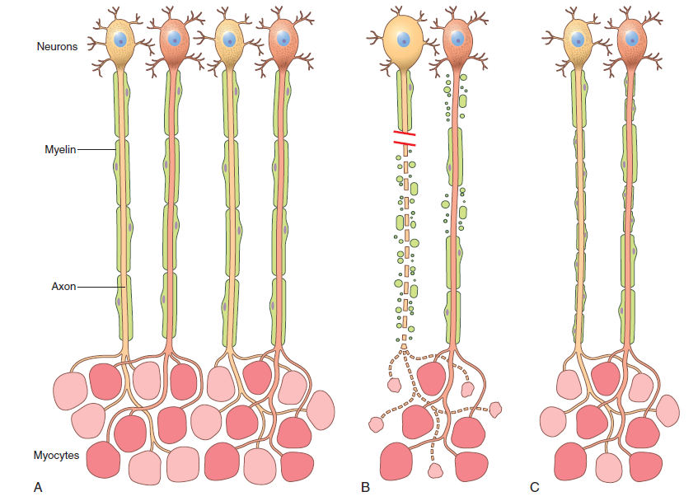
Notes:
Figure 21–1 Patterns of peripheral nerve damage. A, In normal motor units, type I and type II myofibers are arranged in a “checkerboard” distribution, and the internodes along the motor axons are uniform in thickness and length. B, Acute axonal injury (left axon) results in degeneration of the distal axon and its associated myelin sheath, with atrophy of denervated myofibers. By contrast, acute demyelinating disease (right axon) produces random segmental degeneration of individual myelin internodes, while sparing the axon. C, Regeneration of axons after injury (left axon) allows connections with myofibers to re-form. The regenerated axon is myelinated by proliferating Schwann cells, but the new internodes are shorter and the myelin sheaths are thinner than the original ones. Remission of demyelinating disease (right axon) allows remyelination to take place, but the new internodes also are shorter and have thinner myelin sheaths than flanking normal undamaged internodes.

Slide 19
Peripheral neuropathies fall into several ANATOMIC PATTERNS:
Polyneuropathies:
Axonal loss is typically symmetric, diffuse & more pronounced in the distal segments of the longest nerves → usually ass. with loss of sensation and paresthesias.
Polyneuritis multiplex:
Damage randomly affects portions of
individual nerves.
Simple mononeuropathy
Involves only a single nerve mostly due
trauma or entrapment (as carpal tunnel
syndrome).

Slide 20
Disorders Associated with Peripheral Nerve Injury
Diabetic neuropathy:
Most common cause of peripheral neuropathy.
Includes:
Distal symmetric sensorimotor polyneuropathy (most common).
Autonomic neuropathy.
Lumbosacral radiculopathies → asymmetric pain that progress to weakness & muscle atrophy.

Slide 21
Disorders Associated with Peripheral Nerve Injury
Guillain-Barré Syndrome
Autoimmune response triggered by an URT or GI infection or a vaccine that breaks down self-tolerance (as Campylobacter jejuni, EBV…) → Rapidly progressive acute demyelinating disorder affecting motor axons.
Leads to ascending weakness & areflexia→ may cause death from failure of respiratory muscles (diaphragm) within several days.
Surviving pts usually recover.
Notes:
Epstein-Barr virus, cytomegalovirus, and human immunodeficiency virus.
-The injury is most extensive in the nerve roots and proximal nerve segments and is associated with mononuclear cell infiltrates rich in macrophages.
-Both humoral and cellular immune responses are believed to play a role in the disease process.
-Treatments include plasmapheresis (to remove offending antibodies), intravenous immunoglobulin infusions (which suppress immune responses through unclear mechanisms) and supportive care, such as ventilatory support.

Slide 22
Traumatic Neuropathy :
Laceration, avulsion.
Entrapment, compression:
Carpal Tunnel Syndrome
Morton “Neuroma”
Notes:
Do you think the word “neuroma” is in quotes because it is NOT a true clonal proliferative neoplasm? Ans: YES
Laceration regeneration rate = 1mm/day or 1 cm in/mo.

Slide 23
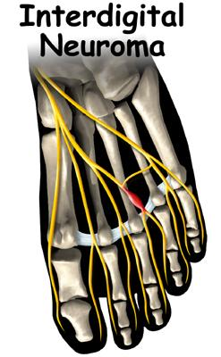
MORTON NEUROMA
Most occur in the 3rd common digital branch of MEDIAL plantar nerve, i.e., 3rd & 4th toe at distal metatarsal level.
Medial planter n.
3rd.common digital n.
Traumatic compression, F ≥ M, ass. with metatarsalgia

Slide 24
TRAUMATIC NEUROMA “Regenerating Axons and Schwann Cells with perineural fibrosis → but with no direction”

