Slide 1
Degenerative diseases of the CNS
Dr. Fatimah Almahasneh
Department of Basic Medical Sciences
Faculty of Medicine – Yarmouk University

Slide 2
Parkinson disease

Slide 3
Desired outcomes of treatment
Maintaining patient independence, ADL, and QOL.
Minimizing the development of response fluctuations
Limiting medication-related adverse effects.

Slide 4
General approach to treatment
Treatment of PD is categorized into three types:
Lifestyle changes, nutrition, and exercise
pharmacologic intervention
surgical treatments after pharmacologic interventions fail.

Slide 5
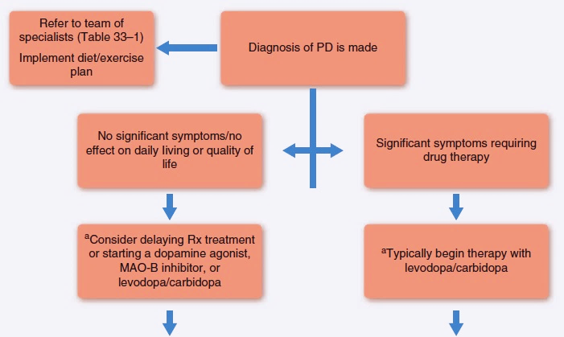

Slide 6
Nonpharmacologic therapy

Slide 7
Lifestyle modifications
Maintaining:
good nutrition
physical condition
social interactions
may improve ADLs, gait, balance and mental health.
Coordinated care with multiple health care professionals maximizes patient outcomes.

Slide 8
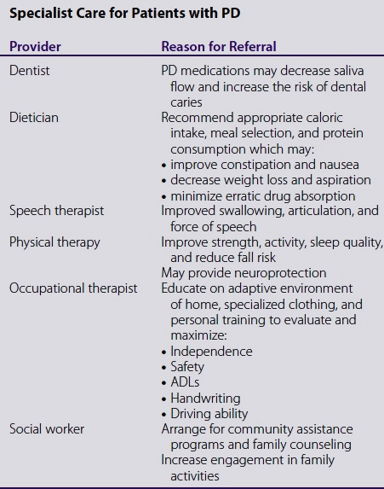

Slide 9
Pharmacologic therapy for motor symptoms

Slide 10
Pharmacologic therapy of motor symptoms
Drug therapy aims to enhance dopaminergic activity in the substantia nigra.
When to initiate dopaminergic therapy is controversial and patient specific.
Medications minimize motor symptoms and improve QOL and ADLs but are not curative
Even with pharmacotherapy, PD patients have greater mortality and morbidity than the general population.
Choice of pharmacologic agent should be individualized based on patient-specific parameters.

Slide 11
Pharmacologic therapy of motor symptoms
Pharmacologic options for PD include:
anticholinergics (Ach)
amantadine
MAO-B inhibitors
dopamine agonists
levodopa/carbidopa
catechol-O-methyltransferase (COMT) inhibitors.

Slide 12
Pharmacologic therapy of motor symptoms
Most pharmacologic treatments in PD aim to:
avoid degeneration of the dopaminergic nigrostriatal pathway
increase dopamine concentrations.
The American Academy of Neurology (AAN) and the Movement Disorder Society recommend most patients initiate treatment with either levodopa/carbidopa or a dopamine agonist.
The 2017 NICE guidelines slightly differ and recommend levodopa/carbidopa for patients once motor symptoms begin to affect QOL.

Slide 13
Drug choice
Starting with a dopamine agonist may delay the onset of dyskinesias and response fluctuations seen with long-term levodopa use
however, less motor benefit and greater risk of hallucinations or somnolence may occur.
Levodopa causes the greatest motor improvement and should be used as initial therapy in the elderly,
but may increase the risk of motor fluctuations over time.

Slide 14
Drug choice
Regardless of the drug initially chosen, the initial dose is low and increased gradually based on symptoms.

Slide 15
Anticholinergics
Anticholinergics block ACh → decrease the acetylcholine:dopamine concentration ratio.
They minimize resting tremor and drooling, but are not as effective as other agents for rigidity, bradykinesia, and gait problems.
Typically avoided in older patients
Because of their side effects, especially cognitive impairment
May cause delayed gastric emptying → erratic and decreased levodopa absorption.
They may worsen urinary retention or constipation.

Slide 16
Amantadine
It is an N-methyl-D-aspartate (NMDA)-receptor antagonist that blocks glutamate transmission, promotes dopamine release, and blocks acetylcholine.
Effective both as monotherapy and as adjunct therapy.
Adverse effects: nausea, dizziness, livedo reticularis, orthostatic hypotension, hallucinations, restlessness, anticholinergic effects, and insomnia.

Slide 17
MAO-B inhibitors
Safinamide, selegiline, and rasagiline work through selective blockade of dopamine metabolism through MAO-B.
Provide a mild symptomatic benefit for patients who choose to delay dopaminergic medications.
Both rasagiline and selegiline may be neuroprotective and thus may be selected early in therapy
but there is no conclusive evidence to validate this.
Safinamide is indicated to be used in combination with levodopa/carbidopa.

Slide 18
Dopamine agonists
Dopamine agonists bind to postsynaptic dopamine receptors and are reasonable as initial therapy.
Their advantages include delay of levodopa therapy and smaller risk of developing motor fluctuations during the first 4 to 5 years of treatment.
Eventually, they inadequately control the patient’s symptoms, and levodopa is necessary.
In advanced disease, they can be added to levodopa.

Slide 19
Dopamine agonists
Dopamine agonists include:
the ergot derivatives (bromocriptine)
the nonergot derivatives (rotigotine, pramipexole, ropinirole, and apomorphine).

Slide 20
Dopamine agonists
Adverse effects:
nausea (most common initial symptom)
vomiting
sedation (greatest with apomorphine)
pedal edema
orthostatic hypotension (greatest with pramipexole)
psychiatric effects, which are greater than with levodopa (nightmares, confusion, and hallucinations).
Dopamine dysregulation syndrome (DDS)

Slide 21
Levodopa/carbidopa
There is no consensus on the when to initiate levodopa/carbidopa.
Its absorption is decrease by excess stomach acid, food, or anticholinergic medications.
Antacids improve levodopa absorption, while iron products bind levodopa and reduce bioavailability.
Levodopa absorption requires active transport by a large neutral amino acid transporter protein → amino acids in food compete for this transport mechanism.

Slide 22
Levodopa/carbidopa

Slide 23
Levodopa/carbidopa
Levodopa is usually administered as a combination product with carbidopa, a dopa-decarboxylase inhibitor, which decreases the peripheral conversion of levodopa to dopamine.
Initial adverse effects:
orthostatic hypotension, dizziness, anorexia, nausea, vomiting, and discoloration of urine/sweat
→ minimized by taking levodopa with food and by slowly titrating the dose.
Later side effects: dyskinesias, sleep attacks, and psychiatric effects.

Slide 24
Catechol-O-Methyltransferase (COMT) Inhibitors
COMT catalyzes the conversion of levodopa to 3-o-methyldopa.
COMT inhibitors (entacapone or tolcapone) are added to levodopa/carbidopa to increase levodopa concentration and extend its half-life.
Adverse effects: diarrhea (worse with tolcapone), nausea, vomiting, dyskinesias, urine discoloration, sleepiness, sleep attacks, orthostatic hypotension, and hallucinations.
Tolcapone is hepatotoxic → should be used only if entacapone not effective or not tolerable.

Slide 25
Treatment of nonmotor symptoms
Depression:
TCAs are effective, but their side effects are limiting.
SSRIs may be considered due to their increased tolerability.
Antidepressants are also useful for the treatment of anxiety disorders.
Dementia
Cholinesterase inhibitors may be effective.

Slide 26
Treatment of nonmotor symptoms
Psychosis
Treating psychosis in PD can be difficult because:
most antipsychotics act as dopamine antagonists
may worsen motor symptoms
all antipsychotics carry a black box warning of increased risk of death when used in patients with dementia.
First treat any underlying medical causes for psychosis; then gradually decrease and stop low-efficacy PD medications.
Clozapine, quetiapine or pimavanserin may be used.

Slide 27
Treatment of nonmotor symptoms
Sleep problems:
Are treated by optimizing PD therapeutic regimen.
Drooling, sexual dysfunction, urine frequency, constipation, sweating, and orthostasis should be addressed and treated.

Slide 28
Treatment of response fluctuations
As the disease progresses, most patients develop response fluctuations.
Treatment is based on capitalizing on the pharmacokinetic and pharmacodynamic properties of PD medications.

Slide 29
Alzheimer disease

Slide 30
Desired outcomes
Delaying disease progression and preservation of functioning as long as possible.
Treating psychiatric and behavioral symptoms that may occur during the course of the disease

Slide 31
General approach to treatment
The current gold standard of treatment for cognitive symptoms includes pharmacologic management with a cholinesterase (ChE) inhibitor and/or an NMDA antagonist.
There are four agents approved for the treatment of Alzheimer disease (AD):
donepezil rivastigmine
galantamine memantine
but none are curative or known to directly reverse the disease process.

Slide 32
General approach to treatment
Psychiatric and behavioral symptoms that occur during the course of the disease should be treated as they occur.
Treatment of AD includes education, communication, and planning with the patient’s family/caregiver.
Treatment options, legal and financial decisions, and course of the illness should be discussed with the patient and family members.

Slide 33
Nonpharmacologic therapy
Using a gentle, calm approach to the patient
Giving reassurance when needed
Empathizing with the patient’s concerns
Using distraction and redirection
Maintaining daily routines
Providing a safe environment
Providing daytime activities
Avoiding overstimulation
Using familiar decorative items in the living area
Bringing abrupt declines in function and the appearance of new symptoms to professional attention

Slide 34
Pharmacologic treatment

Slide 35
Conventional pharmacologic treatment for cognitive symptoms of AD

Slide 36
1. Acetylcholinesterase (AChE) inhibitors
Include: donezepil, rivastigmine and galantamine.
No major differences in outcome.
AChE inhibitors provide only modest benefit which should be communicated to the patient and caregiver.

Slide 37
Donezepil
It is an AChE inhibitor that reversibly and noncompetitively inhibits centrally active acetylcholinesterase.
Effective in patients with either mild-moderate or moderate-severe AD.
Adverse effects: GI symptoms, headache, dizziness, bradycardia, muscle weakness.

Slide 38
Rivastigmine
For mild-moderate AD.
It has central activity for both acetylcholinesterase and butyrylcholinesterase → potential broader efficacy.
Available as oral formulation and a patch.
Adverse effects: cholinergic, but well tolerated at therapeutic doses.

Slide 39
Galantamine
For mild-moderate AD.
It elevates ACh in the cerebral cortex.
It also modulates the nicotinic ACh receptors to increase ACh release from surviving presynaptic nerve terminals.
It may also increase glutamate and serotonin levels → additional benefit is unknown.

Slide 40
2. NMDA receptor antagonist
Memantine is a noncompetitive antagonist of the NMDA type of glutamate receptors located throughout the brain.
NMDA receptors regulate activity throughout the brain by controlling the amount of calcium that enters the nerve cell → essential to store information.
Overstimulation of the NMDA receptor by excessive glutamate → too much calcium into the cell → disruption of information processing.
Blocking NMDA receptors with memantine may protect neurons from the effects of excessive glutamate without disrupting normal neurotransmission.

Slide 41
2. NMDA receptor antagonist
Approved for moderate-severe AD.
Used as monotherapy or in combination with AChE inhibitors.
Produces only modest benefit.
Adverse effects: constipation, confusion, dizziness, headache, coughing, and hypertension.

Slide 42
Treatment of behavioral symptoms
Nonpharmacological treatment
Antipsychotic drugs → for neuropsychiatric symptoms.
Increase the risk of death.
Antidepressants → for depression
SSRIs are the preferred agents.
Benzodiazepines → for anxiety and agitation.

Slide 43
Thank you for your attention
Good luck!

