Slide 1
Communication & teamwork
Lec 6
MED 311
Dr. Ola Soudah

Slide 2
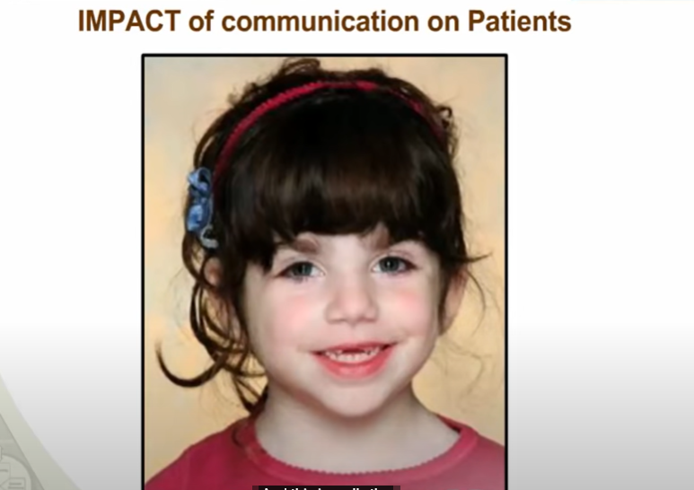
McKinsey Bryant

Slide 3
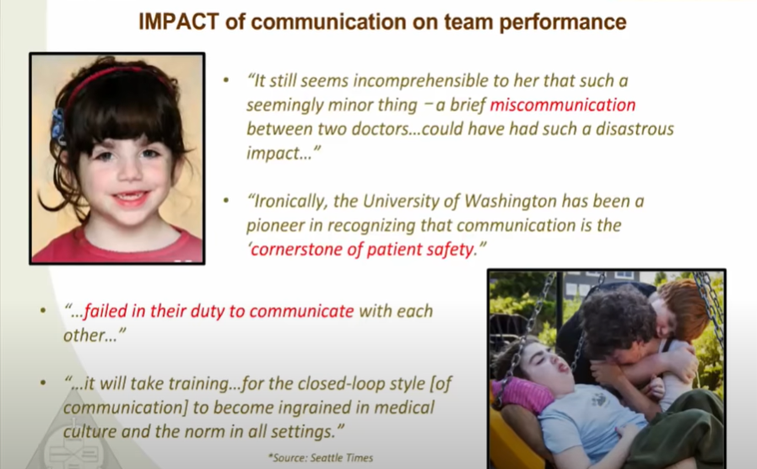

Slide 4
Effective Communication Matters
Communication is a process whereby information is conveyed between a sender and a receiver.
Sender: The producer of a message.
Receiver: One who is given the message produced by the sender
Effective communication: Communication in which the receiver receives and understands the message as the sender intended it.

Slide 5
Communication model in HCOs

Slide 6
ACTIVE LISTENING
A key component of communication is the receiver’s ability to accurately hear what the sender is saying.
Active listening The process of paying close attention to a message so that it is sent and received accurately.
Active listener do communicate by:
    Nonverbal cues (e.g., Body language, posture, and facial expressions like eye contact & nodding).
    Verbal cues (e.g., repeating the information back to the speaker, asking relevant questions)

Slide 7
INTERNAL AND EXTERNAL COMMUNICATIONS
Downward communication the sender primarily in superior organization position (e.g. from department head manager to employee). Such communications are not solely face-to-face interaction also include written forms of communications like e-mails.
Upward communications primarily let managers know about staff issues. Katz (1974) suggests that face-to-face communication in the form of open meetings to discuss employees’ concerns, open-door policies, and walking the halls help create effective forums for this type of communication.
Lateral communication is usually focused on work processes. How the work may be made more efficient, more customer friendly, and more patient centered.

Slide 8

TEAM COMMUNICATION
Frequent, positive communications improve team interactions and increase trust.
Pilots are trained to be team players because a plane full of people may die if they don’t pay attention to their teammates’ observations.
    Crew resource management (CRM) has been developed to address attitudes, change behavior, and improve performance. Anyone can and should speak up if they have safety concerns, from co-pilot to flight attendant.

Slide 9

The military and aviation concepts of CRM and interprofessional teamwork training were picked up and expanded into TeamSTEPPS.
  TeamSTEPPS: A teamwork system designed for health care professionals that is evidence-based and intended to improve communication and teamwork skills among health care professionals.

Slide 10
Call-Out and Check-Back
A call-out is a strategy used to communicate important or critical information.
A call-out:
  Informs all team members simultaneously during situations.
  Helps team members anticipate next steps.
  Directs responsibility to a specific individual assigned to carrying out the task.
  A check-back ensures that information conveyed by the sender is understood by the receiver as intended

Slide 11
Closed-Loop Communication
Use closed loop communication in every clinical
and non-clinical setting.

Slide 12
SBAR
SBAR is a technique for communicating critical information that requires immediate attention and action concerning a patient’s condition.
  Situation - What is going on with the patient?
    “Dr. Smith, this is Barb on 2 West. I am calling about Mrs. Joseph in room 251. Chief complaint is shortness of breath of new onset.”
  Background - What is the clinical background or context?
    “Patient is a 62-year-old female post-op day one from abdominal surgery. No prior history of cardiac or lung disease.”
  Assessment - What do I think the problem is?
    “Breath sounds are decreased on the right side with acknowledgement of pain. Would like to rule out pneumothorax.”
  Recommendation and Request - What should I do to correct it?
    “I feel strongly the patient should be assessed now. Can you come to room 251 now?”

Slide 13

Handover ( For in patients )
Handover is the transfer of information (along with authority and responsibility) during transitions in care across the continuum. It includes an opportunity to ask questions, clarify, and confirm.
One useful handover tool is “I PASS THE BATON.” It enhances information exchange during transitions of care.

Slide 14
“I PASS THE BATON.”
I PASS

Slide 15
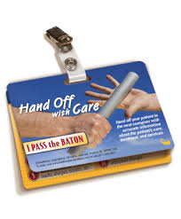
THE
BATON

