Slide 1
Cholinergic antagonists
Dr. Fatimah Almahasneh
Department of Basic Medical Sciences
Faculty of Medicine – Yarmouk University

Slide 2
Cholinergic antagonists
Are agents that bind to cholinoceptors (muscarinic or nicotinic) and prevent the effects of ACh and other cholinergic agents.
Antimuscarinic agents (also known as anticholinergic agents or parasympatholytics) are the most clinically useful cholinergic antagonists and are selective blockers of muscarinic receptors.
The effects of parasympathetic innervation are interrupted, and the actions of sympathetic stimulation are left unopposed.

Slide 3
Cholinergic antagonists
The ganglionic blockers show a preference for the nicotinic receptors of the sympathetic and parasympathetic ganglia.
They are the least clinically important of the cholinergic antagonists.
The neuromuscular-blocking agents (mostly nicotinic antagonists), interfere with transmission of efferent impulses to skeletal muscles.
These agents are used as skeletal muscle relaxant adjuvants in anesthesia during surgery, intubation, and various orthopedic procedures.

Slide 4
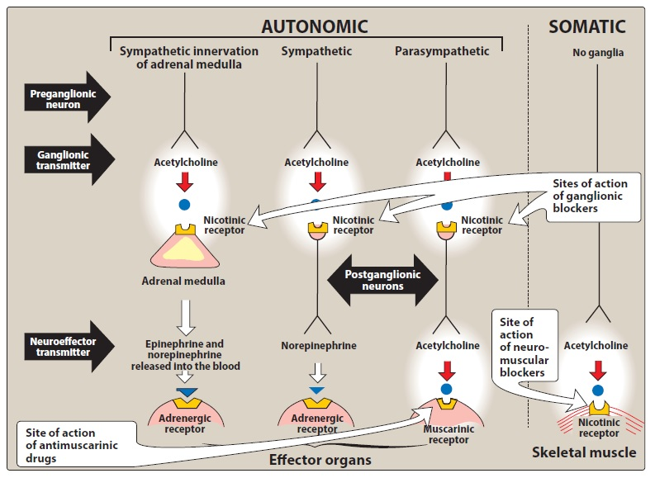
Cholinergic antagonists

Slide 5
Antimuscarinic agents

Slide 6
Antimuscarinic agents
Commonly known as anticholinergic drugs.
They block muscarinic receptors → inhibition of muscarinic functions.
They also block the few exceptional sympathetic neurons that are cholinergic, such as those innervating the sweat glands.
They have little or no action at skeletal neuromuscular junctions (NMJs) or autonomic ganglia.
Note: A number of antihistamines and antidepressants (mainly tricyclic antidepressants) also have antimuscarinic activity.

Slide 7
Atropine
It is a tertiary amine belladonna alkaloid with a high affinity for muscarinic receptors.
It binds competitively and prevents ACh from binding to those sites.
It acts both centrally and peripherally.
Its general actions last about 4 hours, except when placed topically in the eye, where the action may last for days.
The greatest inhibitory effects are on bronchial tissue and the secretion of sweat and saliva.

Slide 8
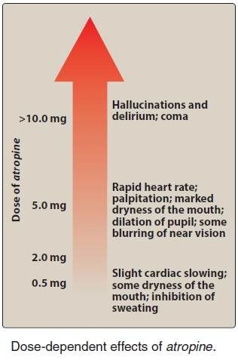
Atropine – Actions

Slide 9
Atropine – Actions
Eye
Atropine blocks muscarinic activity in the eye, resulting in mydriasis (dilation of the pupil), unresponsiveness to light, and cycloplegia (inability to focus for near vision).
In patients with angle-closure glaucoma, intraocular pressure may rise dangerously.

Slide 10
Atropine – Actions
Gastrointestinal
Atropine and its active isomer, L-hyoscyamine can be used as an antispasmodic to reduce activity of the GI tract.
Atropine and scopolamine are probably the most potent antispasmodic drugs available
HCl production is not significantly affected → not effective for the treatment of peptic ulcer.
Doses of atropine that reduce spasms also reduce saliva secretion, ocular accommodation, and urination → poor compliance.

Slide 11
Atropine – Actions
Cardiovascular
Atropine produces divergent effects on the cardiovascular system, depending on the dose.
At low doses, the predominant effect is a slight decrease in heart rate.
results from blockade of the M₁ receptors on the inhibitory presynaptic neurons, thus permitting increased ACh release.
Higher doses of atropine cause a progressive increase in heart rate
by blocking the M₂ receptors on the SA node.

Slide 12
Atropine – Actions
Secretions
Atropine blocks muscarinic receptors in the salivary glands → dryness of the mouth (xerostomia).
The salivary glands are exquisitely sensitive to atropine.
Sweat and lacrimal glands are similarly affected.
Note: Inhibition of secretions by sweat glands can cause elevated body temperature, which can be dangerous in children and the elderly.

Slide 13
Atropine – Therapeutic uses
Ophthalmic
Topical atropine exerts both mydriatic and cycloplegic effects, and it permits the measurement of refractive errors without interference by the accommodative capacity of the eye.
Shorter-acting antimuscarinics (cyclopentolate and tropicamide) have largely replaced atropine due to prolonged mydriasis observed with atropine (7-14 days vs. 6-24 hours with other agents).

Slide 14
Atropine – Therapeutic uses
Antispasmodic
To relax the GI tract.
Cardiovascular
to treat bradycardia of varying etiologies.
Antisecretory
Atropine is sometimes used as an antisecretory agent to block secretions in the upper and lower respiratory tracts prior to surgery.

Slide 15
Atropine – Therapeutic uses
Antidote for cholinergic agonists
treatment of organophosphate (insecticides, nerve gases) poisoning, of overdose of clinically used anticholinesterases such as physostigmine, and in some types of mushroom poisoning (certain mushrooms contain cholinergic substances that block cholinesterases).
The ability of atropine to enter the central nervous system (CNS) is of particular importance in treating central toxic effects of anticholinesterases.

Slide 16
Atropine - Pharmacokinetics
It is readily absorbed, partially metabolized by the liver, and eliminated primarily in urine.
It has a half-life of about 4 hours.

Slide 17
Atropine – Adverse effects
Depending on the dose, atropine may cause dry mouth, blurred vision, “sandy eyes,” tachycardia, urinary retention, and constipation.
Effects on the CNS include restlessness, confusion, hallucinations, and delirium → may progress to depression, collapse of the circulatory and respiratory systems, and death.
Atropine may also induce troublesome urinary retention.

Slide 18
Atropine – Adverse effects
The drug may be dangerous in children, because they are sensitive to its effects, particularly to rapid increases in body temperature that it may elicit.
Low doses of cholinesterase inhibitors, such as physostigmine, may be used to overcome atropine toxicity.

Slide 19
Scopolamine
It is a tertiary amine alkaloid
Produces peripheral effects similar to those of atropine.
Scopolamine has a longer duration of action and a greater action on the CNS than atropine
CNS effects are observed at therapeutic doses

Slide 20
Scopolamine – Actions
Scopolamine is one of the most effective anti–motion sickness drugs available.
It has the unusual effect of blocking short-term memory.
In contrast to atropine, scopolamine produces sedation, but at higher doses, it can produce excitement.
Scopolamine may produce euphoria and is susceptible to abuse.

Slide 21
Scopolamine – Therapeutic uses
Prevention of motion sickness and postoperative nausea and vomiting.
For motion sickness, it is available as a topical patch that provides effects for up to 3 days.
It is much more effective prophylactically than for treating motion sickness once it occurs.
Adverse effects
Similar to atropine

Slide 22
Ipratropium and tiotropium
Quaternary derivatives of atropine.
Approved as bronchodilators for the treatment of bronchospasm in COPD.

Slide 23
Tropicamide and cyclopentolate
Used as ophthalmic solutions to produce mydriasis and cycloplegia.
Tropicamide produces mydriasis for 6 hours and cyclopentolate for 24 hours.

Slide 24
Benztropine and trihexyphenidyl
Are adjuncts to other antiparkinsonian agents to treat Parkinson disease and to treat antipsychotic-induced extrapyramidal symptoms.

Slide 25
Oxybutynin, solifenacin, tolterodine, and trospium
These are synthetic atropine-like drugs used to treat overactive bladder.
By blocking muscarinic receptors in the bladder →
intravesical pressure is lowered
bladder capacity is increased
frequency of bladder contractions is reduced.
Adverse effects
dry mouth, constipation, and blurred vision → limit tolerability of these agents if used continually.

Slide 26
Ganglionic blockers

Slide 27
Ganglionic blockers
Ganglionic blockers specifically act on the nicotinic receptors of both parasympathetic and sympathetic autonomic ganglia.
Some also block the ion channels of the autonomic ganglia.
These drugs show no selectivity toward the parasympathetic or sympathetic ganglia and are not effective as neuromuscular antagonists.
Except for nicotine, the other drugs mentioned in this category are nondepolarizing, competitive antagonists.
Ganglionic blockade is rarely used therapeutically, but often serves as a tool in experimental pharmacology.

Slide 28
Nicotine
Nicotine depolarizes autonomic ganglia, resulting first in stimulation and then in paralysis of all ganglia.
The stimulatory effects are complex and result from increased release of neurotransmitters, due to effects on both sympathetic and parasympathetic ganglia.
The overall response of a physiologic system is a summation of the stimulatory and inhibitory effects of nicotine.

Slide 29
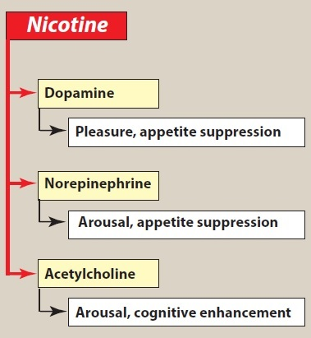
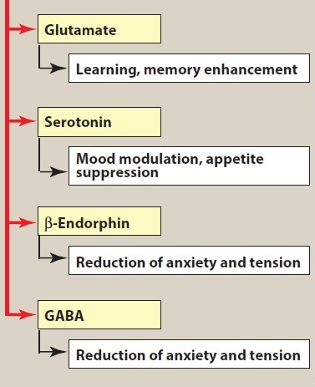
Nicotine

Slide 30
Thank you for your attention

