Slide 1
Adrenergic agonists
Dr. Fatimah Almahasneh
Department of Basic Medical Sciences
Faculty of Medicine – Yarmouk University

Slide 2
Major effects mediated by adrenoceptors

Slide 3
Adrenergic agonists
Catecholamines
Include epinephrine, norepinephrine, isoproterenol, and dopamine.
They share these properties:
High potency
Poor penetration into the CNS: because they are polar / but produce some CNS side effects (anxiety, tremor, headache)
Rapid inactivation: metabolized by catechol-O-methyl-transferase (COMT) postsynaptically and by monoamine oxidase (MAO) intraneuronally, as well as by COMT and MAO in the gut wall, and by MAO in the liver.

Slide 4
Adrenergic agonists
Noncatecholamines
Include phenylephrine, ephedrine, and amphetamine.
Have longer half-life → because they are not inactivated by COMT or MAO.
Have increased lipid solubility → greater access to CNS.

Slide 5
Adrenergic agonists - MOA
Direct-acting agonists
Act directly on α or β receptors, producing effects similar to those that occur following stimulation of sympathetic nerves or release of epinephrine from the adrenal medulla.
Include: epinephrine, norepinephrine, isoproterenol, and phenylephrine.

Slide 6
Adrenergic agonists - MOA
Indirect-acting agonists
These agents block the reuptake of norepinephrine or cause the release of norepinephrine from the adrenergic neuron → norepinephrine then traverses the synapse and binds to α or β receptors.
Examples of reuptake inhibitors and agents that cause norepinephrine release include cocaine and amphetamines, respectively.

Slide 7
Adrenergic agonists - MOA
Mixed-action agonists
Ephedrine and its stereoisomer, pseudoephedrine, both stimulate adrenoceptors directly and release norepinephrine from the adrenergic neuron.

Slide 8
Direct-acting adrenergic agonists

Slide 9
Epinephrine
It is one of the four catecholamines (epinephrine, norepinephrine, dopamine, and dobutamine) commonly used in therapy.
The first three are naturally occurring neurotransmitters, and the latter is a synthetic compound.
Epinephrine interacts with both α and β receptors.
At low doses, β effects (vasodilation) on the vascular system predominate, whereas at high doses, α effects (vasoconstriction) are the strongest.

Slide 10
Epinephrine - Actions
Cardiovascular
Positive inotropic and chronotropic effect (β₁ action) → ↑ CO → ↑ oxygen demands on the myocardium.
Epinephrine activates β₁ receptors on the kidney → renin release.
Epinephrine:
constricts arterioles in the skin, mucous membranes, and viscera → α effects
dilates vessels going to the liver and skeletal muscle → β₂ effects

Slide 11
Epinephrine - Actions
Cardiovascular
Epinephrine also decreases renal blood flow.
The cumulative effect of epinephrine is:
increase in systolic blood pressure, coupled with a slight decrease in diastolic pressure due to β₂ receptor–mediated vasodilation in the skeletal muscle vascular bed.

Slide 12
Epinephrine - Actions
Respiratory
Epinephrine causes powerful bronchodilation by activation of β₂ receptors on bronchial smooth muscles.
It also inhibits the release of allergy mediators such as histamine from mast cells.

Slide 13
Epinephrine - Actions
Hyperglycemia
Epinephrine has a significant hyperglycemic effect because of:
increased glycogenesis in the liver (β₂ effect)
increased release of glucagon (β₂ effect)
decreased release of insulin (α₂ effect).
Lipolysis
through agonist activity on the β receptors of adipose tissue → increased levels of cAMP → stimulate a hormone-sensitive lipase → hydrolyzes triglycerides to free fatty acids and glycerol.

Slide 14
Epinephrine - Therapeutic uses
Drug of choice for the treatment of anaphylactic shock and type I hypersensitivity.
To restore cardiac rhythm in patients with cardiac arrest.
Adjuvant to local anesthetics to produce vasoconstriction → increased duration of action.

Slide 15
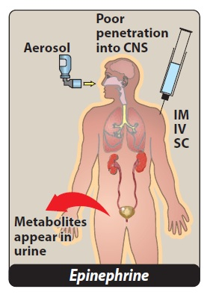
Epinephrine - Pharmacokinetics
Epinephrine has a rapid onset but a brief duration of action (due to rapid degradation).
It is rapidly metabolized by MAO and COMT, and the metabolites metanephrine and vanillylmandelic acid are excreted in urine.

Slide 16
Epinephrine – Adverse effects
Anxiety, fear, tension, headache, and tremor
Cardiac arrhythmias (especially with digoxin)
Pulmonary edema
Nonselective β-blockers prevent vasodilatory effects of epinephrine on β₂ receptors, leaving α receptor stimulation unopposed → increased peripheral resistance and increased blood pressure.

Slide 17
Norepinephrine (NE)
When administered in therapeutic doses, NE mostly affects the α-adrenergic receptors.
Norepinephrine actions
Vasoconstriction: NE causes intense vasoconstriction of most vascular bed, including the kidney (α₁ effect) → ↑ peripheral resistance → ↑ both systolic and diastolic BP.
NE causes greater vasoconstriction than epinephrine, because it does not induce compensatory vasodilation via β₂ receptors on blood vessels supplying skeletal muscles.

Slide 18
Norepinephrine (NE)
Baroreceptor reflex
NE increases blood pressure → stimulates the baroreceptors → rise in vagal activity → reflex bradycardia → counteract the local actions of norepinephrine on the heart.
Therapeutic uses
Treatment of shock

Slide 19
Norepinephrine - Pharmacokinetics
Norepinephrine is given IV for rapid onset of action.
The duration of action is 1 to 2 minutes, following the end of the infusion.
It is rapidly metabolized by MAO and COMT, and inactive metabolites are excreted in the urine.

Slide 20
Norepinephrine – Adverse effects
Similar to epinephrine
May cause blanching and sloughing of the skin along the injected vein.
If extravasation occurs, it can cause tissue necrosis.

Slide 21
Isoproterenol
It is a direct-acting synthetic catecholamine that stimulates both β₁- and β₂-adrenergic receptors.
Rarely used therapeutically.
Isoproterenol produces intense stimulation of the heart → increase heart rate, contractility, and cardiac output.
It dilates the arterioles of skeletal muscle (β₂ effect) → decreased peripheral resistance.
It is a potent bronchodilator

Slide 22
Isoproterenol – Therapeutic uses
Treatment of:
bradycardia and resulting cardiogenic shock.
short QT-syndrome and ventricular tachycardia/ventricular fibrillation storm.
torsades de pointes.

Slide 23
Dopamine
It is the immediate metabolic precursor of norepinephrine.
It occurs naturally in the CNS in the basal ganglia, where it functions as a neurotransmitter, as well as in the adrenal medulla.
Dopamine can activate α- and β-adrenergic receptors.
At higher doses → it causes vasoconstriction by activating α₁ receptors
At lower doses, it stimulates β₁ cardiac receptors.
Binding of dopamine to dopaminergic receptors in the peripheral mesenteric and renal vascular beds produces vasodilation.
Activation of D₂ receptors on presynaptic adrenergic neurons interferes with norepinephrine release.

Slide 24
Dopamine - Actions
Stimulatory effect on the β₁ receptors of the heart → positive inotropic and chronotropic effects.
At very high doses, dopamine activates α₁ receptors on the vasculature → vasoconstriction.
Dopamine dilates renal and splanchnic arterioles by activating dopaminergic receptors → increases blood flow to the kidneys and other viscera.

Slide 25
Dopamine – Therapeutic uses
Treatment of cardiogenic and septic shock.
It raises blood pressure by stimulating
β₁ receptors on the heart to increase cardiac output
α₁ receptors on blood vessels to increase total peripheral resistance.
In addition, it enhances perfusion to the kidney and splanchnic areas → ↑ GFR → diuresis.
Note: NE diminishes blood supply to the kidney and may cause renal shutdown.

Slide 26
Dopamine – Adverse effects
An overdose of dopamine produces the same effects as sympathetic stimulation.
Dopamine is rapidly metabolized by MAO or COMT, and its adverse effects (nausea, hypertension, and arrhythmias) are, therefore, short-lived.

Slide 27
Fenoldopam
It is an agonist of peripheral dopamine D₁ receptors.
It is used as a rapid-acting vasodilator to treat severe hypertension in hospitalized patients, acting on coronary arteries, kidney arterioles, and mesenteric arteries.

Slide 28
Dobutamine
It is a synthetic, direct-acting catecholamine that is a β₁ receptor agonist.
It increases cardiac rate and output with few vascular effects.
Dobutamine is used to increase cardiac output in acute heart failure and for inotropic support after cardiac surgery.

Slide 29
Oxymetazoline
It is a direct-acting synthetic adrenergic agonist that stimulates both α₁- and α₂-adrenergic receptors.
It is found in many over-the-counter short-term nasal spray decongestants, as well as in ophthalmic drops for the relief of redness of the eyes.
Oxymetazoline directly stimulates α receptors on blood vessels supplying the nasal mucosa and conjunctiva, thereby producing vasoconstriction and decreasing congestion.
Rebound congestion and dependence are observed with long-term use.

Slide 30
Phenylephrine
It is a direct-acting, synthetic adrenergic drug that binds primarily to α₁ receptors.
Phenylephrine is a vasoconstrictor that raises both systolic and diastolic blood pressures.
It has no effect on the heart itself but, rather, induces reflex bradycardia when given parenterally.
The drug is used to treat hypotension in hospitalized or surgical patients (especially those with tachycardia).
Phenylephrine acts as a nasal decongestant when applied topically or taken orally.
Phenylephrine is also used in ophthalmic solutions for mydriasis.

Slide 31
Clonidine
It is an α₂ agonist that is used for the treatment of hypertension.
Clonidine acts centrally on presynaptic α₂ receptors → inhibition of sympathetic vasomotor centers → decreased sympathetic outflow to the periphery.
Methyldopa is also an α₂ agonist used to treat hypertension.

Slide 32
Mirabegron
It is a β₃ agonist that relaxes the detrusor smooth muscle during the urine storage phase → increases bladder capacity.
It is used for patients with overactive bladder.

Slide 33
Indirect-acting adrenergic agonists

Slide 34
Amphetamine
It has marked central stimulatory action → drug of abuse.
It has neurologic and clinical effects similar to cocaine.
It significantly increases blood pressure by α₁ agonist action on the vasculature, as well as β₁-stimulatory effects on the heart.
Its actions are mediated primarily through an increase in nonvesicular (intracellular) release of catecholamines such as dopamine and norepinephrine from nerve terminals.

Slide 35
Amphetamine
This group of agents includes:
Dextroamphetamine (major compound)
Methamphetamine (also known as speed)
3,4-Methylenedioxymethamphetamine (also known as MDMA, or Ecstasy) → stimulant and hallucinogenic properties.
Effects: Increases alertness, decreased fatigue, depressed appetite, and insomnia.
Therapeutic uses
Attention deficit hyperactivity disorder (ADHD)
Narcolepsy
Appetite suppression

Slide 36
Cocaine
It is a local anesthetics that blocks the (Na⁺/Cl⁻)-dependent norepinephrine transporter required for cellular uptake of NE into the adrenergic neuron
→ NE accumulates in the synaptic space → enhanced sympathetic activity.
It can increase blood pressure by α₁ agonist actions and β stimulatory effects.

Slide 37
Mixed-action adrenergic agonists

Slide 38
Ephedrine and pseudoephedrine
Release stored onorepinephrine from nerve endings and also directly stimulate both α and β receptors → actions similar to epinephrine but less potent.
Ephedrine and pseudoephedrine are not catechols and are poor substrates for COMT and MAO → long duration of action.
Ephedrine raises systolic and diastolic BP by vasoconstriction and cardiac stimulation → be used to treat hypotension.
It also produces mild stimulation f the CNS.

Slide 39
Ephedrine and pseudoephedrine
Pseudoephedrine is primarily used orally to treat nasal and sinus congestion.
Pseudoephedrine has been illegally used to produce methamphetamine.

Slide 41
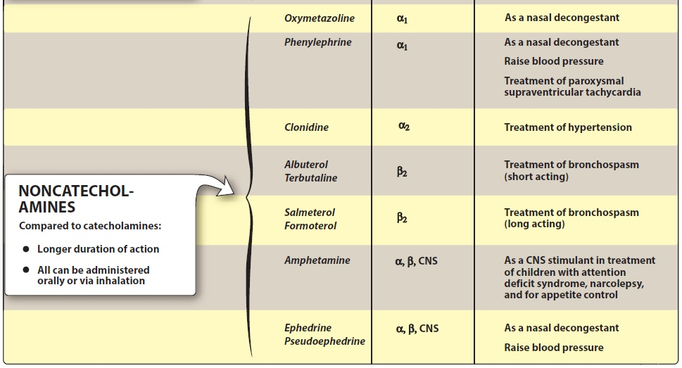

Slide 42
Thank you for your attention

