Slide 1
Cholinergic agonists
Dr. Fatimah Almahasneh
Department of Basic Medical Sciences
Faculty of Medicine – Yarmouk University

Slide 2
Direct-acting cholinergic agonists

Slide 3
Cholinergic agonists
Cholinergic agonists mimic the effects of ACh by binding directly to cholinoceptors (muscarinic or nicotinic).
These agents may be broadly classified into two groups:
endogenous choline esters, which include Ach and synthetic esters of choline, such as carbachol and bethanechol,
naturally occurring alkaloids, such as nicotine and pilocarpine.

Slide 4
Direct-acting cholinergic agonists
All of the direct-acting cholinergic drugs have a longer duration of action than ACh.
The more therapeutically useful drugs (pilocarpine and bethanechol) preferentially bind to muscarinic receptors and are sometimes referred to as muscarinic agents.
However, as a group, the direct-acting agonists show little specificity in their actions, which limits their clinical usefulness.

Slide 5
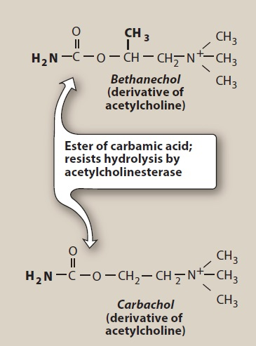
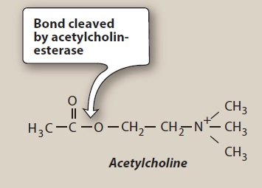
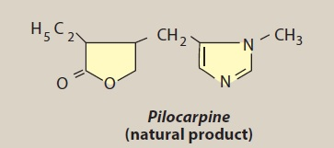
Comparison of the structures of some cholinergic agonists

Slide 6
Acetylcholine
Although it is the neurotransmitter of autonomic ganglia, and parasympathetic and somatic nerves, it lacks therapeutic importance
Multiplicity of actions → diffuse effects
Rapid inactivation by the cholinesterases

Slide 7
Acetylcholine effects
Decrease in heart rate and cardiac output
The actions of ACh on the heart mimic the effects of vagal stimulation.
If injected IV, ACh produces a brief decrease in heart rate (negative chronotropy) and stroke volume, as a result of a reduction in the rate of firing at the sinoatrial (SA) node.

Slide 8
Acetylcholine effects
Decrease in blood pressure
Injection of ACh causes vasodilation and lowering of blood pressure by an indirect mechanism:
ACh activates M₃ receptors found on endothelial cells of the blood vessel smooth muscles → production of NO → NO diffuses to vascular smooth muscle cells → stimulates protein kinase G production → phosphodiesterase-3 inhibition → hyperpolarization → smooth muscle relaxation.

Slide 9
Acetylcholine effects
Decrease in blood pressure
In the absence of administered cholinergic agents, the vascular cholinergic receptors have no known function, because ACh is never released into the blood in significant quantities.
Atropine blocks these muscarinic receptors and prevents ACh from producing vasodilation.

Slide 10
Acetylcholine effects
Other effects of ACh
Increases salivary secretion and stimulates intestinal secretions and motility.
Enhances bronchiolar secretions.
Increases the tone of the detrusor muscle → urination.
Contraction of the ciliary muscle for near vision.
Constriction of the pupillae sphincter muscle → miosis.
→ ACh (1% solution) is instilled into the anterior chamber of the eye to produce miosis during ophthalmic surgery.

Slide 11
Bethanechol
Structurally related to ACh.
It lacks nicotinic actions, but does have strong muscarinic activity.
Its major actions are on the smooth musculature of the bladder and GI tract.
It has about a 1-hour duration of action.

Slide 12
Bethanechol – Actions
Directly stimulates muscarinic receptors, causing increased intestinal motility and tone.
It also stimulates the detrusor muscle of the bladder, whereas the trigone and sphincter muscles are relaxed.
→ These effects produce urination.
Therapeutic uses
Stimulation of atonic bladder
especially in postpartum or postoperative, nonobstructive urinary retention
Treatment of neurogenic atony and megacolon.

Slide 13
Bethanechol – Adverse effects
Are the effects of generalized cholinergic stimulation.
Sweating, salivation, flushing, decreased blood pressure, nausea, abdominal pain, diarrhea, and bronchospasm.
Atropine sulfate may be administered to overcome severe cardiovascular or bronchoconstrictor responses to this agent.

Slide 14
Carbachol
Carbachol has profound effects on both the cardiovascular and GI systems because of its ganglion-stimulating activity.
Locally instilled into the eye, it mimics the effects of ACh → miosis and a spasm of accommodation in which the ciliary muscle of the eye remains in a constant state of contraction.
Therapeutic uses
carbachol is rarely used therapeutically
because of its high potency, receptor nonselectivity, and relatively long duration of action
except in the eye as a miotic agent to treat glaucoma, by causing pupillary contraction and a decrease in intraocular pressure.

Slide 15
Pilocarpine
Actions: Applied topically to the eye, pilocarpine produces rapid miosis and contraction of the ciliary muscle.
When the eye undergoes this miosis, it experiences a spasm of accommodation. The vision becomes fixed at some particular distance, making it impossible to focus.
The drug is beneficial in promoting salivation in patients with xerostomia resulting from irradiation of the head and neck.
Sjögren syndrome, which is characterized by dry mouth and lack of tears, is treated with oral pilocarpine tablets and cevimeline, a cholinergic drug.

Slide 16
Pilocarpine – Use in glaucoma
Pilocarpine is used to treat glaucoma and is the drug of choice for emergency lowering of intraocular pressure of both open-angle and angle-closure glaucoma.
Pilocarpine is extremely effective in opening the trabecular meshwork around the Schlemm canal → increased drainage of aqueous humor → immediate drop in intraocular pressure.
This action occurs within a few minutes, lasts 4 to 8 hours, and can be repeated.
The miotic action of pilocarpine is also useful in reversing mydriasis due to atropine.

Slide 17
Pilocarpine – adverse effects
Pilocarpine can cause blurred vision, night blindness, and brow ache.
Poisoning with this agent is characterized by exaggeration of various parasympathetic effects
Parenteral atropine, at doses that can cross the blood–brain barrier, is administered to counteract the toxicity of pilocarpine.

Slide 18
Indirect-acting cholinergic agonists: anticholinesterase agents (reversible)

Slide 19
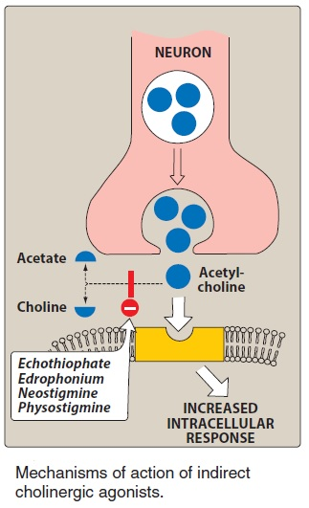
Acetylcholinesterase inhibitors
Inhibitors of AChE (anticholinesterase agents or cholinesterase inhibitors) indirectly provide a cholinergic action by preventing the degradation of ACh. This results in an accumulation of ACh in the synaptic space.
→ these drugs can provoke a response at all cholinoceptors in the body.

Slide 20
Edrophonium
It is the prototype short-acting AChE inhibitor.
It is rapidly absorbed and has a short duration of action of 10 to 20 minutes due to rapid renal elimination.
Edrophonium is a quaternary amine, and its actions are limited to the periphery.

Slide 21
Edrophonium
It is used in the diagnosis of myasthenia gravis
→ Intravenous injection of edrophonium leads to a rapid increase in muscle strength.
Edrophonium may also be used to assess cholinesterase inhibitor therapy, and for reversing the effects of nondepolarizing neuromuscular blockers after surgery.
Due to the availability of other agents, edrophonium use has become limited.

Slide 22
Physostigmine
Physostigmine has a wide range of effects and stimulates not only the muscarinic and nicotinic sites of the ANS but also the nicotinic receptors of the NMJ.
It is an intermediate-acting agent
its duration of action is about 30 minutes to 2 hours.
Therapeutic uses
Treatment of intestine and bladder atony (because it increases their motility).
treatment of overdoses of drugs with anticholinergic actions, such as atropine.

Slide 23
Neostigmine
Unlike physostigmine, neostigmine has a quaternary nitrogen. → it is more polar, is absorbed poorly from the GI tract, and does not enter the CNS.
Its effect on skeletal muscle is greater than that of physostigmine.
Neostigmine has an intermediate duration of action, usually 30 minutes to 2 hours.

Slide 24
Neostigmine
Therapeutic uses
to stimulate the bladder and GI tract
as an antidote for competitive neuromuscular-blocking agents
to manage symptoms of myasthenia gravis.
Adverse effects
salivation, flushing, decreased blood pressure, nausea, abdominal pain, diarrhea, and bronchospasm.
Neostigmine does not cause CNS side effects and is not used to overcome toxicity of central-acting antimuscarinic agents such as atropine.

Slide 25
Pyridostigmine and ambenonium
Pyridostigmine and ambenonium are cholinesterase inhibitors used in the chronic management of myasthenia gravis.
The duration of action are intermediate (3-6 hours and 4-8 hours, respectively).
Adverse effects are similar to those of neostigmine.

Slide 26
Tacrine, donepezil, rivastigmine, and galantamine
Patients with Alzheimer’s disease have a deficiency of cholinergic neurons in the CNS. This observation led to the development of anticholinesterases as possible remedies for the loss of cognitive function.
Tacrine was the first to become available, but it has been replaced by others because of its hepatotoxicity.
Donepezil, rivastigmine, and galantamine are used to delay the progression of Alzheimer’s disease.
GI distress is their primary adverse effect.

Slide 27
Indirect-acting cholinergic agonists: anticholinesterase agents (irreversible)

Slide 28
Anticholinesterase agents (irreversible)
A number of synthetic organophosphate compounds have the capacity to bind covalently to AChE → long-lasting increase in ACh at all sites where it is released.
Many of these drugs are extremely toxic and were developed by the military as nerve agents.
Related compounds, such as parathion and malathion, are used as insecticides.

Slide 29
Echothiophate
Echothiophate is an organophosphate that covalently binds via its phosphate group at the active site of AChE.
Once this occurs, the enzyme is permanently inactivated, and restoration of AChE activity requires the synthesis of new enzyme molecules.
Following covalent modification of AChE, the phosphorylated enzyme slowly releases one of its ethyl groups.
The loss of an alkyl group, which is called aging, makes it impossible for chemical reactivators, such as pralidoxime, to break the bond between the remaining drug and the enzyme.

Slide 30
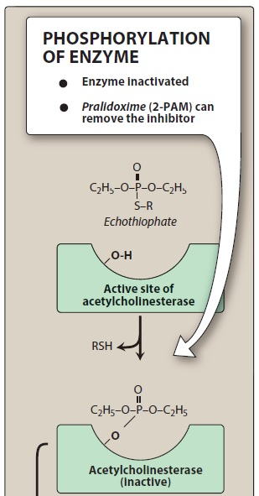
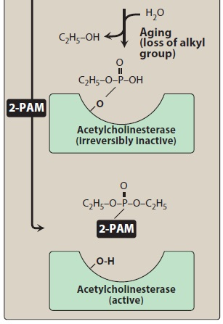
Covalent modification of
acetylcholinesterase by
echothiophate.
Also shown is the reactivation of the enzyme with pralidoxime.
R = (CH3)3N+–CH2–CH2–;
RSH = (CH3)3N+–CH2–CH2–S-H.

Slide 31
Echothiophate
Actions
generalized cholinergic stimulation
paralysis of motor function (causing breathing difficulties)
convulsions.

Slide 32
Echothiophate
Therapeutic uses
Treatment of open-angle glaucoma (topical ophthalmic solution).
It produces intense miosis.
Intraocular pressure falls from the facilitation of outflow of aqueous humor
But rarely used due to its side effects (including the risk of causing cataracts).
Atropine in high dosages can reverse many of the peripheral and some of the central muscarinic effects of echothiophate.

Slide 33
Toxicology of anticholinesterase agents

Slide 34
Toxicology of anticholinesterase agents
Irreversible AChE inhibitors (mostly organophosphate compounds) are commonly used as agricultural insecticides.
numerous cases of accidental poisoning with these agents.
They are frequently used for suicidal and homicidal purposes.
Organophosphate nerve gases such as sarin are used as agents of warfare and chemical terrorism.
Toxicity with these agents is manifested as nicotinic and muscarinic signs and symptoms (cholinergic crisis).
Depending on the agent, the effects can be peripheral or can affect the whole body.

Slide 35
Reactivation of acetylcholinesterase
Pralidoxime (2-PAM) can reactivate inhibited AChE (see slide 50).
However, it is unable to penetrate into the CNS
is not useful in treating the CNS effects of organophosphates.
The presence of a charged group allows it to approach an anionic site on the enzyme, where it essentially displaces the phosphate group of the organophosphate and regenerates the enzyme.
If given before aging of the alkylated enzyme occurs, it can reverse both muscarinic and nicotinic peripheral effects of organophosphates.

Slide 36
Reactivation of acetylcholinesterase
With the newer nerve agents that produce aging of the enzyme complex within seconds, pralidoxime is less effective.
Pralidoxime is a weak AChE inhibitor and, at higher doses, may cause side effects similar to other AChE inhibitors.
In addition, it cannot overcome toxicity of reversible AChE inhibitors (for example, physostigmine).

Slide 37
Other treatments
Atropine is administered to prevent muscarinic side effects of these agents (such as increased bronchial and salivary secretion, bronchoconstriction, and bradycardia).
Diazepam is also administered to reduce the persistent convulsion caused by these agents.
General supportive measures, such as maintenance of patent airway, oxygen supply, and artificial respiration, may be necessary as well.

Slide 38
Thank you for your attention

