Slide 1
Special senses – Olfaction and taste

Slide 2
The chemical senses involve detection of chemical stimuli and transduction of those stimuli into electrical energy that can be transmitted in the nervous system.
Olfaction, the sense of smell, is one of the chemical senses.

Slide 3
Olfaction

Slide 4
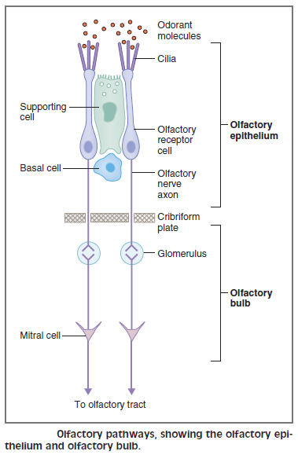
Olfactory pathways

Slide 5
Olfactory pathway
Receptor cells
are located in the olfactory epithelium.
are true neurons that conduct action potentials into the CNS.
Basal cells of the olfactory epithelium are undifferentiated stem cells that continuously turn over and replace the olfactory receptor cells (neurons). These are the only neurons in the adult human that replace themselves.

Slide 6
Olfactory pathway
CN 1 (olfactory)
carries information from the olfactory receptor cells to the olfactory bulb.
The axons of the olfactory nerves are unmyelinated C fibers and are among the smallest and slowest in the nervous system.
Olfactory epithelium is also innervated by CN V (trigeminal), which detects noxious or painful stimuli, such as ammonia.

Slide 7
Olfactory pathway
CN 1 (olfactory)
The olfactory nerves pass through the cribriform plate on their way to the olfactory bulb. Fractures of the cribriform plate sever input to the olfactory bulb and reduce (hyposmia) or eliminate (anosmia) the sense of smell. The response to ammonia, however, will be intact after fracture of the cribriform plate because this response is carried on CN V.

Slide 8
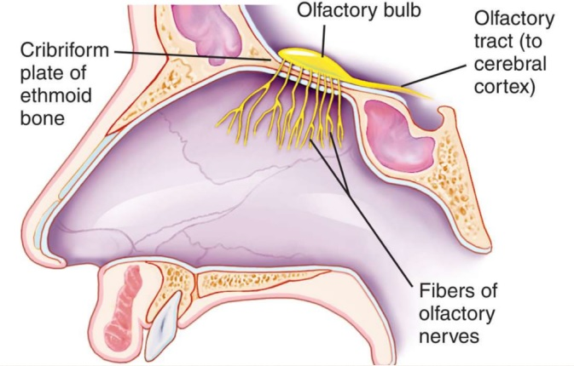

Slide 9
Olfactory pathway
Mitral cells in the olfactory bulb
Are second-order neurons.
Output of the mitral cells forms the olfactory tract, which projects to the prepiriform cortex (in the lateral olfactory area).

Slide 10
Olfactory pathways

Slide 11
Steps in transduction in the olfactory receptor neurons
Odorant molecules bind to specific olfactory receptor proteins located on cilia of the olfactory receptor cells.
When the receptors are activated, they activate G proteins (G_{olf}), which in turn activate adenylate cyclase.
There is an increase in intracellular cAMP that opens Na⁺ channels in the olfactory receptor membrane and produces a depolarizing receptor potential.
The receptor potential depolarizes the initial segment of the axon to threshold, and action potentials are generated and propagated.

Slide 12
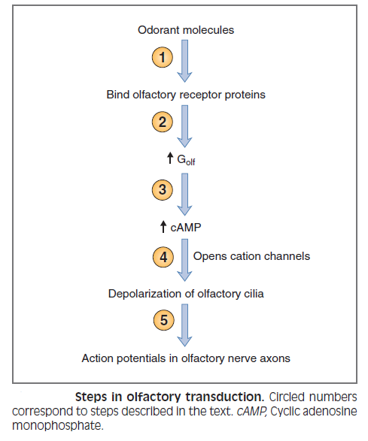
Olfactory transduction

Slide 13
Taste

Slide 14
Taste pathways
Taste receptor cells line the taste buds that are located on specialized papillae. The receptor cells are covered with microvilli, which increase the surface area for binding taste chemicals. In contrast to olfactory receptor cells, taste receptors are not neurons.

Slide 15
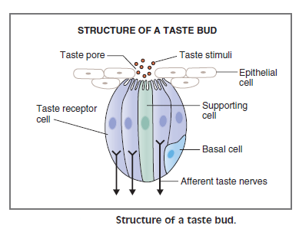
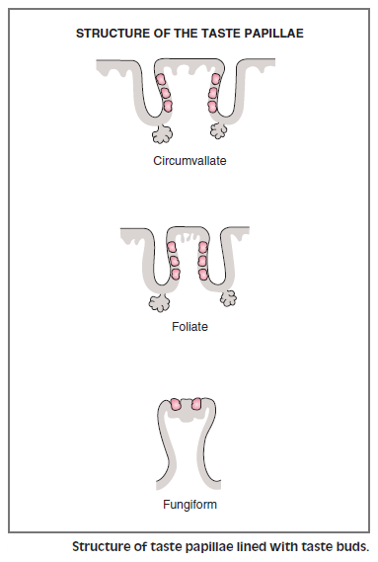

Slide 16
The taste buds consist of three cell types:
Supporting cells: found among the taste receptor cells. Their function is not known.
Basal cells: are undifferentiated stem cells that serve as precursors to taste receptor cells. Basal cells undergo continuous replacement.
Taste receptor cells: are the chemoreceptors of the taste system. They line the taste buds and extend microvilli into the taste pores. They are not neurons. They are specialized epithelial cells that function as chemoreceptors.

Slide 17
Each taste bud usually responds mostly to one of the five primary taste stimuli when the taste substance is in low concentration.
However, at high concentration, most buds can be excited by two or more of the primary taste stimuli, as well as by a few other taste stimuli that do not fit into the “primary” categories.

Slide 18
Taste pathways
The anterior two-thirds of the tongue
has fungiform papillae.
detects salty, sweet, and umami* sensations.
is innervated by CN VII (chorda tympani).
* The fifth category of primary tastes. The word umami means “delicious” in Japanese. Umami taste is triggered by amino acids, especially glutamate. The presence of amino acids, as found in meat, is a marker for a desirable, nutritionally protein-rich food. This taste pathway is also responsible for the distinctive taste of the flavor additive monosodium glutamate (MSG), which is especially popular in Asian dishes.

Slide 19
Taste pathways
The posterior one-third of the tongue
has circumvallate and foliate papillae.
detects sour and bitter sensations.
is innervated by CN IX (glossopharyngeal).
The back of the throat and the epiglottis are innervated by CN X.

Slide 20
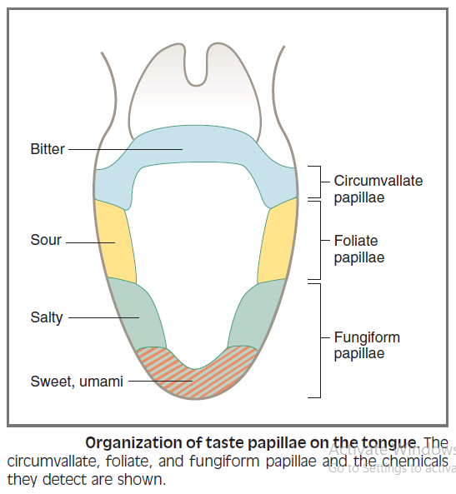

Slide 21
Taste pathways
CN VII, CN IX, and CN X enter the medulla, ascend in the solitary tract, and terminate on second-order taste neurons in the solitary nucleus. They project, primarily ipsilaterally, to the ventral posteromedial nucleus of the thalamus and, finally, to the taste cortex.

Slide 22
Steps in taste transduction
Taste chemicals (sour, sweet, salty, bitter, and umami) bind to taste receptors on the microvilli and produce a depolarizing receptor potential in the receptor cell.

Slide 23
