Slide 1
Special senses – Vision
Dr.Ejlal Abu-El-Rub, Pharm.D, PhD
Physiology and Pathophysiology, Department of Basic Medical Sciences
Faculty of Medicine
Yarmouk University

Slide 2
Introduction
Vision is one of the most important special senses in humans and, along with audition, is the basis for most human communication.
The visual system detects and interprets electromagnetic waves between 400 and 750 nm long, which constitutes visible light

Slide 3
The eye can distinguish two aspects of light, its brightness (or luminance) and its wavelength (or color).
Light enters the eye and impinge on photoreceptors in a specialized sensory epithelium, the retina.
The photoreceptors include rods and cones.
Rods have high sensitivity for detecting low light intensities but do not provide well-defined visual images, nor do they contribute to color vision. Rods operate best under conditions of reduced lighting (scotopic vision).
Cones, by contrast, are not as sensitive to light as rods are and thus operate best under daylight conditions (photopic vision). Cones are responsible for high visual acuity and color vision

Slide 4
Information processing within the retina is performed by retinal interneurons, and the output signals are carried to the brain by the axons of retinal ganglion cells.
The axons travel in the optic nerves; there is a partial crossing in the optic chiasm that results in all input from one side of the visual space being directed to the opposite side of the brain.
Posterior to the optic chiasm, the axons of retinal ganglion cells pass through the optic tracts and synapse in nuclei of the brain.
The main visual pathway in humans is through the lateral geniculate nucleus (LGN) of the thalamus. This nucleus projects through the visual radiation to the visual cortex.
Other visual pathways project to the superior colliculus, pretectum, and hypothalamus, and these structures participate in orientation of the eyes, control of pupil size, and circadian rhythms, respectively.

Slide 5
The Eye structure
The wall of the eye is composed of three concentric layers:
1. The outer layer, or the fibrous coat, includes the transparent cornea, with its epithelium (the conjunctiva), and the opaque sclera.
2.The middle layer, or vascular coat, includes the iris and the choroid. The iris contains both radially and circularly oriented smooth muscle fibers, which make up the pupillary dilator and sphincter muscles. The choroid is rich in blood vessels that support the outer layers of the retina, and it also contains pigment.
3. The innermost layer of the eye is the retina, which is embryologically derived from the diencephalon and is therefore part of the central nervous system (CNS).
The functional part of the retina covers the entire posterior aspect of the eye except for the optic nerve head or optic disc, which is where the optic nerve axons leave the retina. Because there are no receptors at this location, it is often referred to as the anatomic "blind spot"

Slide 6
Light enters the eye through the cornea and passes through a series of transparent fluids and structures that are collectively called the dioptric media.
These fluids and structures consist of the cornea (major refractive area), aqueous humor, lens (can change shape and vary its refractive power ,thus, the lens is responsible for adjusting the optical focus of the eye), and vitreous humor.
The aqueous humor, located in the anterior and posterior chambers and the vitreous humor in the space behind the lens, respectively, help maintain the shape of the eye. The aqueous humor is secreted by the epithelium of the ciliary body into the posterior chamber of the eye. It then circulates through the pupil and into the anterior chamber, where it is drained into the venous system by the canal of Schlemm.
Aqueous humor pressure, which is normally less than 22 mm Hg, determines the pressure within the eye.
The vitreous humor is a gel composed of extracellular fluid that contains collagen and hyaluronic acid; unlike aqueous humor, however, it turns over very slowly.

Slide 7
Muscular control of the eye
A number of functions of the eyes are under muscular control.
Externally attached extraocular muscles ( aim the eyes toward an appropriate visual target and are innervated by the oculomotor (cranial nerve [CN] III), trochlear (CN IV), and abducens (CN VI) nerves.
The muscles in the ciliary body control lens shape and thereby the focus of images on the retina.
The pupillary dilator and sphincter muscles allow the iris to control the amount of light entering the eye, similar to the diaphragm of a camera. The dilator is activated by the sympathetic nervous system, whereas the sphincter and ciliary muscles are controlled by the parasympathetic nervous system (through the oculomotor nerve)

Slide 8
4.Suspensory ligaments (or zonule fibers), which attach to the wall of the eye at the ciliary body, hold the lens in place.
When the muscles in the ciliary body are relaxed, the tension exerted by the suspensory ligaments flattens the lens. When the ciliary muscles contract, the tension on the suspensory ligaments is reduced; this process allows the somewhat elastic lens to assume a more spherical shape.

Slide 9
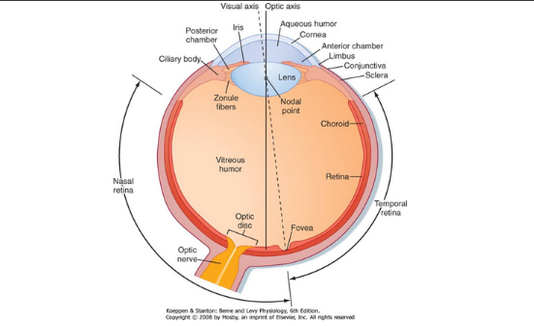

Slide 10
Eye protection
The eye is well protected from injury by the bony walls of the orbit.
The cornea is moistened and kept clear by tears that course from the lacrimal gland in the upper portion of each orbit across the surface of the eye to empty via the lacrimal duct into the nose.
Blinking helps keep the cornea moist (Renewing of the tear film, Mechanical protection)

Slide 12
Retina

Slide 13
Layers of the Retina
The 10 layers of the retina:
The retina begins with the pigmented epithelium (layer 1), which is just inside the choroid.
The pigment cells have tentacle-like processes that extend into the photoreceptor layer (layer 2) and surround the outer segments of the rods and cones.
These processes prevent transverse scatter of light between photoreceptors.
Further, They serve a mechanical function in maintaining contact between layers 1 and 2 so that the pigmented epithelium can:
(1) provide nutrients and remove waste from the photoreceptors;
(2) phagocytose the ends of the outer segments of the rods, which are continuously shed;
(3) reconvert metabolized photopigment into a form that can be reused after it is transported back to the photoreceptors.

Slide 14
Layers of the Retina
Retinal glial cells, known as Müller cells, play an important role in maintaining the internal geometry of the retina.
Müller cells are oriented radially, parallel to the light path through the retina.
The outer ends of Müller cells form tight junctions with the inner segments of the photoreceptors. The numerous connections made between Müller cells and the inner segments give the appearance of a continuous layer, the outer limiting membrane (layer 3 of the retina).

Slide 15
Layers of the Retina
Inside the external limiting membrane is a layer of nuclei called the outer nuclear layer (layer 4 of the retina) that contains the cell bodies and nuclei of the rods and cones.
The next layer of the retina (layer 5) is called the outer plexiform layer, it contains synapses between the photoreceptors and retinal interneurons, including the bipolar cells and horizontal cells, whose cell bodies are found in the inner nuclear layer (layer 6 of the retina).
This layer also contains the cell bodies of other retinal interneurons (the amacrine and interplexiform cells) and the Müller cells

Slide 16
Layers of the Retina
The next layer is the inner plexiform layer (layer 7 of the retina). It contains synapses between the retinal neurons of the inner nuclear layer, including the bipolar and amacrine cells, and the ganglion cells.
Layer 8 of the retina is the ganglion cell layer. The ganglion cells are the output cells of the retina; it is their axons that transmit visual information to the brain.
These axons form the optic fiber layer (layer 9 of the retina), pass along the vitreous surface of the retina while avoiding the fovea, and enter the optic disc, where they leave the eye in the optic nerve.
The portions of the ganglion cell axons that are in the optic fiber layer remain unmyelinated, but the axons become myelinated after they reach the optic disc. The lack of myelin where the axons cross the retina is a specialization that helps permit light to pass through the inner retina with minimal distortion.
The innermost layer of the retina is the inner limiting membrane (layer 10 of the retina). This layer is formed by the end-feet of Müller cells

Slide 17
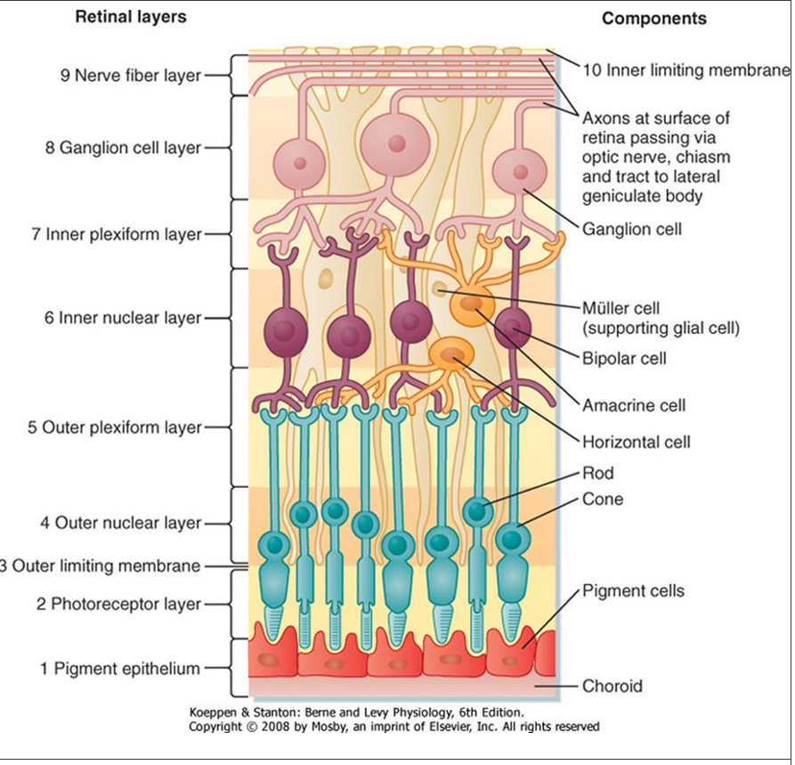

Slide 18
Structure of Photoreceptors: Rods and Cones
Each rod or cone photoreceptor cell is composed of : cell body ,an inner segment and an outer segment, and a synaptic terminal.
1.The outer segment contains stacks of disc membranes , it is short in Cones and long in Rods
These discs are rich in photopigment molecules, but the greater photopigment density of rods accounts for their greater sensitivity to light, single photon can elicit a rod response, whereas several hundred photons may be required for a cone response.

Slide 19
Structure of Photoreceptors: Rods and Cones
2. The inner segments of the photoreceptors are connected to the outer segments by a modified cilium .
The inner segments contain a number of organelles, including numerous mitochondria.
The photopigment is synthesized in the inner segment and incorporated into the membranes of the outer segment.

Slide 20
rods and cones synapse on bipolar cells, which synapse on the ganglion cells.
1.Few cones synapse on a single bipolar cell, which synapses on a single ganglion cell. This arrangement is the basis for the high acuity and low sensitivity of the cones. In the fovea, where acuity is highest, the ratio of cones to bipolar cells is 1:1.
2. Many rods synapse on a single bipolar cell. As a result, there is less acuity in the rods than in the cones. There is also greater sensitivity in the rods because light striking any one of the rods will activate the bipolar cell.
Horizontal and amacrine cells form local circuits with the bipolar cells.

Slide 21
Regional Variations in the Retina
The macula lutea is the area of central vision and is characterized by a slight thickening and a pale color, the thickness is due to the high concentration of photoreceptors and interneurons, which are needed for high-resolution vision. The pale color is a consequence of the fact that both optic nerve fibers and blood vessels are routed around it.
The fovea, which is a depression in the macula lutea, is the region of the retina that has the very highest visual resolution. The fovea has cones with unusually long and thin outer segments. This cone shape permits high packing density. In fact, cone density is maximal in the fovea, and this high density provides for high visual resolution, as well as high quality of the image
The optic disc ,lacks photoreceptors and therefore lacks photosensitivity. Thus, the optic disc is a "blind spot" in the visual surface of the retina.

Slide 22
Pigments in the photoreceptors
The pigment found in the outer segments of rods is rhodopsin. Rhodopsin is comprised of retinal, an aldehyde of vitamin A, and a protein called opsin (Absorb at 500 nm)
Three variants of visual pigment (each contains retinal and an opsin) are found in cones, and these cone pigments absorb best at 437 nm (blue), 533 nm (green), or 564 nm (red).
A few retinal ganglion cells contain melanopsin rather than rhodopsin or cone pigments. The axons of these neurons project to the suprachiasmatic nuclei of the hypothalamus

Slide 23
Pigments in the Photoreceptors
Rhodopsin is formed when a retinal isomer, 11-cis retinal, is combined with a glycoprotein opsin.
When rhodopsin absorbs light, it is "boosted" to a higher energy state. This boost causes a series of chemical changes that lead to isomerization of 11-cis retinal to all-trans retinal.
Separation of all-trans retinal from opsin causes bleaching of the visual pigment

Slide 24
Optic Pathway

Slide 25
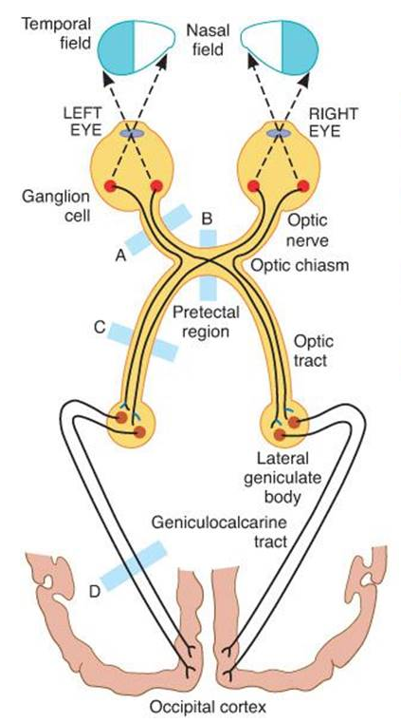
The axons of the ganglion cells pass caudally in the optic nerve and optic tract to end in the lateral geniculate body in the thalamus .
*The fibers from each nasal hemiretina decussate in the optic chiasm.
From the thalamus, the lateral geniculate body will form the
Optic radiation that will end up in the Visual cortex in the Occipital lobe
The visual radiation fans out, upper visual field project to the lingual gyrus, below the calcarine fissure, whereas, lower visual field project to the adjacent cuneus gyrus, which lies just above the calcarine fissure

Slide 26
Steps of photoreception in the rods

Slide 27
In darkness, photoreceptors are slightly depolarized (around -40 mV) because cGMP-gated Na⁺ channels in their outer segments are open, thereby increasing the membrane potential toward the Na⁺ equilibrium potential. This net influx of Na⁺ results in a continuous current, called the dark current.

Slide 28
Light on the retina converts 11-cis retinal to all-trans retinal, a process called photoisomerization.
A series of intermediates is then formed, one of which is metarhodopsin II.
* Vitamin A is necessary for the regeneration of 11-cis rhodopsin. Deficiency of vitamin A causes night blindness.

Slide 29
Metarhodopsin II activates a G protein called transducin (G_{t}), which in turn activates a cyclic guanosine monophosphate phosphodiesterase.
Phosphodiesterase catalyzes the conversion of cyclic guanosine monophosphate (cGMP) to 5′-GMP, and cGMP levels decrease.
Decreased levels of cGMP cause closure of Na⁺ channels, decreased inward Na⁺ current, and, as a result, hyperpolarization of the photoreceptor cell membrane. Increasing light intensity increases the degree of hyperpolarization.

Slide 30
When the photoreceptor is hyperpolarized, there is decreased release of the excitatory transmitter glutamate. There are two types of glutamate receptors on bipolar and horizontal cells, which determine whether the cell is excited or inhibited.
Ionotropic glutamate receptors are excitatory. If decreased release of glutamate from the photoreceptors interacts with ionotropic receptors, there will be hyperpolarization (inhibition) because there is decreased excitation.
Metabotropic glutamate receptors are inhibitory. If decreased release of glutamate from photoreceptors interacts with metabotropic receptors, there will be depolarization (excitation) because there is decreased inhibition.

Slide 31
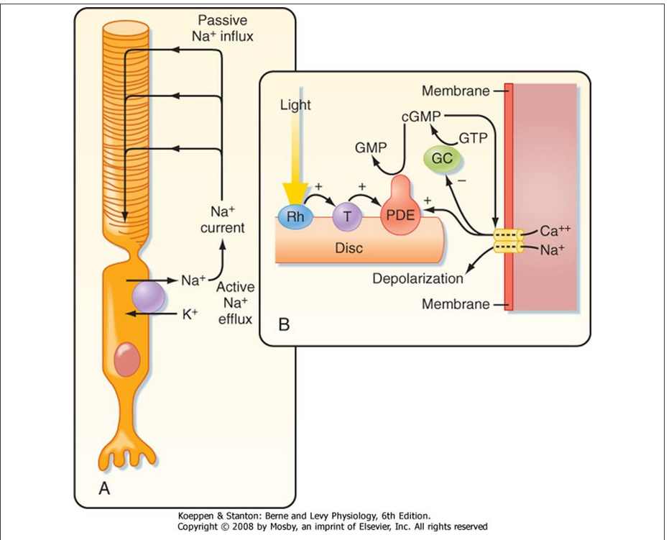

Slide 33
Color Vision

Slide 34
trichromacy theory
The three visual pigments in the cone outer segments have opsins that differ from the opsin found in rhodopsin. As a result of these differences, the three types of cone pigments absorb light best at different wavelengths (Blue, Green, and Red).
These differences in absorption efficiency are presumed to account for color vision because a suitable mixture of three colors can produce any other color.
At least two different kinds of cones are required for color vision.

Slide 35
opponent process theory
It is based on observations that certain pairs of colors seem to activate opposing neural processes.
Green and red are opposed, as are yellow and blue, as well as black and white.
Furthermore, a greenish red or a bluish yellow color does not exist. These observations are supported by findings that neurons activated by green are inhibited by red. Similarly, neurons excited by blue may be inhibited by yellow. Neurons with these characteristics are found both in the retina and at higher levels of the visual pathway and seem to serve to increase our ability to see the contrast between opposing colors

Slide 36
Visual Adaptation

Slide 37
Light adaptation is associated with a reduction in the amount of rhodopsin and the resulting reduced photosensitivity.
Light adaptation, which occurs rapidly, within seconds, favors cone vision because the rhodopsin in rods bleaches (separates from its opsin) more readily than the cone pigments do.

Slide 38
In dark adaptation, a process that results in an increase in visual sensitivity. Cones adapt more rapidly to darkness than rods do, but their adapted threshold is relatively high. Thus, cones do not function when the ambient light level is low. By contrast, rods adapt to darkness slowly, but their sensitivity increases. Within 10 minutes in a dark room, rod vision is more sensitive than cone vision

Slide 39
Visual receptive fields

Slide 40
Photoreceptor, horizontal cells and bipolar cells
A characteristic of the bipolar and ganglion cells, is that they respond best to a small, circular stimulus and that, within their receptive field, an annulus of light around the center (surround illumination) antagonizes the response to the central spot
The characteristics of the receptive fields of retinal ganglion cells constitute an important step in visual information processing because it is this processed information about visual events that is conveyed to the brain.

Slide 41
Ganglion cells and lateral geniculate cells
Each bipolar cell receives input from many receptor cells. In turn, each ganglion cell receives input from many bipolar cells. The receptor cells connected to a ganglion cell form the center of its receptor field. The receptor cells connected to ganglion cells via horizontal cells form the surround of its receptive field. The response of bipolar and horizontal cells to light depends on whether that cell has ionotropic or metabotropic receptors).

Slide 42
On-center, off-surround is one pattern of a ganglion cell receptive field. Light striking the center of the receptive field depolarizes (excites) the ganglion cell, whereas light striking the surround of the receptive field hyperpolarizes (inhibits) the ganglion cell. Off-center, on-surround is another possible pattern.
Lateral geniculate cells of the thalamus retain the on-center, off-surround or off-center, on-surround pattern that is transmitted from the ganglion cell.

Slide 43
Receptive fields of the visual cortex
Neurons in the visual cortex detect shape and orientation of figures.
Three cortical cell types are involved:
Simple cells have center-surround, on-off patterns, but are elongated rods rather than concentric circles. They respond best to bars of light that have the correct position and orientation.
Complex cells respond best to moving bars or edges of light with the correct orientation.
Hypercomplex cells respond best to lines with particular length and to curves and angles.

Slide 44
PROCESSING OF VISUAL INFORMATION IN THE RETINA
In a sense, the processing of visual information in the retina involves the formation of three images. The first image, formed by the action of light on the photoreceptors, is changed to a second image in the bipolar cells, and this in turn is converted to a third image in the ganglion cells.
In the formation of the second image, the signal is altered by the horizontal cells, and in the formation of the third, it is altered by the amacrine cells. There is little change in the impulse pattern in the lateral geniculate bodies, so the third image reaches the occipital cortex.

Slide 45
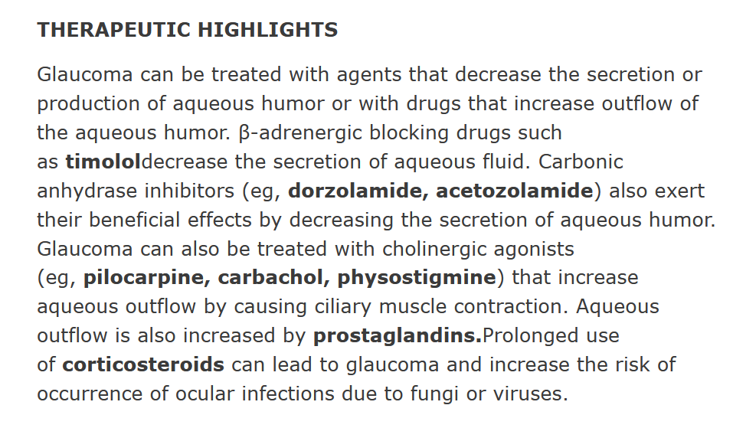
Clinical Insight
Glaucoma is caused by poor drainage of the aqueous humor through the filtration angle formed between the iris and the cornea. If left untreated, glaucoma can lead to blindness.

Slide 46
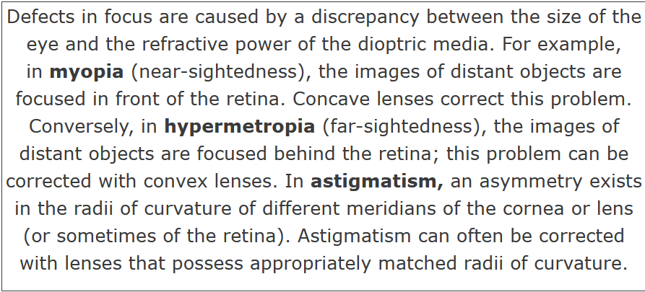
Clinical Insight

