Slide 1
Autonomic nervous system (ANS)
Dr. Ejlal Abu-EL-Rub
Physiology and Pathophysiology, Department of Basic Medical Sciences, faculty of Medicine, Yarmouk University
Chapter 10 Berne and Levy, Chapter 12 Guyton

Slide 2
Autonomic nervous system (ANS)
Is a set of pathways to and from the central nervous system (CNS) that innervates and regulates smooth muscle, cardiac muscle, and glands.
It is distinct from the somatic nervous system, which is a voluntary motor system under conscious control and innervates skeletal muscle.
It has three divisions: sympathetic, parasympathetic, and enteric.

Slide 3
Organization of the ANS

Slide 4
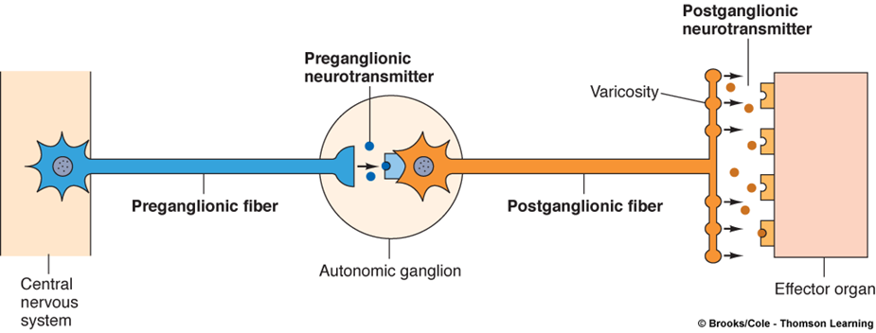
Autonomic nervous system (ANS)
Each pathway in the ANS consists of two neurons: a preganglionic neuron and a postganglionic neuron.

Slide 5
The cell body of each preganglionic neuron resides in the CNS. The axons of these preganglionic neurons synapse on the cell bodies of postganglionic neurons in one of several autonomic ganglia located outside the CNS.
The axons of the postganglionic neurons then travel to the periphery, where they synapse on visceral effector organs such as the heart, bronchioles, vascular smooth muscle…etc.

Slide 6
Synapses between neurons are made in the autonomic ganglia.
Parasympathetic ganglia are located in or near the effector organs.
Sympathetic ganglia are located in the paravertebral chain.

Slide 7
Preganglionic neurons have their cell bodies in the CNS and synapse in autonomic ganglia.
Preganglionic neurons of the sympathetic nervous system originate in spinal cord segments T1–L3 or the thoracolumbar region.
Preganglionic neurons of the parasympathetic nervous system originate in the nuclei of cranial nerves and in spinal cord segments S2–S4 or the craniosacral region.

Slide 8
Postganglionic neurons of both divisions have their cell bodies in the autonomic ganglia and synapse on effector organs (e.g., heart, blood vessels, sweat glands).
In the ANS, post-ganglionic neurons that innervate target tissues form diffuse, branching networks. Beads (varicosities) line these branches and are sites of neurotransmitter synthesis, storage and release → analogous to presynatic nerve terminals of the neuromuscular junction.

Slide 10
There is overlap in the branching networks from different postganglionic neurons, such that target tissues may be innervated by many postganglionic neurons.
In the ANS, postsynaptic receptors are widely distributed on the target tissues.

Slide 11
Adrenal medulla is a specialized ganglion of the sympathetic nervous system.
The cell bodies of its preganglionic neurons are located in the thoracic spinal cord.
Preganglionic fibers synapse directly on chromaffin cells in the adrenal medulla.

Slide 12
The chromaffin cells secrete epinephrine (80%) and norepinephrine (20%) into the circulation (in contrast with sympathetic postganglionic neurons, which release only norepinephrine).
phenylethanolamine-N-methyltransferase (PNMT) in the adrenal medulla but not in sympathetic postganglionic adrenergic neurons.
PNMT catalyzes the conversion of norepinephrine to epinephrine, a step that, interestingly, requires cortisol from the nearby adrenal cortex; cortisol is supplied to the adrenal medulla in venous effluent from the adrenal cortex.

Slide 15
Neurotransmitters of the ANS

Slide 16
Adrenergic neurons release norepinephrine as the neurotransmitter.
Cholinergic neurons, whether in the sympathetic or parasympathetic nervous system, release acetylcholine (ACh) as the neurotransmitter.
Nonadrenergic, noncholinergic neurons include some postganglionic parasympathetic neurons of the gastrointestinal tract, which release substance P, vasoactive intestinal peptide (VIP), or nitric oxide (NO).

Slide 17
Preganglionic neurons of the sympathetic division are always cholinergic. They release ACh, which interacts with nicotinic (N₂) receptors on the cell bodies of postganglionic neurons.
Postganglionic neurons of the sympathetic division are adrenergic in all of the effector organs, except in the thermoregulatory sweat glands (where they are cholinergic).
Most postganglionic neurons of the parasympathetic division are cholinergic. Receptors for ACh in the effector organs are muscarinic receptors rather than nicotinic receptors.

Slide 18
Receptor types in the ANS

Slide 19
Autonomic receptors are G protein–linked receptors.
G proteins couple G protein–linked autonomic receptors to adenylyl cyclase or phospholipase C, which, when activated, generate a second messenger (cyclic adenosine monophosphate [cAMP] or IP3, respectively).
In some cases (e.g., certain muscarinic receptors), the G protein directly alters the function of an ion channel without the mediation of a second messenger.

Slide 20
Adrenergic receptors (adrenoreceptors)
α₁ Receptors
are located on vascular smooth muscle of the skin and splanchnic regions, the gastrointestinal (GI) and bladder sphincters, and the radial muscle of the iris.
produce excitation (e.g., contraction or constriction).

Slide 21
α₁ Receptors
are equally sensitive to norepinephrine and epinephrine. However, only norepinephrine released from adrenergic neurons is present in high enough concentrations to activate α₁ receptors.
Mechanism of action: G_{q} protein, stimulation of phospholipase C and increase in inositol 1,4,5-triphosphate (IP3) and intracellular [Ca²⁺].

Slide 22
α₂ Receptors
are located on sympathetic postganglionic nerve terminals (autoreceptors), platelets, fat cells, and the walls of the GI tract (heteroreceptors).
often produce inhibition (e.g., relaxation or dilation).
Mechanism of action: G_{I} protein, inhibition of adenylate cyclase and decrease in cyclic adenosine monophosphate (cAMP).

Slide 23
β₁ Receptors
Are located in the sinoatrial (SA) node, atrioventricular (AV) node, and ventricular muscle of the heart.
produce excitation (e.g., increased heart rate, increased conduction velocity, increased contractility).
are sensitive to both norepinephrine and epinephrine, and are more sensitive than the α₁ receptors.
Mechanism of action: G_{s} protein, stimulation of adenylate cyclase and increase in cAMP.

Slide 24
β₂ Receptors
are located on vascular smooth muscle of skeletal muscle, bronchial smooth muscle, and in the walls of the GI tract and bladder.
produce relaxation (e.g., dilation of vascular smooth muscle, dilation of bronchioles, relaxation of the bladder wall).
are more sensitive to epinephrine than to norepinephrine.
are more sensitive to epinephrine than the α₁ receptors.
Mechanism of action: same as for β₁ receptors.

Slide 25
Cholinergic receptors (cholinoreceptors)
Nicotinic receptors
are located in the autonomic ganglia (N₂/N_{N}) of the sympathetic and parasympathetic nervous systems, at the neuromuscular junction (N₁/N_{M}), and in the adrenal medulla (N₂/N_{N}).
The receptors at these locations are similar, but not identical.
are activated by ACh or nicotine.

Slide 26
Nicotinic receptors
produce excitation.
are blocked by ganglionic blockers (e.g., hexamethonium) in the autonomic ganglia, but not at the neuromuscular junction.
Mechanism of action: ACh binds to α subunits of the nicotinic ACh receptor. The nicotinic ACh receptors are ion channels for Na⁺ and K⁺.

Slide 27
Muscarinic receptors
Are located in the heart (M₂), smooth muscle (M₃), and glands (M₃).
are inhibitory in the heart (e.g., decreased heart rate, decreased conduction velocity in AV node).
are excitatory in smooth muscle and glands (e.g., increased GI motility, increased secretion).
are activated by ACh and muscarine.
are blocked by atropine.

Slide 28
Muscarinic receptors
Mechanism of action:
Heart SA node: G_{I} protein, inhibition of adenylate cyclase, which leads to opening of K⁺ channels, slowing of the rate of spontaneous Phase 4 depolarization, and decreased heart rate.
Smooth muscle and glands: G_{q} protein, stimulation of phospholipase C, and increase in IP₃ and intracellular [Ca²⁺].

Slide 30
Effects of the ANS on various organ systems

Slide 31
Sympathetic nervous system
The overall function of the sympathetic nervous system is to mobilize the body for activity.
Stressful situation → “fight or flight”
Increased arterial pressure
increased blood flow to active muscles
increased metabolic rate
increased blood glucose concentration
increased mental activity
The sympathetic nervous system operates continuously to modulate the functions of many organ systems.

Slide 32
Parasympathetic nervous system
The overall function of the parasympathetic nervous system is restorative, to conserve energy.
The parasympathetic cholinergic varicosities release both the classic neurotransmitter (ACh) and nonclassic neurotransmitters (e.g., vasoactive intestinal peptide [VIP], NO).

Slide 33
Reciprocal Functions – Sympathetic and Parasympathetic
Most organs have both sympathetic and parasympathetic innervation.
These innervations operate reciprocally or synergistically to produce coordinated responses.

Slide 34
Sinoatrial (SA) node
The SA node is the normal pacemaker of the heart, and its rate of depolarization determines the overall heart rate.
The SA node has both sympathetic and parasympathetic innervations, which function reciprocally to modulate the heart rate.
sympathetic activity → ↑ heart rate
parasympathetic activity → ↓heart rate
↓in BP → vasomotor centers in the brain stem ↑sympathetic activity and ↓ parasympathetic activity → ↑HR
Synergistic effect

Slide 35
Urinary bladder
In adults, micturition (= emptying of the bladder) is under voluntary control → the external sphincter is composed of skeletal muscle.
However, the micturition reflex itself is controlled by the autonomic nervous system (when the bladder is sensed as being “full”) → the detrusor muscle of the bladder wall and the internal bladder sphincter are composed of smooth muscle.
Sympathetic innervation → L1-L3
Parasympathetic innervation → S2-S4

Slide 36
Urinary bladder
When the bladder is filling with urine, sympathetic control predominates
relaxation of the detrusor muscle via β2 receptors
contraction of the internal sphincter muscle via α1 receptors.
When the bladder is full → sensed by mechanoreceptors in the bladder wall → afferent neurons transmit this signal to the spinal cord and then brain stem. Parasympathetic control predominates
contraction of the detrusor muscle (to increase pressure and eject urine)
relaxation of the internal sphincters

Slide 38
Pupil
The size of the pupil is reciprocally controlled by two muscles of the iris: the pupillary dilator (radial) muscle and pupillary constrictor (sphincter) muscle.
The pupillary dilator muscle is controlled by sympathetic innervation through α₁ receptors. Activation of these α₁ receptors causes constriction of the radial muscle, which causes dilation of the pupil (mydriasis).
The pupillary constrictor muscle is controlled by parasympathetic innervation through muscarinic receptors. Activation of these muscarinic receptors causes constriction of the sphincter muscle, which causes constriction of the pupil, or miosis.

Slide 39
There are some notable exceptions to the generalization of reciprocal innervation.
Several organs have only sympathetic innervation:
sweat glands
vascular smooth muscle
pilomotor muscles of the skin
liver
adipose tissue
kidney

Slide 42
Autonomic centers- brain stem and hypothalamus

Slide 43
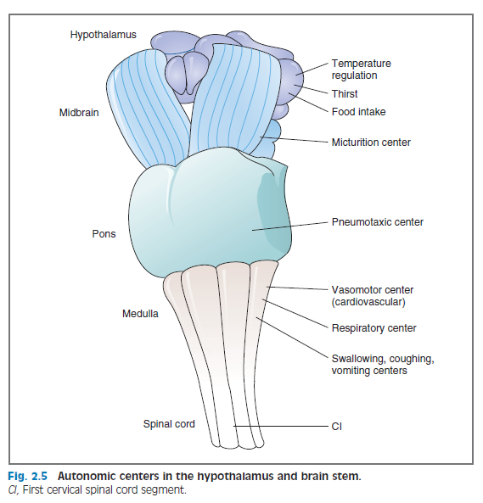
Centers in the hypothalamus and brain stem coordinate the autonomic regulation of organ system functions.

