Slide 1
Teamwork
Lec 6
MED 311
Dr. Ola Soudah

Slide 2
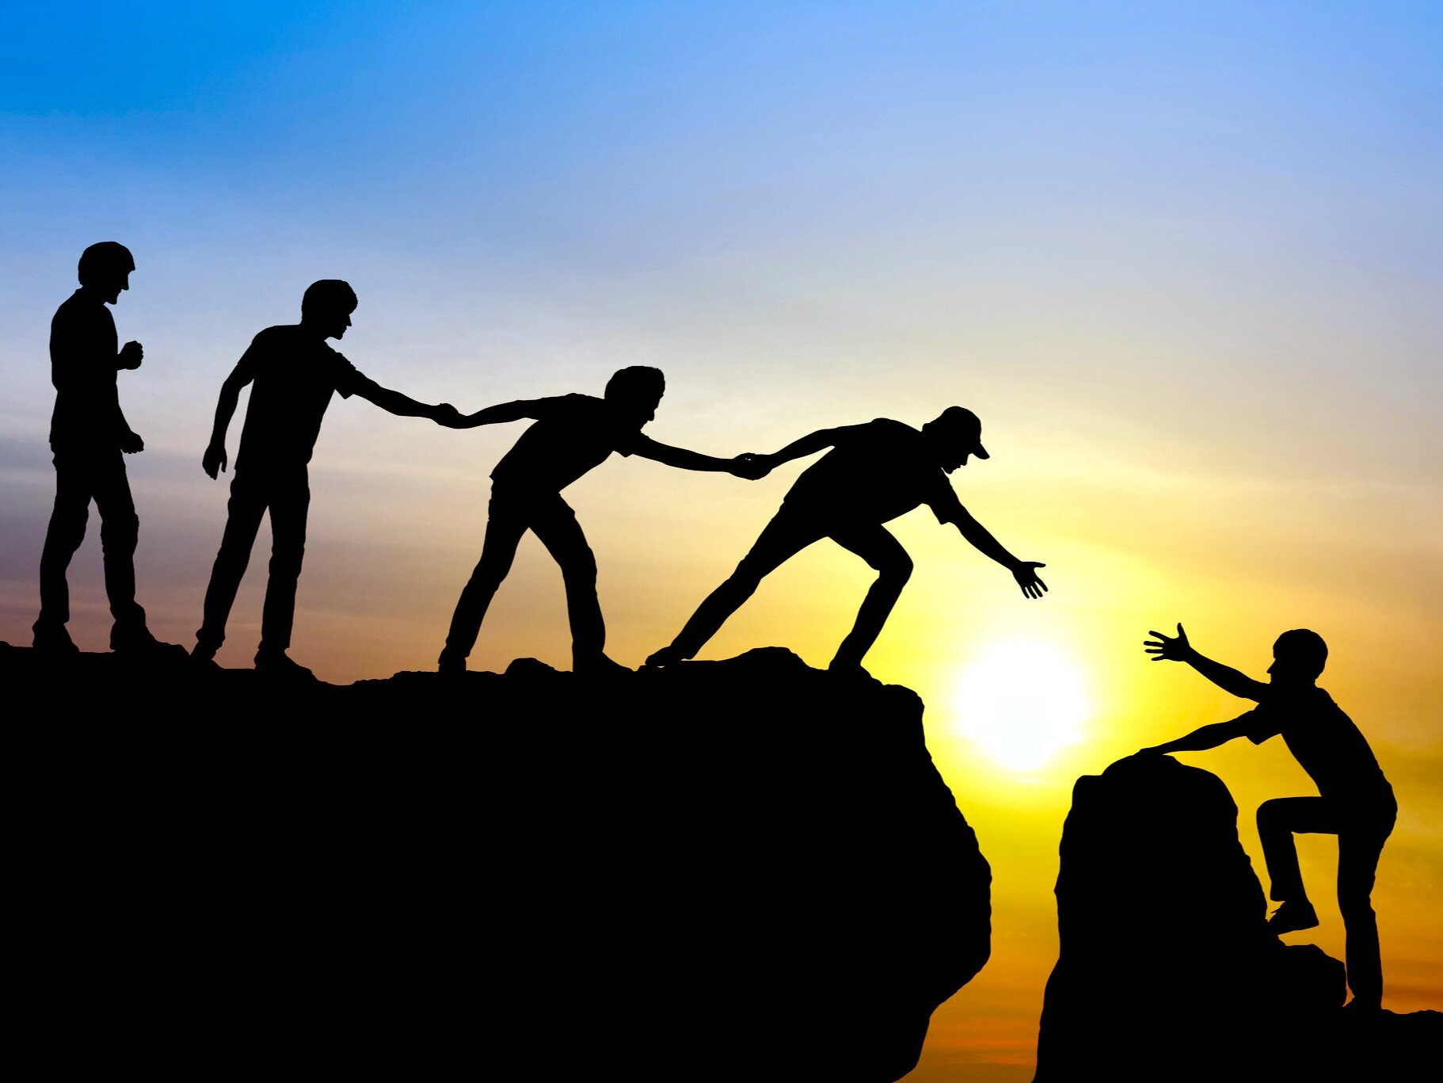
“In “Individuals play the game, but teams win championships
“People have been known to achieve more as a result of working with others and not against them”

Slide 3
As we know HCOs have very complex and dynamic (keep changing) environment.
In order to succeed, HCOs need to rely on the experience, skills and knowledge of wide range of health and non-health professionals.
Teams create an environments in which members can keep up with changes, learn more about their organization, and develop collaborative skills.

Slide 4
Objectives
What is team?
What do we mean by team-work?
Do team have a leader?
What are the teammates (people) characteristics?
What factors make teamwork successful?

Slide 5
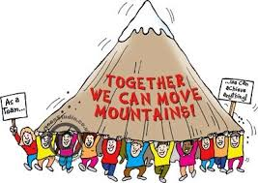
WHAT IS A TEAM?
A team is a group of interdependent people with complementary skills working together to achieve a common goal.
What is teamwork?
Team work is when two or more people work together cohesively, towards a common goal, creating a positive working atmosphere, and supporting each other to combine individual strengths to enhance team performance.

Slide 6
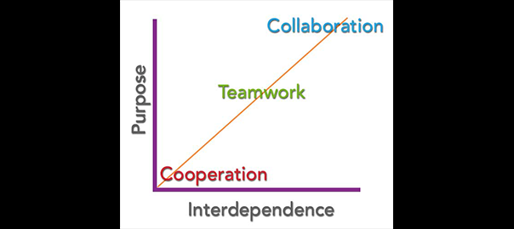
What is Collaboration?
Collaboration is a process that requires relationship and interaction between professionals regardless of whether or not they perceive themselves as part of a team.
Differences between
Teamwork and Collaboration?
Teamwork rely on control, thus we must have a leader and defined task for each member is essential to achieve the goal.
Collaboration rely on trust, thus we don’t need to have a leader, collaborators are equal partners and continuously share their thoughts or achievements.

Slide 7
Types of Teams in HCOs
Team structure depends on
Tasks (clinical teams, surgical teams , managerial teams …)
Timeframe (short term or long term).

Slide 8
Major type of teams found in HCOs:
Multi-displinary Clinical teams: to address patient needs.
Clinical teams can be classified according to client or patient population, disease type, or care delivery setting (e.g., inpatient or outpatient).
Cross-functional team: to address specific organizational needs.
such as service excellence, environmental sustainability and green initiatives, and clinical services marketing.
Task force: groups focus on a specific agenda, have a limited term of tenure, and disband when a report or book is issued.
Committee: Comprised of individuals from many departments who are called upon to review ongoing organizational issues

Slide 9
VIRTUAL TEAMS
Virtual teams have emerged recently in the provision of direct care to patients by health care professionals.
Virtual teams communicate via email, phone, and other technology to maximize communication among members of a treatment team.
These virtual teams can exist in:
Acute care settings, such as a hospital radiologist reading images from remote locations.
Long term care settings addressing patients with chronic illness.

Slide 10
Some of the benefits/advantages of virtual teamwork:
Less interpersonal conflict.
Reduced travel.
Access to diverse employees and talents regardless of geography.
Cutting the cost: non–direct care sector can work remotely such areas as billing, and customer service.
Increase patients accessibility : such as in rural area, or spaceship … (Telemedicine).
Electronic performance monitoring and control systems (EMPCS) : Observation tools that enable an employer to keep an eye on its employees to ensure they remain productive.

Slide 11
THE BENEFITS OF EFFECTIVE HEALTH CARE TEAMS
Improved coordination of care.
Efficient use of health care services.
Increased job satisfaction among team members, and higher patient satisfaction.
Improve quality of care.
Sharing different areas of knowledge and expertise, learning from different perspectives, and realizing innovative ideas that come from other team members.
Benefit from cross-functional team approaches that show increased trust among staff, shared goals, and greater patient satisfaction.

Slide 12
Productive and effective team characteristics
Had common , clear goals.
Injected humor into the process.
Maintained balanced power structures.
Kept focus on the facts and not on personalities in open dialogue.
Motivated team member.
Clear job: Clarity regarding roles on the parts of all team members.
Trust, respect, value, and being valued within the teamwork setting.

Slide 13
Un-successful (failed) teamwork characteristics
Communication: A lack of time to bring people together to reflect and to change.
Insufficient inter-professional education, including continuing education, and the persistence of silos (comfort zone).
Systems of payment that do not reward collaboration.
Few links between collaborative practice and individual goals.
The absence of efforts to capture evidence for success and to communicate this to key stakeholders, including the public.

Slide 14
5 stages of team development
Tuckman provided the following five stages that teams go through: forming, storming, norming, performing, and adjourning.

Slide 15
Stage 1: Forming
Forming Team organizes, becomes oriented to team goals, and finds out what the tasks are, and who they will be working with.
The "forming" stage takes place when the team first meets each other.
In this stage:
In this first meeting, team members are introduced to each. They share information about their backgrounds, interests and experience and form first impressions of each other.
They learn about the project they will be working on, discuss the project's objectives/goals and start to think about what role they will play on the project team.

Slide 16
They are not yet working on the project. They are getting to know each other and to know the project they will work on.
Team leader role is to
Set the team goals as whole
To provide clear direction regarding the role and responsibilities of each individual in the team.
Establish how they will work together ("team norms").

Slide 17
Stage 2: Storming
Storming Intragroup conflict including attempts at dominance, passive-aggressive behaviors, withholding of information, and other forms of resistance to team tasks and goals.
As the team begins to work together, they move into the "storming" stage.
In this stage:
The team members compete with each other for status and for acceptance of their ideas.
They have different opinions on what should be done and how it should be done - which causes conflict within the team.

Slide 18
The team leader role is to :
Ensure the team members learn to listen to each other and respect their differences and ideas.
Coach team members to be more assertive and to be more effective listeners to solve problems.
Establish processes and structures.
Build trust and good relationship between team members.
Resolve conflict as they occur.
Remain positive and motivate your team members.
Explain the "forming, storming, norming, and performing" idea.
Use psychometric indicators to help people learn about different work styles and strengths.

Slide 19
This stage will come to a closure when the team becomes more accepting of each other and learns how to work together for the good of the project.
At this point, the team leader should start transitioning some decision making to the team to allow them more independence, but still stay involved to resolve any conflicts as quickly as possible.

Slide 20
Stage 3: Norming
Norming When the team expectations and roles become codified, either formally or informally, and peace breaks out.
When the team moves into the "norming" stage, they are beginning to work more effectively as a team.
In this stage:
The team has agreed on their team rules for working together, how they will share information and resolve team conflict, and what tools and processes they will use to get the job done.
The team members begin to trust each other and actively seek each other out for assistance and input.
The team members also start to make significant progress on the project.

Slide 21
The team leader role is to :
Step back and help team members take responsibility for progress towards the goal.
The team leader may not be as involved in decision making and problem solving.
Step in to move things along if the team gets stuck.
The team leader should always ensure that the team members are working collaboratively and may begin to function as a coach to the members of the team.

Slide 22
Stage 4: Performing
Performing When the team gets on with the work at hand and cooperates with open dialogue and collaboration to achieve team goals.
In the "performing" stage, teams are functioning at a very high level.
In this stage:
Team functions without oversight and the members have become interdependent.
The team is highly motivated to get the job done.
They can make decisions and problem solve quickly and effectively.

Slide 23
The team leader role is to :
Continue to monitor the progress of the team
Celebrate milestone achievements with the team.
Serve as the gateway when decisions need to be reached at a higher level within the organization.
In this stage, the team leader is not involved in decision making, problem solving or other such activities involving the day-to-day work of the team.

Slide 24
Stage 5: Adjourning
Adjourning The work of the team is over and the team members realize they enjoyed working with each other. There is often a reluctance to let go and move on to the next task because they have become comfortable working with each other.
In the "adjourning" stage the project is coming to an end and the team members are moving off into different directions.
The team leader should ensure that there is time for the team to celebrate the success of the project and capture best practices for future use.

Slide 25
Team Process :How To’s
Team Leader:
Asks for ideas
Acknowledge inputs and write it down.
doesn’t interrupt and doesn’t let others too.
Ask for suggestions
Remains calm and focus on goal.
Teammates (members):
Take assignments with deadlines and follow through.
Critical elements:
Follow up and Summary of meeting is shared.

Slide 26
WHO’S ON THE TEAM?
Getting the right people on a team is one of the most critical tasks a health care manager can have.
Some of the questions that you can ask when you are assigned to a team are:
What are the goals of the team?
How will they be measured?
What are the short-term and long-term deadlines?
When and where does the team meet?
To whom do I report? (Sometimes staff members are loaned to teams, so this is an important issue to resolve.)
What is my role on the team?
What are my responsibilities in that role?

Slide 27
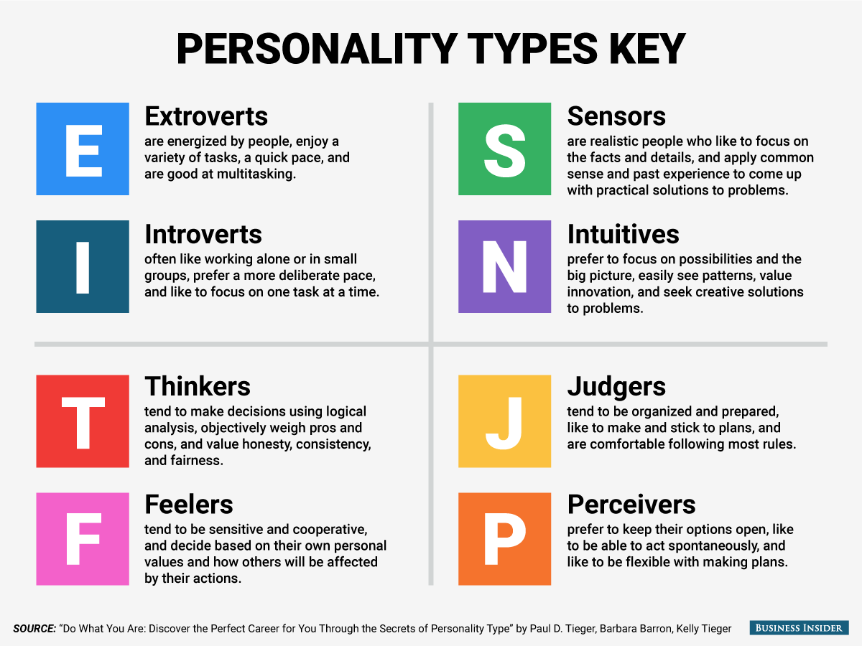
Myers-Briggs Type Indicator (MBTI) : A tool that assesses four domains and four subsets within those domains on a four-by-four grid.

Slide 28
EMOTIONS AND TEAMWORK
Emotions are contagious and can spread within moments.
People has the ability to catch others’ emotions(mood) within nanoseconds.
Emotion contagion EC: means the ability to read other people's’ emotions.
Tools for assessment
Emotion Contagion (EC) scale: This is a scale that measures a variety of feelings and behaviors in various situa­tions.

Slide 29
Team leader competencies
Emotional social competencies (ESC) Those emotional abilities, social skills, personality traits, motivations, interests, goals, values, attachment styles, and life narratives that can contribute to (or detract from) effective performance across a variety of positions.
Emotional intelligence (EI), encompasses self-awareness, self-regulation, self-motivation, social awareness, and social skills (social facility), and within each of these areas, specific skill sets.

Slide 30
Social Intelligence (SI)
Social Awareness
Primary empathy: Feeling with others; sensing nonverbal emotional signals.
Attunement: Listening with full receptivity.
Empathic accuracy: Understanding another person’s thoughts, feelings, and intentions.
Social Facility
Synchrony: Interacting smoothly at the nonverbal level.
Self-presentation: Presenting ourselves effectively.
Influence: Shaping the outcome of social interactions.
Concern: Caring about others’ needs and acting accordingly”

Slide 31
METHODS OF MANAGING TEAMS OF HEALTH CARE PROFESSIONALS
One of the things a team leader can do to facilitate good communication is to establish guidelines for expected behaviors, processes, and outcomes in a written document.
Guidelines for Teamwork, the document does not have to be complicated. This tool can be used to evaluate the performance of individual members of the team, thus avoiding the social loafer or free-rider syndrome, where a member of the team does nothing but gets credit for the work done by others.

Slide 32
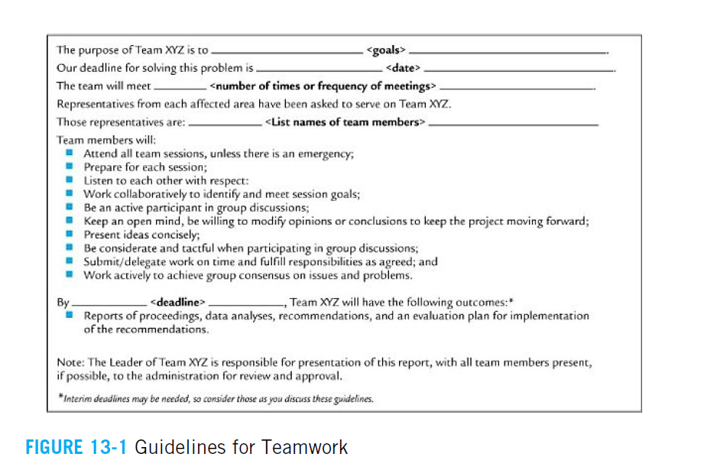

Slide 33
At some point in time, there will be disagreement about which choices and decisions the team should make.
Maginn (1995) recommends five potential strategies for conflict resolution in teams:
bargaining, problem solving, voting, research, and third-party mediation.

Slide 34
Bargaining: When someone says, "If you go along with me this time, I'll back you up next time." If the choices are equally good, then bargaining can be a good tool; if the choices aren't equal, then it may not be a good tool.
Voting: Democratic approach to team problem-solving that also bears the weight of potentially taking a team to the incorrect choice.

Slide 35
Problem solving: Taking time to answer the "what if" scenarios of each alternative.
Research: Additional study to find out if others have created a solution to the problem or if there are factors that have been overlooked by the team.
Third-party mediation: Sometimes teams cannot decide which solution is the best. The team presents the list of alternatives along with pros and cons of each and the boss makes the final decision.

