Slide 1
Medical Ethics
The Doctor–Patient Relationship
Lec#3
Dr. Reema Karasneh

Slide 2
Medicine as a social institution
Medicine was established in response to social needs to:
Take care of the sick
Protect the social system from being misused by individual members
The success of frequent or regular meetings between doctor and patient depends on:
The doctors’ clinical knowledge and technical skills
The nature of the social relationship

Slide 3
Social roles of doctors and patients
Parsons (1951) was one of the earliest sociologists to examine the relationship between doctors and patients.
Talcot Parsons has identified a model of patient-physician relationship and the rights and obligation that govern this relation between parties of the social system:
Society (the public interest)
Physician
Patient

Slide 4
Why does it matter ?
The patient-physician relationship is fundamental for:
Providing excellent care
Promoting healing process
Improving outcomes
Therefore, it is important to understand what elements comprise the relationship and identify those that make it "good."

Slide 5
Parsons’ model: Parsons’ “Ideal Patient” (Sick Role)
Rights (Permitted) to:
Allowed (and may be expected) to shed some normal activities and responsibilities (e.g. employment and household tasks)
Regarded as being in need of care and unable to get better by his or her own decisions and will
Obligations (In Return) :
Towards society
Must want to get well as quickly as possible
Should seek professional medical advice
Towards physician
Cooperate with the doctor

Slide 6
Parsons’ model: Doctor: professional role
Granted right to examine patients physically and to enquire into intimate areas of physical and personal life
Granted considerable autonomy in professional practice
Occupies position of authority in relation to the patient
Rights (Permitted) to:

Slide 7
Parsons’ model: Doctor: professional role
Towards society
Physician is expected to use his expertise to determine
Whether the person is sick or not (legitimize the illness).
how serious is person sickness
if sickness is curable, and
when is he expected to get well.
Towards Patients
Competence:
Apply a high degree of skill and knowledge to the problems of illness
Functionally Specific:
Be guided by rules of professional practice; i.e. the doctor should not have broader contact with patients outside the medical sphere (focus only on the problem presented)
Universalism:
Use of generalized objective criteria to determine if the person is sick and how severe his sickness is.
Affectively Neutral:
Be objective and emotionally detached
i.e. should not judge patients’ behaviour in terms of personal value system or become emotionally involved with them (No room for likes and dislikes)
Collectivity oriented:
Act for welfare of patient and community rather than for own self-interest, desire for money, advancement, etc (put patient’s interest first)
Obligations (In Return) :

Slide 8
Types of doctor-patient relationship (DPR)
Types | Physician control (Low) | Physician control (High)
Patient control (Low) | Default | Paternalism
Patient control (High) | Consumerism | Mutuality

Slide 9
Paternalism
The traditional form of DPR (medical consultations)
A passive patient and a dominant doctor.
Advantages:
More important when patients are very sick
Patients derive considerable comfort from being able to rely on the doctor in this way and being relieved of burdens of worry and decision making
Disadvantages
Manipulation and exploitation of the vulnerable and ill.

Slide 10
Mutuality
The optimal DPR model
Equal partners in the consultation
neither the patient nor the physician as standing aside
Described as a ‘meeting between experts’
Exchange of ideas and sharing of belief systems
Based on the communication between doctors and patients.

Slide 11
Mutuality-Patient’s role
Patients need to define their problems in an open and full manner.
Patients bring their own expertise in terms of their:
Experiences and explanations of their illness
Knowledge of their particular social circumstances
Attitudes to risk, values and preferences.
The patient’s right to seek care elsewhere when demands are not satisfactorily met.

Slide 12
Mutuality-Doctor’s role
Physicians need to work with the patient to articulate the problem and refine the request.
The doctor brings his or her clinical skills and knowledge to the consultation in terms of :
Diagnostic techniques
Knowledge of the causes of disease
Prognosis
Treatment options and preventive strategies
The physician’s right to withdraw services formally from a patient if he or she feels it is impossible to satisfy the patient’s demand.

Slide 13
Mutuality-Advantages
Patients can fully understand what problem they are coping with through physicians’ help.
Physicians can entirely know patient’s value.
Decisions can easily be made from a mutual and collaborative relationship.

Slide 14
Mutuality-Disadvantages
If the communication is fake, both physicians and patients do not have mutual understanding, making decision is overwhelming to a patient.

Slide 15
Consumerism
Reverse of the very basic nature of the power relationship
Patient: active role
Doctor: passive role
Acceding to the patient’s requests for a
second opinion
referral to hospital
a sick note

Slide 16
Consumerism - Patient’s role
Health shoppers
Indications of consumer behaviour:
Cost-consciousness
Information seeking
Exercising independent judgement

Slide 17
Consumerism - Doctor’s role
Health care providers
Technical consultant
To convince the necessity of medical services

Slide 18
Consumerism – Advantages & Disadvantages
Advantages
Patients can have their own choices.
Disadvantages
When things seem to go wrong, when satisfaction is low, or when a patient suspect less than optimal care or outcome, patients are more likely to question physician authority.

Slide 19
Default
Patients adopt a passive role even when the doctor reduces some of his or her control
This can arise:
If patients are not aware of alternatives to a passive patient role
If patients are timid in adopting a more participative relationship

Slide 20
Doctor–patient relationship depends on:
Patient’s medical condition (different conditions and stages of illness)
E.g. Emergency situations: Paternalism
The expectations of doctor and of patient
The structural context of the consultation
Doctor-centred
Patient-centred

Slide 21
Influences on the DPR
Consultation style
Time
Patient
Structural context

Slide 22
Consultation styles:
Doctor centered
Patient centered

Slide 23
Doctor centred
Paternalistic - doctor is the expert and patient expected to cooperate
Doctors focus on the physical aspects of the patients’ disease
little opportunity for patients to express their own beliefs and concerns
Doctors employ tightly controlled interviewing methods to elicit the necessary medical information and reach an organic diagnosis.
Questions are mainly of a ‘closed’ nature:
how long have you had the pain?
is it sharp or dull?
‘Voice of medicine’

Slide 24
Patient centred
Fostering a relationship of ‘mutuality’
Doctors adopt a much less controlling style (less authoritarian)
Doctors spend more time actively listening to patients’ problems through
Picking up and responding to patient cues
Encouraging patients to express their own ideas or feelings
Clarifying and interpreting patients’ statements
Using a more participative style
Greater use of ‘open’ questions, interested in psycho-social aspect of illness
Tell me about the pain; How do you feel?; What do you think is the cause of the problem?
‘Voice of the patient’
Communication of patients beliefs feelings & psychosocial context (bio psychosocial)

Slide 25
Influence of time
Consultations average 6 minutes (range 2-20 min)
Pressures of time
Doctor centred ‘paternalistic’ consultation with less attention paid to the social and psychological aspects of a patient’s illness
Fewer psychological problems are identified and more prescriptions are issued
Patient centric approach needs more time but overall reduces the number of return visits & thus the total consultation time.

Slide 26
Patient characteristics and behaviours
The patient’s ability to ask questions and assume a more participative role depends on a number of factors:
Age
Younger people are more likely to expect a relationship of mutual participation than elderly people
Social and educational level
Patients with a high social and educational level tend to participate more in the consultation in terms of asking questions and asking for explanations and clarification than patients from a lower socioeconomic background and educational level

Slide 27
The course of an illness
Patients are often passive and unquestioning during initial hospital consultations, whereas by the second or third consultation they generally initiate questions themselves and take a more participative approach
Doctors assumptions of the interests of different patient groups
For example, there is some evidence that doctors volunteer more explanations to some groups of patients:
Male patients
More educated patients
Different languages

Slide 28
4. Influence of structural context
General practice/Hospital situation
The system of financing of health care

Slide 29
General practice/Hospital situation
GP→ Consultations take place in a familiar context and can benefit from the doctor’s prior awareness of the patient’s social situation, past history and concerns.
Hospital→ patients rarely experience personal continuity
Ward →communication is frequently limited
Patient's feelings of a lack of privacy
Difficulties of interaction can arise if the doctor or medical team stand at the end of the bed rather than coming close to and preferably sitting at the same level as the patient.

Slide 30
The system of financing of health care
Fee-for-service basis
Associated with a greater availability of resources→ there is less institutional pressure to achieve a high patient throughput→ doctors feel a greater need to achieve a high level of patient satisfaction
Patients tend to expect a longer consultation and a full discussion with the doctor and are frequently more active in asking questions.
Paid on a per capita or salaried basis

Slide 31
PARTNERSHIPS IN TREATMENT DECISION MAKING

Slide 32
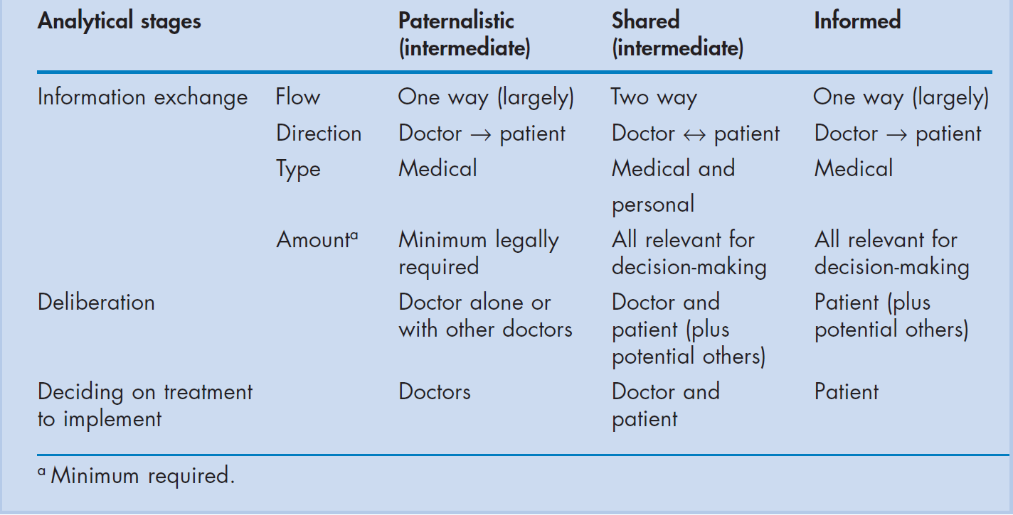
Models of treatment decision-making in a doctor–patient dyad

Slide 33
Models of decision making
3 models –
Paternalist
Shared
Informed

Slide 34
Paternalist model
The doctor, as medical expert, as solely responsible for treatment decisions with the patient expected merely to cooperate with advice and treatment.

Slide 35
Shared decision-making
Both doctor and patient are involved in the decision making process
Both parties share information
Both parties take steps to build a consensus about the preferred treatment
An agreement (consensus) is reached on the treatment to implement

Slide 36
Shared decision making -impetus
Increased medical knowledge among patients
Prevailing social values- individual autonomy and responsibility
Chronic illness
To make choices between the treatment options and to balance risks & benefits
Doctors make inaccurate guesses about patients concerns & their preferences and treatment choices differ

Slide 37
Informed model
Partnership between doctor and patient
Doctor - information on all relevant options and their benefits and risks
Patient – decision making

Slide 38
Principle of AUTONOMY and DPR
It is the ability of the person to make his or her own decisions
The principle of respect for patient autonomy has had an enormous effect in changing attitudes to the doctor-patient relationship over the past 30 years.
It has been used to criticize medical paternalism
Has informed the development of 'patient-centred' medicine
It has led to ever increasing standards in providing patients with information, and to the development of the concept of informed consent

Slide 39
References
Scambler, Graham. Sociology As Applied to Medicine. 6th ed. Edinburgh ; New York: Saunders/Elsevier, 2008. Myfanwy Morgan, The Doctor–Patient Relationship, Chapter 4.

