Slide 1
Systemic Module PNS
Anatomy
Vagus Nerve
Dr. Ramada khasaenrh

Slide 2
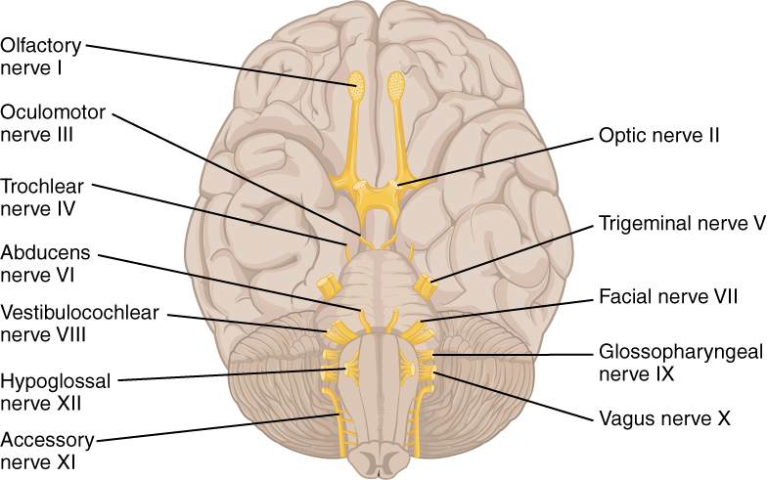
The vagus nerve is the 10th cranial nerve (CN X), named from “vagary” which mean the wonderer in latin. It is sometimes referred to as the wandering nerve.
It is a functionally diverse nerve, offering many different modalities of innervation.
It is the longest and most widely distributed cranial nerve.
It spreads the fibers of a cranial part of the accessory nerve and carries majority of the efferent fibers of the cranial part of the parasympathetic outflow.

Slide 3
Its innervation is not limited to the structures in the head, but also extends into the neck, thorax, and abdomen.
The vagus nerve connecting the brain to the gut, allowing them to communicate back and forth, This explains how stress and all kinds of feelings and emotions generate gut sensations and alter digestion.

Slide 4
Sensory: Innervates the skin of the external acoustic meatus and the internal surfaces of the laryngopharynx and larynx. Provides visceral sensation to the heart and abdominal viscera.
Special Sensory: Provides taste sensation to the epiglottis and root of the tongue
Motor: Provides motor innervation to the majority of the muscles of the pharynx, soft palate and larynx
Parasympathetic: Innervates the smooth muscle of the trachea, bronchi and gastro-intestinal tract and regulates heart rhythm

Slide 5
It is associated with the derivatives of the fourth and sixth pharyngeal arches.
The fourth pharyngral arch → The associated nerve is the superior laryngeal branch of the vagus nerve
It innervates the muscular derivatives of the fourth arch; the constrictors of the pharynx, levator palatini and cricothyroid.
Innervation to the root of the tongue is provided by the superior laryngeal branch.
The sixth pharyngeal arch → The associated nerve is the recurrent laryngeal branch of the vagus nerve
It innervates the intrinsic muscles of the larynx
The sensory field of the recurrent laryngeal branch is widespread.

Slide 7
Anatomical Course

Slide 8
In the Head

Slide 9
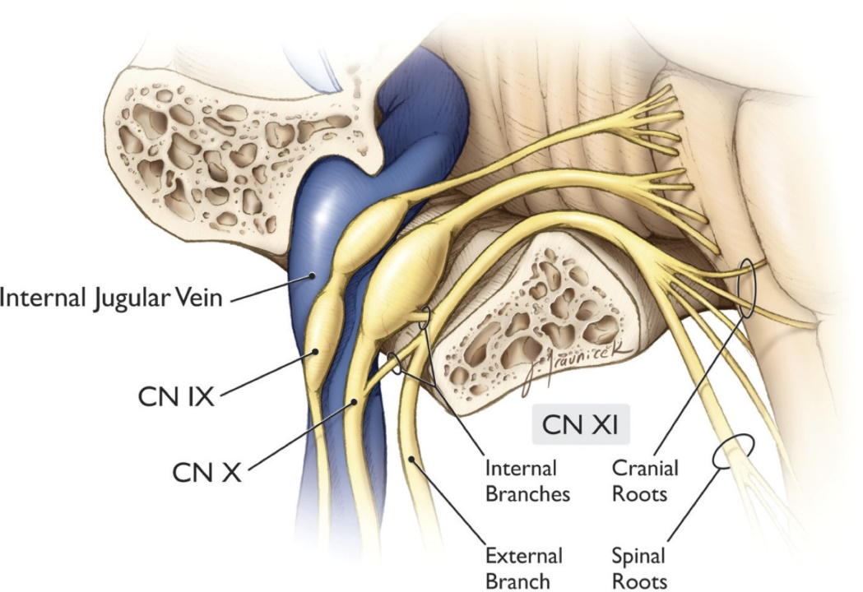
The vagus nerve originates from the medulla of the brainstem. It exits the cranium via the jugular foramen, with the glossopharyngeal and accessory nerves (CN IX and XI respectively).

Slide 10
Within the cranium, the auricular branch arises. This supplies sensation to the posterior part of the external auditory canal and external ear.

Slide 11
In the Neck

Slide 12
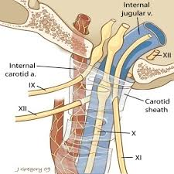
In the neck, the vagus nerve passes into the carotid sheath, travelling inferiorly with the internal jugular vein and common carotid artery.

Slide 13
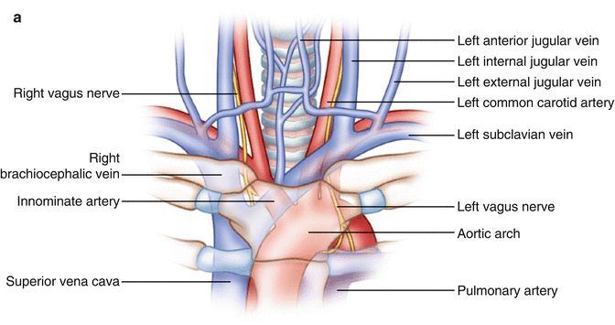
At the base of the neck, the right and left nerves have differing pathways:
The right vagus nerve passes anterior to the subclavian artery and posterior to the sternoclavicular joint, entering the thorax.
The left vagus nerve passes inferiorly between the left common carotid and left subclavian arteries, posterior to the sternoclavicular joint, entering the thorax.

Slide 14
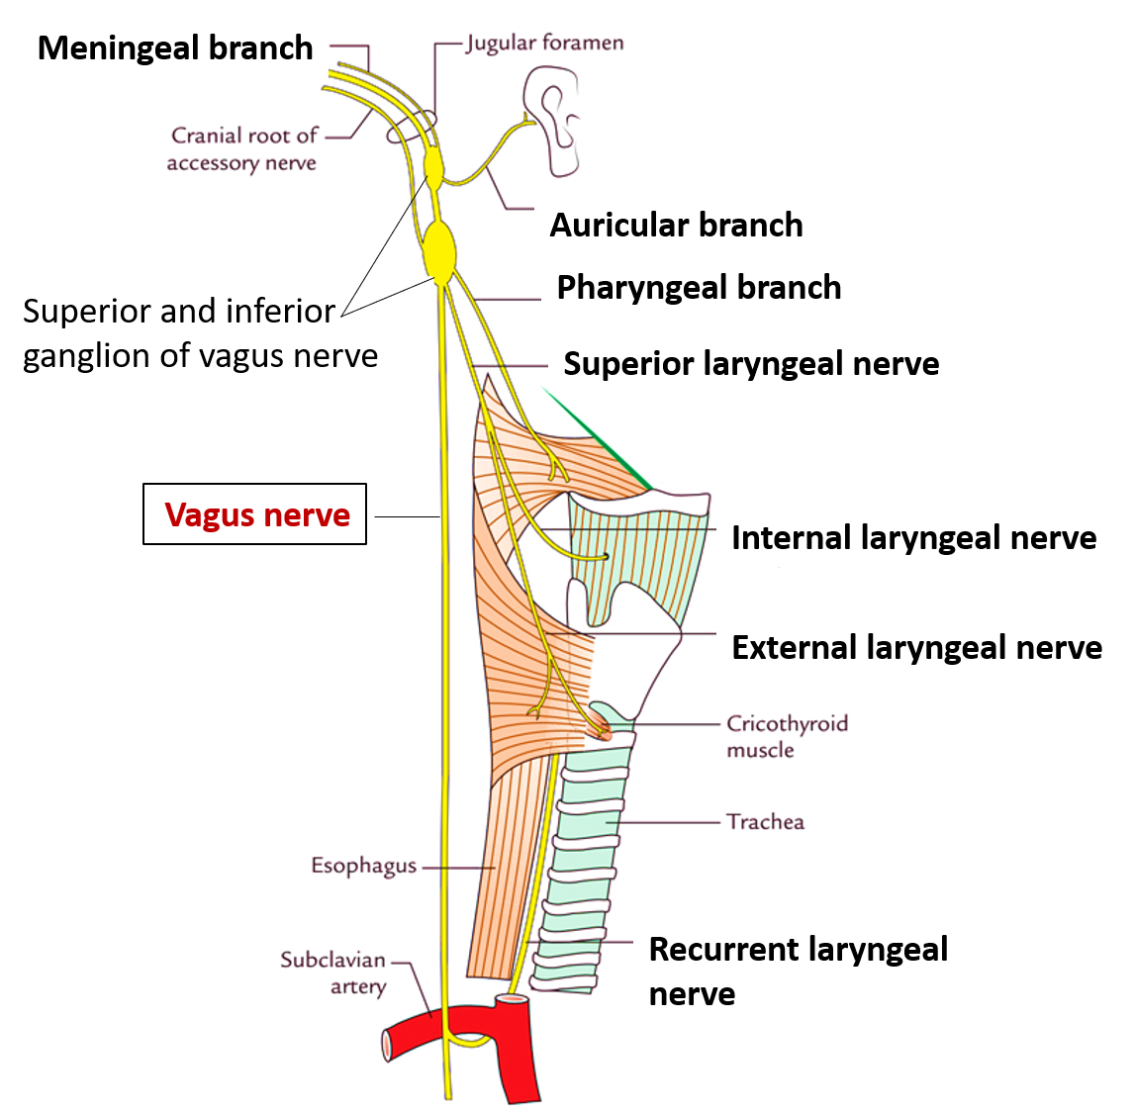
Several branches arise in the neck:
Pharyngeal branches: Provides motor innervation to the majority of the muscles of the pharynx and soft palate.
Superior laryngeal nerve: Splits into internal and external branches. The external laryngeal nerve innervates the cricothyroid muscle of the larynx. The internal laryngeal provides sensory innervation to the laryngopharynx and superior part of the larynx.
Recurrent laryngeal nerve: (right side only) – Hooks underneath the right subclavian artery, then ascends towards to the larynx. It innervates the majority of the intrinsic muscles of the larynx.

Slide 15
In the Thorax

Slide 16
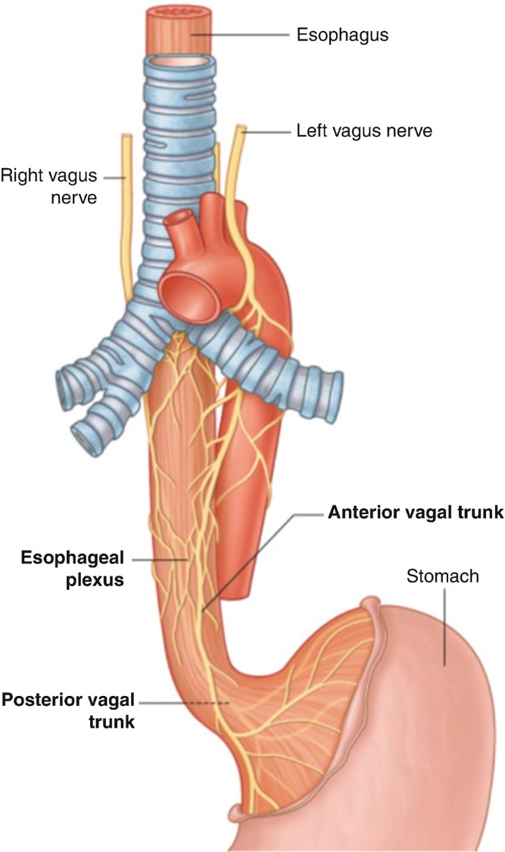
In the thorax:
the right vagus nerve forms the posterior vagal trunk
the left forms the anterior vagal trunk.
Branches from the vagal trunks contribute to the formation of the oesophageal plexus, which innervates the smooth muscle of the oesophagus.

Slide 17
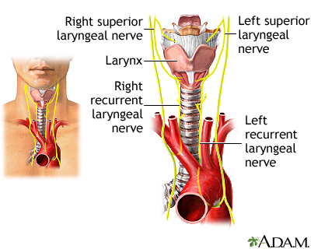
Two other branches arise in the thorax:
Left recurrent laryngeal nerve – it hooks under the arch of the aorta, ascending to innervate the majority of the intrinsic muscles of the larynx.
Cardiac branches – these innervate regulate heart rate and provide visceral sensation to the organ.

Slide 18
The vagal trunks enter the abdomen via the oesophageal hiatus, an opening in the diaphragm.

Slide 19
In the Abdomen

Slide 20
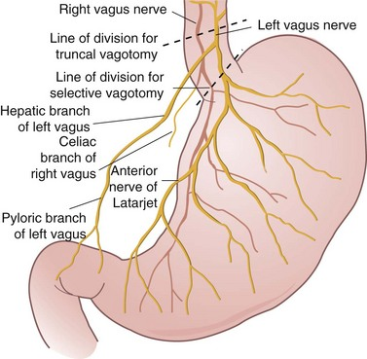
In the abdomen, the vagal trunks terminate by dividing into branches that supply the: oesophagus, stomach and the small and large bowel (up to the splenic flexure).

Slide 21
Sensory Functions

Slide 22
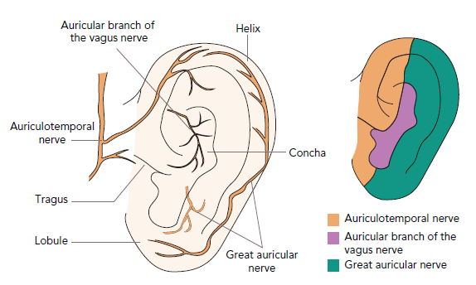
There are somatic and visceral components to the sensory function of the vagus nerve.
Somatic sensation:
Somatic refers to sensation from the skin and muscles.
This is provided by the auricular nerve, which innervates the skin of the posterior part of the external auditory canal and external ear.

Slide 23
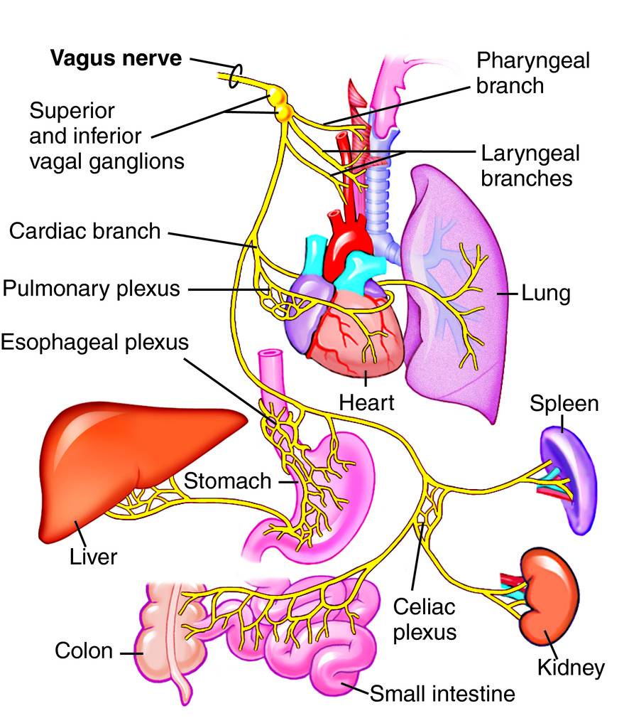
Viscera sensation is that from the organs of the body. The vagus nerve innervates:
Laryngopharynx – via the internal laryngeal nerve.
Superior aspect of larynx (above vocal folds) – via the internal laryngeal nerve.
Heart – via cardiac branches of the vagus nerve.
Gastro-intestinal tract (up to the splenic flexure) – via the terminal branches of the vagus nerve.

Slide 24
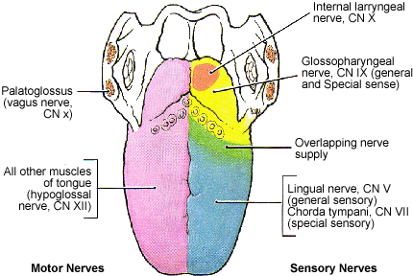
Special Sensory Functions
The vagus nerve has a minor role in taste sensation. It carries afferent fibres from the root of the tongue and epiglottis.

Slide 25
Motor Functions

Slide 26
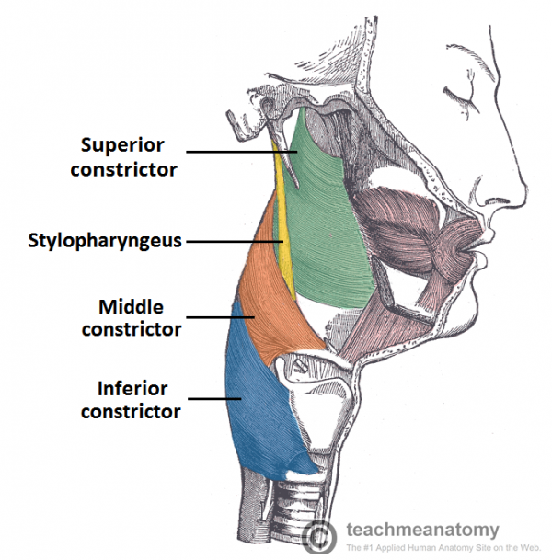
The vagus nerve innervates the majority of the muscles associated with the pharynx and larynx. These muscles are responsible for the initiation of swallowing and phonation

Slide 27
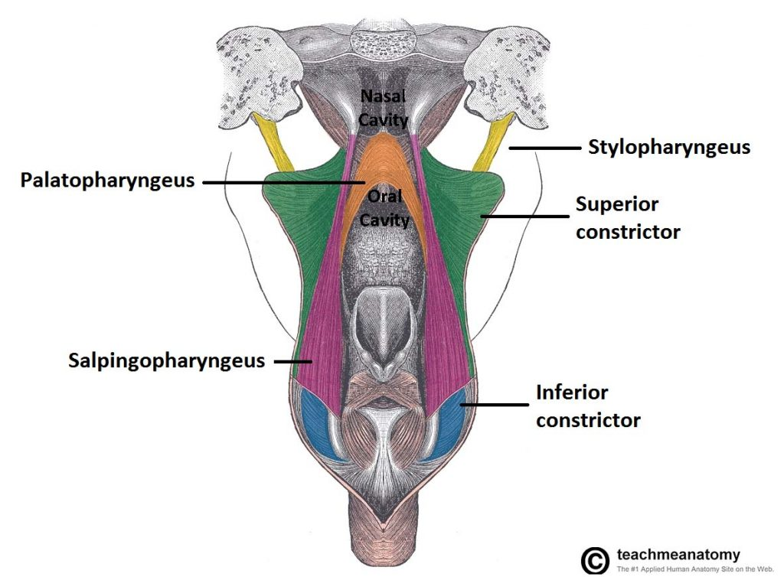
Pharynx
Most of the muscles of the pharynx are innervated by the pharyngeal branches of the vagus nerve:
Superior, middle and inferior pharyngeal constrictor muscles
Palatopharyngeus
Salpingopharyngeus
An additional muscle of the pharynx, the stylopharyngeus, is innervated by the glossopharyngeal nerve.

Slide 28
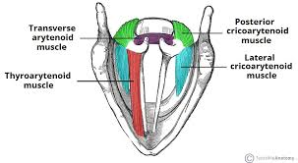
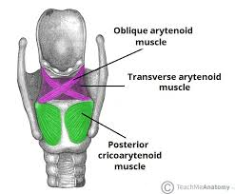
Larynx
Innervation to the intrinsic muscles of the larynx is achieved via the recurrent laryngeal nerve and external branch of the superior laryngeal nerve.
Recurrent laryngeal nerve:
Thyroarytenoid
Posterior cricoarytenoid
Lateral cricoarytenoid
Transverse and oblique arytenoids
Vocalis
External laryngeal nerve:
Cricothyroid

Slide 29
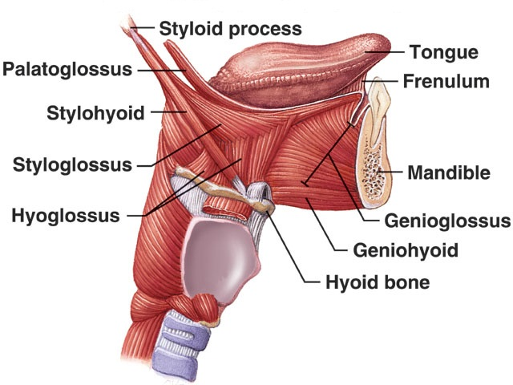
Other Muscles
In addition to the pharynx and larynx, the vagus nerve also innervates the:
Palatoglossus of the tongue
The majority of the muscles of the soft palate.

Slide 30
Parasympathetic Functions

Slide 31
In the thorax and abdomen, the vagus nerve is the main parasympathetic outflow to the heart and gastro-intestinal organs.

Slide 32
The Heart
Cardiac branches arise in the thorax, conveying parasympathetic innervation to the sino-atrial and atrio-ventricular nodes of the heart
These branches stimulate a reduction in the resting heart rate. They are constantly active, producing a rhythm of 60 – 80 beats per minute. If the vagus nerve was lesioned, the resting heart rate would be around 100 beats per minute.

Slide 33
Gastro-Intestinal System
The vagus nerve provides parasympathetic innervation to the majority of the abdominal organs. It sends branches to the oesophagus, stomach and most of the intestinal tract – up to the splenic flexure of the large colon.
The function of the vagus nerve is to stimulate smooth muscle contraction and glandular secretions in these organs. For example, in the stomach, the vagus nerve increases the rate of gastric emptying, and stimulates acid production.

Slide 34
Thank you Ramada@yu.edu.jo

