Slide 1
Motivation
Lec 5
MED 311
Dr. Ola Soudah

Slide 2
Motivation – the concept
A motive is “something (a need or desire) that causes a person to act.”
Motivate, in turn, means “to provide with a motive,”
Thus, motivation is the act or process of providing a motive that causes a person to take some action.
In most cases, motivation comes from some need that leads to behavior which, in turn, results in some type of reward when the need is fulfilled.

Slide 3
THEORIES OF MOTIVATION
Needs-Based Theories of Motivation
Maslow’s Hierarchy of Needs
Alderfer’s ERG Theory
Herzberg’s Two-Factor Theory
McClelland’s Acquired Needs Theory
Extrinsic Factor Theories of Motivation
Reinforcement Theory
Intrinsic Factor Theories of Motivation
Adams’ Equity Theory
Vroom’s Expectancy Theory
Locke’s Goal-Setting Theory

Slide 4
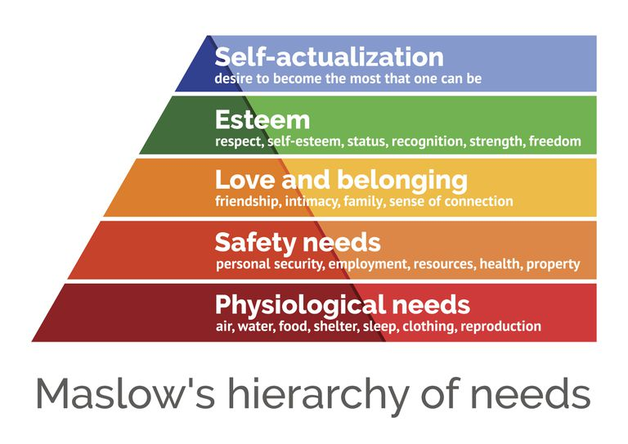
Needs-Based Theories of Motivation
Maslow’s Hierarchy of Needs

Slide 5
Physiological needs
Safety needs : including a healthy and safe work environment, access to health care, money.
Belonging needs: including the desire for social contact and interaction, friendship, affection, and various types of support.
Esteem needs: including status, recognition, and positive regard;
Self-actualization needs: including the desire for achievement, personal growth and development, and autonomy.

Slide 6
The movement from one level to the next was termed satisfaction progression by Maslow, and it was assumed that over time individuals were motivated to continually progress upward through these levels.

Slide 7
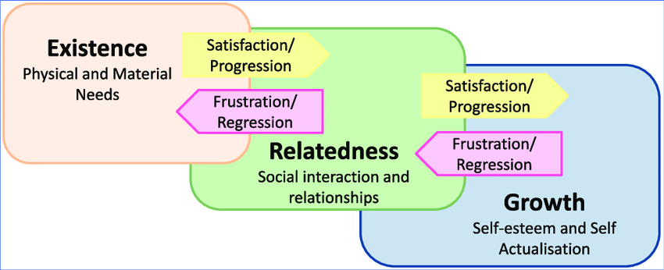
Alderfer’s ERG Theory
Drew upon Maslow’s theory, but also suggested individuals were motivated to move forward and backward through the levels in terms of motivators frustration–regression principle.

Slide 8
Existence—which related to Maslow’s first two needs, thus combining the physiological and safety needs into one level;
Relatedness—which addressed the belonging needs; and
Growth—which pertained to the last two needs, thereby combining esteem and self-actualization.

Slide 9
McClelland’s Acquired Needs Theory
The idea here is that needs are acquired throughout life.
Three types of needs:
Need for achievement—which emphasizes the desires for success, for mastering tasks, and for attaining goals;
Need for affiliation—which focuses on the desire for relationships and associations with others; and
Need for power—which relates to the desires for responsibility for, control of, and authority over others.

Slide 10
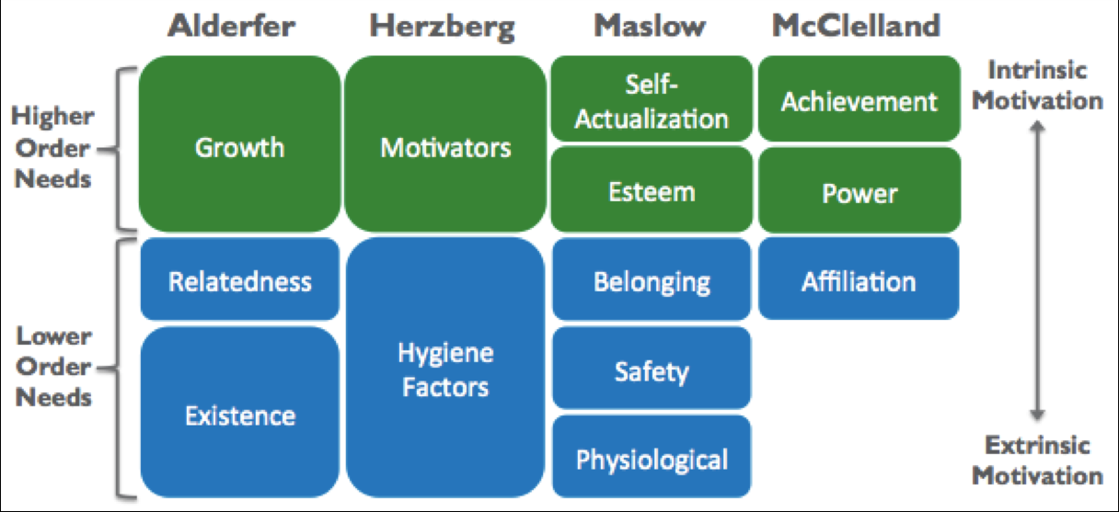
The relationship between motivation theories

Slide 11
Extrinsic Factor Theories of Motivation
Reinforcement Theory
Positive reinforcement —relates to taking action that rewards positive behaviors;
Avoidance learning —occurs when actions are taken to reward behaviors that avoid undesirable or negative behaviors. This is sometimes referred to as negative reinforcement;
Punishment—includes actions designed to reduce undesirable behaviors by creating negative consequences for the individual; and
Extinction—represents the removal of positive rewards for undesirable behaviors. Likewise, if the rewards for desirable behaviors cease, those actions can be impacted as well.

Slide 13
Cons: The primary criticism of the reinforcement approach is that it fails to account for employees’ abilities to think critically and reason, both of which are important aspects of human motivation.

Slide 14
Intrinsic Factor Theories of Motivation
Adams’ Equity Theory —proposes individuals are motivated when they perceive they are treated equitably in comparison to others within the organization.
Vroom’s Expectancy Theory —addresses the expectations of individuals and hypothesizes they are motivated by performance and the expected outcomes of their own behaviors.
Locke’s Goal-Setting Theory —hypothesizes establishing goals motivates individuals to take action to achieve those goals.

Slide 15
Management Theories of Motivation
Scientific Management Theory
focused on studying job processes, determining the most efficient means of performing them, and in turn rewarding employees for their productivity and hard work.
Cons: sacrificing the quality.

Slide 16
McGregor’s Theory X and Theory Y
This theory first classifies managers into one of two groups.
Theory X managers view employees as unmotivated and disliking work. Under the Theory X approach, the manager’s role is to focus on the hygiene's and to control and direct employees; it assumes employees are mainly concerned about safety.
Theory Y managers focus on Herzberg’s motivators and work to assist employees in achieving these higher levels.
Cons: is shortsighted.

Slide 17
Ouchi’s Theory Z
The idea that employees who are involved in and committed to an organization will be motivated to increase productivity.
Based on the Japanese approach to management and motivation, Theory Z managers provide rewards, such as long-term employment, promotion from within, participatory management, and other techniques to engage and motivate employees.
In fact, Theory Z can be considered an early form of engagement theory.

Slide 18
What Are Rewards?
Intrinsic rewards are derived from within the individual.
For a health care employee, this could mean taking pride and feeling good about a job well done.
Extrinsic rewards pertain to those reinforcements that are given by another person,
such as a health care organization giving bonuses to teams of workers when quality and patient satisfaction are demonstrated to be exceptional.

Slide 19
INCENTIVES AND REWARDS
Extrinsic Rewards
These include tangible rewards, such as: money (pay, bonuses, stock options), benefits (health, dental, vision, paid time off, retirement accounts, etc.), flexible schedules, job responsibilities and duties, promotions, changes in status, supervision of others, praise, feedback and recognition, a good boss, a strong leader, other inspirational people, and a nurturing organizational culture.

Slide 20
Intrinsic Rewards
Five types of intrinsic rewards that have been summarized by Manion (2005) include:
Healthy relationships : to belong and connect to other.
Meaningful work: employees feel they make a difference in people’s lives.
Competence: enable them to perform at or above standards.
Choice: to participate in the organization in various ways, such as by expressing their views and opinions, sharing in decision making.
Progress: where managers find ways to hold employees accountable, facilitate their ability to make headway toward completing their assigned tasks, and celebrate when progress is made toward completing important milestones within a project.

Slide 21
Intrinsic rewards, coupled with extrinsic ones, lead to high personal
satisfaction and serve as motivators for most employees.

