Slide 1
Leadership
Lec. 4
MED 311
Spring 2020/2021
Dr. Ola Soudah

Slide 2
Leadership vs. Management: What’s the Difference?
While there’s some overlap between the work that leaders and managers do, there are also significant distinctions.
Here are three differences between leadership and management.
      1. Process vs. Vision
      2. Organizing vs. Aligning
      3. Position vs. Quality

Slide 3
      Process vs. Vision
Effective leadership is centered on a vision to guide change.
Whereas managers set out to achieve organizational goals through implementing processes, such as budgeting, organizational structuring, and staffing, leaders are more intent on thinking ahead and capitalizing on opportunities.

Slide 4
      2. Organizing vs. Aligning
The manager administers; the leader innovates.
The manager maintains; the leader develops.
The manager focuses on systems and structure; the leader focuses on people.
Leaders, are less focused on how to organize people to get work done and more on finding ways to align and influence them.

Slide 5
      3. Position vs. Quality
The title “manager” often denotes a specific role within an organization’s hierarchy, while referring to someone as a “leader” has a more fluid meaning.

Slide 6
LEADERSHIP VS. MANAGEMENT
Leader an individual who influence other persons to achieve particular goals and objectives.
    A person who takes an external focus and spends the majority of time communicating and aligning with outside groups that can benefit their organizations (partners, community, vendors) or influence them (government, public agencies, media).
Manager an individual who formally appointed to positions of authority in organization that enable him to direct or support the work of other individuals, hold responsibility for resources use, and accountable for work results.
    A person who takes an internal focus, maintains current operations, and aligns the organization’s functions with strategic objectives.

Slide 7
Stakeholders they are individuals or group with a stake, or significant interest, in HCOs performance and results.
Two types of stakeholders:
    Internal stakeholders
    External stakeholders

Slide 8
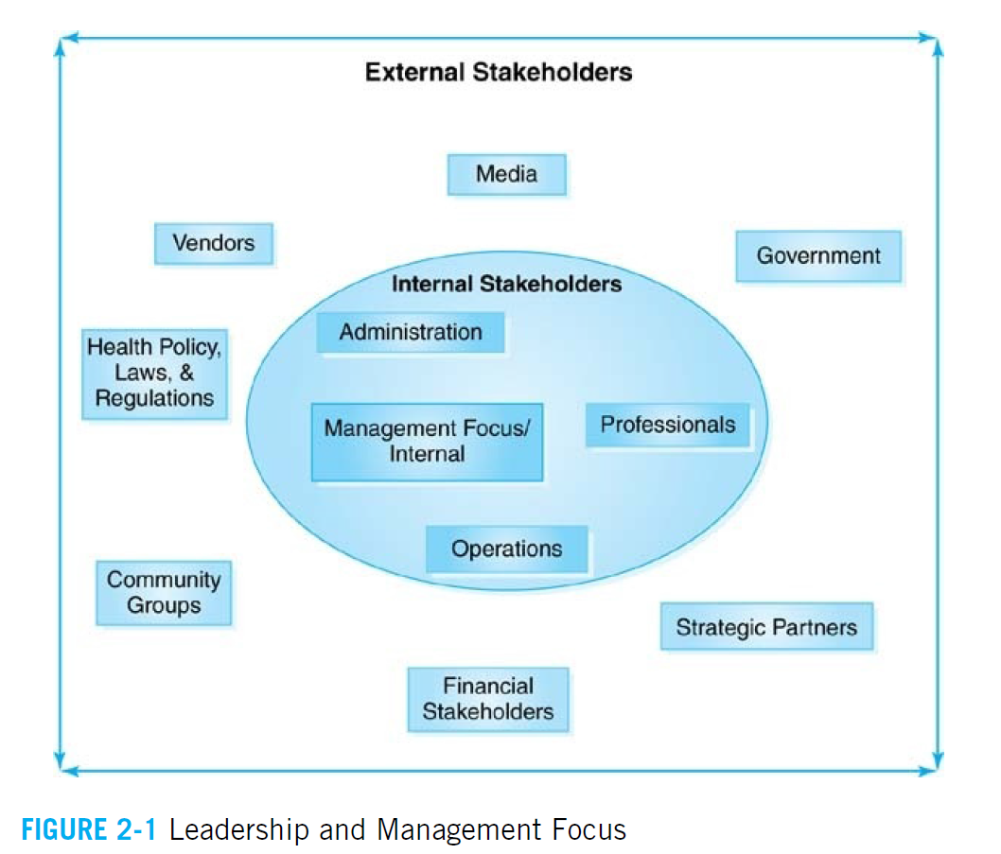

Slide 9
Types of leaders
  A strategic leader, who defines purpose and vision and aligns people, processes, and values, may be needed.
  A network leader, who could connect people across disciplines, organizational departments, and regions, may be essential.
  A Operational leader A leader who has functional oversight responsibilities.

Slide 10
Usually the top person in the organization (e.g., Chief Executive Officer (CEO), Administrator, Director) has full and ultimate accountability, strategic Leaders.
Operational managers (e.g., Chief Nursing Officer, Physician Director, Chief Information Officer) can certainly be leaders in their own areas, but their focus will be more internal within the organization’s operations, operational leaders.

Slide 11
Essential Leadership Skills and Qualities: Competencies
Consider the question: What defines an “effective” leader?
Effective leadership requires more than just developing your skills—you also need to cultivate and maintain an environment that enables those around you to thrive.

Slide 12
LEADERSHIP COMPETENCIES
Competencies : A leader needs certain skills, knowledge, and abilities to be successful.
Four main domains for leader competencies:
  Functional and Technical Domain.
  Behavioral:
    About leader himself: Self-Development and Self-Understanding
    About other: Interpersonal
    Cultural perspective: Organizational

Slide 13
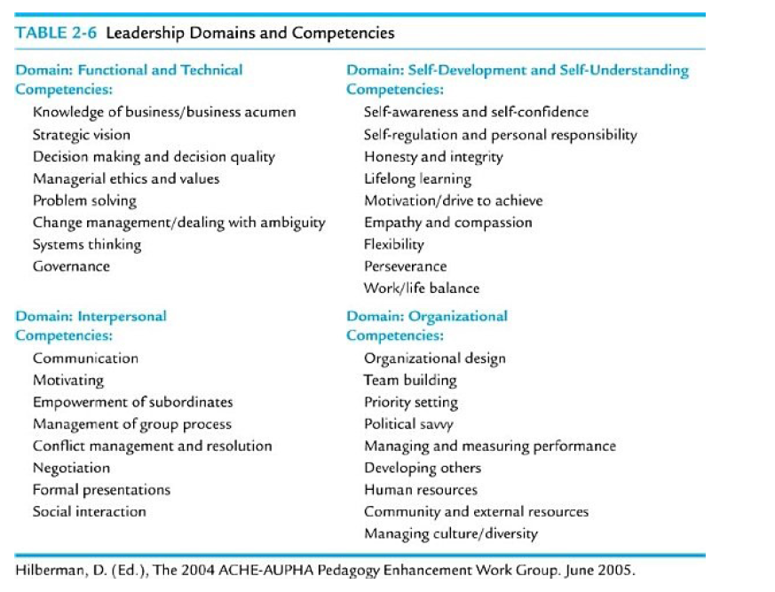

Slide 14

Skill 1: Emotional Intelligence (EI)
Emotional intelligence is the ability to understand and manage your emotions, as well as recognize and influence the emotions of those around you.
It suggests that there are certain skills (intrapersonal and interpersonal) that a person needs to be well adjusted in today’s world.

Slide 15
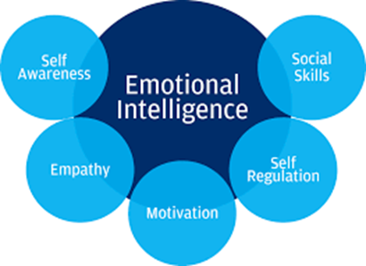
Emotional intelligence—
also known as EQ—is typically broken down into four core competencies:

Slide 16
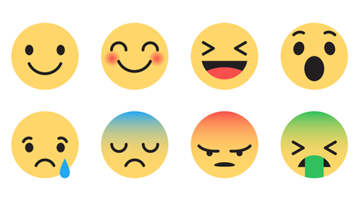

Self-awareness (having a deep understanding of one’s emotions, strengths, weaknesses, needs, and drives).
Self-regulation (refers to how you manage your emotions, behaviors, and impulses).

Slide 17
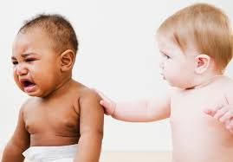


Empathy (is the capability of understanding another person’s experiences and emotions).
Motivation (refers to your ability to inspire both yourself and others to action).
Social skills (are all about how you perceive emotions and interact and communicate with others.).

Slide 18
SKILL 2: EMPLOYEE ENGAGEMENT
Advantages: Highly engaged employees tend to:
    Productive, better outcomes
    Provide better quality
    Loyal, stay for long time in HCOs
    Experience less burnout

Slide 19
Six strategies for engaging your employees.
Ongoing feedback.
Effective communication
Delegation
Show recognition
Be respectful
Empower

Slide 20
1. Base Feedback on Observations
  Ongoing peer feedback and check-ins are key to successful outcomes.
“I’ve found that some of the smallest tweaks we’ve been able to make by observing those people in action are some of the most meaningful.”
2. Delegation
To delegate effectively, ensure you’re assigning tasks to employees who are equipped with the knowledge, skills, and resources to handle them, or who stand to gain a valuable learning experience by taking on additional responsibilities.

Slide 21
3. Show Recognition
Assuring your employees that their work and opinions are important is essential to enabling your team to perform at its optimal level.
4. Foster Transparent Communication
Effective communication is foundational to fostering strong team dynamics and collaboration.

Slide 22
5. Support Learning and Development
Encouraging your employees to bolster their skills and knowledge through professional development and learning opportunities.
6. Be Respectful

Slide 23
SKILL 3: NEGOTIATION
Negotiation is, by nature, chaotic, as you don’t know the desired outcome of those seated across the table.
Here are seven negotiation tactics to try :
    1. Keep an Open Mind
    2. Show Your Cards
    3. Set and Stretch Your Goal
    4. Turn Anxiety into Excitement
    5. Project Power
    6. Take a Timeout
    7. Silence Can Be Golden
Negotiation principles https://www.youtube.com/watch?v=RfTalFEeKKE&list=RDCMUCcDybCgTDVNRKe_SPkv06Zw&start_radio=1&t=149

Slide 24
SKILL 4: DECISION-MAKING
“It’s really important to get clarity upfront around the roles people are going to play and the ways in which decisions are going to get made,” Schlesinger says.

Slide 25
SKILL 5: ORGANIZATIONAL CHANGE MANAGEMENT

Slide 26

How to manage change??
Understand the change process:
    All change processes have a set of starting conditions (Point A) and an endpoint (Point B).
    Preparation – Implementation – Follow up through.
Understand the forces of change:
    What pressures are driving change?
    Are they internal pressures?
    Are they external pressures?
Create a plan.
Communicate the plan.
Prepare for roadblocks.

Slide 27
BARRIERS AND CHALLENGES
Health care leaders are confronted with many situations that must be dealt with as they lead their organizations.
Some can be considered:
    Barriers that will stymie the capacity to lead.
    Challenges that must be addressed if the leader is to be successful.

Slide 28
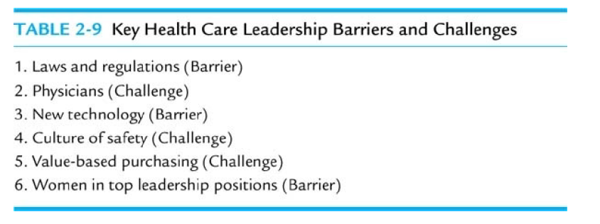
Notes:
Mistakes will not be tolerated developing systems and mechanisms to prevent them from ever occurring.

Slide 29
Free tools for medical students leadership development
AMA Health system sciences
https://edhub.ama-assn.org/health-systems-science/interactive/18028219
The Medical Leadership Competency Framework Self assessment tool
NHSLeadership-Framework-MLCFSelfAssessmentTool.pdf

Slide 30
LEADERSHIP STYLES
Styles demonstrate a particular type of leadership behavior that is consistently used.
The environment must also be considered when deciding which style is the best fit.

Slide 31

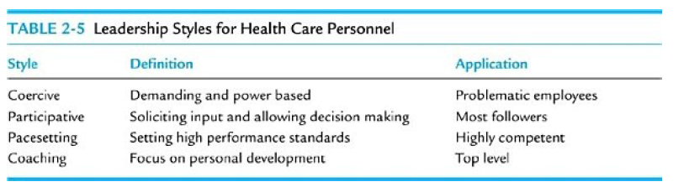

Slide 32
Coercive leadership style: power is used inappropriately to get a desired response from a follower.
Participative: Asking these managers for their input and giving them a voice in making decisions will let them know they are respected and valued.
    Many health care workers are highly trained, specialized individuals who know much more about their area of expertise than their supervisor.

Slide 33
Pacesetting style: a leader sets high performance standards for his or her followers.
Coaching style: the leader focuses on the personal development of his or her followers rather than the work tasks.

Slide 34
Master leadership A systems-thinking leader who balances being a motivator, vision-setter, analyzer, and task-master.

Slide 35
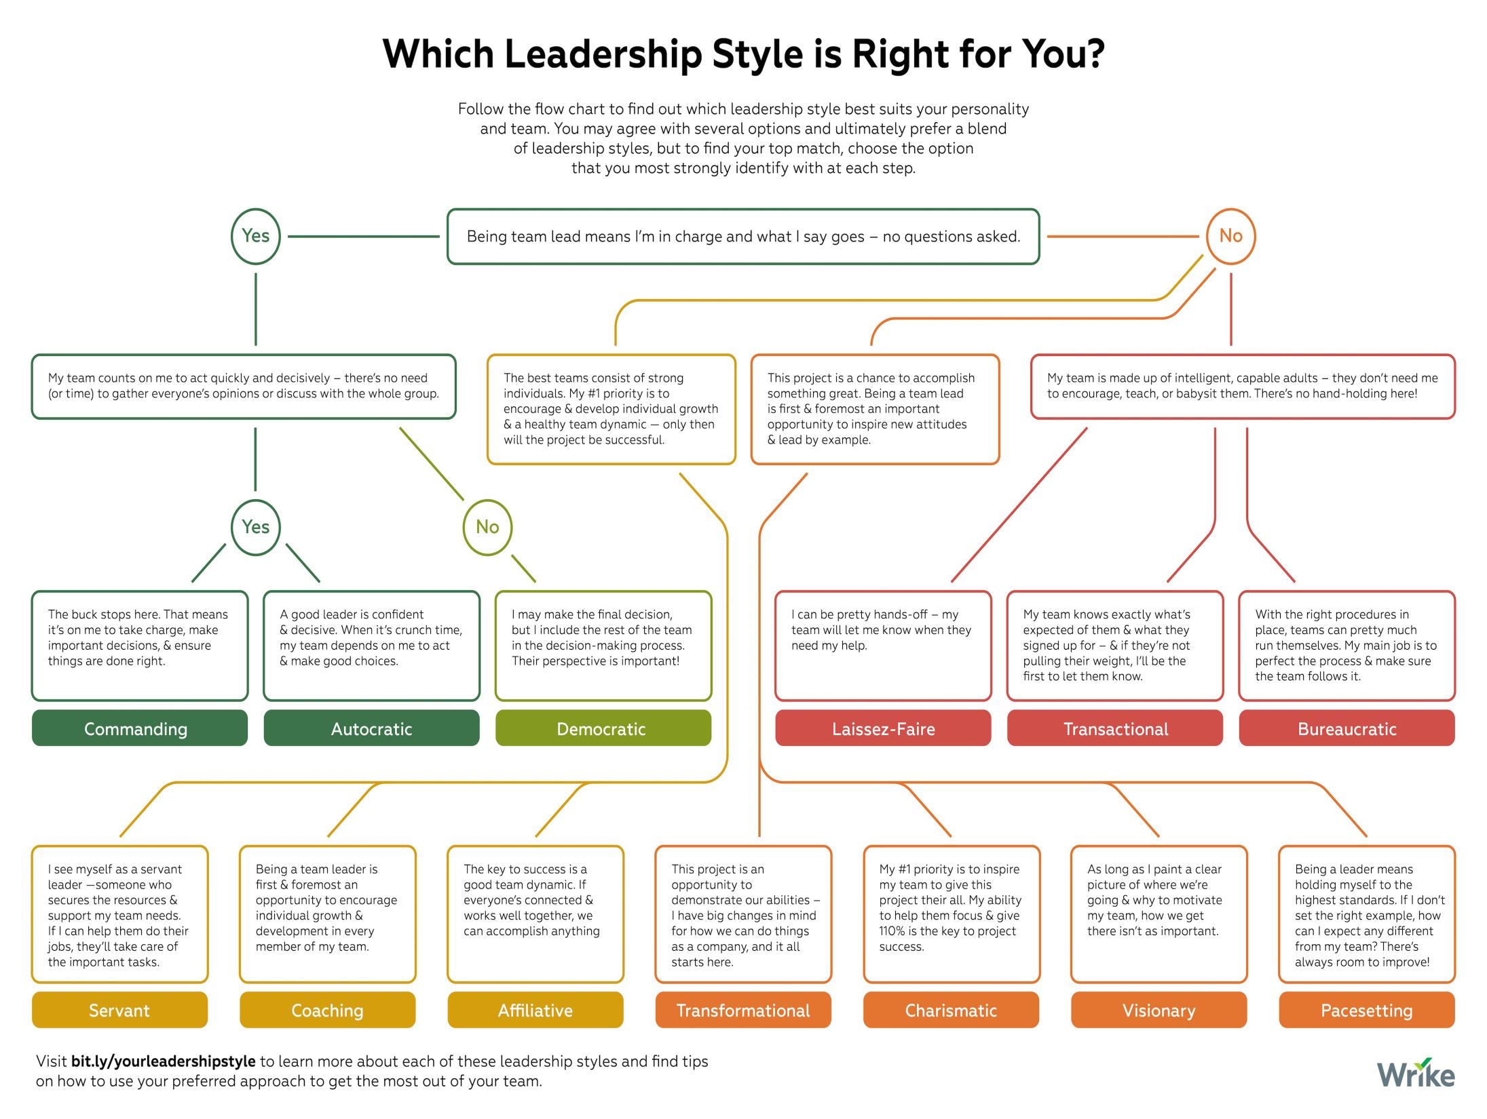

Slide 36
LEADERSHIP PROTOCOLS
Leaders are role models for their organizations’ employees, and they need to be aware that their actions are being watched at all times.
Health care administrators are expected to act a certain way.
These appropriate ways in which a leader acts are called protocols.

Slide 37
Assessing Leaders as Individuals
Each leader has an annual 360-degree performance appraisal;
  A multi-source feedback approach to assessing the job performance of an individual employee, using input from a manager, subordinates, peers, and internal and external customers.

Slide 38
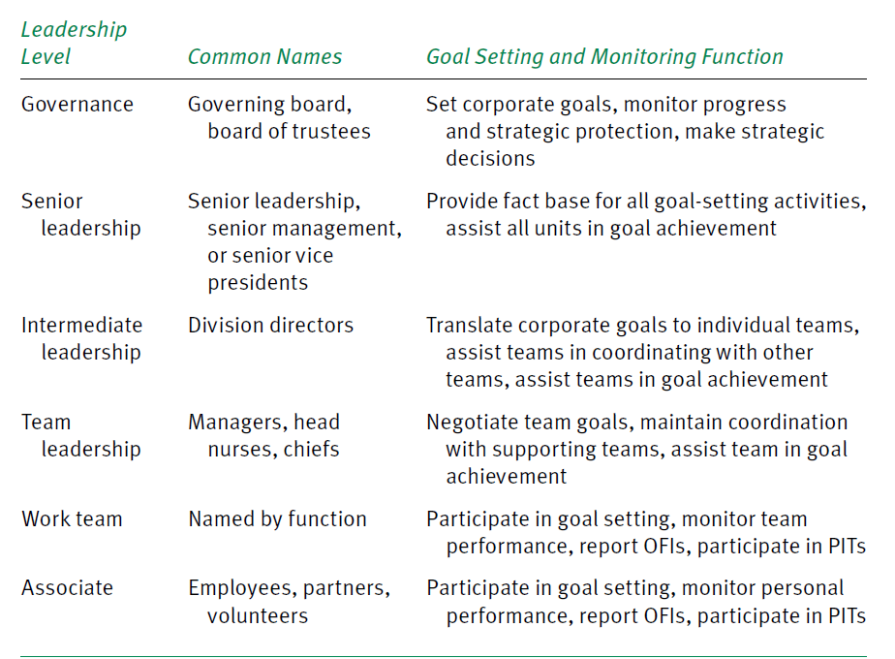
Leadership structure (levels)

Slide 39
GOVERNANCE
Governing bodies Groups of individuals who oversee organizations, such as boards of trustees or directors, who have ultimate legal responsibility for the organization’s actions and performance.

Slide 40
The American Hospital Association (AHA)Center for Healthcare Governance
Blue Ribbon Panel Report (2012) which identified recommendations for health care governance during this period of transformation.
These included:
  Strengthen the board and organizational capacity to manage change.
  Encourage collaboration among providers.
  Actively oversee physician alignment, integration, engagement and development.
  Create a compelling vision for the future.

Slide 41
Governance board member qualification
Skills and character criteria
    Familiarity of the community
    Familiarity of business decision
    Available time
    Reputation and successful history
Representative criteria
    A good board should have representation from all stakeholders.

