Slide 1
Staffing: The Strategic Management of Human Resources
Lec. 3
MED 311
Spring 2020/2021
Dr. Ola Soudah

Slide 2
A medium-sized HCO requires more than 1,500 associates/employees working at about 1,000 full-time jobs in about 100 different skills.
Organizations need to view their human resources as a strategic asset (source of power and profit) that helps create competitive advantage.

Slide 3
Purpose
Human resources management addresses the need to ensure that qualified and motivated personnel are available to staff the business units operated by the HCOs by designing and implementing appropriate policies and programs.

Slide 4
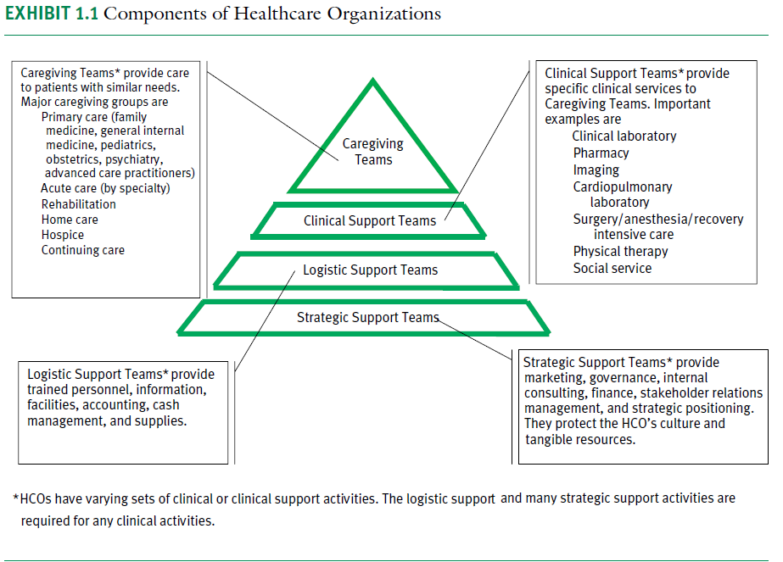
HCO People

Slide 5
The human resources activities (HR) are carried out by:
HR department.
Line managers; who are charged with hiring, supervising, evaluating, developing, and, when necessary, terminating staff.

Slide 7
Understanding employees as drivers of organizational performance
HCOs are only as good as their employees.
Why is this so for health services organizations?

Slide 8
KEY FUNCTIONS of HR department
Typically, these key functions can be collapsed into two major domains called workforce planning/recruitment and employee retention.
Activities in these two domains are typically carried out by human resources staff professionals

Slide 9
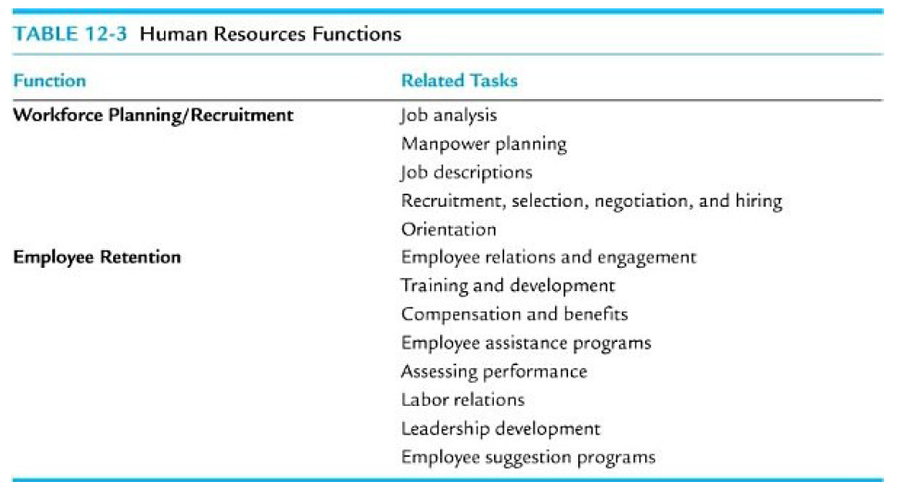

Slide 10
WORKFORCE PLANNING/RECRUITMENT
It includes all the activities associated with new employment: job vacancy, description, recruitment, selecting, negotiation, hiring, and new employee orientation.

Slide 11
Workforce Planning
Purpose: To estimate the number of staff members needed at the present time, as well as projections of the number of staff members needed at some future target date.
Identifying current numbers of staff and projected needs is based on:
A) Volume statistics: The number of patients admitted, number of outpatient visits, or the number of patients receiving a specific service.
B) Amount of work to be accomplished in non-clinical areas.
C) In some cases, need will be determined by licensure standards that govern the minimum number of staff for certain services.
D) Consideration is also made for retiring staff, transfers, and service changes

Slide 12
Job Analysis
Job analysis involves identifying those unique responsibilities, duties, and activities specific to every position in the HSO.
This is necessary to clarify individual responsibilities but is also critical to avoid duplication of tasks and responsibilities across positions.

Slide 13
Establishing Job Descriptions
Job descriptions are necessary to define the required knowledge, skills, responsibilities, training, experience, certification or licensure for a specific job within the HSO.
Position descriptions are developed through joint efforts of line managers and HR department.

Slide 14
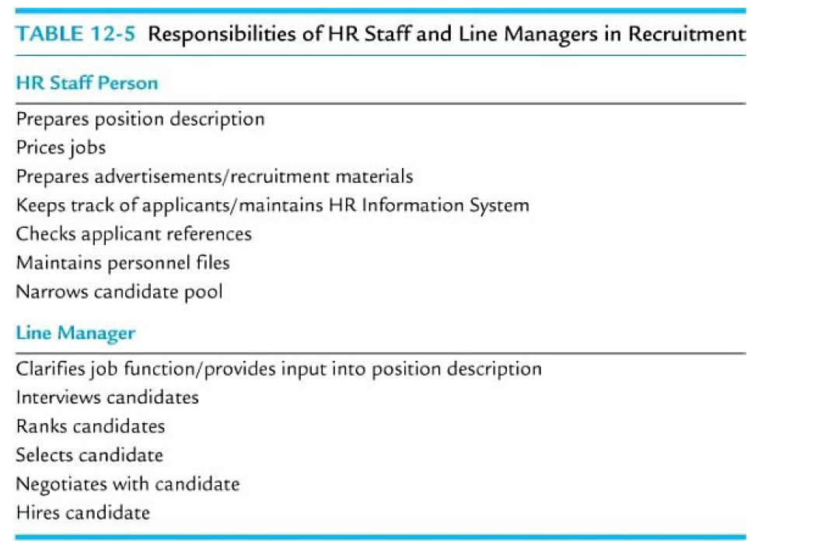
Recruitment, Selection, Negotiation, and Hiring of New Employees

Slide 15
Recruitment, Selection, Negotiation, and Hiring of New Employees
Human resources recruitment personnel use a standard process for external recruiting.
These steps include advertising, screening applicants, determining those to be interviewed, conducting interviews, selecting the candidate, negotiating, and hiring.

Slide 16
Interviewing, Selection, Negotiation, and Hiring
First, Application review by HR staff .
Meet the requirement, check candidate references, and identify past employers’ satisfaction with the candidates.
Second, narrow down the pool.
Find the best fit based on training, experience, and other factors such as motivation and attitude.
Finally, selection for interview.
These applicants are then discussed with the line manager to select those to be interviewed.

Slide 17
Interview is important for both HCOs and the new employee:
HCOs: Check point to find the best fit.
Candidate: To take a closer look at the organization culture .
Structured interviews with clearly defined questions are thought to be best for assessing candidates.
Behavioral-based questioning focuses on the candidate’s response to questions that yield insight into actions taken in particular situations.
(e.g., “Tell me a time when a project could not be completed and how you resolved the problem,” or “Describe a situation in the past where you have experienced conflict with co-workers or a supervisor, and how you resolved the conflict”).

Slide 18
An offer of employment (offer letter)
must specify the position for which the offer is made, start date, associated salary/compensation and benefits, and any other key information regarding the offer.

Slide 19
Orientation
An orientation program informs the new employee of policies, procedures, and requirements, and it offers an opportunity for the new employee to ask questions and clarify understanding about the organization.
The Employee Staff Manual is provided to each new employee.

Slide 20
It should cover:
The organization’s values, mission, vision, and goals.
Strategic and long-range plans.
Standards of behavior and codes of conduct; proper attire and behavior.
Various policies and procedures
Expectations for the work day.
Employee assessment, disciplinary actions and grievances, probationary period.
Opportunities for training and development.

Slide 21
EMPLOYEE RETENTION
Employee retention: includes all of those key activities that address care, support, and development of employees to facilitate their long-term commitment to the organization.
The key functions under employee retention include:
Employee relations and engagement.
Training and development.
Managing compensation and benefits.
Grievance (complains) admiration.
Providing employee assistance programs.
Assessing performance.
Managing labor relations.
Leadership development programs.

Slide 22
Employee Relations and Engagement
The purpose of employee relations and engagement efforts is to identify and address the needs of employees so that they will be satisfied (happy), perform at a high level (increase productivity) , and remain with the organization (loyal).
The HR department works with line managers to determine appropriate employee relations activities.
Employee engagement and satisfaction surveys are commonly used indicators.

Slide 23
Happy employee contribute more to the organizations and perform better.
HCOs follows different strategies to increase employee relations and engagement (participative management):
Employee decision making about aspects of their work.
Recognition and reward programs, such as employee of the month, staff appreciation events, and greatest improvement by department or unit in balanced scorecard measures.
Observation of work units and meeting with employees through Manager walk-a rounds, meetings, daily huddles, and employee focus groups.

Slide 24
Training and Development
Importance stem from :
The changing nature of HCOs; new technologies, updated health protocols …. Etc.
To provide for continuing education

Slide 25
All training programs should be routinely evaluated at three Kirkpatrick levels;
Level 1: is recipient satisfaction
Level 2: is content mastery
Level 3 is application
Level 4: performance improvement after training

Slide 26
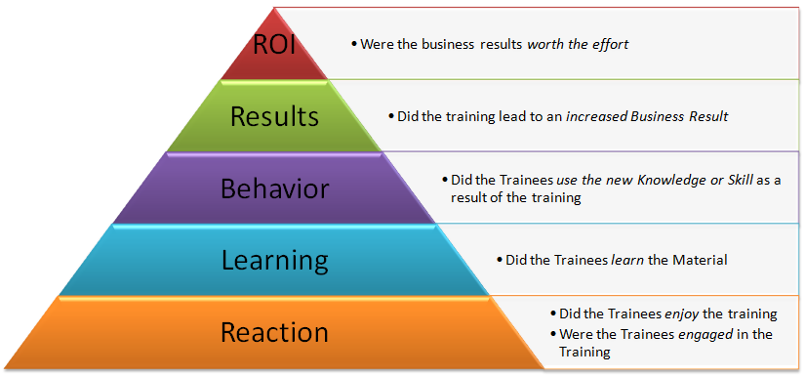
Kirkpatrick levels.
Level 4
Level 3
Level 2
Level 1

Slide 27
Grievance administration
Complaints or questions should be fully and fairly answered.
When disagreements arise (resolving conflicts), good grievance administration stimulates the following reactions:
Documentation of issue
Credible, unbiased, and informal review
Informal negotiations
Counseling for the supervisor involved aimed at improving future human relations
Settlement without formal review whenever possible
Implementation of changes designed to prevent recurrences

Slide 28
Managing Compensation and Benefits
Compensation
The HR department has the specific responsibility of managing the pay or base compensation (salary) and benefits (eg. Health insurance) associated with all positions held within the HSO.

Slide 29
Base Compensation mean to determine the financial value for each position.
Compensation for each position is set based on the consideration of a number of factors:
The specialized knowledge and skills.
The experience.
The relative availability of skilled individuals to fill the position.
Average wages that are specific to the local labor market.
This is called job pricing

Slide 30
Incentive compensation: Reward systems beyond base pay, considered of greater importance to employees.
In an incentive or pay for-performance plan, the purpose of the plan is to stimulate employees to higher levels of achievement and performance that benefit the organization.

Slide 31
Benefits
A benefit is defined as any type of compensation provided in a form other than salary or direct wages, that is paid for totally or in part by an employer.
Typical benefits offered by HSOs include the following:
Sick leave.
Vacation.
Holidays.
Bereavement leave.
Health insurance
Life insurance
Retirement benefits

Slide 32
Assessing Employee Performance
Performance appraisal means assessing the job performance of an individual employee.
The assessment form includes several criteria that are determined to be important for the HSO in evaluating performance. These criteria may include :
Measures of work productivity, quality, and quantity as specified in the position description and include technical skill assessment as well as
Other criteria that address the employee’s motivation, attitude, and interpersonal skills in carrying out their respective work.

Slide 33
Leadership Development
Leadership development efforts in HSOs are also employed to provide for succession planning for senior/executive and midlevel managers.

