Slide 1
Management competencies
ACHE HEALTHCARE EXECUTIVE 2021 COMPETENCIES ASSESSMENT TOOL

Slide 2
The Medical Leadership Competency Framework, UK

Slide 3
Types of managers
The traditional classification of HCO managers is by level in the organization hierarchy.
The primary difference between levels is the degree of authority, the scope of responsibilities and the organizational activities.

Slide 4
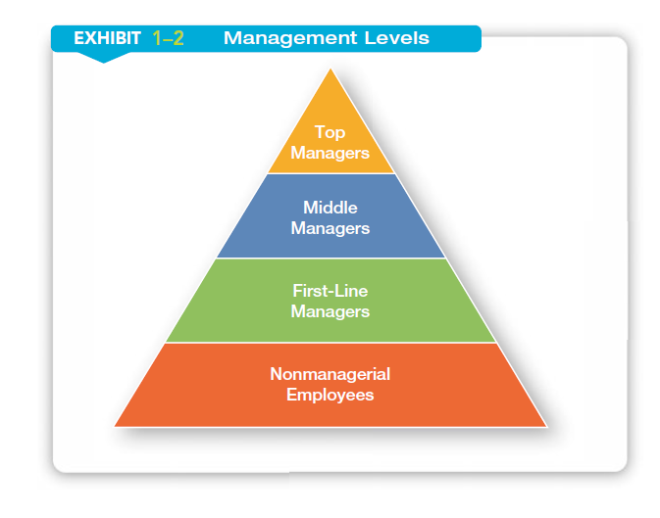

Slide 5
Levels of management and their roles
Top level managers
Make decisions about the direction of the organization.
Ex: CEO, vice president.
Mid level managers
Manage the activities of other managers
Ex: department or division manager
Low level managers
Manage the activities of non-managerial employees
Ex: supervisor , team leader.

Slide 6
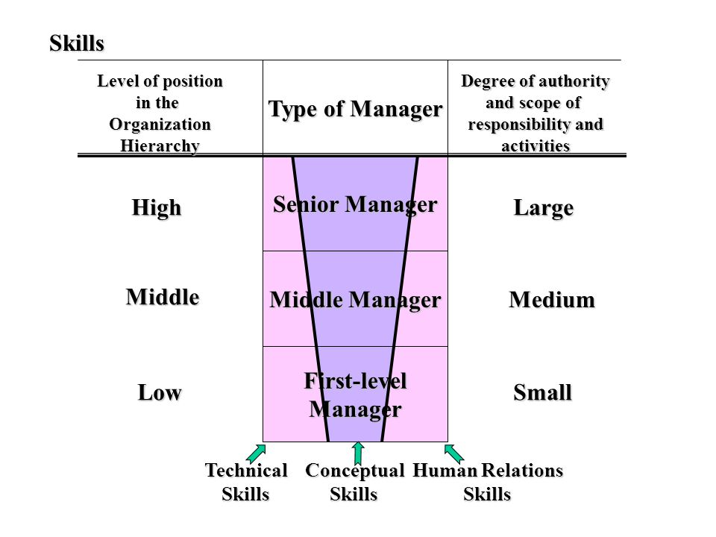

Slide 7
Management Functions
Lecture 2
MED 311
Spring 2020/2021
Dr. Ola Soudah

Slide 8
Decision making or problem solving

Slide 9
Decision making or problem solving
Decision: is a choice made from available alternatives.
However, make a decision is not one step,
it is a process …
Decision making is the process of identifying problems or opportunities and then resolving them.

Slide 10
Types of decisions in management
Programmed: are made as a response to organizational problem. Usually managers make decision with a level of certainty.
Non-Programmed: managers deal with uncertainty, risk, ambiguity situations while making a decision. It is more related to HCOs strategic plan.

Slide 11
Certainty: all information needed for decision making is available.
Risk: all information is available, and decision goals are clear, however, the outcome is unknown and subjected to loss or failure.
Un-certainty: decision goals is clear however, information about alternatives or outcomes is not enough.
Ambiguity: means that the goals to be achieved is not clear , alternatives is difficult to define, and information about the outcome is not available .

Slide 12
Problem occur when performance or accomplishment is less than established goals (unsatisfactory level).
Opportunity occur when manager sees potential accomplishment will exceed the goals (outstanding performance).

Slide 13
The decision-making process, the two main phases are:
The recognition phase of decision making involves recognizing and identifying the decision or problem and its causes, setting goals, and generating options.
The choice phase of decision making involves assessing options and choosing, implementing, and evaluating the chosen solution.

Slide 14
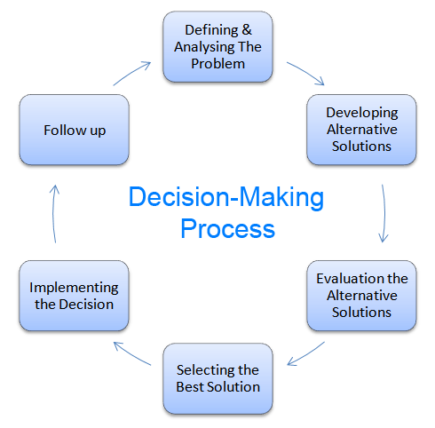
Decision-making process steps:
Recognize decision requirement.
Diagnosis and analyze problem.
Define and develop alternatives
(build decision matrix).
4. Implement.
5. Evaluate (feedback).

Slide 15
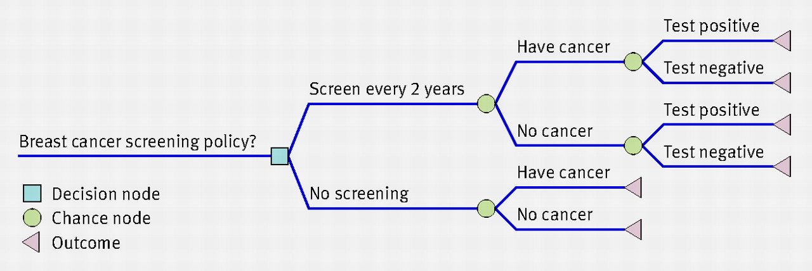
Decision matrix
Decision tree

Slide 16
What Common Errors Are Committed in the Decision-Making Process?
Individuals compensate for their limited capacity to effectively process information with unconscious judgment, and shortcuts that simplify the decision process and create serious biases that distort their judgments.
This called heuristics “or rule of thumb” and cognitive bias

Slide 17
Heuristics Mental or cognitive shortcuts that simplify thinking and can cause bias.
It could be useful in simplifying the decision making process, however, it usually ended up with biases.

Slide 18
Biases: systematic errors of perception and judgment.
Most common biases :
Overconfidence bias
Confirmation bias
Availability heuristics
Familiarity heuristics.

Slide 19
Overconfidence bias is the widespread tendency to overestimate the accuracy of our own judgments.
Confirmation bias means we unconsciously and selectively notice information that simply confirms our existing beliefs.

Slide 20
Availability heuristic refers to judging the importance of information because it is easy to recall examples.
Familiarity heuristic refers to judging an unknown quality of something simply because we are familiar with that thing.

Slide 21
The successful manager is able to handle complex, ambiguous problems that are not clearly defined and for which opinions vary on the nature of the problem and possible solutions.
Managers who are aware of biases (including their own) can reduce bias and error.

Slide 22
Strategies to reduce the effects of bias:
Wide participation in decision-making,
Evaluating multiple alternatives,
Decision protocols,
Evidence-based medicine/management,
Bias awareness and training,
Use of cognitive aids and decision support systems.

Slide 23
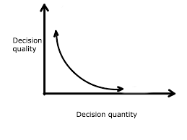
Decision fatigue
Decision fatigue: decision making ability declines after long session of decisions.
Simply when you have to many things (decisions) you have to decide about in short period of time.

Slide 24
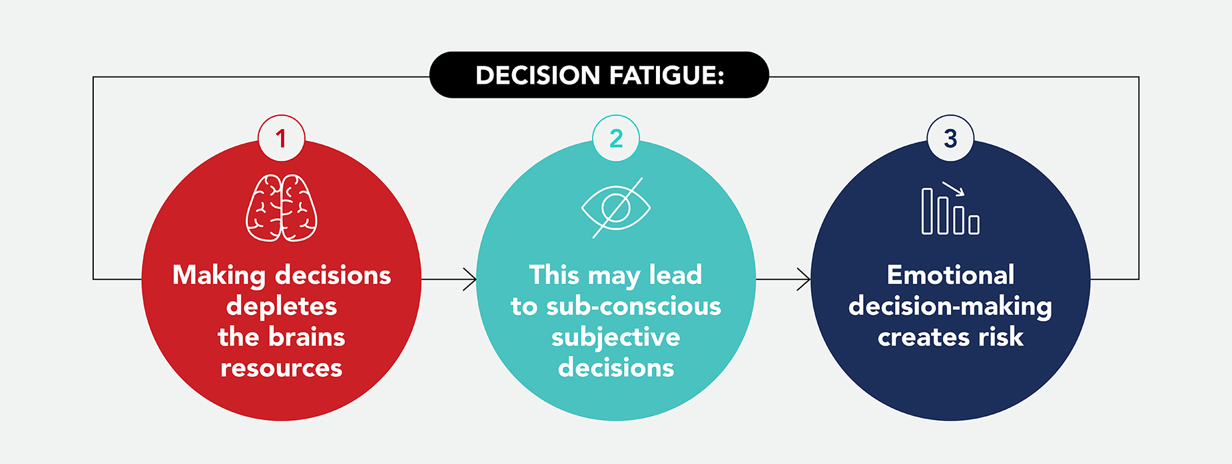
Consequences of decision fatigue

Slide 27
Planning

Slide 28
What is the plan for?
Planning is the process of identifying a desired future state for an organization and a means to achieve it.
Determine what to do and how to do as well as anticipating the future.

Slide 29
Types of planning
Type of planning refer to: the level (strategic / operational) and the scope of the plan (broad/ narrow).
Strategic planning:
Performed at senior management level,
Broad; covering the overall goals of HCOs,
Over extended period of time (long term goals).
Operational planning:
Performed at department/group level,
Narrow; sub-objectives that is aligned with the strategic plan,
Over short period of time (short term goals).

Slide 30
The purpose of strategic planning
Determine the organization direction.
Prepare for change.
Deal with uncertainties.
Identify market forces and how they may affect the organization.
Determine an appropriate strategic direction for the organization.
Focus the organization and also its resource allocation.

Slide 31
THE PLANNING PROCESS
The development of the plan phase: often done with a multiyear time horizon (3, 5, or 10 years, for example) and updated annually.
The execution of the plan phase: is done on a continuous basis and the continual feedback for the development of any future plans.

Slide 32
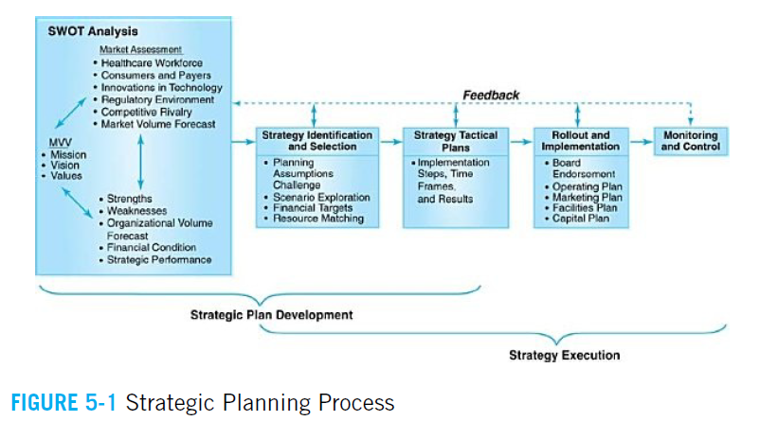

Slide 33
SWOT analysis
The SWOT (Strengths, Weaknesses, Opportunities, Threats) Analysis provides a foundation for strategy development.
It aims to identify the
Internal strengths and weaknesses of an organization.
External market opportunities and threats.

Slide 34
SWOT analysis components:
The market assessment.
The statement of the mission, vision, and values (MVV) of the organization.
The organizational assessment.

Slide 35
Market Assessment
It aims to determine opportunities or threats for the organization and to determine their future implications for the organization.
It is the most complex and time consuming part.

Slide 36
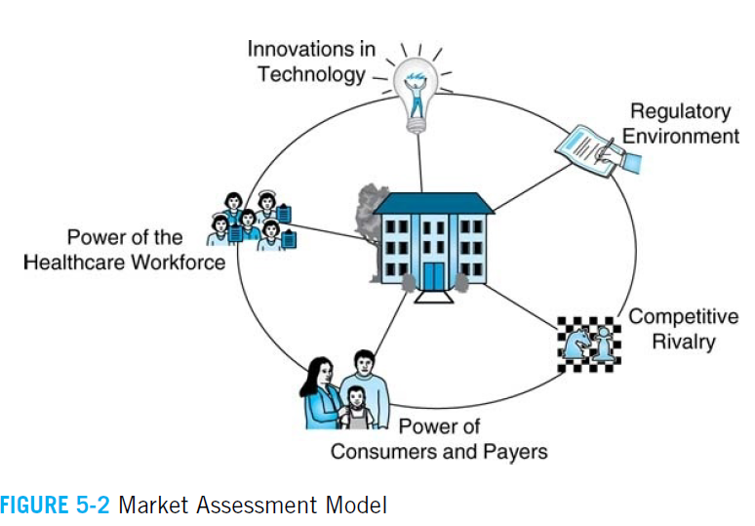
Market assessment models: the most common one for HCOs is Five Forces Model.

Slide 37
1. Power of the Health Care Workforce
In the SWOT analysis, an organization should look at the availability of all subsets of health care providers that are critical to its success.
The influence and availability of these and other health care personnel (and the organization’s dependency on them) must be considered when developing future strategies.

Slide 38
2. Power of Consumers and Payers
Power of consumers:
The patient is becoming the central focus of customer service.
Today’s consumers are demanding more and more from their health care providers on all levels (e.g., physicians, payers, and hospitals), both in terms of:
the availability of specific service offerings,
and in the delivery of those services.

Slide 39
By identifying specific community needs, health care organizations can better target their services and potential growth opportunities.

Slide 40
Power of payers:
Some markets have multiple payers of various sizes and strengths, while others have one or two major payers that dictate market payments.

Slide 41
3. Innovations in Technology
New technologies often replace standard operations and services.
Technology may reduce the need or number of certain workers or may increase the cost of certain medical services.

Slide 42
4. The regulatory forces
The regulatory environment—on all levels, federal, state, and local—needs to be monitored for its effects on strategy development as well.
Legislation at all government levels can have significant and rippling effects on all participants in the health care industry.

Slide 43
5. Competitive Rivalry
Strategically savvy organizations always track their competitors’ moves and suspected intentions.
Information on their service volumes, market share, and news coverage and press releases should be monitored.
Ongoing discussions with your own physicians, staff, and suppliers will likely also yield valuable competitive intelligence.

Slide 44
Mission, Vision, Values
The information gathered in SWOT analysis is matched against the organization’s Mission, Vision, and Value (MVV) statements.
The MVVs reviewed in the strategic plan to ensure they continue to be aligned with the organization’s future market environment and to help identify future desired strategic directions.

Slide 45
The mission statement of purpose. It aims to identify what the organization does, whom it serves, and how it does it.
The vision statement strives to identify a specific future state of the organization, usually an inspiring goal for many years down the road.
The values statement should help define the organization’s culture; what characteristics it wants employees to convey to customers.

Slide 46
Reaffirming and/or adjusting these three statements in relation to market activity is a critical step in determining the desired future state of the organization.

Slide 47
Organizational Assessment
It is an internal assessment, to examine the areas in which it has strengths and weaknesses, as well as how it may build or sustain a competitive advantage in the market.
Consist of two parts:
The quantitative section: assessment of the organizational volume forecast and the financial condition.
The qualitative section: focuses on past strategic performance and leadership’s interpretation of the organization’s core capabilities (or lack thereof).

Slide 48
1. Organizational Volume Forecast
The volume forecast is initiated by identifying the organization’s service area (define area where 70–80% of its patients are came from) and determining the population use rates for applicable service lines (e.g., how many patients visit cardiology clinics per year).
Data are usually collected for several historical time periods (e.g., the previous 3 years or twelve quarters).

Slide 49
Importance of forecasting:
Formulate a preliminary idea of how well the HCOs will be if it stays performing in similar way (examining the trend).
Identifies service lines or areas of strength that may need to be protected and service lines or areas that could be developed further.

Slide 50
2. Financial Condition
Financial indicators forecast for several years along with volume forecasting is helpful to:
Identify the HCOs weakness and strengths.
Provide budget targets for the upcoming year(s).
Also, it is critical to tie the financial reserves and needs of the organization to the strategic planning process to ensure the resulting strategies can and will be funded appropriately.

Slide 51
3. Strategic Performance
A review of the organization’s past strategic performance should be included as part of future strategy development.
An assessment of whether past strategies accomplished their intended goals.
Identifies roadblocks that led to failure or factors that drove success.

Slide 52
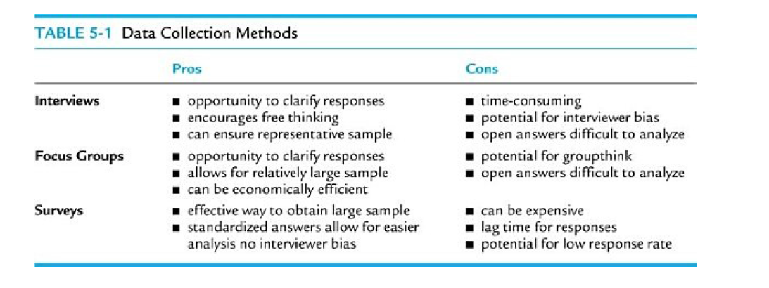
4. Organizational Core Capabilities
Is to identify subjective strengths and weaknesses, qualitative assessment.

Slide 53
STRATEGY IDENTIFICATION AND SELECTION
Throughout the development of the SWOT, the building blocks for strategy identification begin to emerge.
It includes:
Scenario Development
Outcomes
Strategy Tactical Plans

Slide 54
A. Scenario Development
WHAT IF GAME ….
This is where strategic planning really becomes an art VS. a science
Strategy identification usually begins with the baseline scenario developed for the volume forecast, and financial plan.
Then applying different planning assumptions to the baseline scenario yield to more scenarios to be analyzed.
From this scenario analysis, several potential strategic directions for the organization may emerge.

Slide 55
B. Outcomes (What to do)
Once a scenario is chosen, specific desired outcomes should be targeted and strategies to accomplish this identified.
A strategy is a carefully designed plan to accomplish the desired outcomes.

Slide 57
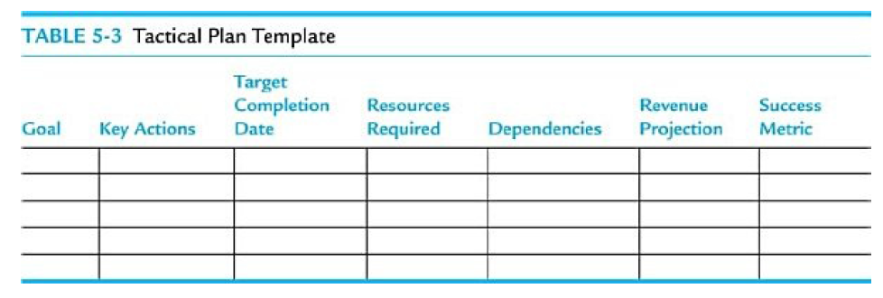
C. Strategy Tactical Plans (Working plan , HOW?)
Tactical plans for each strategy are necessary for translating the plan into action.
Tactical plans answer the who, what, when, where, and how questions of strategy implementation

Slide 59
ROLLOUT AND IMPLEMENTATION
Rollout of the plan has two main steps:
First, the plan is communicated at all levels of the organization.
Second, develop supporting plans in order to reinforce the strategic direction.

Slide 60
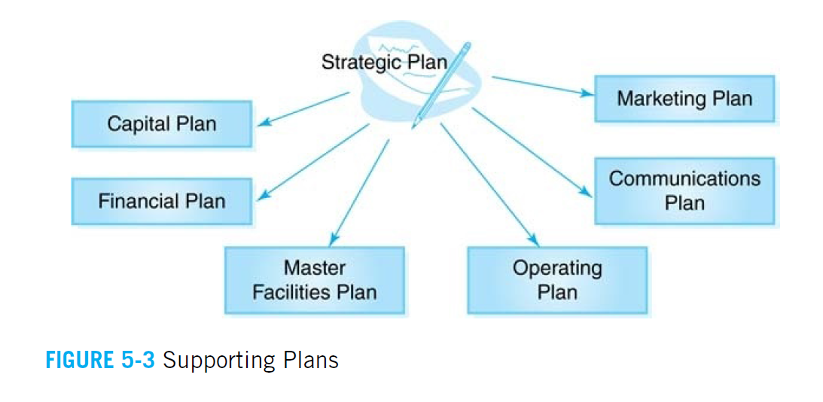

Slide 61
OUTCOMES MONITORING AND CONTROL
It is accomplished through the use of an organizational dashboard, or scorecard.
A dashboard is a visual reference used to monitor an organization’s performance against targets over time.

Slide 62
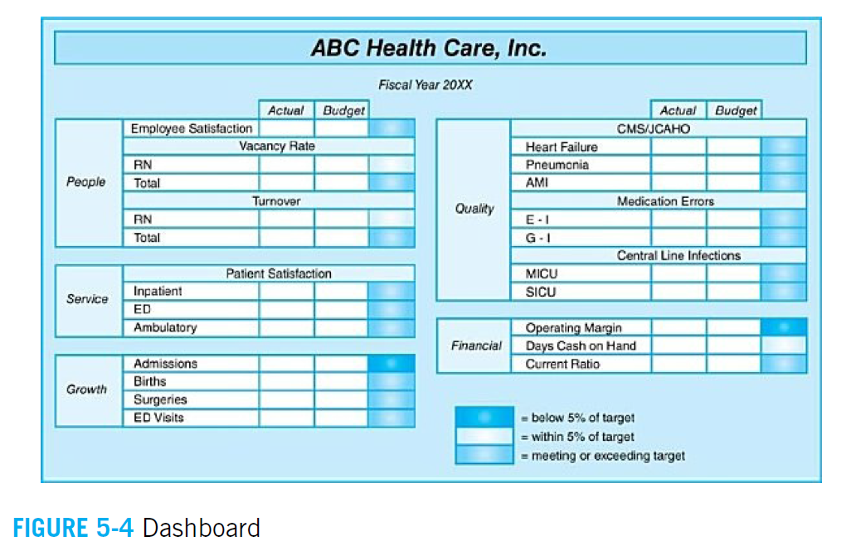

Slide 63
STRATEGY EXECUTION
Successful organizations know that execution is much more important than the plan.
Barriers and roadblocks
“culture eats strategy for lunch.”
If an organization’s stakeholders are not ready for the strategy, it will not be executed by even the most tenacious of leaders.
So, strategy execution to start early in the planning process.

Slide 64
Other barriers include a lack of focus of the strategy, so many strategies than it can successfully execute.
Fund and resources.
Competing priorities.
In order to execute strategies successfully HCOs need:
Strong leadership to maintain a long term focus.
Organizational buy-in at all levels

Slide 65
EXAMPLE of Strategic plan

Slide 66
Example: JHK hospital strategic plan 2014-2018

Slide 71
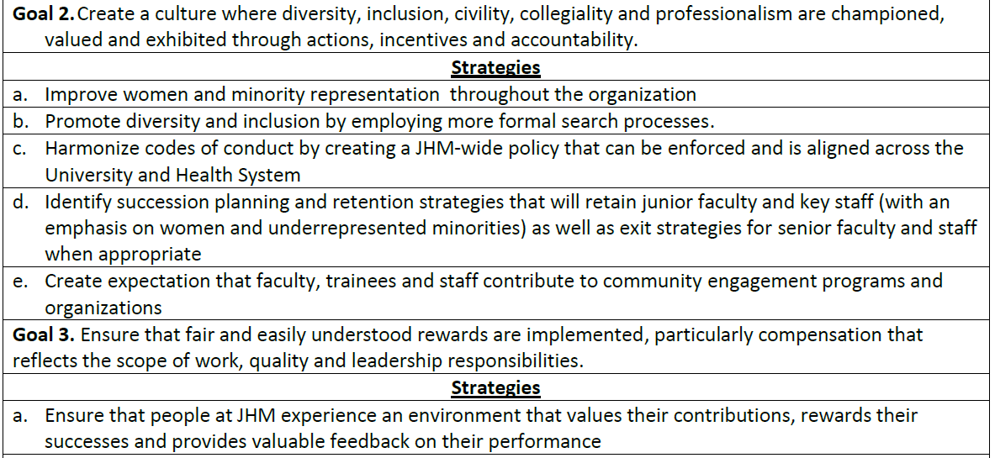

Slide 72
https://www.hopkinsmedicine.org/strategic-plan/

