Slide 1
Introduction to healthcare administration
MED 311
Spring 2020/2021
Dr. Ola Soudah

Slide 2
Who are managers ? Where they work?
Organizations
Organization: Is a deliberate arrangement of people brought together to achieve certain goals.
Healthcare organization (HCO) A formal legal entity that reaches across the panorama of medicine, other clinical disciplines, and business to identify and deliver care to its community.
HCOs include all organizations that provide healthcare.

Slide 4
Organization consist of :
Goals:
Based on IOM: HCOs goal is to provide care that is safe, effective, patient-centered, timely, efficient, and equitable.
People.
Structure.

Slide 5
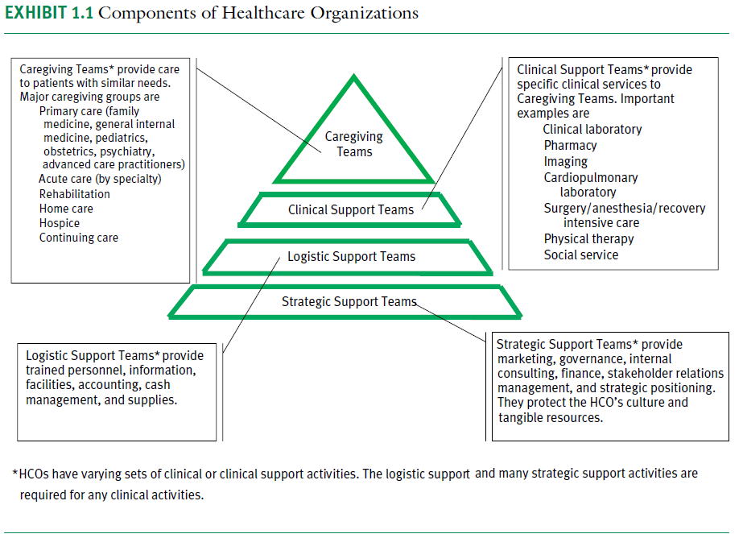
People

Slide 6
Structure

Slide 7
Non-managerial employee
Have no responsibility on overseeing the work of others.
They do their tasks only.
Ex: registration officer, nurse …. Etc.
Managers
Individuals in the organization who direct the work and the activities of others.

Slide 8
What is management ???
Management: The process of getting things done effectively and efficiently with and through people.
Managers who are formally pointed to positions of authority and power to work through others to accomplish organizational goals.
HCOs managers are defined as persons appointed to positions and authority who enable others to do their work effectively and efficiently, who have responsibility for utilization of resources, who are accountable for work results.

Slide 9
Effectiveness:
“doing the right things” ; the task that help the organization reach their goals.
Efficiency:
“doing things right” ; is the useful use of resources time, human, supplies and equipment to achieve similar goals.

Slide 10
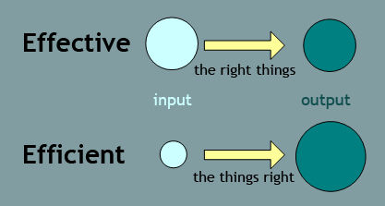
The difference between effectiveness and efficiency is that effective is to do the job (outcome), meanwhile efficiency is to do the job with less use of resources (time and cost) and from the first time.

Slide 12
The work of managers in HCOs
Direct work in HCOs that may include some combination of patient care, research , education, and provide a certain services.
Support work by conducting activities like fund raising, public health, marketing …etc.
Manage the organization ……….. (the focus of this course)

Slide 13
Manager in HCOs
Supervisors.
Team manager.
Office or medical directors.
CMO: chief of medical officer.
CNO: Chief of nursing officer.
CFO: Chief of financial officer.
CIO: chief of information officer.
Vice president.
CEO: chief executive officer (president).

Slide 14
Management
Management at all levels has four main elements:
It is a process: an ongoing set of activities and functions.
It involves establishing goals and objectives.
It involves achieving these objectives through people.
It occurs in formal setting (HCOs).

Slide 15
Management
Functions: activities which manager performs
Skills: skills manager use to do their work.
Roles: manager plays tin performing their work.
Competencies: qualities they need to do their job well.

Slide 17
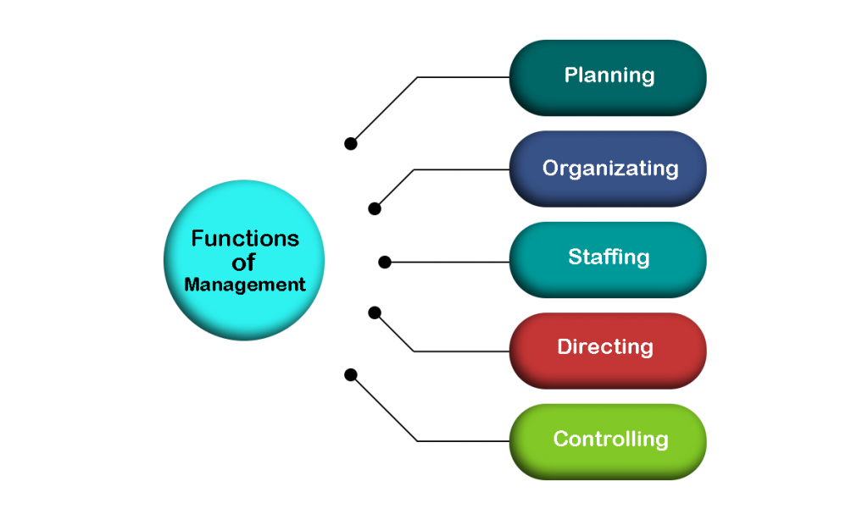
Management functions
Planning
Organizing
Staffing
Controlling
Directing
Decision making
Decision making

Slide 19
Planning
Planning means deciding prospectively what to do.
Setting mission, vision, values.
Setting short term goals and objectives.
Setting priorities and determining performance targets (indicators or benchmarks).

Slide 20
Controlling: involves gathering information and monitoring activities and performance, comparing actual results with predetermined desired results and correcting deviations when they occur.
Directing: initiating actions in the organization through effective leadership and motivation of, and communication with, subordinates. It is social and behavioral in nature.

Slide 21
Organizing
Refers to the overall design of the organization or the specific division, unit, or service for which the manager is responsible.
Managers are responsible for designating reporting relationships and intentional patterns of interaction.
Determining positions, teamwork assignments, and distribution of authority and responsibility are critical components of this function.

Slide 22
Staffing
Acquiring and retaining human resources.
Developing and maintaining the workforce through various strategies and tactics.

Slide 23
Decision making
This function is critical to all of the aforementioned management functions and means making effective decisions based on consideration of benefits and the drawbacks of alternatives.

Slide 24
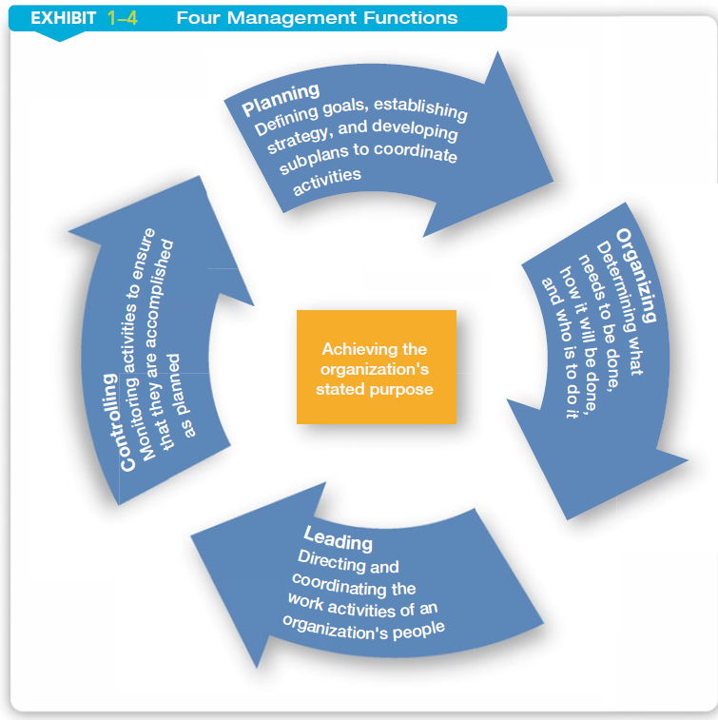
Management cycle process

Slide 25
What management skills are needed to be successful ?
Conceptual skills
Technical skills
Interpersonal skills

Slide 26
Conceptual skills
Those skills that involve the ability to critically analyze and solve complex problems.
Examples:
a manager conducts an analysis of the best way to provide a service
a manager determines a strategy to reduce patient complaints regarding food service

Slide 27
Technical skills
Those skills that reflect expertise or ability to perform a specific work task.
Examples:
a manager develops and implements a new incentive compensation program for staff
a manager designs and implements modifications to a computer-based staffing model

Slide 28
Interpersonal skills
Those skills that enable a manager to communicate with and work well with other individuals, regardless of whether they are peers, supervisors, or subordinates.
Examples:
A manager counsels an employee whose performance is below expectations.
A manager communicates to subordinates the desired performance level for a service for the next fiscal year

Slide 29
Management Roles Role’s that manager they can play
Managerial roles referred to specific categories of managerial actions or behaviors expected of a manager.
Roles are …
Interpersonal roles.
Informational roles.
Decisional roles.

Slide 31
The interpersonal roles are ones that involve people (subordinates and persons outside the organization) and other duties that are ceremonial and symbolic in nature. The three interpersonal roles are figurehead, leader, and liaison.
The informational roles involve collecting, receiving, and disseminating information. The three information roles include monitor, disseminator, and spokesperson.
The decisional roles entail making decisions or choices. The four decisional roles are entrepreneur, disturbance handler, resource allocator, and negotiator.

Slide 32
Other model of management roles

Slide 33
Examples of HCO managers roles ..
Establishing and maintaining organizational culture.
Talent management.
Ensuring high performance.
Leadership development and succession planning.
Innovation and change management.
Healthcare policy.

Slide 34
Management competencies
ACHE HEALTHCARE EXECUTIVE 2021 COMPETENCIES ASSESSMENT TOOL

Slide 35
The Medical Leadership Competency Framework, UK

Slide 36
Types of managers
The traditional classification of HCO managers is by level in the organization hierarchy.
The primary difference between levels is the degree of authority, the scope of responsibilities and the organizational activities.

Slide 37
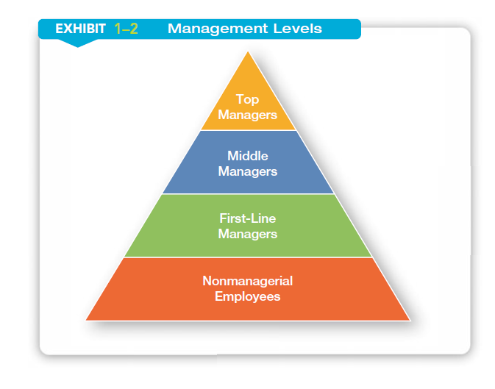

Slide 38
Levels of management and their roles
Top level managers
Make decisions about the direction of the organization.
Ex: CEO, vice president.
Mid level managers
Manage the activities of other managers
Ex: department or division manager
Low level managers
Manage the activities of non-managerial employees
Ex: supervisor , team leader.

Slide 39
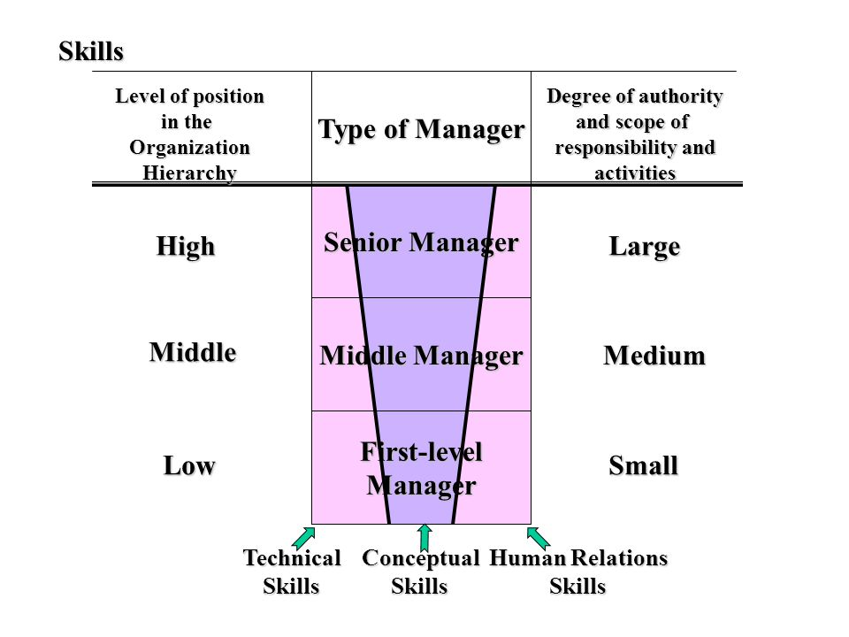

Slide 40
Questions

