Slide 1
brain waves and sleep-wake cycle
Dr. Ejlal Abu-El-Rub , Pharm.D, PhD
Department of Basic Medical Sciences
Yarmouk University

Slide 2
Brain waves
Electrical recordings from the surface of the brain or from the outer surface of the head demonstrate that there is continuous electrical activity in the brain.
The undulations in the recorded electrical potentials are called brain waves, and the entire record is called an EEG (electroencephalogram).
The character of the waves is dependent on the degree of activity in respective parts of the cerebral cortex, and the waves change markedly between the states of wakefulness and sleep and coma.

Slide 3
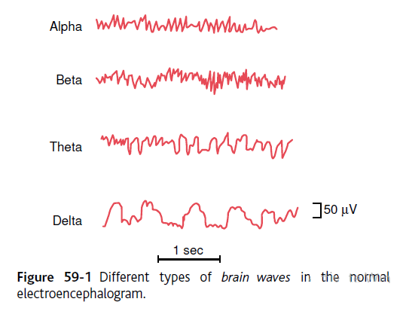
Brain waves
Alpha waves:
Found in EEGs of normal awake adults and in a quiet, resting state.
Mostly intense in the occipital region.
Disappear during deep sleep.
Beta waves:
Beta waves are produced when an external stimulus induces logical thinking, computation, and reasoning during consciousness.
Mainly recorded from parietal and frontal regions.

Slide 4
Brain waves
Theta waves:
Strong during internal focus, meditation, prayer, and spiritual awareness. It reflects the state between wakefulness and sleep and relates to the subconscious mind.
It is abnormal in awake adults but is perfectly normal in children up to 13 years old. It is also normal during sleep.
Delta waves:
the slowest recorded brain waves in human beings. They are found most often in infants and young children, and are associated with the deepest levels of relaxation and restorative, healing sleep. Delta is prominently seen in brain injuries, learning problems, inability to think

Slide 5
Origin of Brain waves
Many thousands or even millions of neurons or fibers must fire synchronously so that potentials from the individual neurons or fibers summate enough to be recorded all the way through the skull.

Slide 6
Sleep
Sleep is defined as unconsciousness from which the person can be aroused by sensory or other stimuli.
The Electroencephalogram (EEG) is a recording of neuronal electrical activity that can be made from the cerebral cortex via electrodes placed on the skull, used for determining the stages of sleep-wake cycle

Slide 7
Types of sleep
Slow-wave sleep (Non-REM)
The brain waves are strong and of low frequency
Deep, restful sleep during the first hours of sleep
Associated with decreased peripheral vascular tone, BP, RR and BMR.
Dreams may happen, but are not associated with bodily muscle activity and usually are not remembered.
Most sleep during each night.

Slide 8
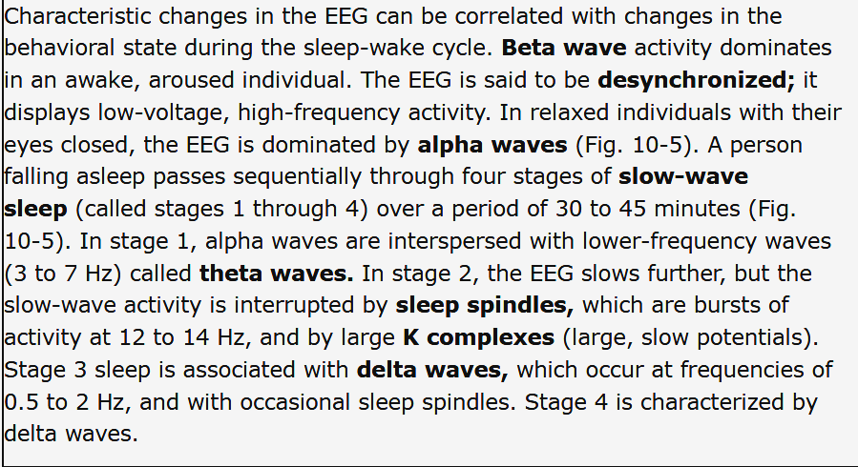
EEG characteristics of Non-REM sleep

Slide 9
Types of sleep
Rapid eye movement sleep (REM sleep)
In which the eyes undergo rapid movements.
Occupies about 25% of the sleep time / 5-30 minute episodes recurring every 90 minutes.
Not restful; associated with vivid dreaming and active irregular bodily movements.
Person more difficult to arouse by stimuli, but people usually wake up spontaneously during a REM episode.
Muscle tone depressed.
HR and RR become irregular.
Brain highly active (20% increase in metabolic rate) → Paradoxical sleep.

Slide 10
In REM sleep, the EEG again becomes desynchronized. The low-voltage, fast activity of REM sleep resembles that seen in the EEG from an aroused subject (the EEG proposed to show beta (15–35 Hz) and theta (3–7 Hz) waves oscillations).
The similarity of the EEG to that of an awake individual and the difficulty awaking the person have suggested the term paradoxical sleep for this type of sleep.
Muscle tone is completely lost, but phasic contractions occur in a number of muscles, most notably the eye muscles. The resulting rapid eye movements are basis of the name for this type of sleep. Many autonomic changes also take place.

Slide 11
Basic theories of sleep
The mechanism of sleep is incompletely understood.
Stimulation in the brainstem reticular formation in a large region known as the reticular activating system causes arousal and low-voltage, fast EEG activity.
Sleep was once thought to be caused by a reduced level of activity in the reticular activating system.
Investigators have tried to relate sleep mechanisms to brainstem networks that use particular neurotransmitters, including serotonin, norepinephrine, and acetylcholine, because manipulations of the levels of these transmitters in the brain can affect the sleep-wake cycle. However, a detailed neurochemical explanation of the neural mechanisms of sleep is not yet available.

Slide 12
Basic theories of sleep
The raphe nuclei in the lower half of the pons and in the medulla
Nerve fibers from these nuclei spread
locally in the brain stem reticular formation
upward into the thalamus, hypothalamus, most areas of the limbic system, and even the neocortex of the cerebrum.
downward into the dorsal dorsal horns of spinal cord.
Many nerve endings of fibers from these raphe neurons secrete serotonin.

Slide 13
The nucleus of the tractus solitarius
This nucleus is the termination in the medulla and pons for visceral sensory signals entering by way of the vagus and glossopharyngeal nerves.
Activation of NTS muscrainic receptors after low-frequency EA stimuli increases concentrations of β-endorphin,
Several regions in the diencephalon, including
the rostral part of the hypothalamus, mainly in the suprachiasmal area,
an occasional area in the diffuse nuclei of the thalamus.

Slide 14
Cycle between sleep and wakefulness
When the sleep centers are not activated → reticular activating nuclei become spontaneously active → excite cerebral cortex and peripheral nervous system → positive feedback signals to nuclei.
After brain stays activated for many hours → neurons become fatigued → feedback mechanism fades → the sleep-promoting effects of the sleep centers take over → rapid transition from wakefulness back to sleep.

Slide 15
Physiologic functions of sleep
Sleep has an essential role in homeostasis.
Even mild sleep restriction over a few days may degrade cognitive and physical performance, overall productivity, and health of a person.
Lack of sleep affects the functions of the CNS.
progressive malfunction of the thought processes and sometimes abnormal behavioral activities.
Sleep restores both normal levels of brain activity and normal “balance” among the different functions of the CNS.

Slide 16
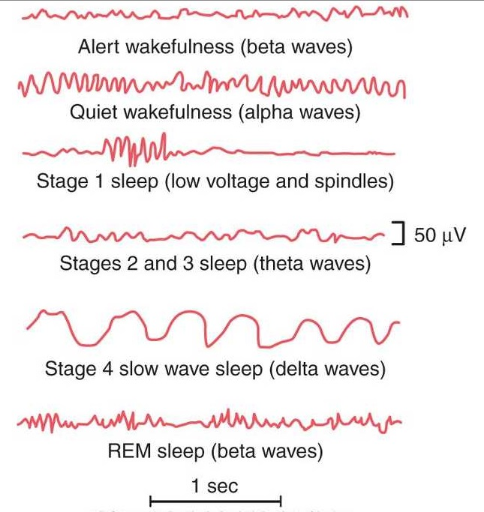
Changes in the EEG at Different Stages of Wakefulness and Sleep

