Slide 1
Motor systems
Dr.Ejlal Abu-El-Rub, Pharm.D, PhD
Physiology and Pathophysiology, Department of Basic Medical Sciences, Faculty of Medicine, Yarmouk University

Slide 2
Posture and movement depend on a combination of involuntary reflexes coordinated by the spinal cord and voluntary actions controlled by higher brain centers.

Slide 3
Posture and movement ultimately depend on contraction of some skeletal muscles while, simultaneously, other muscles remain relaxed.
Activation and contraction of skeletal muscles are under the control of the motoneurons that innervate them.
The motor system is designed to execute this coordinated response largely through reflexes integrated in the spinal cord.

Slide 4
Motor unit
Motor unit consists of a single motoneuron and the muscle fibers that it innervates.
For fine control (e.g., muscles of the eye), a single motoneuron innervates only a few muscle fibers.
For larger movements (e.g., postural muscles), a single motoneuron may innervate thousands of muscle fibers.

Slide 5
Motor unit
The motoneuron pool is the group of motoneurons that innervates fibers within the same muscle.

Slide 6
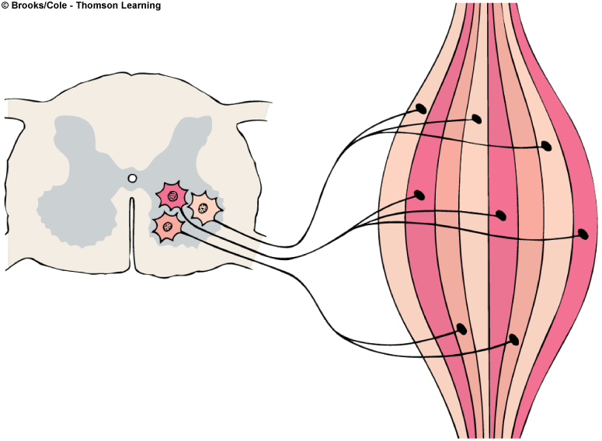
= Motor unit 1
= Motor unit 2
= Motor unit 3

Slide 7
Motor unit
The force of muscle contraction is graded by recruitment of additional motor units (size principle).
The size principle states that as additional motor units are recruited, more motoneurons are involved and more tension is generated.

Slide 8
Motor units
Small motor neurons
innervate a few muscle fibers.
have the lowest thresholds and, therefore, fire first.
generate the smallest force.

Slide 9
Motor units
Large motor neurons
innervate many muscle fibers.
have the highest thresholds and, therefore, fire last.
generate the largest force.

Slide 10
Types of motoneurons
α-Motoneurons innervate extrafusal skeletal muscle fibers →contraction.
γ-Motoneurons innervate specialized intrafusal muscle fibers → adjust the sensitivity of the muscle spindles (so that they respond appropriately as the extrafusal fibers contract and shorten).

Slide 11
Muscle sensor
Types of muscle sensors
Muscle spindles (groups Ia and II afferents) are arranged in parallel with extrafusal fibers. They detect both static and dynamic changes in muscle length.
Golgi tendon organs (group Ib afferents) are arranged in series with extrafusal muscle fibers. They detect muscle tension.
Pacinian corpuscles (group II afferents) are distributed throughout muscle. They detect vibration.
Free nerve endings (groups III and IV afferents) detect noxious stimuli.

Slide 12
Types of muscle fibers
Extrafusal fibers
make up the bulk of muscle.
are innervated by α-motoneurons.
generate the force for muscle contraction.
Intrafusal fibers
are smaller than extrafusal muscle fibers.
are innervated by γ-motoneurons.
are encapsulated in sheaths to form muscle spindles.
run in parallel with extrafusal fibers, but not for the entire length of the muscle.
are too small to generate significant force.

Slide 13
Muscle spindles
are spindle-shaped organs composed of small, encapsulated intrafusal muscle fibers and innervated by sensory and motor nerve fibers.
distributed throughout muscle.
connected in parallel with large (force-generating) extrafusal fibers.
The finer the movement required, the greater the number of muscle spindles in a muscle.

Slide 14
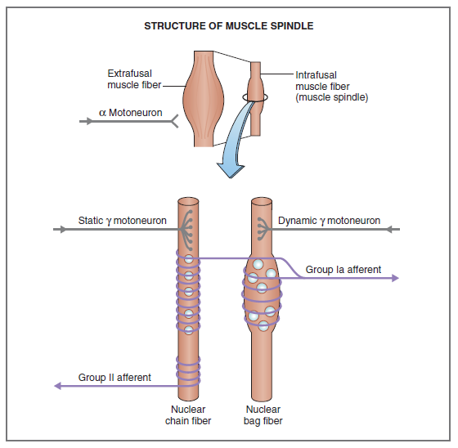
Muscle spindles

Slide 15
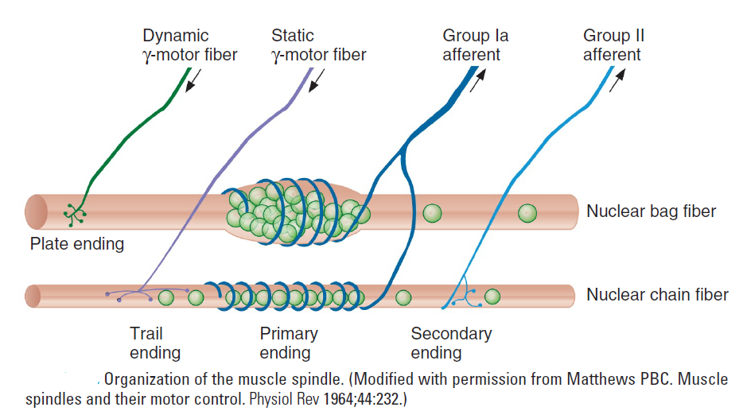

Slide 16
Types of intrafusal fibers in muscle spindles
Nuclear bag fibers
detect the rate of change in muscle length (fast, dynamic changes).
are innervated by group Ia afferents.
have nuclei collected in a central “bag” region.
Nuclear chain fibers
detect static changes in muscle length.
are innervated by group II afferents.
are more numerous than nuclear bag fibers.
have nuclei arranged in rows.

Slide 17
How the muscle spindle works
Muscle spindle reflexes oppose (correct for) increases in muscle length (stretch).
Sensory information about muscle length is received by group Ia (velocity) and group II (static) afferent fibers.
When a muscle is stretched (lengthened), the muscle spindle is also stretched, stimulating group Ia and group II afferent fibers.
Stimulation of group Ia afferents stimulates α-motoneurons in the spinal cord. This stimulation in turn causes contraction and shortening of the muscle. Thus, the original stretch is opposed and muscle length is maintained.

Slide 18
Function of γ-motoneurons
innervate intrafusal muscle fibers.
adjust the sensitivity of the muscle spindle so that it will respond appropriately during muscle contraction.
α-Motoneurons and γ-motoneurons are coactivated so that muscle spindles remain sensitive to changes in muscle length during contraction.

Slide 19
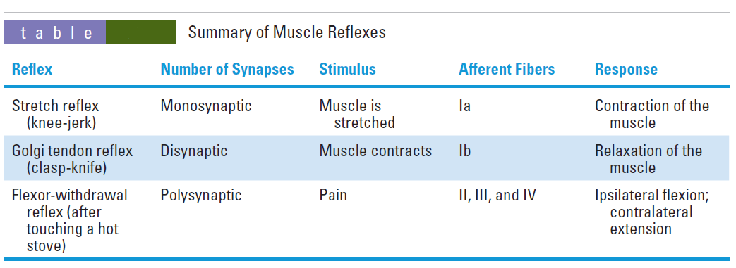
Muscle reflexes

Slide 20
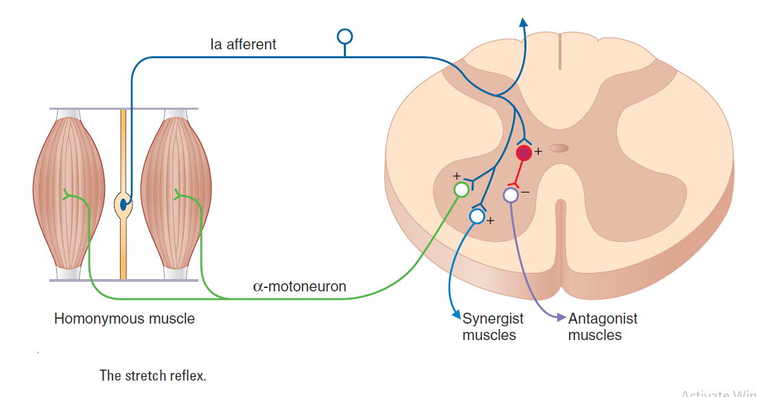
Muscle reflexes
Stretch (myotatic) reflex - knee jerk
Is monosynaptic

Slide 21
Stretch (myotatic) reflex - knee jerk
Muscle is stretched, and the stretching stimulates group Ia afferent fibers.
Group I a afferents synapse directly on α-motoneurons in the spinal cord. The pool of α-motoneurons that is activated innervates the homonymous muscle.
Stimulation of α-motoneurons causes contraction in the muscle that was stretched. As the muscle contracts, it shortens, decreasing the stretch on the muscle spindle and returning it to its original length.
At the same time, synergistic muscles are activated and antagonistic muscles are inhibited.

Slide 22
Example of the knee-jerk reflex
Tapping on the patellar tendon causes the quadriceps to stretch. Stretch of the quadriceps stimulates group Ia afferent fibers, which activate α-motoneurons that make the quadriceps contract. Contraction of the quadriceps forces the lower leg to extend.
Increases in γ-motoneuron activity increase the sensitivity of the muscle spindle and therefore exaggerate the knee-jerk reflex.

Slide 23
Golgi tendon reflex (inverse myotatic)
Is disynaptic
Is the opposite, or inverse, of the stretch reflex
Active muscle contraction stimulates the Golgi tendon organs and group lb afferent fibers.
The group Ib afferents stimulate inhibitory interneurons in the spinal cord. These interneurons inhibit α-motoneurons and cause relaxation of the muscle that was originally contracted.
At the same time, antagonistic muscles are excited.

Slide 24
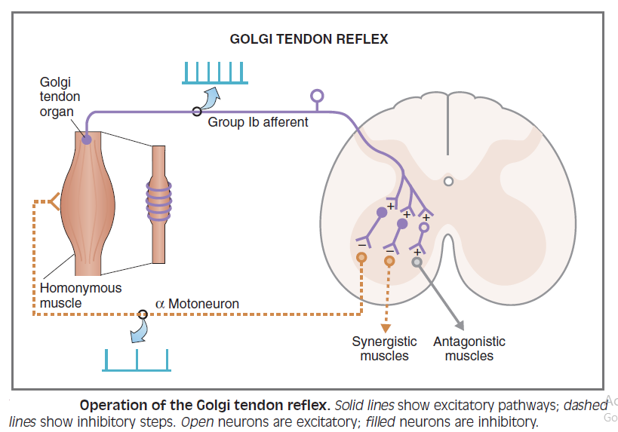
Golgi tendon reflex (inverse myotatic)

Slide 25
Flexor withdrawal reflex
is polysynaptic.
results in flexion on the ipsilateral side and extension on the contralateral side. Somatosensory and pain afferent fibers elicit withdrawal of the stimulated body part from the noxious stimulus.

Slide 26
Flexor withdrawal reflex
Pain (e.g., touching a hot stove) stimulates the flexor reflex afferents of groups II, III, and IV.
The afferent fibers synapse polysynaptically (via interneurons) onto motoneurons in the spinal cord.
On the ipsilateral side of the pain stimulus, flexors are stimulated (they contract) and extensors are inhibited (they relax), and the arm is jerked away from the stove. On the contralateral side, flexors are inhibited and extensors are stimulated (crossed extension reflex) to maintain balance.

Slide 27
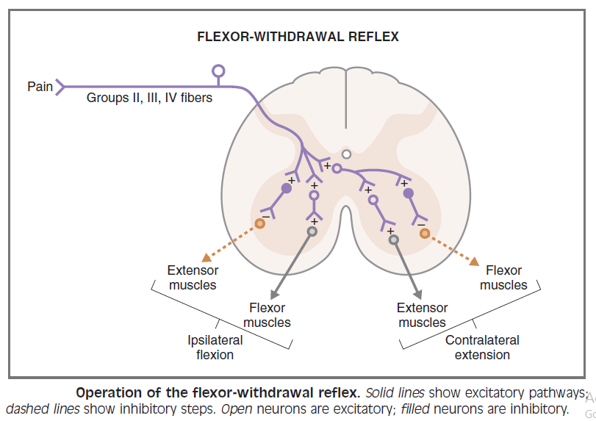
Flexor withdrawal reflex

Slide 28
Brain stem control of posture

Slide 29
Motor centers and pathways
Pyramidal tracts (corticospinal and corticobulbar) pass through the medullary pyramids and descend directly onto lower motoneurons in the spinal cord.
All others are extrapyramidal tracts and originate primarily in the following structures of the brain stem:

Slide 30
Extrapyramidal tracts
Rubrospinal tract
originates in the red nucleus and projects to interneurons in the lateral spinal cord.
Stimulation of the red nucleus produces stimulation of flexors and inhibition of extensors.

Slide 31
Extrapyramidal tracts
Pontine reticulospinal tract
originates in the nuclei in the pons and projects to the ventromedial spinal cord.
Stimulation has a general stimulatory effect on both extensors and flexors, with the predominant effect on extensors.

Slide 32
Extrapyramidal tracts
Medullary reticulospinal tract
originates in the medullary reticular formation and projects to spinal cord interneurons in the intermediate gray area.
Stimulation has a general inhibitory effect on both extensors and flexors, with the predominant effect on extensors.

Slide 33
Extrapyramidal tracts
Lateral vestibulospinal tract
originates in Deiters nucleus and projects to ipsilateral motoneurons and interneurons.
Stimulation causes a powerful stimulation of extensors and inhibition of flexors.
i.e. intercostal and back muscles, as well as the extensors of the limbs

Slide 34
Extrapyramidal tracts
Tectospinal tract
originates in the superior colliculus and projects to the cervical spinal cord.
is involved in the control of neck muscles.

Slide 35
Cerebellum – central control of movement
Functions of the cerebellum
Vestibulocerebellum - control of balance and eye movement
Pontocerebellum - planning and initiation of movement
Spinocerebellum - synergy, which is control of rate, force, range, and direction of movement

Slide 36
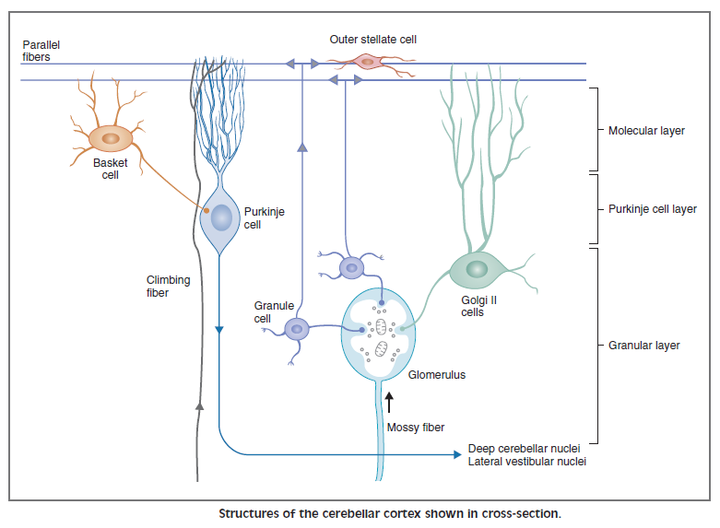
Layers of the cerebellar cortex

Slide 37
Layers of the cerebellar cortex
Granular layer
is the innermost layer.
contains granule cells, Golgi type II cells, and glomeruli.
In the glomeruli, axons of mossy fibers form synaptic connections on dendrites of granular and Golgi type II cells.

Slide 38
Layers of the cerebellar cortex
Purkinje cell layer
is the middle layer.
contains Purkinje cells.
output is always inhibitory.

Slide 39
Layers of the cerebellar cortex
Molecular layer
is the outermost layer.
contains stellate and basket cells, dendrites of Purkinje and Golgi type II cells, and parallel fibers (axons of granule cells).
The parallel fibers synapse on dendrites of Purkinje cells, basket cells, stellate cells, and Golgi type II cells.

Slide 40
Connections in the cerebellar cortex

Slide 41
Input to the cerebellar cortex
Climbing fibers
originate from a single region of the medulla (inferior olive).
make multiple synapses onto Purkinje cells, resulting in high-frequency bursts, or complex spikes.
“condition” the Purkinje cells.
play a role in cerebellar motor learning.

Slide 42
Input to the cerebellar cortex
Mossy fibers
originate from many centers in the brain stem and spinal cord.
include vestibulocerebellar, spinocerebellar, and pontocerebellar afferents.
make multiple synapses on Purkinje fibers via interneurons. Synapses on Purkinje cells result in simple spikes.

Slide 43
Output of the cerebellar cortex
Purkinje cells are the only output of the cerebellar cortex.
Output of the Purkinje cells is always inhibitory; the neurotransmitter is (GABA).
The output projects to deep cerebellar nuclei and to the vestibular nucleus. This inhibitory output modulates the output of the cerebellum and regulates rate, range, and direction of movement.

Slide 44
Basal ganglia – control of movement
consists of the striatum, globus pallidus, subthalamic nuclei, and substantia nigra.
modulates thalamic outflow to the motor cortex to plan and execute smooth movements.
Many synaptic connections are inhibitory and use GABA as their neurotransmitter.
The striatum communicates with the thalamus and the cerebral cortex by two opposing pathways.
Indirect pathway is, overall, inhibitory.
Direct pathway is, overall, excitatory.

Slide 45
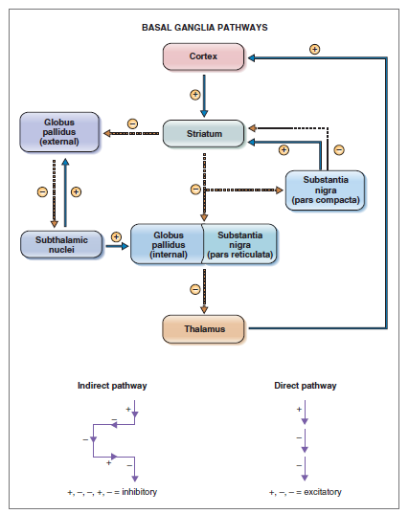

Slide 46
Basal ganglia – control of movement
Connections between the striatum and the substantia nigra use dopamine as their neurotransmitter.
Dopamine is inhibitory on the indirect pathway (D₂ receptors) and excitatory on the direct pathway (D₁ receptors).
Thus, the action of dopamine is, overall, excitatory.

Slide 47
Motor cortex

Slide 48
1. Premotor cortex and supplementary motor cortex (area 6)
are responsible for generating a plan for movement, which is transferred to the primary motor cortex for execution.
The supplementary motor cortex programs complex motor sequences and is active during “mental rehearsal” for a movement.

Slide 49
2. Primary motor cortex (area 4)
is responsible for the execution of movement. Programmed patterns of motoneurons are activated in the motor cortex. Excitation of upper motoneurons in the motor cortex is transferred to the brain stem and spinal cord, where the lower motoneurons are activated and cause voluntary movement.
is somatotopically organized (motor homunculus). Epileptic events in the primary motor cortex cause Jacksonian seizures, which illustrate the somatotopic organization.

