Slide 1
Somatic sensation - Sensory systems (Part 2)
Dr.Ejlal Abu-El-Rub, Pharm.D, PhD
Physiology and Pathophysiology, Department of Basic Medical Sciences, Faculty of Medicine, Yarmouk University

Slide 2
Why the Decussations are important ??????

Slide 3
Decussated path-ways may be prevalent in vertebrate nervous systems because decussation minimizes pathfinding errors and preserves the genetic information content required, and thereby provides significant evolutionary advantages. Surprisingly, even in small networks of only 100–1,000 neurons, the order of the number of neural connections in decussation can reduce the rate of erroneous connections by over an order of magnitude.
To provide a 3D spatial connections and pathways.
Allow for the sprouting at the site of crossing following any injury

Slide 4
Pathways in the somatosensory system

Slide 5
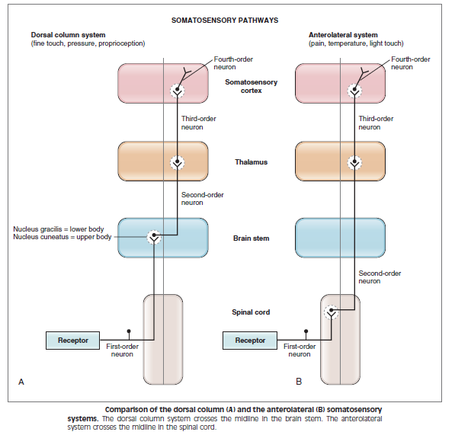

Slide 6
Dorsal column system
Also known as posterior column-medial lemniscus pathway.
Processes sensations of fine touch, pressure, two-point discrimination, vibration, and proprioception.
Consists primarily of group II fibers.

Slide 7
Dorsal column system
Course:
Primary afferent neurons have cell bodies in the dorsal root. Their axons ascend ipsilaterally to the nucleus gracilis and nucleus cuneatus of the medulla.
From the medulla, the second-order neurons cross and decussate the midline and ascend to the contralateral thalamus, where they synapse on third-order neurons.
Third-order neurons ascend to the somatosensory cortex, where they synapse on fourth-order neurons.

Slide 8
Special features
(1) dorsal column neurons have larger receptive fields because multiple primary afferent fibers synapse on a given dorsal column neuron
(2) dorsal column neurons sometimes respond to more than one class of sensory receptor because of the convergence of several different types of primary afferent fibers on the second-order neurons,

Slide 9
Anterolateral system
Also referred to as spinothalamic tract.
Processes sensations of temperature, pain, and light touch.
Consists primarily of group III and IV fibers, which enter the spinal cord and terminate in the dorsal horn.

Slide 10
Anterolateral system
Course:
The first-order neurons synapse on second order neurons in the spinal cord.
Second-order neurons cross the midline to the anterolateral quadrant of the spinal cord and ascend to the contralateral thalamus, where they synapse on third order neurons.
Third-order neurons ascend to the somatosensory cortex, where they synapse on fourth-order neurons.

Slide 11
Thalamus
Information from different parts of the body is arranged somatotopically.
Destruction of the thalamic nuclei results in loss of sensation on the contralateral side of the body.

Slide 12
Somatosensory cortex – The sensory homunculus
The major somatosensory areas of the cerebral cortex are SI and SII.
SI has a somatotopic representation similar to that in the thalamus.

Slide 13
Pain

Slide 14
Pain is a Protective Mechanism
Pain
Pain is associated with the detection and perception of noxious stimuli (nociception).
Most ailments of the body cause pain.
Pain occurs when tissues are being damaged, and it causes the individual to react to remove the stimulus.

Slide 15
Types of Pain and Their Qualities
Fast Pain
Also called sharp pain, pricking pain, acute pain, and electric pain.
Felt within 0.1 sec after the stimulus is applied
Not felt in most deeper tissues of the body

Slide 16
Types of Pain and Their Qualities
Slow Pain
Also called slow burning pain, aching pain, throbbing pain, nauseous pain, and chronic pain
Felt only after one second or more and then increases slowly over many seconds or even minutes
Usually associated with tissue destruction
Can lead to prolonged, almost unbearable suffering.

Slide 17
Types of Pain and Their Qualities
Pain Receptors and Their Stimulation
Pain receptors are free nerve endings.
Two major classes:
Thermal or mechanical → supplied by finelt myelinated A-δ afferent nerve fibers and respond to mechanical stimuli (sharp, pricking pain).
Polymodal → supplied by unmyelinated C fibers and respond to high-intensity mechanical or chemical stimuli, and hot and cold stimuli.

Slide 18
Types of Pain and Their Qualities
Pain Receptors and Their Stimulation
Widespread in the superficial layers of the skin, muscles and certain internal tissues (periosteum, arterial walls, joint surfaces, falx and tentorium in the cranial vault).

Slide 19
Pain Receptors and Their Stimulation
Fast pain is elicited by mechanical and thermal
Slow pain by all three types
Damaged skin releases chemicals, such as: bradykinin, serotonin, K ions, histamine, acids, ACh, proteolytic enzymes → inflammatory response.
Prostaglandins and substance P enhance the sensitivity of pain endings but do not directly excite them → hyperalgesia.

Slide 20
Non-Adapting Nature of Pain Receptors
Pain receptors adapt very little, and sometimes not at all.
Under some conditions, excitation of pain fibers becomes progressively greater as the pain stimulus continues(especially for slow-aching-nauseous pain).
Increase in sensitivity of the pain receptors is called hyperalgesia.

Slide 21
Rate of Tissue Damage as a Stimulus for Pain
Pain is usually felt when the skin is heated above 45°C = the same temperature at which tissues begin to be damaged by heat.
Intensity of pain is also closely correlated with the rate of tissue damage from causes other than heat (bacterial infection, tissue ischemia, tissue contusion, etc.)

Slide 22
Importance of Chemical Pain Stimuli During Tissue Damage
Bradykinin is thought to be the agent most responsible for causing pain following tissue damage.
Intensity of pain felt correlates with local increase in K⁺ concentration or increase in proteolytic enzymes (which attack nerve endings and make membranes more permeable to ions → excite pain).

Slide 23
Tissue Ischemia as a Cause of Pain
When blood flow is blocked, the tissue often becomes very painful and the greater the rate of metabolism, the more rapidly the pain occurs.
May be due to the large accumulation of lactic acid (consequence of anaerobic metabolism), as well as bradykinin and proteolytic enzymes (formed in the tissues because of cell damage).

Slide 24
Muscle Spasm as a Cause of Pain
Results from:
the direct effects of muscle spasm in stimulating mechanosensitive pain receptors
the indirect effects of muscle spasm to compress blood vessels and cause ischemia
Spasm increases the rate of metabolism in the muscle tissue, making the relative ischemia even greater → release of chemical pain-inducing substances.

Slide 25
Dual Pathways for Transmission of Pain Signals
Pain receptors use two separate pathways for transmitting pain signals into the CNS.
They correspond to the two types of pain:
Fast – sharp pain pathway
Slow – chronic pain pathway

Slide 26
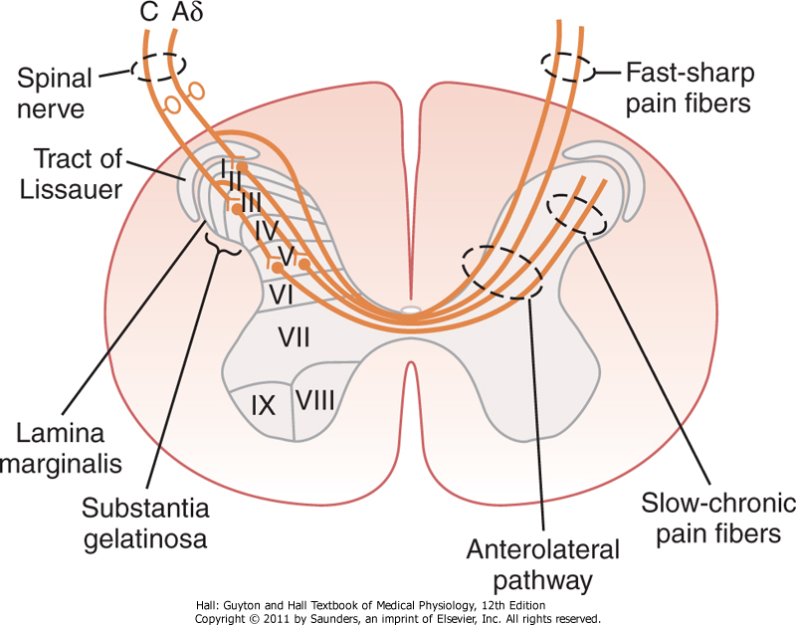
Peripheral Pain Fibers- Fast and Slow Fibers
Transmission of both “fast-sharp” and “slow-chronic” pain signals into and through the spinal cord on their way to the brain.

Slide 27
Peripheral Pain Fibers- Fast and Slow Fibers
Slow-chronic pain | Fast-sharp pain
Chemical or prolonged mechanical and thermal | Mechanical or thermal | Types of stimulus
C fibers (large) | Aδ fibers (small) | Type of fiber
0.5-2 m/sec | 6-30 m/sec | Velocity
A sudden painful stimulus often gives a “double” pain sensation: a fast-sharp pain → makes the person react immediately; then a slow pain that increases with time → intolerable → the person tries to relieve the cause of pain.
Pain fibers enter the spinal cord from the dorsal spinal roots → pain terminate on relay neurons in the dorsal horns.

Slide 28
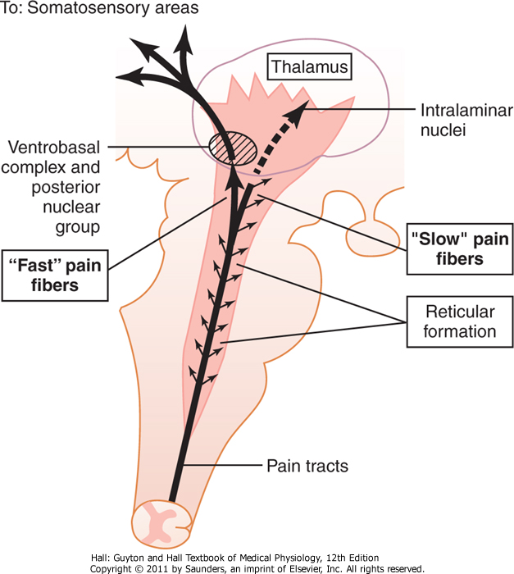
Dual pain pathways in the cord and brain stem
On entering the spinal cord the pain signlas take two pathways to the brain:
Neospinothalamic tract
Paleospinothalamic tract
Transmission of pain signals into the brain stem, thalamus, and cerebral cortex by way of the fast pricking pain pathway and the slow burning pain pathway

Slide 29
Neospinothalamic Tract (for fast pain)
Type Aδ pain fibers → Terminate mainly in lamina I of the dorsal horn → excite second-order neurons → long fibers cross immediately to the opposite side of the cord → anterolateral columns → brain.
A few fibers terminate in the reticular areas of the brain stem.
Most fibers pass all the way to the thalamus, terminating in the ventrobasal complex along with the dorsal column-medial lemniscus tract (touch).
A few fibers also terminate in the posterior nuclear group of the thalamus.

Slide 30
Neospinothalamic Tract (for fast pain)
Fast-sharp pain is localized much more exactly than slow pain.
Localization is more exact when tactile receptors are stimulated simultaneously.
Glutamate is the primary neurotransmitter secreted in the spinal cord at Aδ fiber endings.

Slide 31
Paleospinothalamic Pathway (for slow-chronic pain)
Transmission of slow-chronic pain (C pain fibers + some signals from type Aδ fibers).
Fibers terminate in laminae II and III of the dorsal horns (substantia gelatinosa). Most of the signals then pass through one or more additional short fibers within the dorsal horns themselves before entering lamina V.
These last neurons give rise to long axons that mostly join the fibers from the fast pain pathway → pass through the anterior commissure to the opposite side of the cord, then upward to the brain in the anterolateral pathway.

Slide 32
Paleospinothalamic Pathway (for slow-chronic pain)
Type C pain fiber terminals entering the spinal cord release both glutamate transmitter (rapid and short) and substance P transmitter (builds up over seconds and minutes).
Substance P is the main neurotransmitter for slow-chronic pain.
Inhibition of the release of substance P is the basis of pain relief by opioids.

Slide 33
Paleospinothalamic Pathway (for slow-chronic pain)
Localization of pain transmitted by the paleospino-thalamic pathway is imprecise
Projects widely into the brain stem.
1/10 - ¼ fibers pass all the way to the thalamus; most terminate in the:
reticular nuclei of the medulla, pons and mesencephalon
tectal area of the mesencephalon
periaqueductal gray (PAG)
Then short fibers → intralaminar and ventrolateral nuclei of the thalamus, hypothalamus and others.

Slide 34
Pain Suppression (“Analgesia”) System in the Brain and Spinal Cord

Slide 35
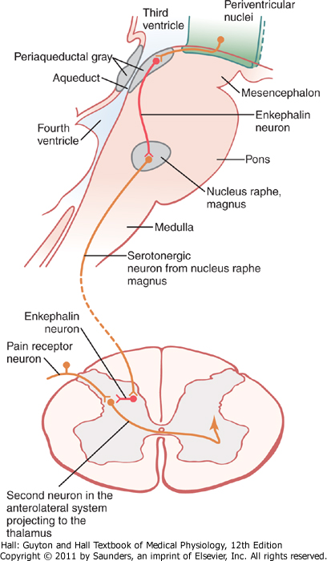
Analgesia system has three components
Periaqueductal gray (PAG) and periventricular areas of mesencephalon and pons
Raphe magnus nucleus in the pons and the nucleus reticularis in the medulla
Pain inhibitory complex in the dorsal horns of the spinal cord
Analgesia system of the brain and spinal cord

Slide 36
Transmitter substances involved in the analgesia system
Enkephalin
Many nerve fibers derived from the periventricular nuclei and from the periaqueductal gray area secrete enkephalin at their endings (in the raphe magnus nucleus) when stimulated.
Enkephalin is believed to cause both presynaptic and postsynaptic inhibition of incoming type C and type Aδ pain fibers where they synapse in the dorsal horns.

Slide 37
Transmitter substances involved in the analgesia system
Serotonin
Fibers originating in raphe magnus nucleus send signals to the dorsal horns to secrete serotonin.
Serotonin causes the release of enkephalin from local cord neurons.

Slide 38
Brain’s Opiate System – Endorphins and Enkephalins
About a dozen opiate-like substances have been found at different points of the nervous system.
All are breakdown products of three large protein molecules:
pro-opiomelanocortin,
proenkephalin,
prodynorphin.

Slide 39
Brain’s Opiate System – Endorphins and Enkephalins
Among the most important of these opiate-like substances are
β-endorphin met-enkephalin,
leu-enkephalin dynorphin.
Enkephalins → found in the brain stem and spinal cord.
β-endorphin → in hypothalamus and pituitary gland
Dynorphin → in the same areas as enkephalins, but in much lower quantities.

Slide 40
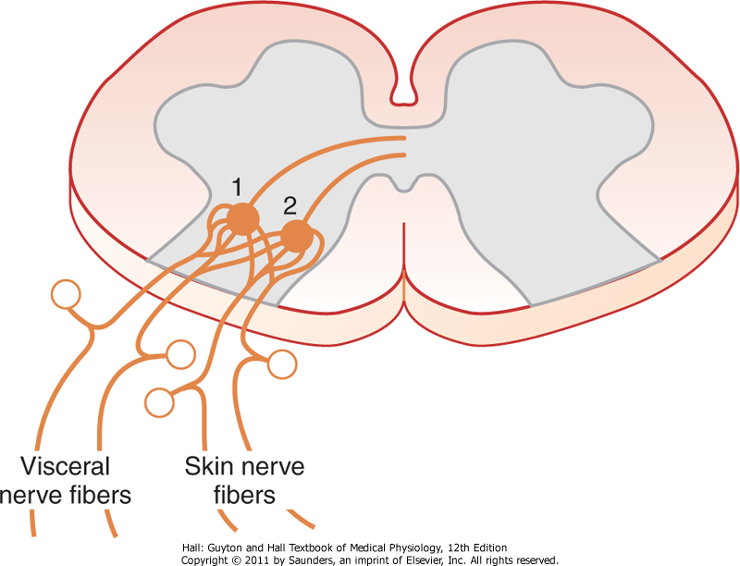
Referred Pain
Mechanism
Branches of visceral pain fibers synapse in the spinal cord on the same second-order neurons that receive pain signals from the skin.
When the visceral pain fibers are stimulated, pain signals from the viscera are
Mechanism of referred pain and referred hyperalgesia
conducted through at least some of the same neurons that conduct pain signals from the skin → Feeling that the sensations originate in the skin itself. (convergence–projection theory)

Slide 41
Visceral pain
Visceral pain differs from surface pain in several important aspects.
highly localized types of damage to the viscera seldom cause severe pain (ex: cut in surgery)
any stimulus that causes diffuse stimulation of pain nerve endings throughout a viscus causes pain that can be severe (ex.: ischemia)

Slide 42
Causes of true visceral pain
All visceral pain that originates in the thoracic and abdominal cavities is transmitted through small type C pain fibers and, therefore, can transmit only the chronic-aching suffering type of pain.
Ischemia
Chemical stimuli: proteolytic acidic gastric juice may leak through a ruptured gastric or duodenal ulcer → widespread to the visceral peritoneum → stimulating broad areas of pain fibers → excruciating and severe pain.

Slide 43
Causes of true visceral pain
Spasm of a hollow viscus
causes pain, possibly by mechanical stimulation of the pain nerve endings or by dimishing blood flow to the muscle.
Often occurs in the form of intermittent cramps.
Overdistension of a hollow viscus
because of overstretch of the tissues themselves and collapse of the blood vessels.

