Slide 1
Somatic sensation - Sensory systems (Part 1)
Dr.Ejlal Abu-El-Rub, Pharm.D, PhD
Physiology and Pathophysiology, Department of Basic Medical Sciences, Faculty of Medicine, Yarmouk University

Slide 2
General features of sensory and motor systems

Slide 3
Definition
The somatosensory system provides information to the central nervous system (CNS) about the state of the body and its contact with the world.
It does so by using a variety of sensory receptors that transduce mechanical (pressure, stretch, and vibrations) and thermal energies into electrical signals.
These electrical signals, called generator potentials, occur in the distal ends of axons of first-order somatosensory neurons and trigger action potential trains that reflect information about the characteristics of the stimulus.

Slide 4
Synaptic relays
The simplest synapses are one-to-one connections consisting of a presynaptic element and a postsynaptic element.
However, many synapses are more complicated and use synapses in relay nuclei to integrate converging information.
Relay nuclei are found throughout the CNS, but they are especially prominent in the thalamus.

Slide 5
Synaptic relays
Relay nuclei contain several different types of neurons including local interneurons and projection neurons.
The projection neurons extend long axons out of the nuclei to synapse in other relay nuclei or in the cerebral cortex.
Almost all information going to and coming from the cerebral cortex is processed in thalamic relay nuclei.

Slide 6
Topographic Organization
Information of sensory and motor systems is encoded in neural maps.

Slide 7
Topographic Organization
The topographic coding is preserved at each level of the nervous system, even as high as the cerebral cortex.
Thus in the somatosensory system, the topographic information is represented as a sensory homunculus in the cerebral cortex.
In the visual system, the topographic representation is called retinotopic.
In the auditory system it is called tonotopic.

Slide 8
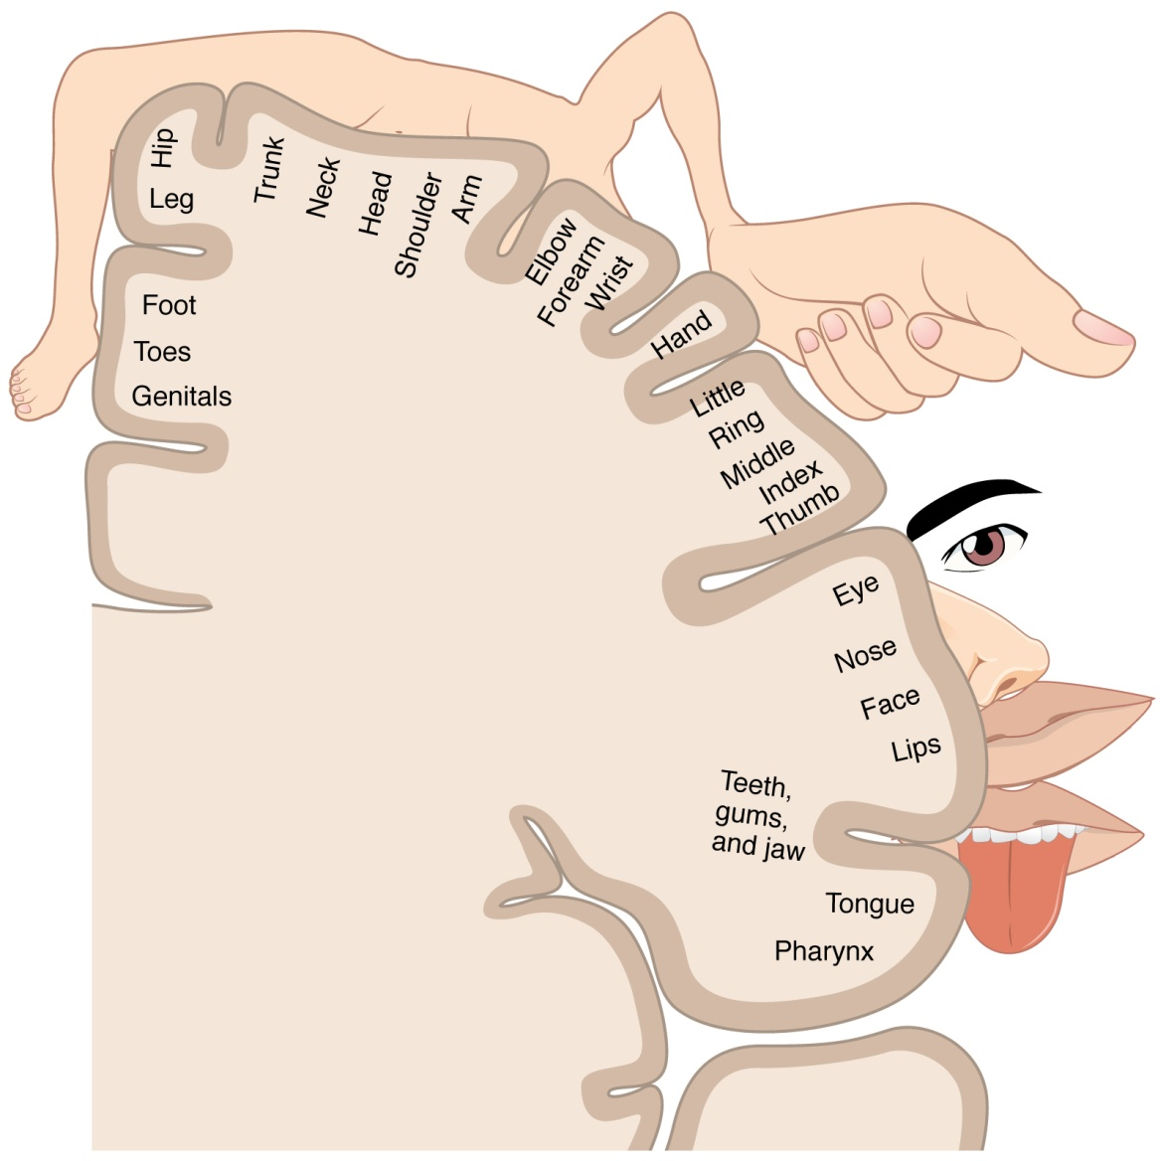
Sensory homunculus
A motor homunculus represents a map of brain areas dedicated to motor processing. The primary motor cortex is located in the precentral gyrus (anterior to central sulcus), and handles signals coming from the premotor area of the frontal lobes
A sensory homunculus represents a map of brain areas dedicated to sensory processing. The primary sensory cortex is located in the postcentral gyrus (posterior to central sulcus) , and handles signals coming from the thalamus

Slide 9
Decussations
Almost all sensory and motor pathways are bilaterally symmetric, and information crosses from one side (ipsilateral) to the other (contralateral) side of the brain or spinal cord.
All pathways do not cross at the same level of the CNS. Some pathways cross in the spinal cord (e.g., pain), and many cross in the brain stem.
These crossings are called decussations.

Slide 10
Decussations
Areas of the brain that contain decussating axons are called commissures (ex.: corpus callosum).
Some systems are mixed, having both crossed and uncrossed pathways.
For example, in the visual system, half of the axons from each retina cross to the contralateral side and half remain ipsilateral. Visual fibers that cross do so in the optic chiasm.

Slide 11
Types of nerve fibers
Nerve fibers are classified according to their conduction velocity, which depends on:
the size of the fibers, and
the presence or absence of myelination.
The larger the fiber, the higher the conduction velocity.
Conduction velocity also is increased by the presence of a myelin sheath around the nerve fiber.

Slide 12
There are two classification systems for nerve fibers according to their conduction velocities.
A, B and C nomenclature → applies to both sensory (afferent) and motor (efferent) nerve fibers.
I, II, III, IV nomenclature → applies only to sensory nerve fibers.

Slide 13
Fiber types and conduction velocity

Slide 14
Sensory systems

Slide 15
Sensory pathways from the sensory receptor to the cerebral cortex
Sensory receptors
First-order neurons
Second-order neurons
Third-order neurons
Fourth-order neurons

Slide 16
Sensory pathways from the sensory receptor to the cerebral cortex

Slide 17
Sensory pathways from the sensory receptor to the cerebral cortex
Sensory receptors
are activated by environmental stimuli.
may be specialized epithelial cells (e.g., photoreceptors, taste receptors, auditory hair cells).
may be primary afferent neurons (e.g., olfactory chemoreceptors).
transduce the stimulus into electrochemical energy (i.e., receptor potential).

Slide 18
Sensory pathways from the sensory receptor to the cerebral cortex
First-order neurons
are the primary sensory afferent neurons that receive the transduced signal and send the information to the CNS.
Cell bodies of the primary afferent neurons are usually in a dorsal root or spinal cord ganglion. (Exceptions are the auditory, olfactory, and visual systems.)

Slide 19
Sensory pathways from the sensory receptor to the cerebral cortex
Second-order neurons
are located in the spinal cord or brain stem.
receive information from one or more primary afferent neurons in relay nuclei and transmit it to the thalamus.
Axons of second-order neurons may cross the midline in a relay nucleus in the spinal cord before they ascend to the thalamus.
Therefore, sensory information originating on one side of the body ascends to the contralateral thalamus.

Slide 20
Sensory pathways from the sensory receptor to the cerebral cortex
Third-order neurons
are located in the relay nuclei of the thalamus. From there, encoded sensory information ascends to the cerebral cortex.

Slide 21
Sensory pathways from the sensory receptor to the cerebral cortex
Fourth-order neurons
are located in the appropriate sensory area of the cerebral cortex. The information received results in a conscious perception of the stimulus.

Slide 22
Sensory receptors
are specialized epithelial cells or neurons that transduce environmental signals into neural signals.
The environmental signals that can be detected include
mechanical force
light
sound
chemicals
temperature

Slide 23
Types of sensory transducers
Mechanoreceptors
Pacinian corpuscles (Glabrous skin)
Joint receptors
Stretch receptors in muscle
Hair cells in auditory and vestibular systems
Baroreceptors in carotid sinus
Photoreceptors
Rods (low light levels ) and cones (high light levels) of the retina

Slide 24
Types of sensory transducers
Chemoreceptors
Olfactory receptors
Taste receptors
Osmoreceptors
Carotid body O₂ receptors
Extremes of temperature and pain
Nociceptors

Slide 25
Receptive field
Is an area of the body that, when stimulated, changes the firing rate of a sensory neuron.
If the firing rate of the sensory neuron is increased, the receptive field is excitatory.
If the firing rate of the sensory neuron is decreased, the receptive field is inhibitory.

Slide 26
Receptive field

Slide 27
Steps in sensory transduction
Stimulus arrives at the sensory receptor.
The stimulus may be a photon of light on the retina, a molecule of NaCl on the tongue, a depression of the skin, and so forth.
Ion channels are opened in the sensory receptor, allowing current to flow.
Usually, the current is inward, which produces depolarization of the receptor.
The exception is in the photoreceptor, where light causes decreased inward current and hyperpolarization.

Slide 28
Steps in sensory transduction
The change in membrane potential of the receptor produced by the stimulus is the receptor potential, or generator potential.
If the receptor potential is depolarizing, it brings the membrane potential closer to threshold. If the receptor potential is large enough, the membrane potential will exceed threshold, and an action potential will fire in the sensory neuron.
Receptor potentials size depend on the size of the stimulus.

Slide 29
Steps in sensory transduction

Slide 30
Sensory encoding
Sensory neurons are responsible for encoding stimuli in the environment.
Coding begins with a stimulus and continues as the information is transmitted to progressively higher levels of the CNS.
Example,: in seeing a red ball, its size, location, color, and depth all are encoded

Slide 31
Sensory encoding
Modality → consist of pathways of sensory neurons dedicated to that modality.
Location → encoded by the receptive field of sensory neurons.
Threshold → is the minimum stimulus that can be detected.
Intensity → encoded in:
Number of receptors activated
Differences in firing rates of sensory neurons in the pathway
Activating different types of receptors.

Slide 32
Stimulus information also is encoded in neural maps → formed by arrays of neurons receiving information from different locations on the body.
However, receptors may adapt to stimulus and change their firing rates.

Slide 33
Adaptation of sensory receptors
Slowly adapting, or tonic, receptors (muscle spindle; pressure; slow pain)
respond repetitively to a prolonged stimulus.
detect a steady stimulus.
Rapidly adapting, or phasic, receptors (pacinian corpuscle; light touch)
respond maximally but briefly to stimuli; their response decreases if the stimulus is maintained.

Slide 35
Somatosensory system
includes the sensations of:
touch
movement
temperature
pain

Slide 36
Mechanoreceptors for touch and pressure

Slide 37
Mechanoreceptors for touch and pressure

Slide 38
Thermoreceptors
Thermoreceptors are slowly adapting receptors that detect changes in skin temperature.
cold receptors
warm receptors
Each type of receptor functions over a broad range of temperatures, with some overlap in the moderate temperature range (e.g., at 36°C, both receptors are active).
When the skin is warmed above 36°C, the cold receptors become quiescent, and when the skin is cooled below 36°C, the warm receptors become quiescent.

Slide 39
Thermoreceptors
If skin temperature rises to damaging levels (above 45°C), warm receptors become inactive; thus warm receptors do not signal pain from extreme heat.
At temperatures above 45°C, polymodal nociceptors will be activated. Likewise, extremely cold (freezing) temperatures also activate nociceptors.

Slide 40
Thermoreceptors
Transduction of temperatures involves transient receptor potential (TRP) channels in the family of vanilloid receptors (i.e., TRPV).
compounds in the vanilloid class, which includes capsaicin, an ingredient in spicy foods gives warm sensation.
compounds like menthol (which gives a cold sensation).

Slide 41
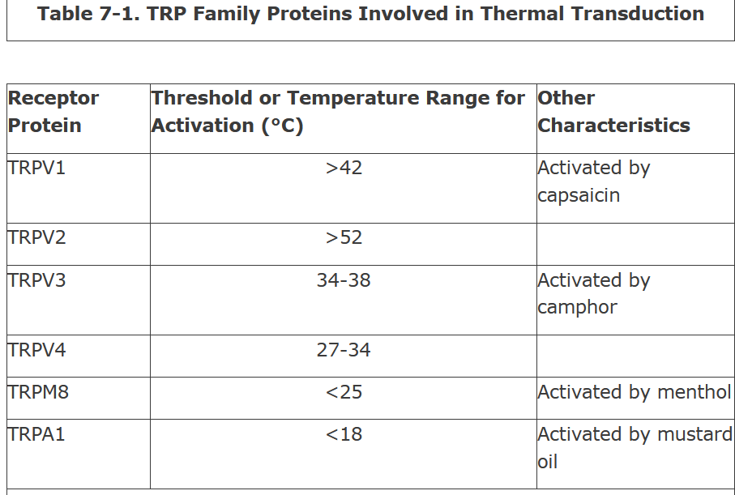

Slide 42
Nociceptors
Nociceptors respond to noxious stimuli that can produce tissue damage.

