Slide 1
Cerebral blood flow
Dr. Ejlal Abu-El-Rub, Pharm.D, PhD
Department of Basic Medical Sciences
Faculty of Medicine, Yarmouk University

Slide 2
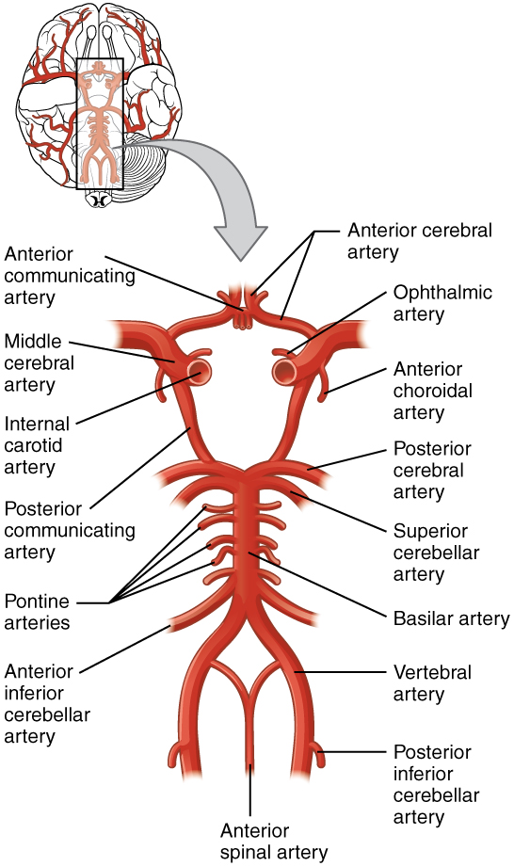
Cerebral Blood Flow
Blood flow to the brain is supplied by four large arteries:
Two vertebral arteries unite to form the basilar artery, and the basilar artery merge with two carotids arteries to form the circle of Willis below the hypothalamus
Arteries then travel along the brain surface and branch extensively.

Slide 3
Venous drainage from the brain by way of the deep veins and dural sinuses empties principally into the internal jugular veins in humans.
Small amount of venous blood drains through the ophthalmic and pterygoid venous plexuses, through emissary veins to the scalp, and down the system of paravertebral veins in the spinal canal.

Slide 4
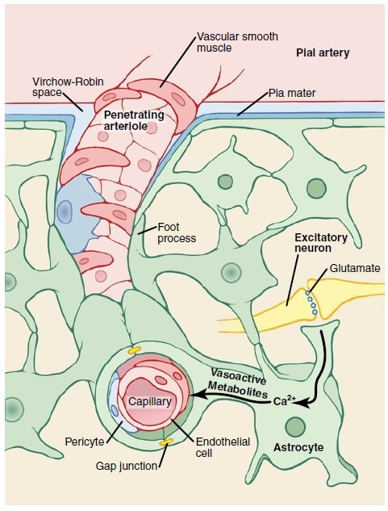
The cerebral vessels have a number of unique anatomic features:
1. There are tight junctions between the endothelial cells that limit the passage of substances via the paracellular route.
2.There are relatively few vesicles in the endothelial cytoplasm, and thus little vesicular transport.
3. The brain capillaries are surrounded by the endfeet of astrocytes. These endfeet are closely applied to the basal lamina of the capillaries, but they do not cover the entire capillary wall, these endfeet induce the tight junctions in the capillaries (discontinuous membrane around the capillary)
Architecture of cerebral blood vessels and potential mechanism for blood flow regulation by astrocytes.

Slide 5
INNERVATION
Three systems of nerves innervate the cerebral blood vessels:
1.Postganglionic sympathetic neurons have their cell bodies in the superior cervical ganglia, and their endings contain norepinephrine. Many also contain neuropeptide Y.
2. Cholinergic neurons that probably originate in the sphenopalatine ganglia also innervate the cerebral vessels, and the postganglionic cholinergic neurons on the blood vessels contain acetylcholine. Many also contain vasoactive intestinal peptide (VIP) and peptide histidyl methionine (PHM-27).
3. Sensory nerves are found on more distal arteries. They have their cell bodies in the trigeminal ganglia and contain substance P, neurokinin A, and calcitonin gene-related peptide (CGRP). Substance P, CGRP, VIP, and PHM-27 cause vasodilation, whereas neuropeptide Y is a vasoconstrictor. Touching or pulling on the cerebral vessels causes pain.

Slide 6
Normal Rate of Cerebral Blood Flow
50-65 ml/100 g brain tissue per minute
For the entire brain, 750-900 ml/min
Brain constitutes about 2% of the body weight, but receives 15% of the resting cardiac output.

Slide 7
Regulation of Cerebral Blood Flow
Metabolic factors that contribute to cerebral blood flow regulation:
Carbon dioxide concentration
Hydrogen ion concentration
Oxygen concentration
Substances released from astrocytes

Slide 8
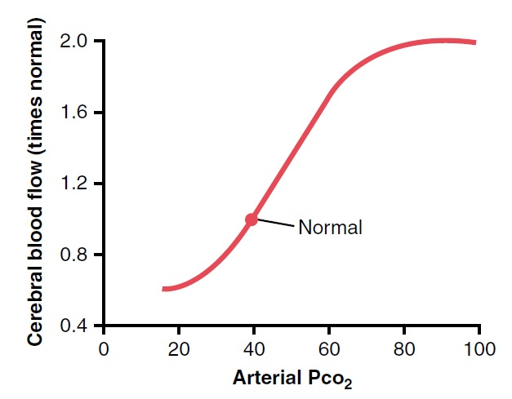
Importance of Control by Carbon Dioxide and Hydrogen Ions
An increase in carbon dioxide concentration in the arterial blood perfusing the brain greatly increases cerebral blood flow.
Relationship between arterial P_{CO2} and cerebral blood flow

Slide 9
Importance of Control by Carbon Dioxide and Hydrogen Ions
How?
CO₂ + H₂O → H₂CO₃ → H⁺ + HCO3⁻
Increased H⁺ concentration depresses neuronal activity, but increases blood flow (by causing vasodilation).
Dilation is almost directly proportional to the increase in H⁺ concentration up to a blood flow limit of about twice normal.

Slide 10
Importance of Control by Carbon Dioxide and Hydrogen Ions
Increased blood flow carries H⁺ , CO₂, and other acids away from the brain tissues.
Loss of CO₂ removes carbonic acid from the tissues and reduces the H⁺ concentration back toward normal.
→ a constant H⁺ concentration in the cerebral fluids is maintained → maintain a normal, constant level of neuronal activity.

Slide 11
Oxygen Deficiency as a Regulator of Cerebral Blood Flow
The rate of utilization of oxygen by the brain tissue remains almost always within narrow limits — 3.5 (±0.2) milliliters of oxygen per 100 grams of brain tissue per minute.
If blood flow to the brain becomes insufficient to supply the needed amount of oxygen, vasodilation occurs returning the brain blood flow and transport of oxygen to the brain to near normal.

Slide 12
Oxygen Deficiency as a Regulator of Cerebral Blood Flow
A decrease in cerebral tissue P_{O2} below about 30 mm Hg (normal value is 35 to 40 mm Hg) immediately begins to increase cerebral blood flow.
At lower values of P_{O2}, especially so at P_{O2} levels below 20 mm Hg, brain functions become deranged (even coma can result at these low levels).

Slide 13
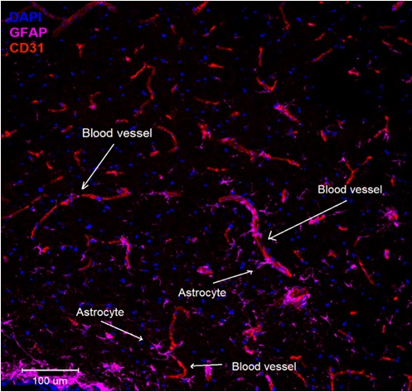
Substances Released from Astrocytes
They are a series of metabolites that mediate local vasodilation.
Astrocytes are star-shaped non-neuronal cells that support and protect neurons, as well as provide nutrition. They have numerous projections that make contact with neurons and the surrounding blood vessels, providing a potential mechanism for neurovascular communication.

Slide 14
Substances Released from Astrocytes
Electrical stimulation of excitatory glutaminergic neurons → ↑ in intracellular Ca²⁺ concentration in astrocyte foot processes → vasodilation of nearby arterioles.
Vasodilation is mediated by several vasoactive metabolites released from astrocytes, such as nitric oxide, metabolites of arachidonic acid, potassium ions and adenosine

Slide 15
Effect of brain activity on cerebral blood flow
Blood flow in each individual segment of the brain changes as much as 100 to 150 percent within seconds in response to changes in local neuronal activity.
Examples: making a fist of the hand causes an immediate increase in blood flow in the motor cortex of the opposite side of the brain.
Reading a book: especially in the visual areas of the occipital cortex and in the language perception areas of the temporal cortex.

Slide 16
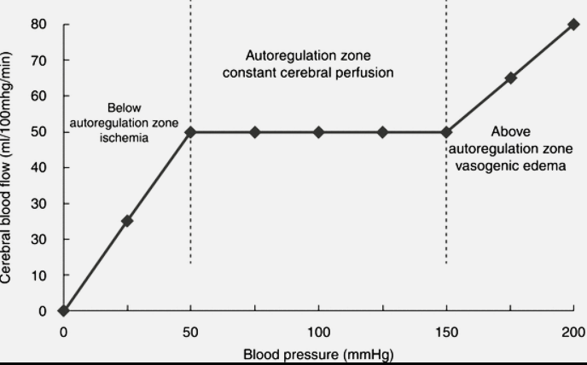
Cerebral blood flow autoregulation protects the brain from fluctuations in arterial pressure changes
Despite the significant flactuations in arterial blood pressure during the day, cerebral blood flow is “autoregulated” extremely well between mean arterial pressure limits of 50 and 150 mm Hg (160-180 in HTN).

Slide 17
Role of the Sympathetic Nervous System in Controlling Cerebral Blood Flow
The cerebral circulatory system has strong sympathetic innervation.
But usually, the blood flow autoregulation mechanism overrides the nervous effects.
However, when MAP rises acutely to exceptionally high level → the sympathetic nervous system constricts the large- and intermediate-sized brain arteries to prevent the high pressure from reaching the smaller brain blood vessels → prevents vascular hemorrhages.

Slide 18
Cerebral “Stroke” Occurs When Cerebral Blood Vessels Are Blocked
Most strokes are caused by arteriosclerotic plaques that occur in one or more of the feeder arteries to the brain → clotting mechanisms → clot blocks blood flow → acute loss of brain function.

Slide 19
Cerebral Microcirculation
The number of capillaries is greatest where the metabolic needs are the greatest
Less leaky than the blood capillaries in almost any other tissue of the body.
Supported on all sides by glial cells that prevent overstretching of the capillaries in case of high capillary BP.
The walls of the small arterioles leading to the brain capillaries become greatly thickened in people who develop high BP, and they remain significantly constricted all the time.

Slide 20
Cerebrospinal fluid system

Slide 21
Cerebrospinal fluid (CSF) system
CSF fills the ventricles and subarachnoid space.
In humans, the volume of CSF is about 150 mL and the rate of CSF production is about 550 mL/d. Thus the CSF turns over about 3.7 times a day.
The CSF in the ventricles flows through the foramens of Magendie and Luschka to the subarachnoid space and is absorbed through the arachnoid villi into veins, primarily the cerebral venous sinuses.
The villi consist of projections of the fused arachnoid membrane and endothelium of the sinuses into the venous sinuses.
These projections may contribute to the outflow of CSF into venous blood by a process known as bulk flow, which is unidirectional.
The reabsorption via one-way valves (of uncertain structural basis) in the arachnoid villi may assume a greater role if CSF pressure is elevated. Likewise, when CSF builds up abnormally, aquaporin water channels may be expressed in the choroid plexus and brain microvessels as a compensatory adaptation.

Slide 22
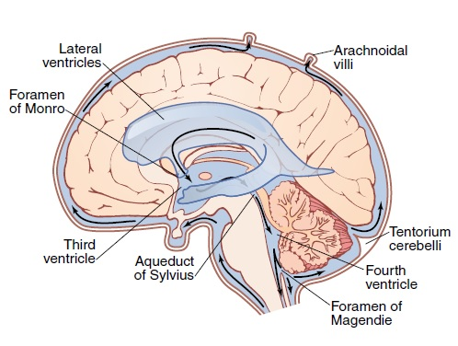
Cerebrospinal fluid (CSF) system
Cerebral cavity = 1600-1700 ml
CSF = 150 ml
Present in the ventricles
of the brain, in the cisterns
around the outside of the
brain, and in the subarachnoid space around both the brain and
the spinal cord.
All these chambers are connected with one another, and the pressure of the fluid is maintained at a constant level.

Slide 23
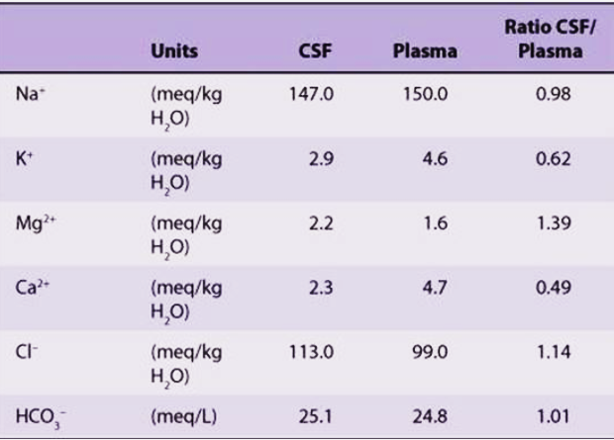
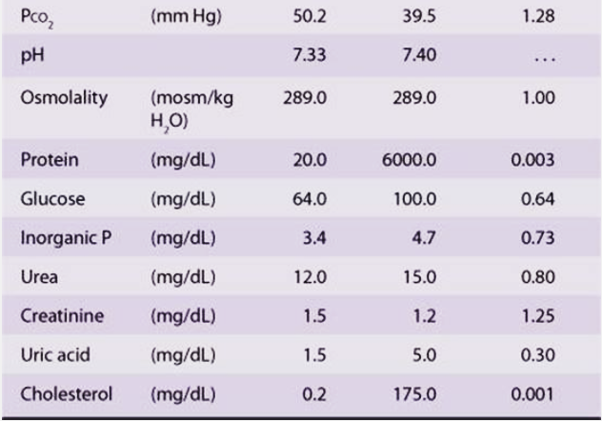

Slide 24
Cerebrospinal fluid (CSF) system
Cushioning function of the CSF
The brain and the CSF have about the same specific gravity, so the brain simply floats in the fluid.
a blow to the head, if it is not too intense, moves the entire brain simultaneously with the skull → no one portion of the brain is contorted by the blow.

Slide 25
Cerebrospinal fluid (CSF) system
Formation, flow, and absorption of CSF
Mainly secretion from the choroid plexuses in the ventricles, mainly in the two lateral ventricles.
Absorption through the arachnoidal villi.
Perivascular spaces have lymphatic functions
excess protein in the brain tissue leaves the tissue flowing with fluid through the perivascular spaces into the subarachnoid spaces → protein flows with the CSF → absorbed through arachnoidal villi into large cerebral veins.

Slide 26
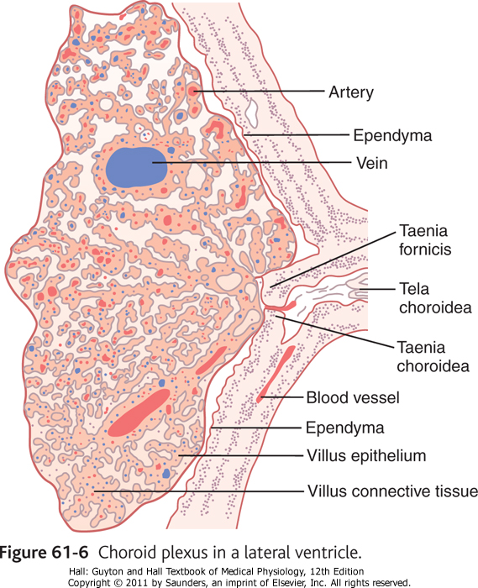
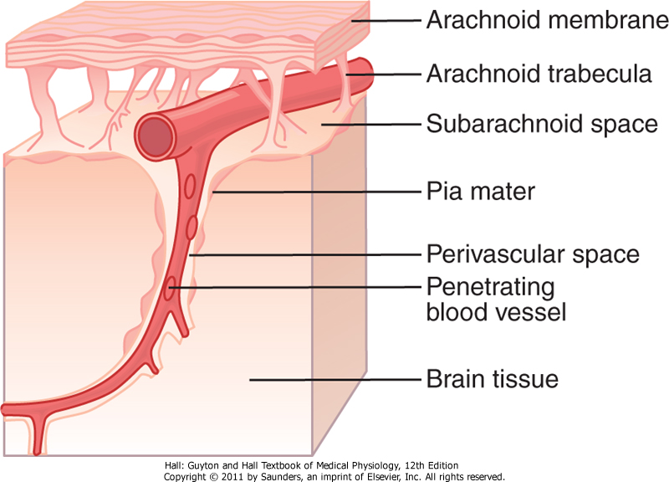
Fig. 61.7 Drainage of a perivascular space into the
subarachnoid space

Slide 27
CSF circulation

Slide 28
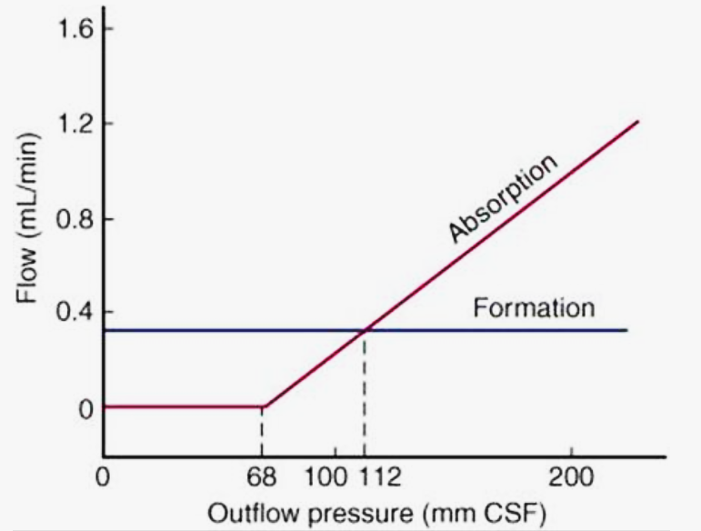
Cerebrospinal Fluid Pressure
Lumbar CSF pressure is normally 70–180 mm H2O.
The rate of CSF formation is independent of intraventricular pressure.
The absorption is proportional to the pressure At a pressure of 112 mm H2O, which is the average normal CSF pressure, filtration and absorption are equal.
Below a pressure of approximately 68 mm H2O, absorption stops.
Large amounts of fluid accumulate when the capacity for CSF reabsorption is decreased (external hydrocephalus, communicating hydrocephalus).
Fluid also accumulates proximal to the block and distends the ventricles when the foramens of Luschka and Magendie are blocked or there is obstruction within the ventricular system (internal hydrocephalus, noncommunicating hydrocephalus).

Slide 29
Cerebrospinal Fluid Pressure
Regulation of CSF pressure by the arachnoid villi
Pathological conditions produce high CSF pressure
Ex: brain tumor, hemorrhage, infection
Obstruction can cause “hydrocephalus” = excess water in the cranial vault.
Communicating hydrocephalus
Noncommunicating hydrocephalus → a block in the aqueduct of Sylvius

Slide 30
Blood-CSF and Blood-Brain Barriers
The concentrations of constituents of CSF are not the same as in ECF elsewhere in the body.
Large molecules hardly pass at all from the blood into the CSF or into the interstitial fluids of the brain, even though these same substances pass readily into the usual interstitial fluids of the body.
Barriers exist at the choroid plexus and at the tissue capillary membranes in all areas of the brain ,except: hypothalamus, pineal gland and a few others.

Slide 31
Blood-CSF and Blood-Brain Barriers
Exception areas: have sensory function that respond to changes in the body, as well as hormone functions.
Barriers are highly permeable to water, carbon dioxide, oxygen and most lipid soluble substances (alcohol and anesthetic).
Slightly permeable to electrolytes such as sodium, chloride, and potassium.
Almost totally impermeable to plasma proteins and most non-lipid-soluble large organic molecules.

Slide 32
Brain Edema
Most commonly caused by concussion (increased capillary pressure or leakiness to fluids).
Compresses the vasculature → decreases blood flow → brain ischemia [+ destruction of brain tissue] → arteriolar dilation → ↑capillary pressure.
Decreased cerebral flow → Decreases oxygen delivery → Increases permeability of capillaries, allowing more leakage.

Slide 33
Brain metabolism

Slide 34
Total Brain Metabolic Rate and Metabolic Rate of Neurons
Metabolism of the brain accounts for about 15 % of the total metabolism in the body, even though the mass of the brain is only 2% of the total body mass.
Most of this excess metabolism of the brain occurs in the neurons, mainly for pump functioning in action potentials.

Slide 35
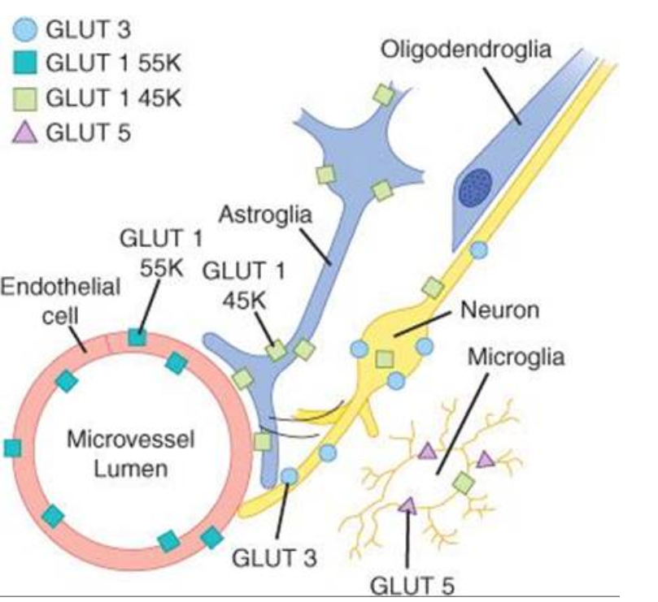
Special requirement of the brain for oxygen
Lack of significant anaerobic metabolism
Under normal conditions, most brain energy is supplied by glucose.
Glucose delivery to brain cells is not dependent on insulin.

