Slide 1
Overview of synaptic transmission
Dr. Ejlal Abu-El-Rub, Pharm.D, PhD
Department of Basic Medical Sciences
Faculty of Medicine
Yarmouk University

Slide 2
CNS synapses
Synaptic transmission is the major process by which electrical signals are transferred between cells within the nervous system (or between neurons and muscle cells or sensory receptors)
Synapses: specialized junctions between neurons

Slide 3
Synaptic functions of neurons
Information is transmitted in the central nervous system mainly in the form of nerve action potentials, called simply “nerve impulses,” through a series of neurons, one after another.
However, in addition, each impulse:
(1) may be blocked in its transmission from one neuron to the next
(2) may be changed from a single impulse into repetitive impulses, or
(3) may be integrated with impulses from other neurons to cause highly intricate patterns of impulses in successive neurons.

Slide 4
Types of Synapses - Chemical and Electrical
There are two major types of synapses:
(1) the chemical synapse and
(2) the electrical synapse.
*Almost all the synapses used for signal transmission in the central nervous system of the human being are chemical synapses.

Slide 5
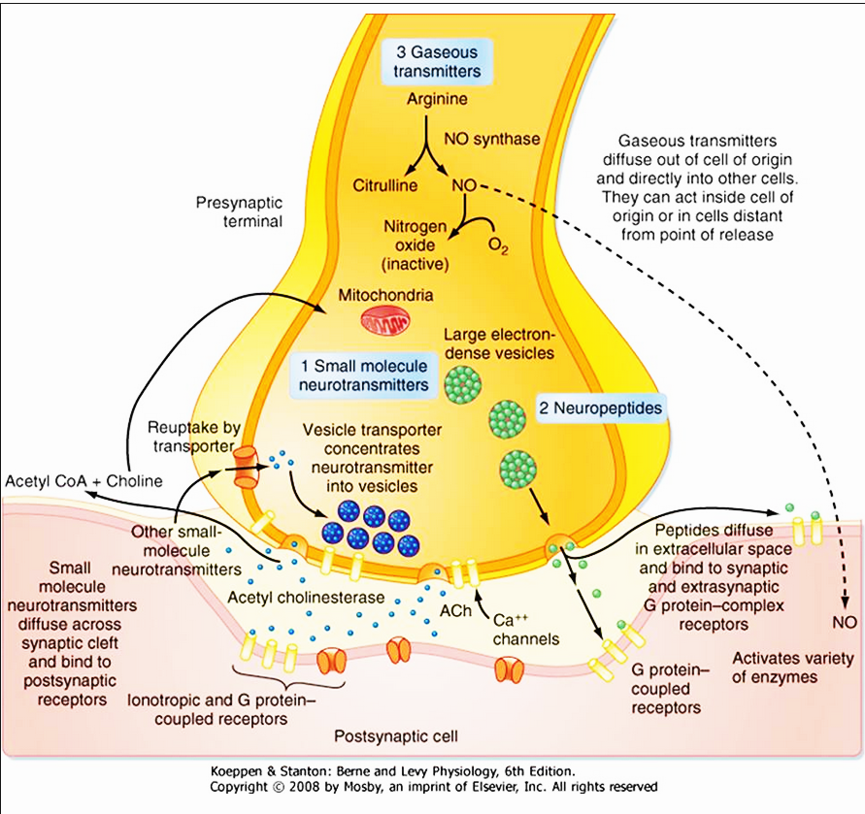
Chemical synapses
In chemical synapses, the first neuron secretes at its nerve ending synapse (Synaptic cleft) a chemical substance called a neurotransmitter (or often called transmitter substance), and this transmitter in turn acts on receptor proteins in the membrane of the next neuron to excite the neuron, inhibit it, or modify its sensitivity in some other way.
Schematic of a chemical synaptic terminal

Slide 6
Chemical synapses
More than 40 important transmitter substances have been discovered thus far. The best known are acetylcholine, norepinephrine, epinephrine, histamine, gamma-aminobutyric acid (GABA), glycine, serotonin, and glutamate.

Slide 7
Electrical synapses
An electrical synapse is effectively a low-resistance pathway between cells that allows current to flow directly from one cell to another and, more generally, allows the sharing of small molecules between cells.
A gap junction are plaque-like structures in which the plasma membranes of coupled cells become closely apposed .The intercellular channels connecting the cells have a large diameter (1 to 2 nm), thus making it permeable not only to ions but also other small molecules up to approximately 1 kDa in size.

Slide 8
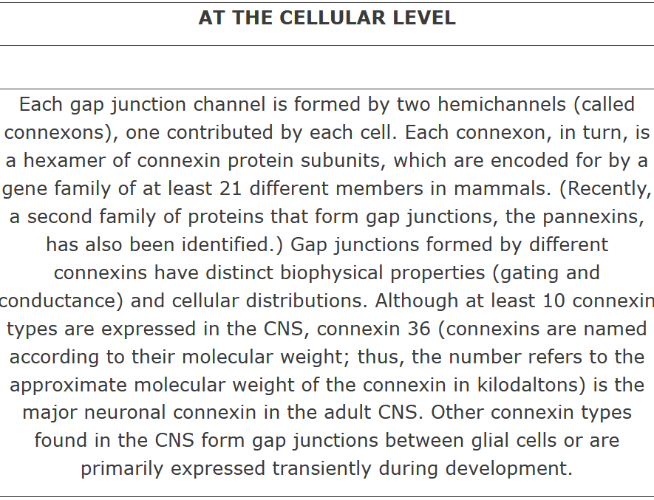
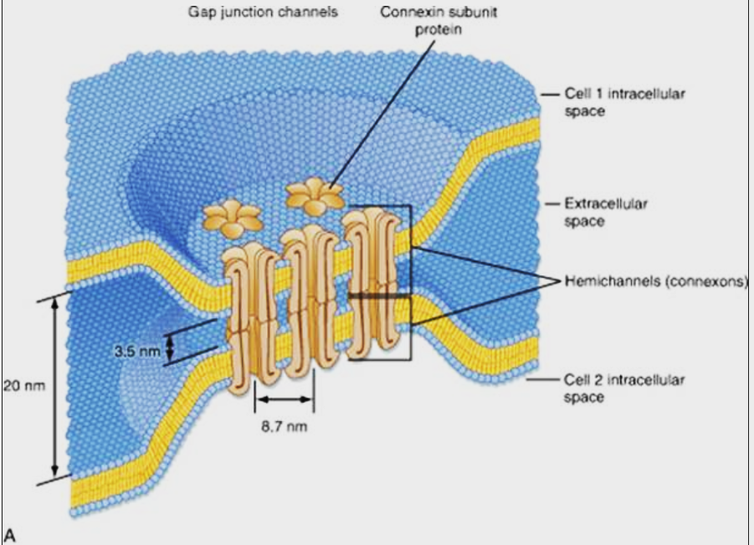

Slide 9
“One-way” conduction at chemical synapses
Chemical synapses always transmit the signals in one direction:
from the neuron that secretes the transmitter substance (presynaptic neuron) to the neuron on which the transmitter acts (postsynaptic neuron).
Electrical synapses often transmit signals in either direction.

Slide 10
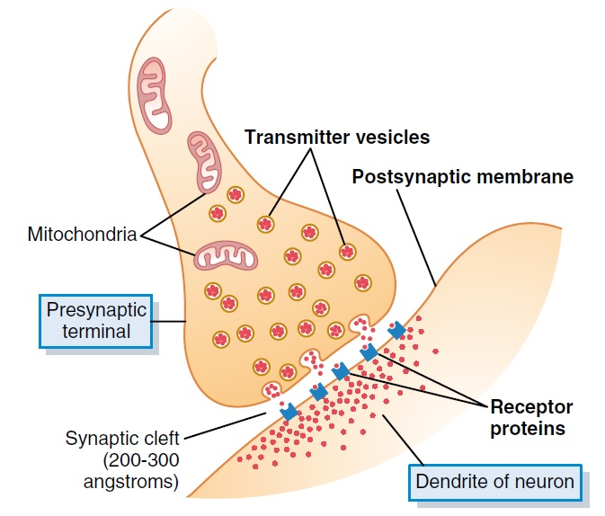
Presynaptic terminals
Presynaptic terminals have varied anatomical forms, but most resemble small round or oval knobs

Slide 11
Presynaptic terminals
Action potential spreads over a presynaptic terminal
depolarization of its membrane
a small number of vesicles to empty into the cleft
The released transmitter causes an immediate change in the permeability of the postsynaptic neuronal membrane
excitation or inhibition of the postsynaptic neuron, depending on the neuronal receptor characteristics.

Slide 12
Mechanism by which an action potential causes transmitter release from the presynaptic terminals - Role of calcium ions
Presynaptic membrane contains large numbers of voltage-gated calcium channels.
Action potential → depolarization of the presynaptic membrane → calcium channels open → large number of calcium ions flow into the terminal.
Ca²⁺ binds with release sites (special protein molecules on the inside of the presynaptic membrane) → release sites open through the membrane → allow a few transmitter vesicles to release their transmitter into the cleft after each single action potential.

Slide 13
Action of the Transmitter Substance on the Postsynaptic Neuron – Function of “Receptor Proteins”
The membrane of the postsynaptic neuron contains large numbers of receptor proteins.
Receptor proteins have two components:
(1) a binding component that protrudes outward from the membrane into the synaptic cleft -here it binds the neurotransmitter coming from the presynaptic terminal
(2) an ionophore component that passes all the way through the postsynaptic membrane to the interior of the postsynaptic neuron.

Slide 14
The ionophore is one of two types:
an ion channel that allows passage of specified types of ions through the membrane, or
(2) a “second messenger” activator that is not an ion channel but instead is a molecule that protrudes into the cell cytoplasm and activates one or more substances (second messengers) inside the postsynaptic neuron.

Slide 15
Ion Channels
Postsynaptic ion channels are usually of two types:
(1) Cation channels
Lined with negative charges → attract +ve ions and repel –ve ions.
Most often allow sodium ions to pass when opened but sometimes allow potassium and/or calcium ions as well.
(2) Anion channels
allow mainly chloride ions to pass and only little quantities of other anions (mainly because their hydrated ions are too large).

Slide 16
Ion Channels
A transmitter substance that opens cation channels is called an excitatory transmitter.
Transmitter substances that open anion channels are called inhibitory transmitters.
Opening and closing of an ion channel occur in a fraction of a millisecond → very rapid control of postsynaptic neurons.

Slide 17
“Second Messenger” System in the Postsynaptic Neuron
Many functions of the nervous system require prolonged changes in neurons (for seconds to months after the initial transmitter substance is gone) → ion channels not suitable.
Prolonged postsynaptic neuronal excitation or inhibition is achieved by activating a “second messenger” chemical system inside the postsynaptic neuronal cell itself, and then it is the second messenger that causes the prolonged effect.

Slide 18
“Second Messenger” System in the Postsynaptic Neuron – G-protein

Slide 19
Excitatory or Inhibitory Receptors in the Postsynaptic Membrane
The presence of both inhibitory and excitatory types of receptors gives an additional dimension to nervous function, allowing restraint of nervous action and excitation.

Slide 20
Excitation
Opening of sodium channels to allow large numbers of positive electrical charges to flow to the interior of the postsynaptic cell.
Raises the intracellular membrane potential in the positive direction up toward the threshold level for excitation.

Slide 21
Excitation
Depressed conduction through chloride or potassium channels, or both.
decreases the diffusion of Cl⁻ ions to the inside of the postsynaptic neuron, or
decreases the diffusion of positively charged potassium ions to the outside. In either instance, the effect is to make the internal membrane potential more positive than normal, which is excitatory.

Slide 22
Excitation
Changes in the internal metabolism of the postsynaptic neuron

Slide 23
Inhibition
Opening of chloride ion channels through the postsynaptic neuronal membrane → rapid diffusion of Cl⁻ ions from outside the postsynaptic neuron to the inside → increasing the negativity inside, which is inhibitory.

Slide 24
Inhibition
Increase in conductance of potassium ions out of the neuron → positive ions diffuse to the exterior → increased negativity inside the neuron; this is inhibitory.

Slide 25
Inhibition
Activation of receptor enzymes that inhibit cellular metabolic functions that increase the number of inhibitory synaptic receptors or decrease the number of excitatory receptors.

Slide 26
Chemical Substances That Function as Synaptic Transmitters

Slide 27
Small-molecule rapidly-acting* transmitters
Class I
Acetylcholine
Class II: The Amines
Norepinephrine
Epinephrine
Dopamine
Serotonin
Histamine
Class III: Amino Acids
Gamma-aminobutyric acid (GABA)
Glycine
Glutamate
Aspartate
Class IV
Nitric oxide (NO)
* For example, transmission of sensory signals to the brain and of motor signals back to the muscles.

Slide 28
Neuropeptide, slowly acting* transmitters or growth factors

Slide 29
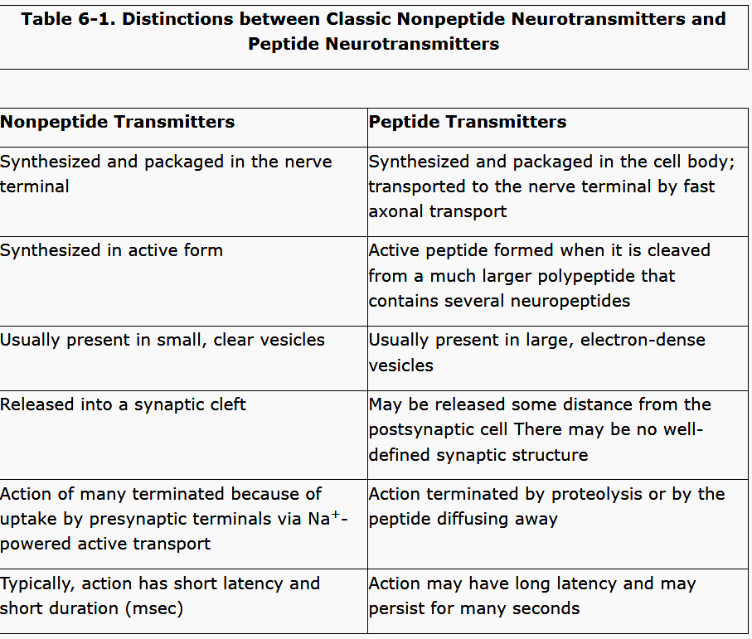

Slide 30
Small-Molecule, Rapidly Acting Transmitters
Synthesized in the cytosol of the presynaptic terminal and absorbed by active transport into the many transmitter vesicles in the terminal.
The effect is usually to increase or decrease conductance through ion channels.
Small-molecule transmitter vesicles are continually recycled and used over and over again → after fusion with presynaptic membrane and release of transmitter, the vesicle portion of the membrane invaginates back to the inside of the terminal and pinches off to form a new vesicle.
Example: acetylcholine

Slide 31
Some of the Most Important Small-Molecule Transmitters
Norepinephrine | Acetylcholine
(1) The brain stem and hypothalamus (specifically, norepinephrine-secreting neurons located in the locus ceruleus in the pons). (2) Most postganglionic neurons of the sympathetic nervous system | (1) the terminals of the large pyramidal cells from the motor cortex, (2) several different types of neurons in the basal ganglia, (3) the motor neurons that innervate the skeletal muscles, (4) the preganglionic neurons of the autonomic nervous system, (5) the postganglionic neurons of the parasympathetic nervous system, (6) some of the postganglionic neurons of the sympathetic nervous system. | Sites of secretion
-Mostly, it activates excitatory receptors, but in a few areas, it activates inhibitory receptors instead. -In postganglionic neurons it excites some organs but inhibits others. | -Mostly excitatory -Inhibitory effects at some peripheral parasympathetic nerve endings (such as inhibition of the heart by the vagus nerves). | Properties

Slide 32
Some of the Most Important Small-Molecule Transmitters
Glutamate | GABA | Glycine | Dopamine
Presynaptic terminals in many of the sensory pathways entering the central nervous | (gamma-aminobutyric acid) Nerve terminals in the spinal cord, cerebellum, basal ganglia, and many areas of the cortex. It is believed always to cause inhibition. | Mainly at synapses in the spinal cord. | Neurons that originate in the substantia nigra. The termination of these neurons is mainly in the striatal region of the basal ganglia. | Sites of secretion
It probably always causes excitation |  | It is believed to always act as an inhibitory transmitter | Effect of dopamine is usually inhibition. | Properties

Slide 33
Some of the Most Important Small-Molecule Transmitters
Nitric oxide | Serotonin
Especially secreted by nerve terminals in areas of the brain responsible for long-term behavior and for memory. It is not preformed and stored in vesicles in the presynaptic terminal as are other transmitters. Instead, it is synthesized almost instantly as needed, and it then diffuses out of the presynaptic terminals over a period of seconds rather than being released in vesicular packets. Next, it diffuses into postsynaptic neurons nearby. In the postsynaptic neuron, it usually does not greatly alter the membrane potential but instead changes intracellular metabolic functions that modify neuronal excitability for seconds, minutes, or perhaps even longer. | nuclei that originate in the median raphe of the brain stem and project to many brain and spinal cord areas, especially to the dorsal horns of the spinal cord and to the hypothalamus. | Sites of secretion
 | inhibitor of pain pathways in the cord, and an inhibitor action in the higher regions of the nervous system is believed to help control the mood of the person, perhaps even to cause sleep. | Properties

Slide 34
Neuropeptides
neuropeptides are synthesized as integral parts of large-protein molecules by ribosomes in the neuronal cell body (not in the cytosol)
enter the spaces inside the endoplasmic reticulum of the cell body and subsequently inside the Golgi apparatus
enzymatically split into smaller fragments
Golgi apparatus packages the neuropeptide into transmitter
vesicles that are released into the cytoplasm
vesicles are transported all the way to the tips of the nerve fibers by axonal streaming of the axon cytoplasm
vesicles release their transmitter at the neuronal terminals in the same manner as for small-molecule transmitters.
The vesicle is autolyzed and is not reused.

Slide 35
Neuropeptides
Much smaller quantities of neuropeptides are usually released than those of the small-molecule transmitters.
However, neuropeptides are generally a thousand or more times as potent as the small-molecule transmitters.
They often cause much more prolonged actions. Some of these actions include:
prolonged closure of calcium channels,
prolonged changes in the metabolic machinery of cells,
prolonged changes in activation or deactivation of specific genes in the cell nucleus,
prolonged alterations in numbers of excitatory or inhibitory receptors.
Some of these effects last for days, but others perhaps for months or years

Slide 36
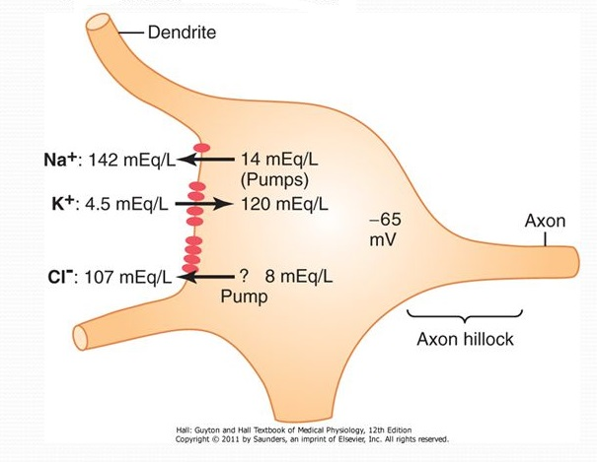
Electrical Events During Neuronal Excitation
Resting Membrane Potential of the Neuronal Soma
resting membrane potential of about −65 millivolts (less negative than the −90 millivolts found in large peripheral nerve fibers and in skeletal muscle fibers)

Slide 37
Concentration differences of ions across the neuronal somal membrane
Sodium ion concentration is high in the ECF (142 mEq/L) but low inside the neuron (14 mEq/L).
This sodium concentration gradient is caused by a strong somal membrane sodium pump that continually pumps sodium out of the neuron.
Potassium ion concentration is high inside the neuronal soma (120 mEq/L) but low in the extracellular fluid (4.5 mEq/L).
A potassium pump (the other half of the Na⁺ - K⁺ pump) pumps potassium to the interior.

Slide 38
Chloride ion has high concentration in the extracellular fluid but low concentration inside the neuron.
This is because:
The membrane may be somewhat permeable to chloride ions
there may be a weak chloride pump.
Of the −65 millivolts in the neuron, which repels the negatively charged chloride ions, forcing them outward through the pores until the concentration is much less inside the membrane than outside

Slide 39
Effect of Synaptic Excitation on the Postsynaptic Membrane - Excitatory Postsynaptic Potential

Slide 40
Generation of action potentials in the initial segment of the axon leaving the neuron – Threshold for Excitation
When the EPSP rises high enough in the positive direction, there comes a point at which this initiates an action potential in the neuron.
The action potential begins in the initial segment of the axon where the axon leaves the neuronal soma →Axon Hillock
The EPSP that will elicit an action potential in the axon initial segment is between +10 and +20 millivolts. This is in contrast to the +30 or +40 millivolts or more required on the soma.

Slide 41
Electrical Events During Neuronal Inhibition
Effect of inhibitory synapses on the postsynaptic membrane - Inhibitory postsynaptic potential
The inhibitory synapses open mainly chloride channels, allowing easy passage of chloride ions.
Opening potassium channels will allow positively charged potassium ions to move to the exterior, and this will also make the interior membrane potential more negative than usual.
hyperpolarization
An increase in negativity beyond the normal resting membrane potential level is called an inhibitory postsynaptic potential (IPSP).

Slide 42
Presynaptic inhibition
Presynaptic inhibition is caused by release of an inhibitory substance onto the outsides of the presynaptic nerve fibrils
Mostly GABA → opens anion channels → Cl⁻ ions → inhibit synaptic transmission by cancel much of the excitatory effect of the positively charged sodium ions that also enter the terminal fibrils when an action potential arrives.

Slide 43
Time Course of Postsynaptic Potentials

Slide 44
Summation in Neurons – Threshold for Firing
Excitation of a single presynaptic terminal on the surface of a neuron almost never excites the neuron.
Many presynaptic terminals spread over wide areas of the neuron are usually stimulated at the same time, and their effects can summate; that is, they can add to one another until neuronal excitation does occur.
The “excitatory state” of a neuron is defined as the summated degree of excitatory drive to the neuron.
If there is a higher degree of excitation than inhibition of the neuron at any given instant, then it is said that there is an excitatory state.

Slide 45
Types of summation
spatial summation response evoked by synapses that are electrically independent of each other .
Temporal summation. The postsynaptic response to two spikes in the same axonal synapse occurs in rapid sequence

Slide 46
Special Functions of Dendrites for Exciting Neurons
Most dendrites cannot transmit action potentials, but they can transmit signals within the same neuron by electrotonic conduction (= direct spread of electrical current by ion conduction in the fluids of the dendrites but without generation of action potentials).

Slide 47
Some special characteristics of synaptic transmission

Slide 48
Fatigue of Synaptic Transmission
When excitatory synapses are repetitively stimulated at a rapid rate, the number of discharges by the postsynaptic neuron is at first very great, but the firing rate becomes progressively less in succeeding milliseconds or seconds. This is called fatigue of synaptic transmission.
When areas of the nervous system become overexcited, fatigue causes them to lose this excess excitability after a while
the development of fatigue is a protective mechanism against excess neuronal activity.
Mechanism of fatigue is mainly exhaustion or partial exhaustion of the stores of transmitter substance in the presynaptic terminals.

Slide 49
Effects of acidosis or alkalosis on synaptic transmission
Normally, alkalosis greatly increases neuronal excitability.
Ex.: a rise in arterial blood pH from normal 7.4 to 7.8 to 8.0 often causes cerebral epileptic seizures.
Acidosis greatly depresses neuronal activity.
Ex.: a fall in pH from 7.4 to below 7.0 usually causes a comatose state.

Slide 50
Effect of hypoxia on synaptic trasmission
Cessation of oxygen for only a few seconds can cause complete inexcitability of some neurons.
When the brain’s blood flow is temporarily interrupted because within 3 to 7 seconds, the person becomes unconscious.

Slide 51
Synaptic delay
During synaptic transmission, some time is consumed in:
discharge of the transmitter substance by the presynaptic terminal
diffusion of the transmitter to the postsynaptic neuronal membrane
action of the transmitter on the membrane receptor
action of the receptor to increase the membrane permeability
inward diffusion of sodium to raise the excitatory postsynaptic potential to a high enough level to elicit an action potential.

