Slide 1
Organization of the Nervous System
Dr.Ejlal Abu-El-Rub, Pharm.D, PhD
Department of Basic Medical Sciences
Faculty of Medicine
Yarmouk University

Slide 2
What is the Nervous System ???
The nervous system is a communications and control network that allows an organism to interact in appropriate ways with its environment.
The environment includes both the external environment (the world outside the body) and the internal environment (the components and cavities of the body).
The nervous system can be divided into central and peripheral parts, each with further subdivisions.

Slide 3
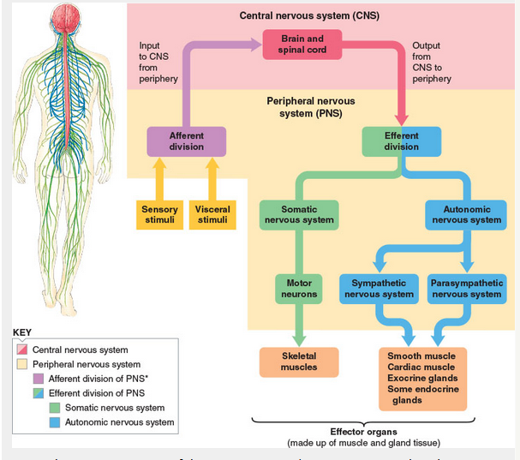

Slide 4
General Functions of the NS
Sensory Detection (Energy that can be sensed including mechanical, light, sound, chemical, thermal, and in some animals, electrical)
Information processing (involve both electrical and chemical events)
Expression of behavior (organism's responses to its environment)

Slide 5
Information processing includes the following:
1. Transmission of information via neural networks
2. Transformation of information by recombination with other information (neural integration)
3. Perception of sensory information
4. Storage and retrieval of information (memory)
5. Planning and implementation of motor commands
6. Thought processes and conscious awareness
7. Learning
8. Emotion and motivation

Slide 6
General design of the nervous system

Slide 7
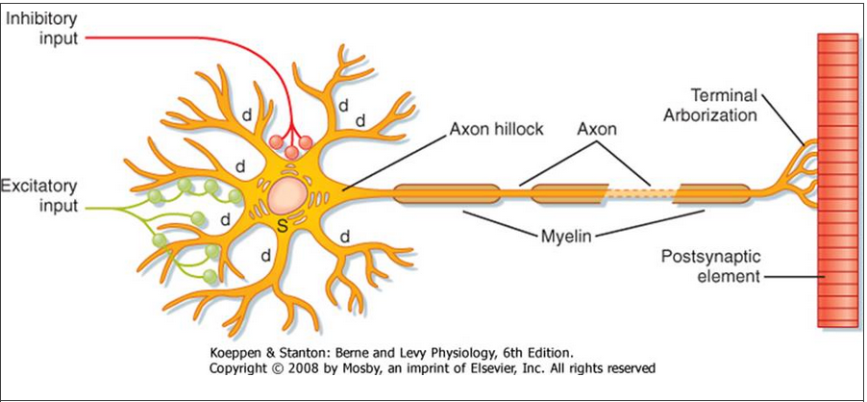
The Neuron

Slide 8
Cellular components of the NS
The nervous system is made up of cells, connective tissue, and blood vessels.
The major cell types are : Neurons (nerve cells) : specialized for communication and signaling. Each neuron consists of cell body (perikaryon, soma) they have Nissi Bodies, dendrites, and the axon
Neuroglia ("nerve glue") :neuroglia, or just glia, are characterized as supportive cells that sustain neurons both metabolically and physically, as well as isolate individual neurons from each other and help maintain the internal milieu of the nervous system.

Slide 9
The neuron
In the CNS → 100 billion neurons interconnected synaptically
Neural activity is generally coded by sequences of action potentials propagated along axons in the neural circuits
Input signals →through synapses located mostly on the neuronal dendrites. Some inputs pass to the soma.
Output signal → in single axon (with many separate branches) leaving the neuron.
Signal propagates in only one direction

Slide 10
Neuron
Soma
Dendrites
Axon
Nissl bodies, which are stacks of rough endoplasmic reticulum, and a prominent Golgi apparatus.
The soma also contains numerous mitochondria and cytoskeletal elements, including neurofilaments and microtubules
Main cytoplasmic organelles in dendrites are microtubules and neurofilaments
Receives synaptic input from other neurons
Conveys the output of the cell to the next cell
Each neuron has only one axon
They lack rough endoplasmic reticulum, free ribosomes, and Golgi apparatus
Exons degenerate when disconnected from the cell body

Slide 11
Axonal transport
Not by simple diffusion – some axons are too long
Axonal transport depends on the movement of transport filaments.
Energy is required and is supplied by glucose. Mitochondria control the level of cations in the axoplasm by supplying ATP to the ion pumps. An important cation for axonal transport is Ca⁺⁺. Transport filaments move along the cytoskeleton (microtubules or neurofilaments)
Membrane-bound organelles and mitochondria are transported relatively rapidly by fast axonal transport .Substances that are dissolved in cytoplasm, such as proteins, are moved by slow axonal transport

Slide 12
Axonal Transport
Special microtubule-associated motor proteins called kinesin and dynein are required for axonal transport
Axonal transport occurs in both directions. Transport from the soma toward the axonal terminals is called anterograde axonal transport. This process involves kinesin, and it allows the replenishment of synaptic vesicles and enzymes responsible for the synthesis of neurotransmitters in synaptic terminals. Transport in the opposite direction, which is driven by dynein, is called retrograde axonal transport. This process returns recycled synaptic vesicle membrane to the soma for lysosomal degradation.

Slide 13
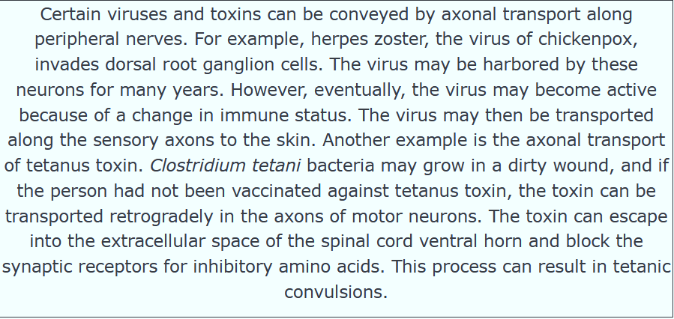
Clinical insight

Slide 14
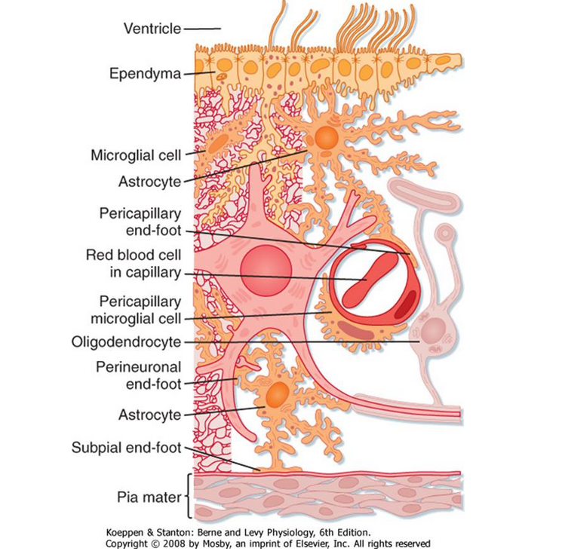
Nonneuronal cellular elements

Slide 15
The supportive Matrix of the CNS-(nonneuronal cellular elements)
Neuroglia:
Central neuroglial cells are : Astrocytes ,Oligodendroglia, Microglia and Ependymal cells.
Astrocytes:
Star –shaped cells with processes.
They regulate the microenvironment of the CNS
Their foot processes contact the capillaries and connective tissue at the surface of the CNS, the pia mater-regulate the entry of substances into CNS
The cytoplasm of astrocytes contains glial filaments, which provide mechanical support for CNS tissue. After injury, the astrocytic processes that contain these glial filaments hypertrophy and form a glial "scar."

Slide 16
The supportive Matrix-nonneuronal cellular elements
Oligodendroglial cells:
In CNS, the axons are surrounded by a myelin sheath, which is a spiral multilayered wrapping of oligodendroglia cell membrane
Myelin increases the speed of action potential conduction

Slide 17
The supportive Matrix-nonneuronal cellular elements
Microglia :are latent phagocytes. When the CNS is damaged, microglia help remove the cellular products of the damage. They are assisted by other phagocytes from the circulation.
Ependymal cells: the epithelium lining the ventricular spaces of the brain that contain CSF. Many substances diffuse readily across the ependyma, which lies between the extracellular space of the brain and the CSF. CSF is secreted in large part by specialized ependymal cells of the choroid plexuses located in the ventricular system.

Slide 18
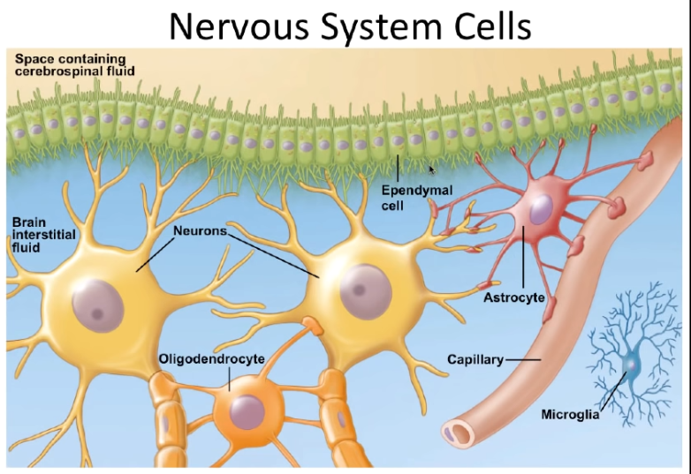

Slide 19
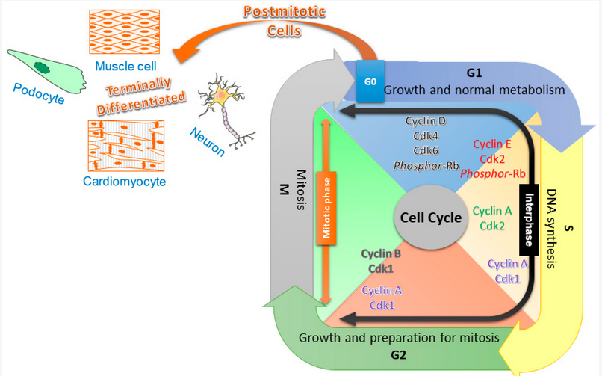

Slide 20
The Blood-Brain Barrier
Movement of large molecules and highly charged ions from blood into the brain and spinal cord is severely restricted.
The restriction is due to the barrier action of the capillary endothelial cells of the CNS and the tight junctions between them.
Astrocytes may also help limit the movement of certain substances

Slide 21
Clinical Insight

Slide 22
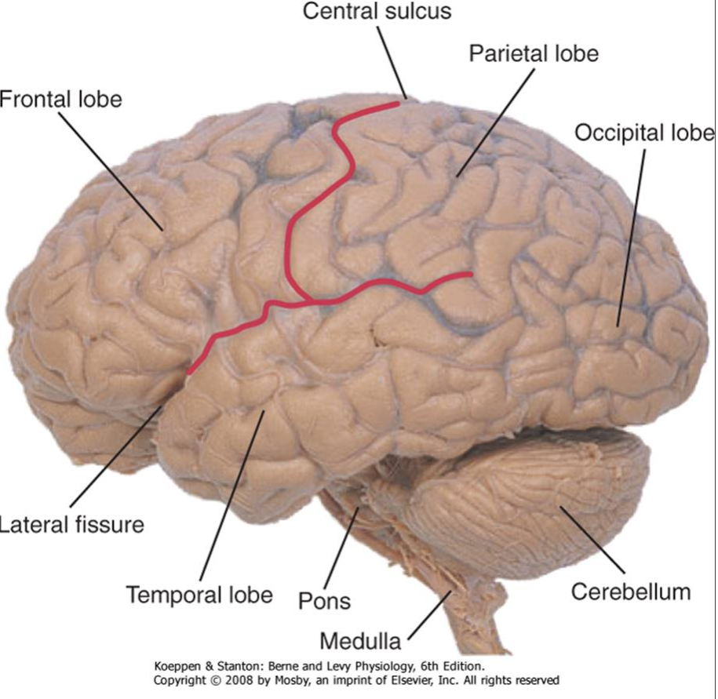
The Central Nervous system
The Brain

Slide 23
The CNS
The spinal cord can be subdivided into a series of regions, each composed of a number of segments named for the vertebrae where their nerve roots enter or leave:
8 cervical, 12 thoracic, 5 lumbar, 5 sacral, and 1 coccygeal.

Slide 24
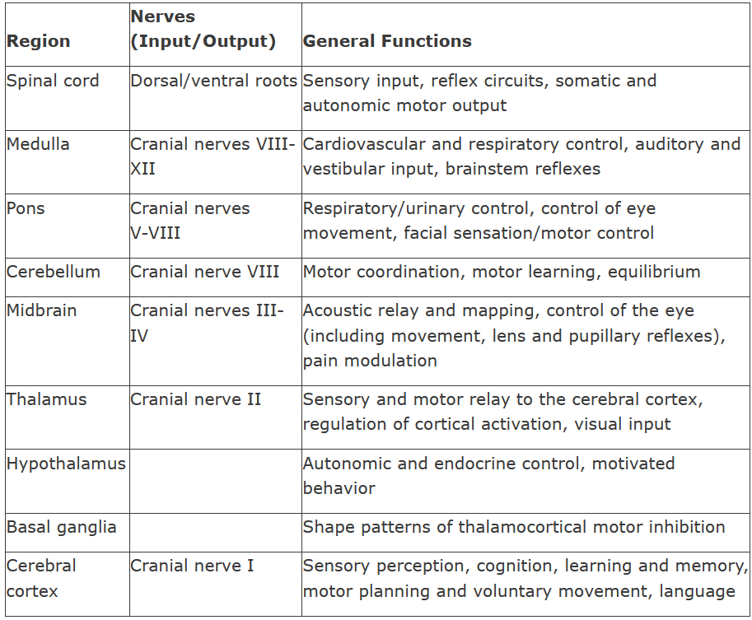
The functions of CNS

Slide 25
Cellular Circuitry in the Central Nervous System
1-Sensory receptors can be classified by
The type of energy that they transduce, e.g., photoreceptors transduce light, mechanoreceptors transduce force
The source of the input e.g., exteroceptors signal external events, proprioceptors signal the position of a body part with respect to space or another body part

Slide 26
It transmits sensory information from the receptors of the entire body surface and from some deep structures.
Information enters the CNS through peripheral nerves and is conducted immediately to multiple sensory areas in:
(1) the spinal cord at all levels;
(2) the reticular substance of the medulla, pons, and mesencephalon (midbrain);
(3) the cerebellum;
(4) the thalamus;
(5) areas of the cerebral cortex.

Slide 27
Somatic sensory part of CNS

Slide 28
2- Motor Part of the Nervous System – Effectors
Control of bodily activities is achieved by controlling:
(1) contraction of appropriate skeletal muscles throughout the body
(2) contraction of smooth muscle in the internal organs
(3) secretion of active chemical substances by both exocrine and endocrine glands in many parts of the body.

Slide 29
2- Motor Part of the Nervous System – Effectors
These activities are collectively called motor functions of the nervous system.
The muscles and glands are called effectors they perform the functions dictated by the nerve signals.

Slide 30
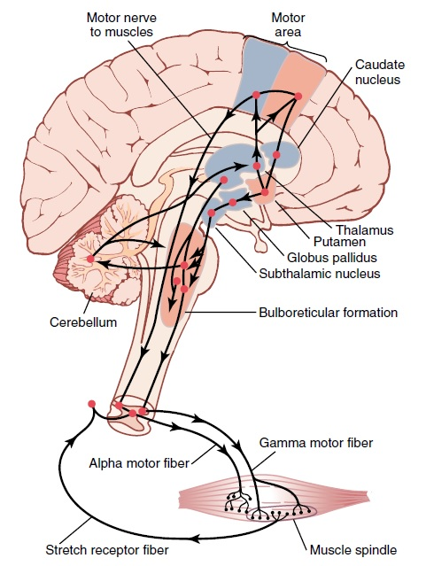
Motor Part of the
Nervous System – Effectors

Slide 31
Motor Part of the Nervous System – Effectors
The skeletal muscles can be controlled from:
(1) the spinal cord
(2) the reticular substance of the medulla, pons, and mesencephalon
(3) the basal ganglia
(4) the cerebellum
(5) the motor cortex.
The lower regions concerned primarily with automatic, instantaneous muscle responses to sensory stimuli.
The higher regions are involved with deliberate complex muscle movements controlled by the thought processes of the brain.

Slide 32
Processing of Information – “Integrative” Function of the Nervous System
One of the most important functions of the nervous system is to process incoming information in such a way that appropriate mental and motor responses will occur.
99% of all sensory information is discarded as irrelevant.
When important sensory information excites the brain, it is immediately channeled into proper integrative and motor regions of the brain to cause desired responses → this is called integrative function of the nervous system.

Slide 33
Processing of Information – “Integrative” Function of the Nervous System
Example:
A person places a hand on a hot stove
instantaneous response to lift the hand
associated responses follow
(moving the entire body away from the stove, shouting with pain)

Slide 34
Role of synapses in processing information
Synapses determine the directions that the nervous signals will spread through the nervous system.
Some synapses transmit signals from one neuron to the next with ease, whereas others transmit signals only with difficulty.
Excitatory and inhibitory signals from other areas in the nervous system can control synaptic transmission by opening the synapses for transmission and at other times closing them.

Slide 35
Role of synapses in processing information
Some postsynaptic neurons respond with large numbers of output impulses, and others respond with only a few.
Thus, the synapses perform a selective action by
blocking weak signals while allowing strong signals to pass
selecting and amplifying certain weak signals
channeling these signals in many directions rather than in only one direction.

Slide 36
Storage of information - Memory
Most of the sensory information is stored for future control of motor activities and for use in the thinking processes.
Most storage occurs in the cerebral cortex, but even the basal regions of the brain and the spinal cord can store small amounts of information.
Memory is the process of information storage, in which also synapses are involved.

Slide 37
Storage of information - Memory
Facilitation: each time certain types of sensory signals pass through sequences of synapses, these synapses become more capable of transmitting the same type of signal the next time.
The sensory signals pass through the synapses a large number of times → synapses become so facilitated in generating the same sequences of impulses → causes a perception of experiencing the original sensations.

Slide 38
Storage of information - Memory
Once memories have been stored in the nervous system, they become part of the brain processing mechanism for future “thinking.”
The thinking processes of the brain compare new sensory experiences with stored memories → the memories then help to select the important new sensory information and to channel this into appropriate memory storage areas for future use or into motor areas to cause immediate bodily responses.

Slide 39
Major levels of CNS function

Slide 40
Spinal cord level
The spinal cord is not only a conduit for signals from the periphery of the body to the brain, or in the opposite direction from the brain back to the body.
Even after the spinal cord has been cut in the high neck region, many highly organized spinal cord functions still occur.

Slide 41
Spinal cord level
Neuronal circuits in the cord can cause
(1) walking movements,
(2) reflexes that withdraw portions of the body from painful objects
(3) reflexes that stiffen the legs to support the body against gravity
(4) reflexes that control local blood vessels, gastrointestinal movements, or urinary excretion.
The upper levels of the nervous system often operate not by sending signals directly to the periphery of the body but by sending signals to the control centers of the cord.

Slide 42
Lower brain (subcortical) level
Many of the subconscious activities of the body are controlled in the lower areas of the brain (in the medulla, pons, mesencephalon, hypothalamus, thalamus, cerebellum, and basal ganglia).

Slide 43
Lower brain (subcortical) level
Examples:
Subconscious control of arterial pressure and respiration → medulla and pons
Equilibrium → older portions of the cerebellum and the reticular substance of the medulla, pons, and mesencephalon.
Feeding reflexes → areas in the medulla, pons, mesencephalon, amygdala and hypothalamus.
Many emotional patterns → can still occur after destruction of much of the cerebral cortex.

Slide 44
Higher (cortical) level
The cerebral cortex is an extremely large memory storehouse.
The cortex never functions alone but always in association with lower centers of the nervous system.
Without the cerebral cortex, the functions of the lower brain centers are often imprecise.
Cortical information usually converts these functions to determinative and precise operations.

Slide 45
Higher (cortical) level
The cerebral cortex is essential for most of our thought processes, but it cannot function by itself.
In fact, it is the lower brain centers, not the cortex, that initiate wakefulness in the cerebral cortex, thus opening its bank of memories to the thinking machinery of the brain.
Thus, each portion of the nervous system performs specific functions. But it is the cortex that opens a world of stored information for use by the mind.

