Slide 1
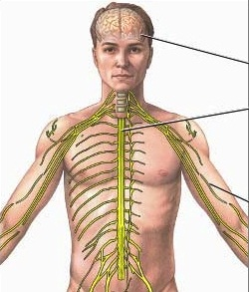
Central Nervous System
Instructor : Noor Al-Saleh

Slide 2
Introduction
The central nervous system has NO indigenous micro flora
Microbes gain access to the CNS through:
Trauma
Blood or lymph
Peripheral nerves

Slide 3
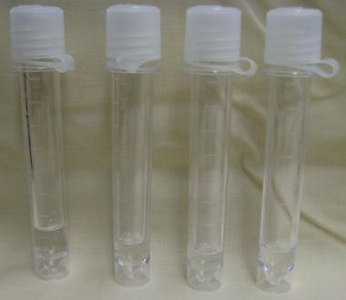
CerebroSpinal Fluid
The representative clinical sample to diagnose medical disorders that affect the Central Nervous System is
Cerebro-Spinal Fluid (CSF)

Slide 4
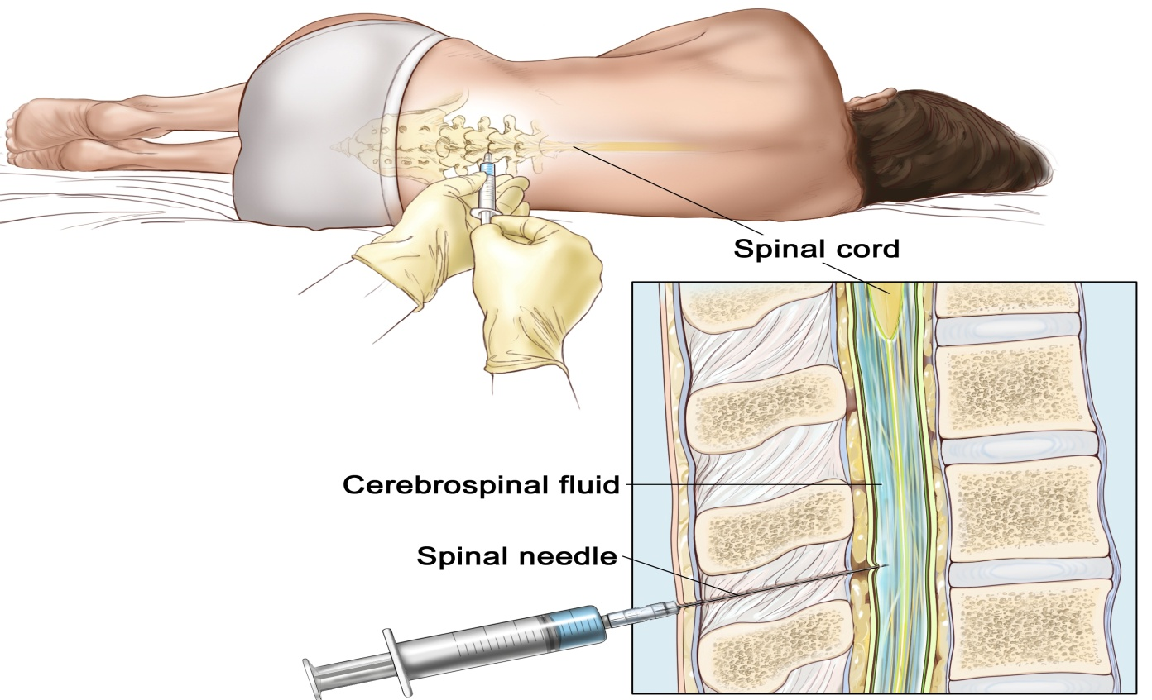
Lumber Spinal Puncture
The most common method used to collect small volume of CSF from the lower spine is
LUMBER PUNCTURE (Spinal Tap)

Slide 5
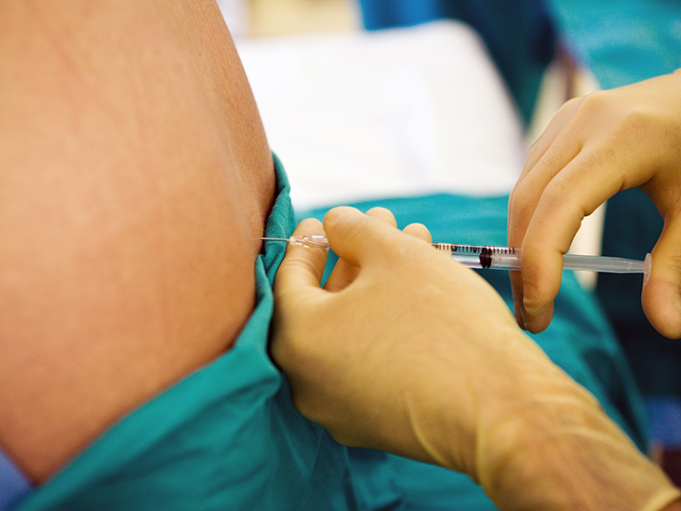
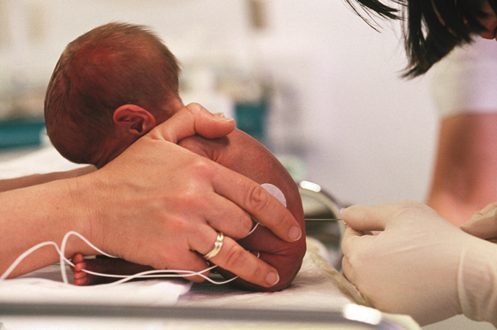
Lumber Spinal Puncture
Adults L3 – L4
2-3 ml for each tube
Children L4 – L5
1 ml for each tube

Slide 6
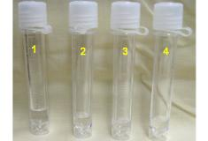
CSF sample tubes
Tube #1 : Microbiology lab (Gram stain + Acid Fast stain + india ink stain + Culture)
Tube #2 : Biochemistry lab (Glucose + Protein)
Tube #3: Cytology lab (Cell count + Differential stain)
Tube #4: Serology lab and others

Slide 7
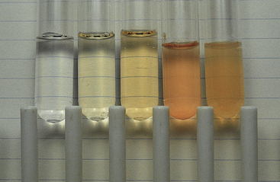
Macroscopic Examination
Normal CSF is crystal clear and colorless
Pathological processes can cause fluid to appear cloudy, turbid, bloody, viscous, or clotted

Slide 8
Microscopic Examination
Culture
- Primary plates ( Blood + Chocolate + MacConkey media)
- Thayer Martin agar media → Neisseria spp
- Löwenstein Jensen media → M. tuberculosis
Staining
- Gram Staining
- Acid Fast staining → M. tuberculosis
- India ink staining → Cryptococeus neoformans

Slide 9
Most encountered organisms
Newborn (Infants):
S. aglactia , L. monocytogenes, K. pneumoniae
Children from 6 months up to 3 years:
H. influenzae, N. meningitidis, S. pneumoniae
Adults (5-29 years): N. meningitidis
Old Adults: S. pneumoniae
More than 60 years: L. monocytogenes

Slide 10
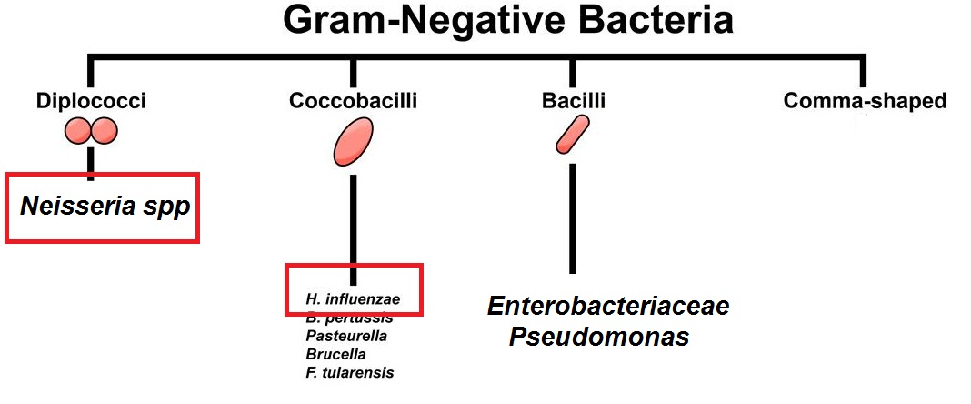

Slide 11
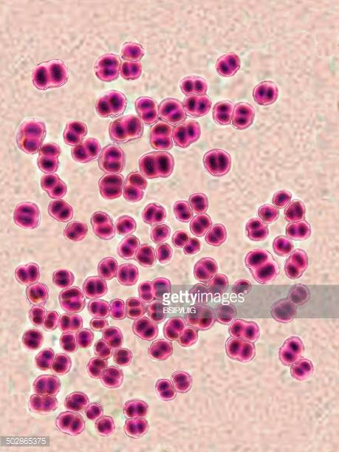
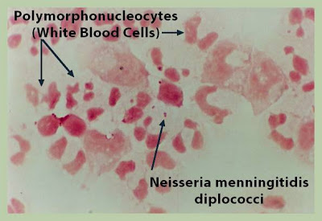
Neisseria meningitidis
Under microscope (Gram stain)
-Gram-negative cocci in pairs (diplococci) → Coffee beans
Oxidase positve

Slide 12
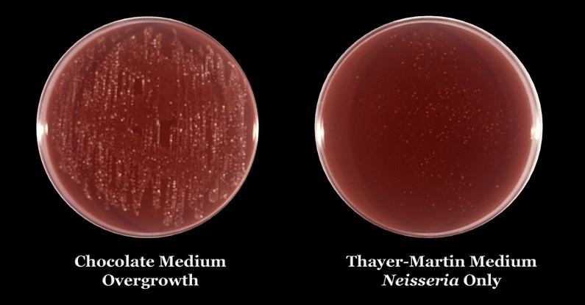
Thayer-Martin agar
Thayer-Martin agar is a selective-enriched medium for the isolation and cultivation of Neisseria spp

Slide 13
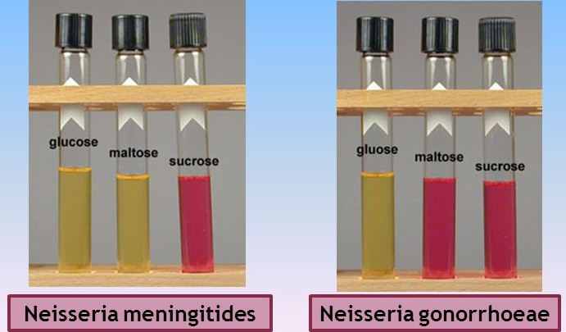
CTA test
CTA (Broth) Media determines carbohydrate fermentation pattern for Neisseria spp
+ve
+ve
- ve
+ve
- ve
- ve

Slide 14
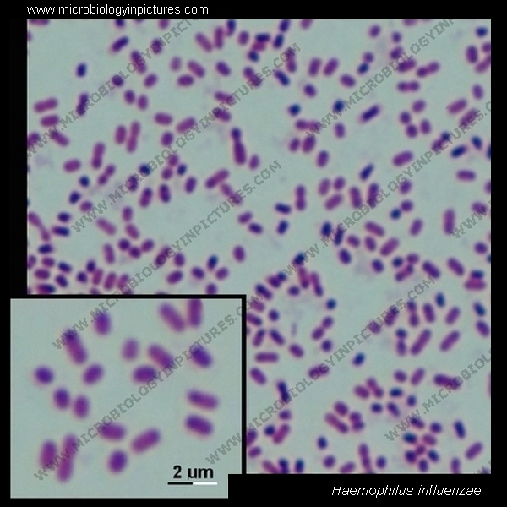
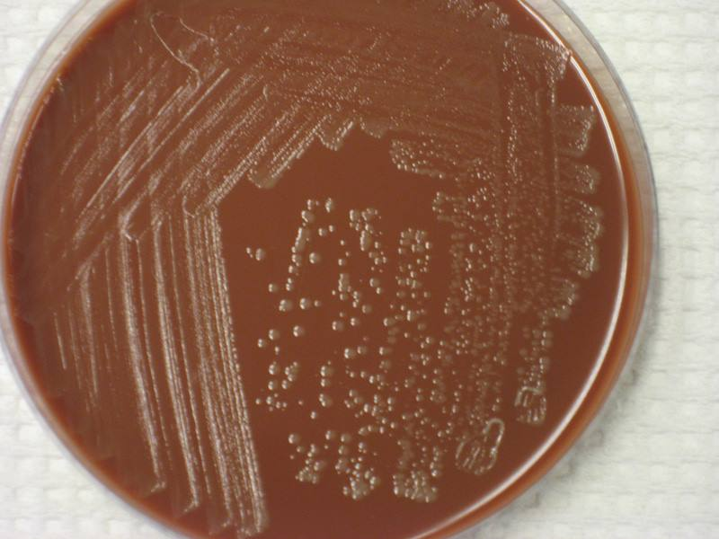
Haemophilus influenzae
Under microscope (Gram stain)
- Gram-negative coccobacilli
Grow on Chocolate agar hemin (factor X) & NAD (factor V)
Small, grey, mucoid colonies
(fastidious)
Greek haemophilus, meaning "blood-loving"

Slide 15
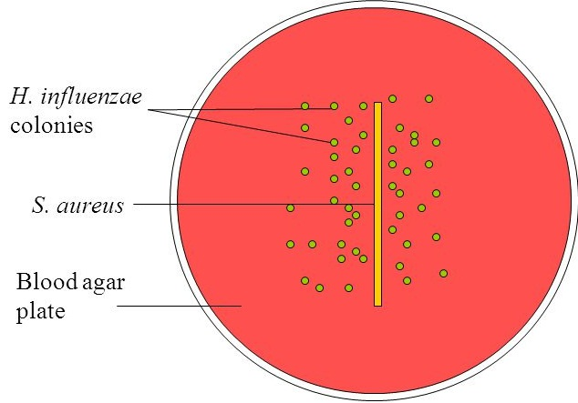
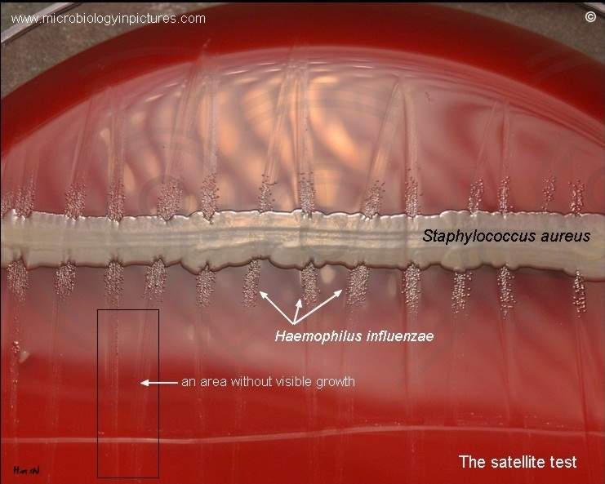
Satellitism
Satellitism test to identify Haemophilus influenzae
- Staphylococcus aureus produce NAD as a metabolic byproduct when grow in a blood media
- Haemophilus influenzae spp grow on blood agar very close to the colonies of Staphylococcus aureus

Slide 16
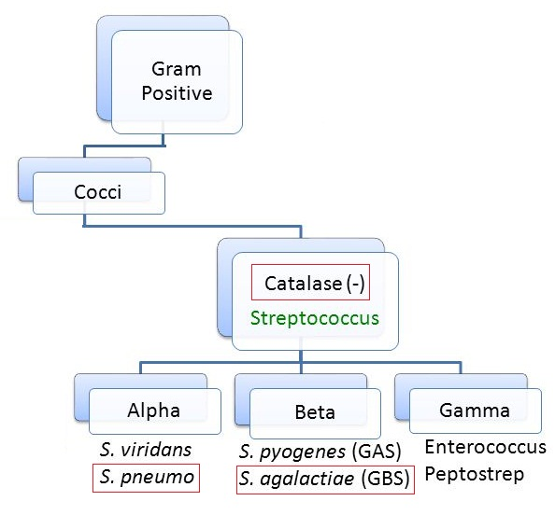
Streptococcus

Slide 17
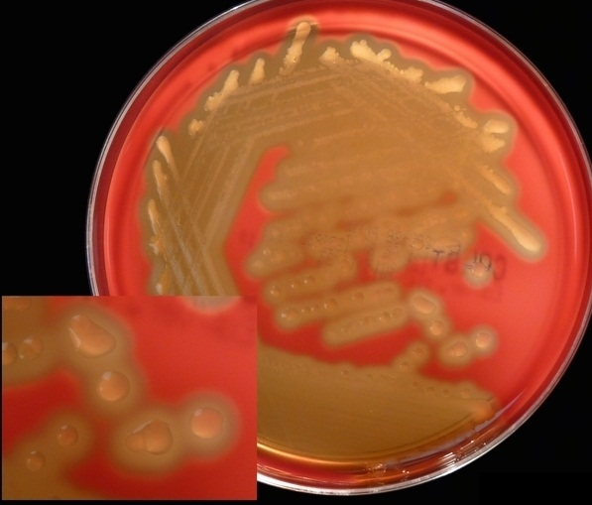
Streptococcus pneumoniae
Under microscope (Gram stain)
Gram +ve cocci in short chains,
diplococci and single cocci
Colony characteristics
-Small, round, gleamy colonies
-Alpha hemolysis around colonies

Slide 18
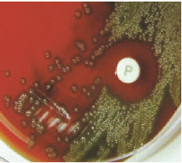
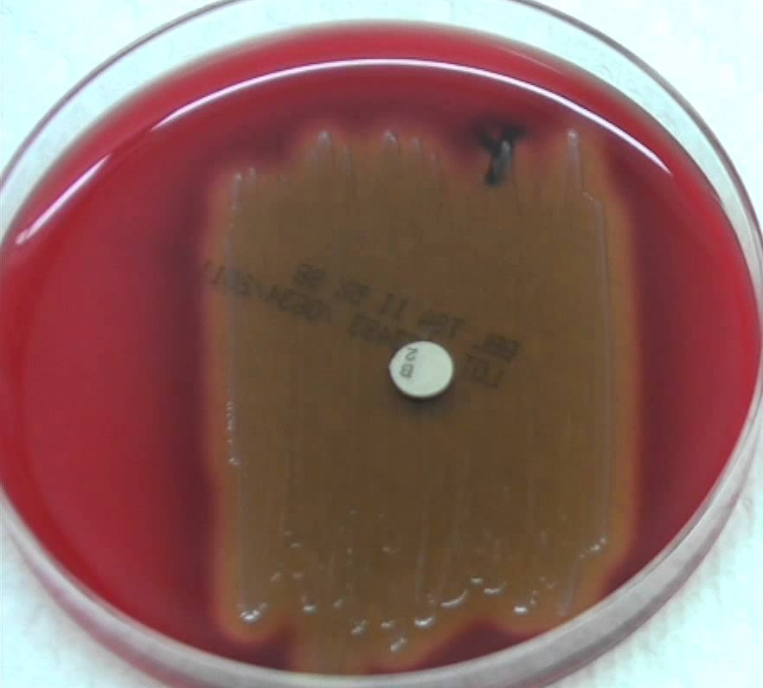
S. pneumoniae – Optochin test
Optochin is used to differentiate Streptococcus pneumoniae from other alpha-hemolytic streptococci
Streptococcus pneumoniae is sensitive to optochin (inhibition zone)

Slide 19
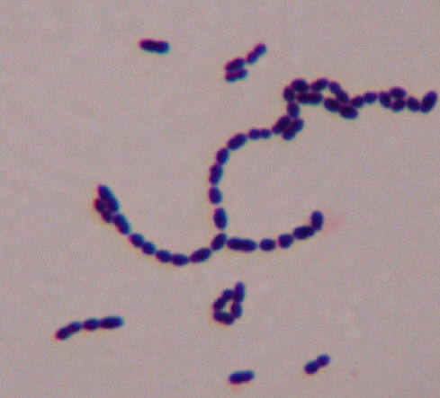
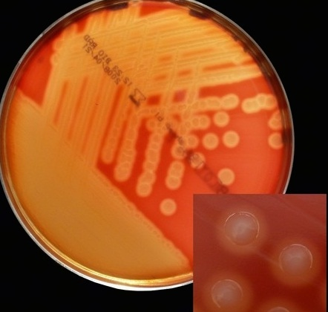
Streptococcus agalactiae
Group B Streptococcus
Under microscope (Gram stain)
Gram +ve cocci in short chains,
diplococci and single cocci
Colony characteristics
-Small, round, colorless colonies
-Beta hemolysis around colonies

Slide 20
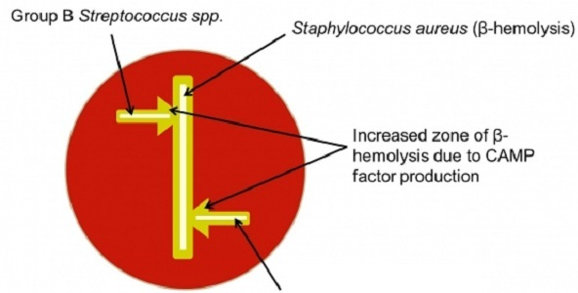
CAMP test
CAMP test is used to identify Group B Strep
Group B Strep forms (CAMP factor) that enlarges the area of hemolysis formed by β-hemolysin from Staphylococcus aureus

Slide 21
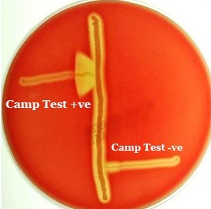
CAMP test

Slide 22
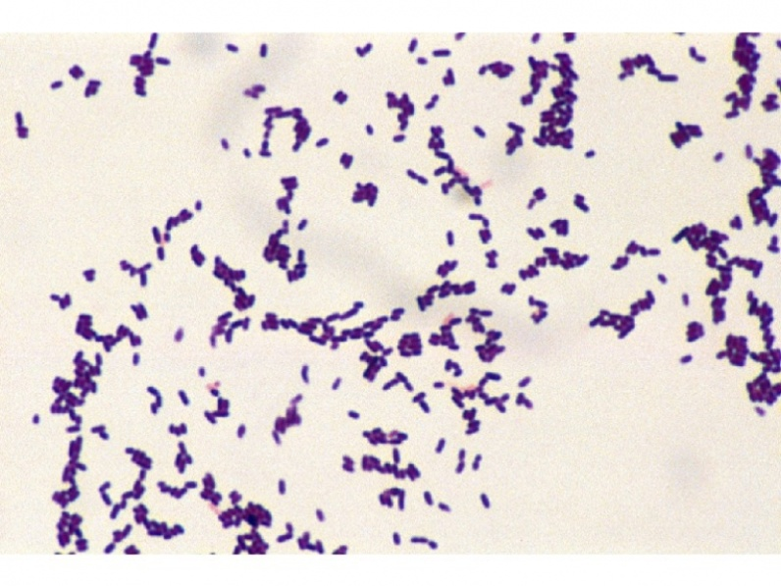
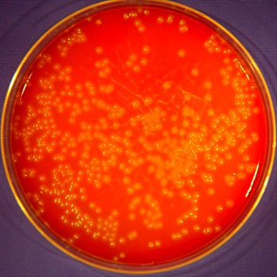
Listeria monocytogenes
Under microscope (Gram stain)
Gram +ve bacilli
Colony characteristics
-Small, round, colorless colonies
-Beta hemolysis around colonies

Slide 23
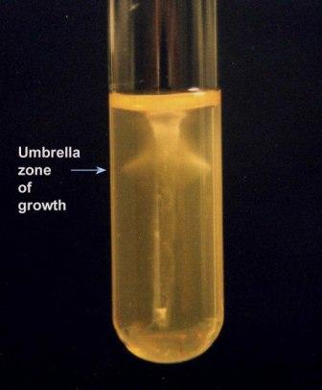
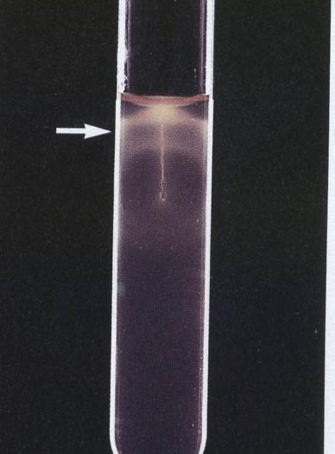
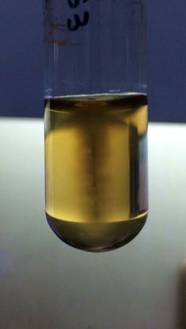
Listeria monocytogenes
The motility of L.monocytogenes is best demonstrated by stabbing a tube of semisolid medium and incubating it at room temperature (20 - 25°C)
An umbrella-like zone of growth 2 to 5 mm below the surface of the medium is characteristic of L. monocytogenes

