Slide 1
Cerebrovascular Diseases 2 & CNS Trauma

Slide 2
II-Subarachnoid Hemorrhage:
Causes:
1- Rupture saccular (berry) aneurysm
2- Vascular malformations
3- Trauma
4- Coagulopathies
5- Tumors

Slide 3
A- Saccular ( Berry ) aneurysm :
Commonest cause of spontaneous subarachnoid hemorrhage
2% of population, Rupture in fifth decade, F > M
Not present at birth, but develop over time because of underlying defect in media of the vessel
Rate of bleeding: 1.3% / year.

Slide 4
Conditions Associated with Saccular Aneurysms
Genetic:
Polycystic kidney disease (autosomal dominant)
Defects in extracellular matrix proteins
e.g. Marfan’s syndrome, Others
Non-genetic:
Coarctation of aorta
Predisposing conditions:
Hypertension
Cigarette smoking

Slide 5
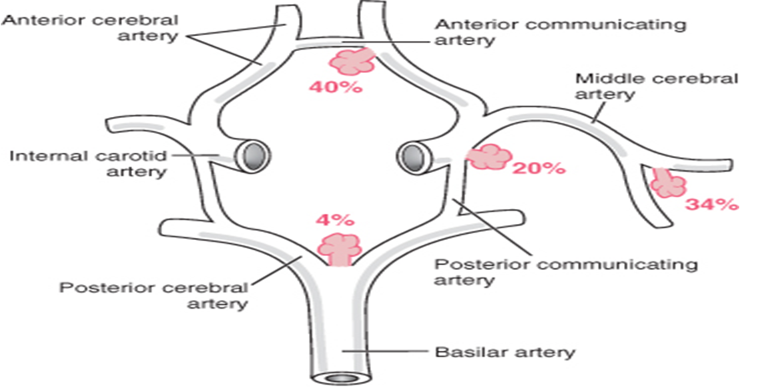
About 90% near major arterial branch points in anterior circulation
20-30% multiple

Slide 6
Morphology
Size: from few mm to 2-3 cm.
Muscular wall and internal elastic lamina are absent beyond the neck of the aneurysm.
Aneurysm sac is lined only by thickened hyalinized intima. The adventitia covering the sac is continuous with that of the parent artery.
Rupture usually occurs at the apex of the sac, releasing blood into the subarachnoid space or the substance of the brain, or both.

Slide 7
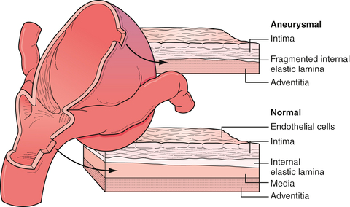

Slide 8
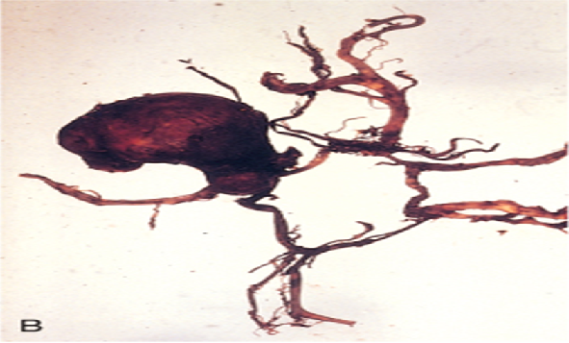
Apex/ Site of rupture

Slide 9
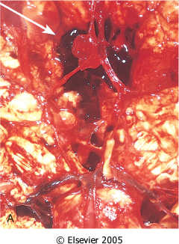
Berry aneurysm

Slide 10
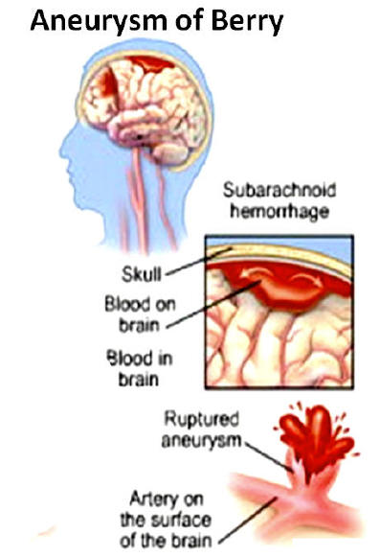
Clinical features of rupture
“Worst headache of my entire life”, sudden, excruciating with loss of consciousness
- 25-50% die at time of first rupture

Slide 11
Sequelae :
Acute: in the first few days
Vasospasm of other vessels:
Increased risk of additional ischemic injury
Repeat bleeding
Associated with ↑mortality
Chronic (healing phase):
Meningeal fibrosis and scarring → obstruction of CSF flow or disruption of CSF resorption leading to hydrocephalus.

Slide 12
B- Vascular Malformations
Types:
1) Arteriovenous malformations (AVM)
2) Cavernous malformation
3) Venous angioma
Capillary telengiectasis
1+2 are the types associated with risk of hemorrhage and development of neurological symptoms.

Slide 13
1-Arteriovenous malformation
More in males
Spontaneous hemorrhage between 10-30 years old
Clinical problems :Seizures, Intracerebral or subarachnoid hemorrhage.
Site: subarachnoid vessels extending into brain parenchyma or within the brain

Slide 14
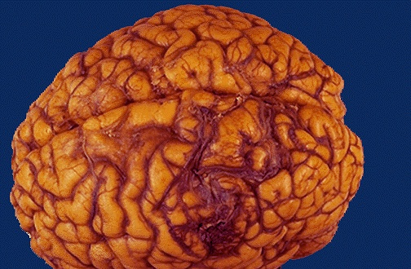
Gross: Prominent Pulsatile wormlike vascular channels.
Arteriovenous Malformation

Slide 15
Microscopy: Enlarged blood vessels seperated by gliotic tissue.
Arteriovenous Malformation

Slide 16
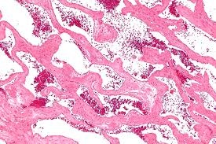
2- Cavernous Hemangioma
Dilated thin-walled vascular channels devoid of intervening brain tissue.
Site: Cerebellum, pons and subcortical region.

Slide 17
3- Capillary Telengectasias
Microscopic foci of dilated, thin walled vascular channels separated by normal brain parenchyma, mostly in pons.
4- Venous Angioma (Varices)
Aggregates of ectatic venous channels
brain, spinal cord & meninges

Slide 18
III and IV-Epidural & Subdural Hemorrhage
usually TRAUMATIC

Slide 19
CNS TRAUMA

Slide 20
CENTRAL NERVOUS SYSTEM TRAUMA :
Result & morphology depend on :
Penetrating or Blunt trauma→ Open or Closed
Mobile or immobile head at time of trauma
Edema may occur & worsen the condition
Skull fracture

Slide 21
A- Parenchymal injury :
1- Concussion :
Transient neurologic dysfunction, +/-loss of consciousness, and loss of reflexes
Due to head injury.
Complete neurologic recovery
2- Direct Parenchymal injury:
Lacerations: Penetration of the brain by bullet or skull fragment from fracture
Contusions: More on crests of gyri

Slide 22
Contusions:
Caused by rapid tissue displacement, disruption of vascular channels
Hemorrhage, tissue injury and edema.
Neuronal injury: take about 24 hours
Coup lesions:
Contusions at point of contact
Immobile or mobile head
Contrecoup lesions :
- Contusions opposite to the point of trauma
- Mobile head

Slide 23
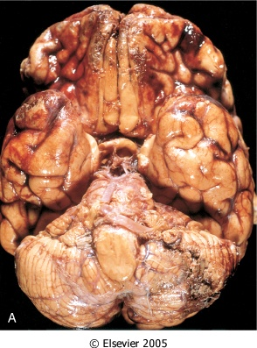
Multiple contusions involving the inferior surfaces of frontal lobes, anterior temporal lobes, and cerebellum.
Elsevier

Slide 24
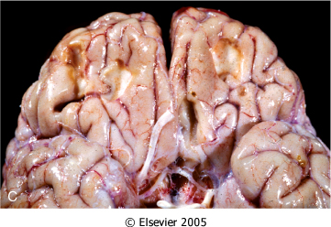
Remote contusions (depressed, retracted) are present on the inferior frontal surface of this brain, with a yellow color

Slide 25
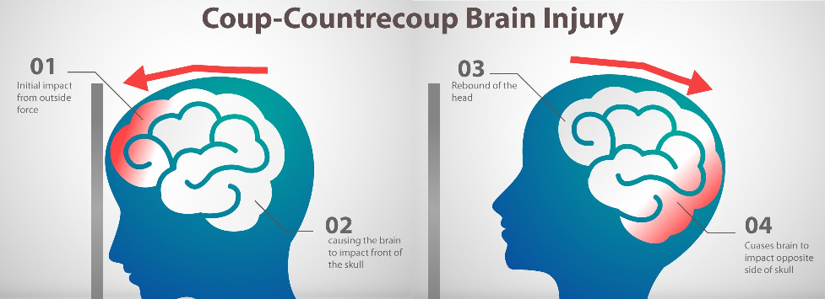

Slide 26
3- Intracerebral hemorrhage
4- Cerebral Edema
5- Diffuse Axonal Injury

Slide 27
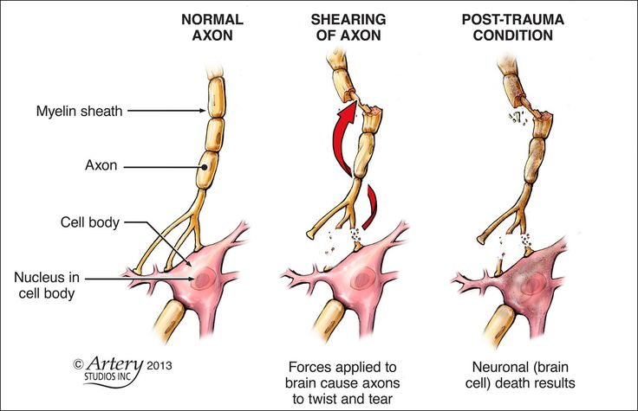
Diffuse Axonal Injury :
Rapid displacement of the head and brain can tear axons
Sever, irreversible neurologic deficits.
-Seen in 50% of patients with post traumatic coma even without cerebral contusions
- Affect deep white matter
-Microsopy: axonal swelling.

Slide 28
B-Traumatic vascular injuries
1- Epidural Hematoma :
Usually acute & accompanied by skull fracture
Rupture of middle meningeal artery
Mass effect → Dura & Brain compression
Clinically :
- When blood accumulates slowly: Patient has short LUCID interval followed by rapid loss of consciousness
- May expand rapidly → Neurologic emergency

Slide 29
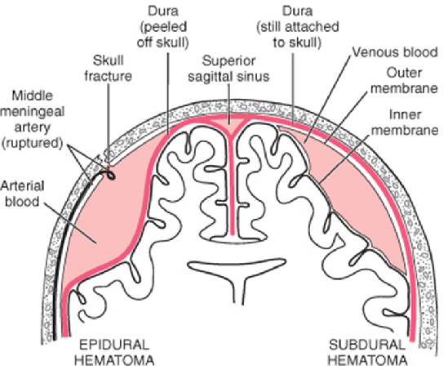
Epidural and subdural hemorrhage

Slide 30
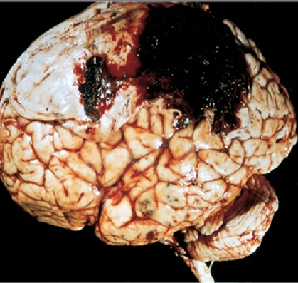
Epidural hematoma covering a portion of the dura.

Slide 31
2- Subdural hematoma :-
Source: Tearing of Bridging Veins
Gross: Collection of fresh blood
Mass effect → Brain compression
Clinically: - Headache and confusion
- Slow progressive neurologic deterioration
Treatment: remove blood and associated organizing tissue.

Slide 32
Epidural and subdural hemorrhage

Slide 33
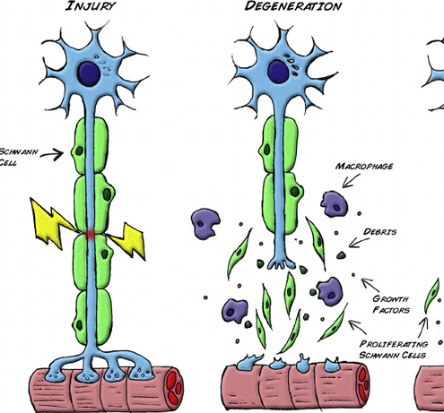
Spinal cord trauma:
Level of injury determines outcome
Acute: hemorrhage and necrosis → cystic foci
Late effects : Wallerian degeneration (degeneration of the axon distal to a site of transection)

Slide 34
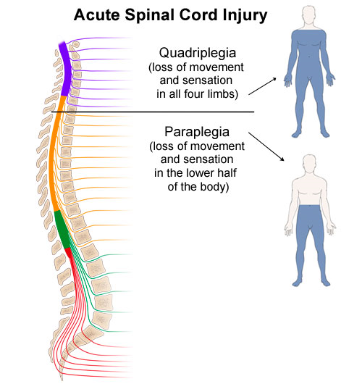
Effects depend on level :
Above C4 →Paralysis of diaphragm, respiratory compromise
Cervical → Quadriplegia
Thoracic or below →Paraplegia

Slide 36
Thank you

